Slide 1
PHY 711 Classical Mechanics and Mathematical Methods
10-10:50 AM MWF online or (occasionally) in Olin 103
Discussion for Lecture 32: Chap. 9 of F&W
Sound generation and scattering;
non-linear effects
Sound generation
Sound scattering
Introduction to non-linear effects
Notes:
In this lecture, we will consider traveling wave solutions to the sound wave equations.

Slide 2
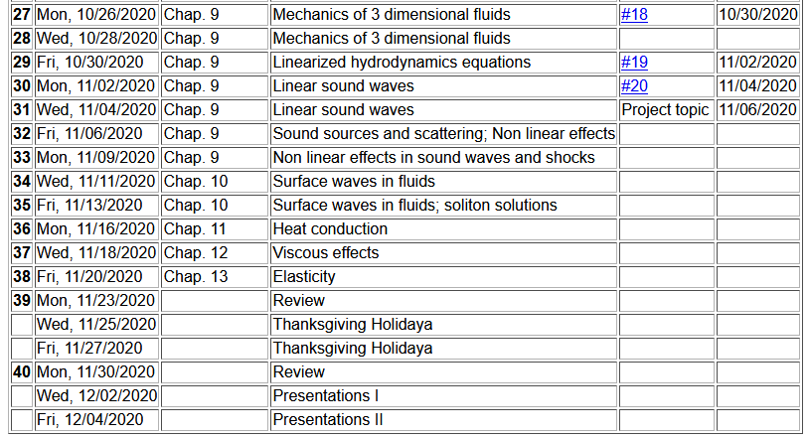
Notes:
Schedule.

Slide 3
Wave equation with source:
Notes:
Now think of wave equation with a source. The Green’s function is a very powerful tool for solving these problems. We will use similar techniques in solving the wave equation for electromagnetic waves.

Slide 4
Wave equation with source -- continued:
Notes:
Result that we will derive.

Slide 5
Derivation of Green’s function for wave equation -- continued
Notes:
Spatial equation for Fourier amplitudes.

Slide 6
In our case --
Fourier transform of forcing term.
extra contributions from boundary
Notes:
Derivation continued.

Slide 7
Wave equation with source:
z
y
x
Notes:
Now consider a simplified model of a sound amplifier where the red cylinder moves up and down in the z direction at a particular frequency omega.

Slide 8
Treatment of boundary values for time-harmonic force:
Notes:
In this case, we need to use a modified Green’s function to satisfy the boundary condition at z=0.

Slide 9
Notes:
Some details.

Slide 10
Notes:
Changing to more convenient coordinates. Preparing to evaluate the expression far from the moving piston.

Slide 11
From integral from of Bessel functions.
Another Bessel function identity.
Analytic result for r→∞
Notes:
Approximate solution continued. In this approximation, the integral can be evaluated in terms of Bessel functions.

Slide 12
Notes:
Estimating the power of the sound wave in this asymptotic regime.

Slide 13
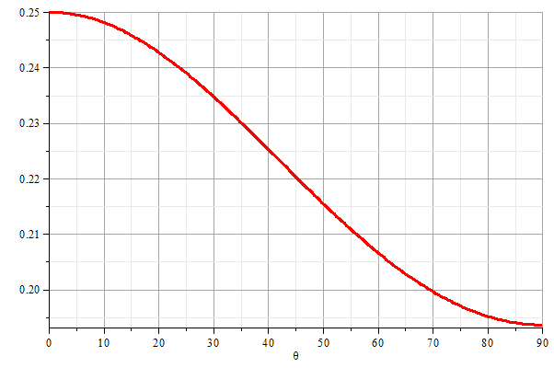
z
θ
y
x
Notes:
Graph of the power as a function of the polar angle theta.

Slide 14
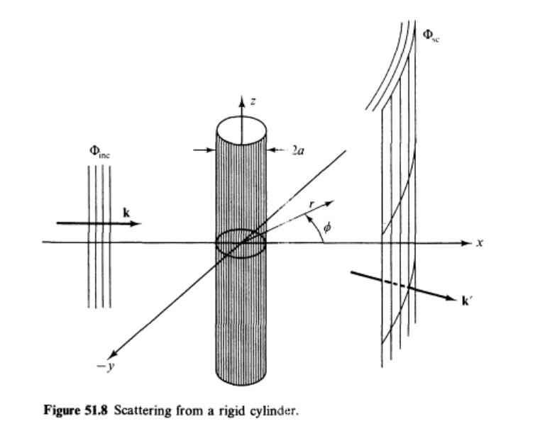
Scattering of sound waves –
for example, from a rigid cylinder
Figure from Fetter and Walecka pg. 337
Notes:
Now consider the case of a plane wave of sound, scattering off of a cylindrical object. Can you think of a physical situation for this model?

Slide 15
Scattering of sound waves –
for example, from a rigid cylinder
Notes:
Analysis of the scattering wave using cylindrical coordinates.

Slide 16
Notes:
In this case we expect a cylindrical wave that can be represented in terms of Bessel and Neumann functions, or more conveniently in terms of Hankel functions H. Satisfying the boundary values on the surface of the scattering cylinder, we find the coefficients of the expression.

Slide 17
Notes:
Using the asymptotic form of the Hankel functions we can analyze the results further.

Slide 18
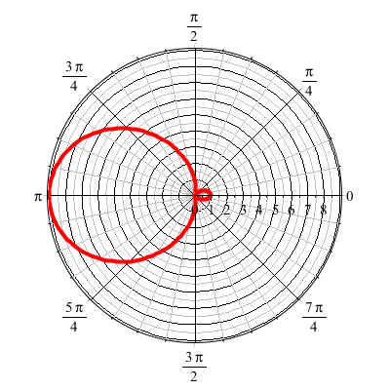
For ka << 1
Notes:
Defining the appropriate scattering cross section, we can analyze the results further. For ka<<1 (long wavelengths, low frequencies) we find that most of the sound is scattered backwards from the propagation direction.

Slide 19
Now consider some non-linear effects

Slide 20
Effects of nonlinearities in fluid equations
-- one dimensional case
Notes:
Review of basic equations, specializing in one spatial dimension.

Slide 21
Notes:
Decoupling the variables.

Slide 22
Notes:
More analysis.

Slide 23
Notes:
Further derivations.

Slide 24
Notes:
Using adiabatic relationships.

Slide 25
Notes:
Analysis of fluid velocity from a knowledge of the wave velocity.

Slide 26
Traveling wave solution:
Notes:
Analysis for a traveling wave.

Slide 27
Traveling wave solution -- continued:
Notes:
Checking the linear result

Slide 28
Traveling wave solution -- full non-linear case:
w
Notes:
Analysis of how to visualize the traveling wave solution.

Slide 29
Visualization continued:
Notes:
More details.

Slide 30
Summary
Notes:
Summary.

Slide 31
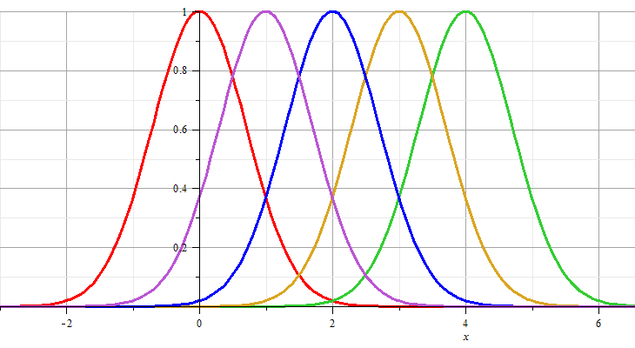
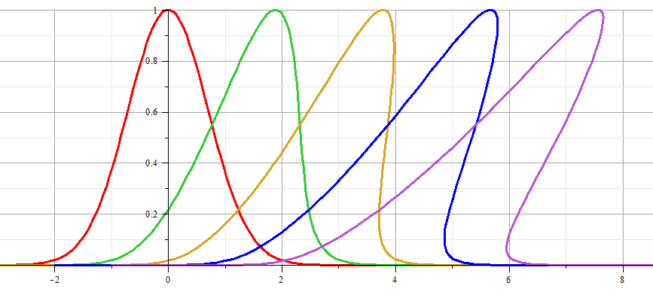
Linear wave:
Non-linear wave:
Notes:
Example visualization.

