Slide 1
PHY 711 Classical Mechanics and Mathematical Methods
10-10:50 AM MWF online
Discussion for Lecture 33: Chap. 9 of F&W
Wave equation for sound beyond the linear approximation
Non-linear effects in sound waves
Shock wave analysis
Notes:
In today’s lecture, we will review the basic hydrodynamic equations, specializing to one dimensional traveling waves, and analyzing some of the effects of nonlinearities.

Slide 2
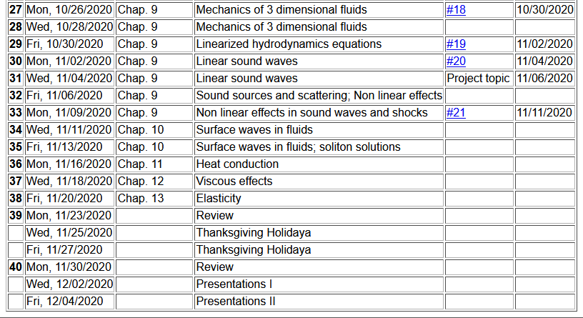
Notes:
Updated schedule

Slide 3
Notes:
Homework for Wednesday.

Slide 4
Schedule for weekly one-on-one meetings
(EST)
Nick – 11 AM Monday
Tim – 9 AM Tuesday
Gao – 9 PM Tuesday
Jeanette – 11 AM Friday
Derek – 12 PM Friday

Slide 5
Your questions –
From Tim –
Is gamma = degrees of freedom?
From Gao –
1. Why can we assume rho is a function of (x-u(rho)t)?

Slide 6
Effects of nonlinearities in fluid equations
-- one dimensional case
Notes:
Starting with the basic hydrodynamic equations and expressing them for the one spatial dimensional case (along the x axis).

Slide 7
Notes:
The equations depend on density (rho), pressure (p), and velocity (v). We need to express all of the results in terms of density (rho). Here we further assume an ideal gas and express the results in terms of the parameter gamma.

Slide 8
Digression – What is gamma?

Slide 9
Notes:
Here we also express the velocity in terms of the density rho.

Slide 10
Notes:
Combining the results from the two coupled equations, we arrive at a first order differential equation for rho(x,t).

Slide 11
Notes:
Using the results of an adiabatic ideal gas, we can find the explicit functional forms for v and c as they depend on the density rho.

Slide 12
Notes:
Summary of previous slides.

Slide 13
Traveling wave solution:
Notes:
Now we can analyze the results. We introduce the parameter u(rho) as v(rho)+c(rho) for the + solution; representing a traveling wave.

Slide 14
Some details

Slide 15
Traveling wave solution -- continued:
Notes:
For this case, and evaluating the expressions for the adiabatic ideal gas, we obtain the given equations. Checking for the result in the linear limit, we retrieve the expected behavior.

Slide 16
Traveling wave solution -- full non-linear case:
w
Notes:
In order to visualize what the results mean, we can use Maple or Mathematica in the parametric plot mode.

Slide 17
Visualization continued:
Notes:
Details of the parametric formulation

Slide 18
Summary
Notes:
Summary of results.

Slide 19
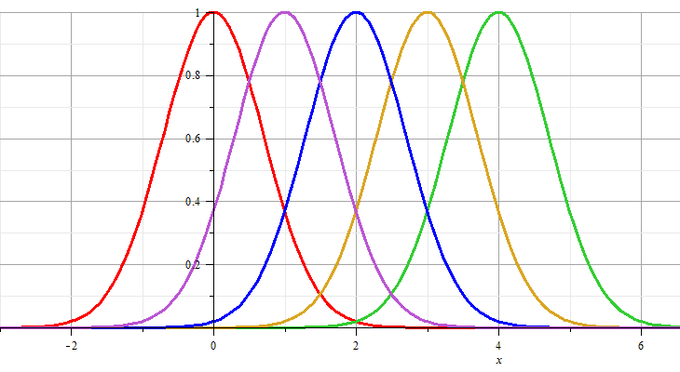
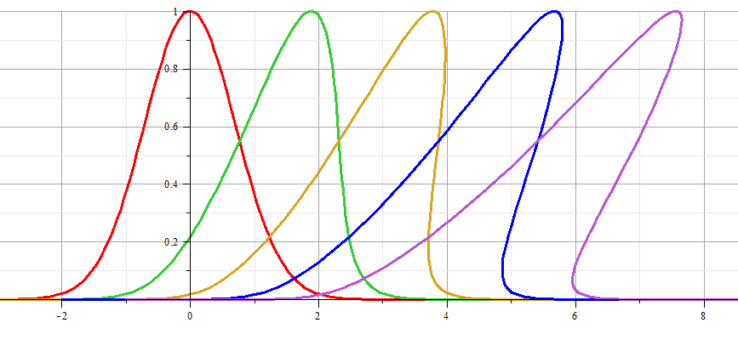
Linear wave:
Non-linear wave:
Notes:
Snap shots of solution for an initial Gaussian waveform for the linear and non-linear solutions.

Slide 20
Linear wave
Non-linear wave
Notes:
Animations from Maple.

Slide 21
Analysis of shock wave
Plots of δρ
Solution becomes unphysical
Notes:
Note that the vertical axis represents the longitudinal wave displacement. When this displacement becomes multivalued for a given coordinate x as shown, the solution becomes unphysical. At this point we need to consider the analysis in a different way.

Slide 22
Analysis of shock wave -- continued
After shock
t₂
δρ₂, δv₂, δp₂
Before shock
t₁
δρ₁, δv₁, δp₁
Shock front
x
u
Note that in this case u is assumed to be a given parameter of the system.
Notes:
Your textbook discusses the shock wave analysis. Here we assume that there is a region (blue) where the analysis fails, but assumes that we can properly analyze the physics before and after the shock. The notation given here is similar to that given in your text.

Slide 23
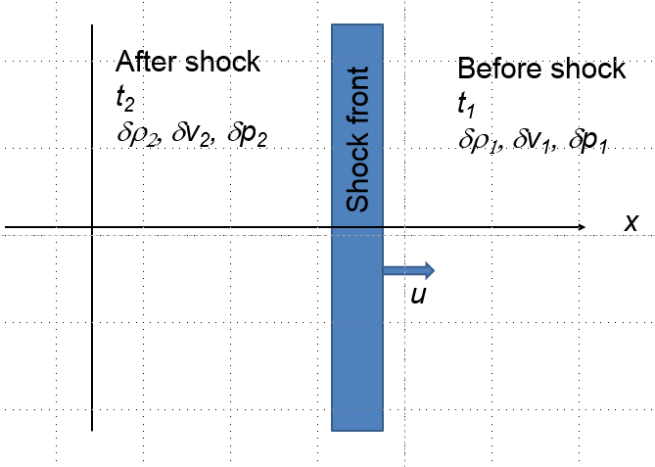
Analysis of shock wave – continued
While analysis in the shock region is complicated, we can use conservation laws to analyze regions 1 and 2
Notes:
Some of the details of the analysis before and after the shock event.

Slide 24
Analysis of shock wave – continued
While analysis in the shock region is complicated, we can use conservation laws to analyze regions 1 and 2
Notes:
Analyzing the equations.

Slide 25
Analysis of shock wave – continued
For adiabatic ideal gas, also considering energy and momentum conservation:
ρ₂/ρ₁
p₂/p₁
Notes:
Analyzing ratio of the density after and before the shock wave.

Slide 26
Analysis of shock wave – continued
For adiabatic ideal gas, entropy considerations::
Notes:
Analyzing the entropy before and after the shock wave. In general, many more relationships can be analyzed. Consult your textbook for more details.

