Slide 1
PHY 711 Classical Mechanics and Mathematical Methods
10-10:50 AM MWF online
Discussion for Lecture 34:
    Chapter 10 in F & W: Surface waves
      Water waves in a channel
      Wave-like solutions; wave speed
Notes:
In today’s lecture we will investigate transverse waves at the surface of a channel of water.

Slide 2

Thursday, Nov. 12, 2020
4 PM
Notes:
Thursday’s colloquium speaker is a Professor of Physics and Astronomy at UNC Asheville who will be talking about simulations of astronomical observables to better understand galaxies for example.

Slide 3
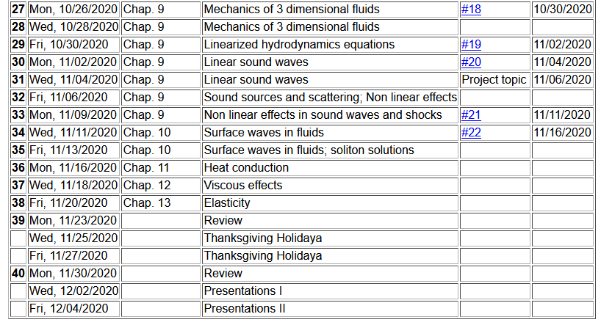
Notes:
Update to schedule including a homework dealing with today’s topic.

Slide 4
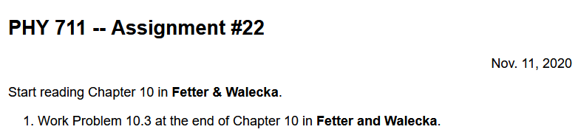
Notes:
Homework problem.

Slide 5
Schedule for weekly one-on-one meetings
(EST)
Nick – 11 AM Monday
Tim – 9 AM Tuesday
Gao – 9 PM Tuesday
Jeanette – 11 AM Friday
Derek – 12 PM Friday

Slide 6
Your questions –
From Gao –
1. How does this equation [arise]?

Slide 7
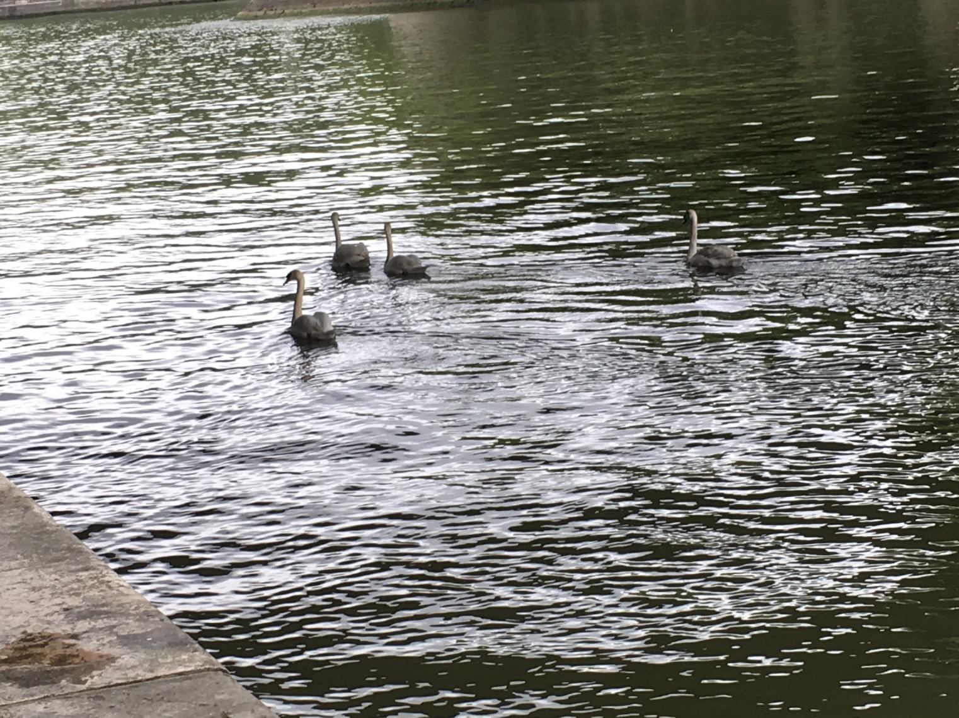
Physics of incompressible fluids and their surfaces
Reference: Chapter 10 of Fetter and Walecka

Slide 8
Consider a container of water with average height h and surface h+ζ(x,y,t); (h ⬅➔ z₀ on some of the slides)
p₀
ζ
z
h
y
x
Notes:
Defining the system and the notation.

Slide 9
Why do we not consider ρ_{air} in this analysis?
  Because it is a reasonable approximation
  Because it simplifies the analysis

Slide 10
within the water
Notes:
Hydrodynamic equations for this case.

Slide 11
Consider a surface ζ(x,t) wave moving in the x-direction in a channel of width b(x) and height h(x):
ζ(x,t)
v(x,t)
v(x+dx,t)
h(x)
b(x)
dx
Notes:
Considering an increment along the propagation direction including the effects of the continuity equation.

Slide 12
Some details
ζ(x,t)
v(x,t)
v(x+dx,t)
h(x)
b(x)
dx
Here, we are assuming that ρ is constant

Slide 13
ζ(x,t)
v(x,t)
v(x+dx,t)
h(x)
b(x)
dx
Notes:
Some details for the homework problem which is a special case.

Slide 14
Example continued
Notes:
More details pertaining to the homework problem.

Slide 15
Example continued
Notes:
Continued.

Slide 16
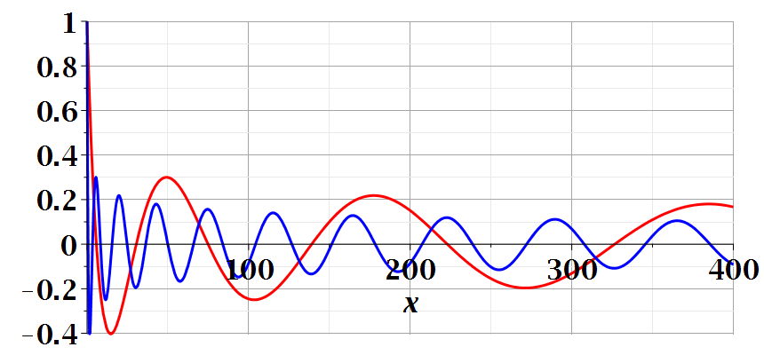
Notes:
Continued.

Slide 17
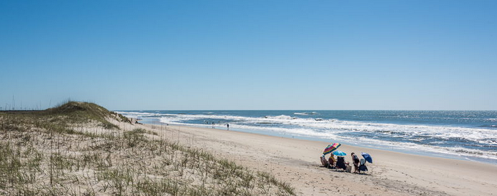
Imagine watching the waves at a beach – can you visualize the configuration for the surface wave pattern to approximation this situation?
  Long flat beach
  Beach in which average water level increases
  Beach in which average water level decreases

Slide 18
A simplier example:
ζ(x,t)
v(x,t)
v(x+dx,t)
h(x)
b(x)
dx
Special case, where b and h are constant --
Notes:
A simpler example.

Slide 19
Example with b and h constant -- continued
dζ(x,y,t)/dt
z₀
v(x,y,t)
v(x+dx,y+dy,t)
Notes:
Considering the surface height.

Slide 20
For uniform channel:
Notes:
For the simple case, we find the wave equation for the surface height. In the following slides, we will find a more complete solution depends on the wavelength the of surface wave.

Slide 21
More details: -- recall setup --
Consider a container of water with average height h and surface h+ζ(x,y,t)
p₀
ζ
z
h
y
x
Notes:
Some details for the more general case.

Slide 22
Equations describing fluid itself (without boundaries)
Notes:
Considering the case of irrotational flow.

Slide 23
p₀
ζ
z
h
y
x
(We have absorbed p₀ in “constant”)
Notes:
Considering the equations within the wave and at the surface.

Slide 24
Full equations:
(We have absorbed p₀ in “constant”)
Linearized equations:
Notes:
Taking the linear limit.

Slide 25
For simplicity, keep only linear terms and assume that horizontal variation is only along x:
Notes:
Solution for the linear equations.

Slide 26
For simplicity, keep only linear terms and assume that horizontal variation is only along x – continued:
Notes:
An expression for c.

Slide 27
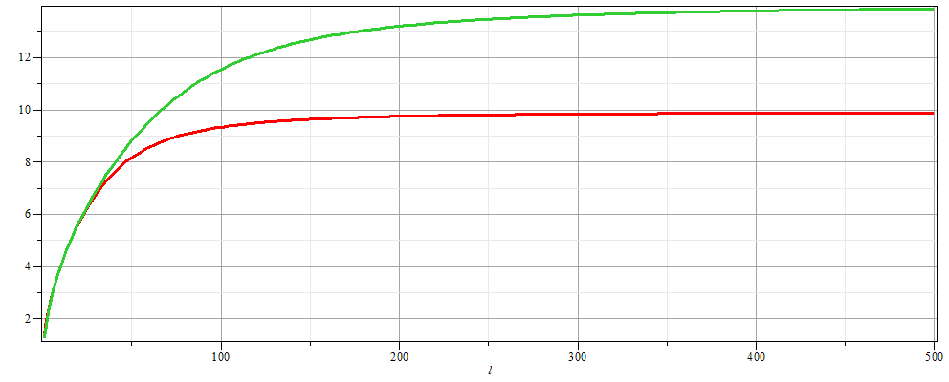
For simplicity, keep only linear terms and assume that horizontal variation is only along x – continued:
h=20 m
c
h=10 m
λ
Notes:
Evaluating c as a function of wavelength.

Slide 28
For simplicity, keep only linear terms and assume that horizontal variation is only along x – continued:
Notes:
Form of the surface wave form.

Slide 29
General problem
  including
  non-linearities
p₀
ζ
z
h
y
x
Notes:
Introducing the equations beyond the linear approximation that we will cover next time.

