Slide 1
PHY 711 Classical Mechanics and Mathematical Methods
10-10:50 AM MWF online
Plan for Lecture 34:
Chapter 10 in F & W: Surface waves
Water waves in a channel
Wave-like solutions; wave speed
Notes:
In today’s lecture we will investigate transverse waves at the surface of a channel of water.

Slide 2
Thursday, Nov. 12, 2020
4 PM
Notes:
Thursday’s colloquium speaker is a Professor of Physics and Astronomy at UNC Asheville who will be talking about simulations of astronomical observables to better understand galaxies for example.

Slide 3
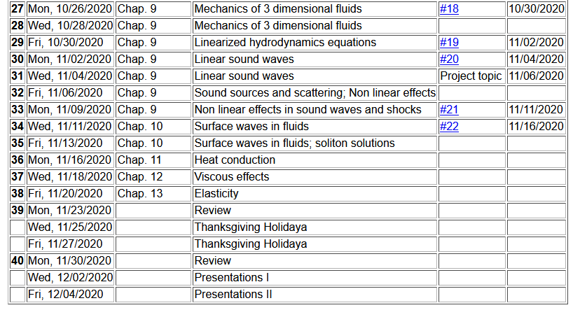
Notes:
Update to schedule including a homework dealing with today’s topic.

Slide 4
Notes:
Homework problem.

Slide 5
Physics of incompressible fluids and their surfaces
Reference: Chapter 10 of Fetter and Walecka

Slide 6
Consider a container of water with average height h and surface h+ζ(x,y,t); (h ⬅➔ z₀ on some of the slides)
p₀
ζ
z
h
y
x
Notes:
Defining the system and the notation.

Slide 7
within the water
Notes:
Hydrodynamic equations for this case.

Slide 8
Consider a surface ζ(x,t) wave moving in the x-direction in a channel of width b(x) and height h(x):
ζ(x,t)
v(x,t)
v(x+dx,t)
h(x)
b(x)
dx
Notes:
Considering an increment along the propagation direction including the effects of the continuity equation.

Slide 9
ζ(x,t)
v(x,t)
v(x+dx,t)
h(x)
b(x)
dx
Notes:
Some details for the homework problem which is a special case.

Slide 10
Example continued
Notes:
More details pertaining to the homework problem.

Slide 11
Example continued
Notes:
Continued.

Slide 12
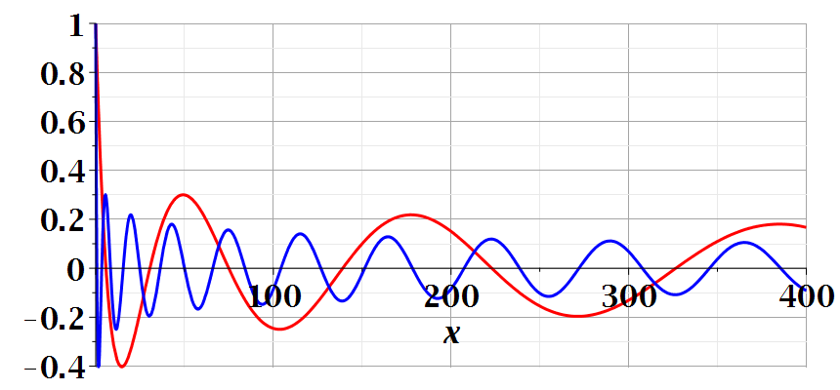
Notes:
Continued.

Slide 13
Another example:
ζ(x,t)
v(x,t)
v(x+dx,t)
h(x)
b(x)
dx
Special case, where b and h are constant --
Notes:
A simpler example.

Slide 14
Example with b and h constant -- continued
dζ(x,y,t)/dt
z₀
v(x,y,t)
v(x+dx,y+dy,t)
Notes:
Considering the surface height.

Slide 15
For uniform channel:
Notes:
For the simple case, we find the wave equation for the surface height. In the following slides, we will find a more complete solution depends on the wavelength the of surface wave.

Slide 16
More details: -- recall setup --
Consider a container of water with average height h and surface h+ζ(x,y,t)
p₀
ζ
z
h
y
x
Notes:
Some details for the more general case.

Slide 17
Equations describing fluid itself (without boundaries)
Notes:
Considering the case of irrotational flow.

Slide 18
p₀
ζ
z
h
y
x
(We have absorbed p₀ in “constant”)
Notes:
Considering the equations within the wave and at the surface.

Slide 19
Full equations:
(We have absorbed p₀ in “constant”)
Linearized equations:
Notes:
Taking the linear limit.

Slide 20
For simplicity, keep only linear terms and assume that horizontal variation is only along x:
Notes:
Solution for the linear equations.

Slide 21
For simplicity, keep only linear terms and assume that horizontal variation is only along x – continued:
Notes:
An expression for c.

Slide 22
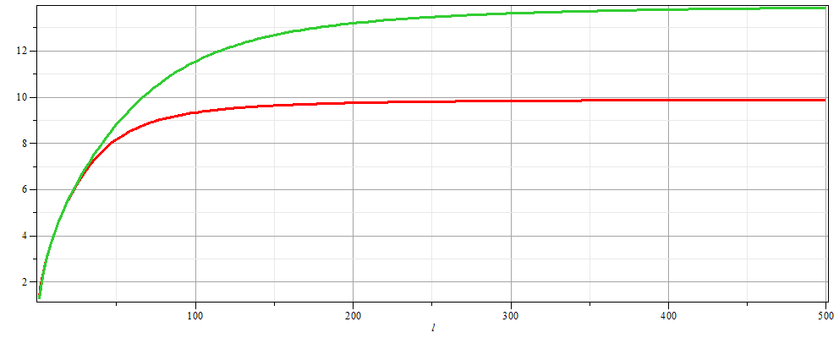
For simplicity, keep only linear terms and assume that horizontal variation is only along x – continued:
h=20 m
c
h=10 m
λ
Notes:
Evaluating c as a function of wavelength.

Slide 23
For simplicity, keep only linear terms and assume that horizontal variation is only along x – continued:
Notes:
Form of the surface wave form.

Slide 24
General problem
including
non-linearities
p₀
ζ
z
h
y
x
Notes:
Introducing the equations beyond the linear approximation that we will cover next time.

