Slide 1
PHY 711 Classical Mechanics and Mathematical Methods
10-10:50 AM MWF online
Plan for Lecture 35: Chapter 10 in F & W
Surface waves
Summary of linear surface wave solutions
Non-linear contributions and soliton solutions
Notes:
In this lecture, we will continue analyzing surface waves in water including the special non-linear soliton solutions.

Slide 2
This material is covered in Chapter 10 of your textbook using similar notation.

Slide 3
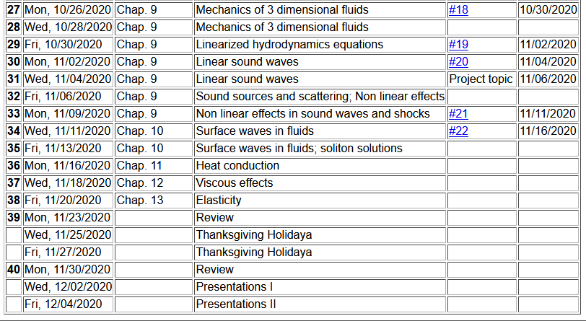
Notes:
Schedule.

Slide 4
Consider a container of water with average height h and surface h+ζ(x,y,t)
p₀
ζ
z
h
y
x
Notes:
Reference system and notation.

Slide 5
p₀
ζ
z
h
y
x
Notes:
Summarizing the linear analysis.

Slide 6
Keep only linear terms and assume that horizontal variation is only along x:
Notes:
Continue analysis of linear equations.

Slide 7
Note that this solution represents a pure plane wave. More likely, there would be a linear combination of wavevectors k.
Additionally, your text considers the effects of surface tension. In this lecture, we will focus on the effects of the non-linear effects of Euler and continuity equations.
Notes:
Consistent analysis of the wave speed.

Slide 8
Surface waves in an incompressible fluid
General problem
including
non-linearities
p₀
ζ
z
h
y
x
Notes:
Returning to the full problem with non-linearities.

Slide 9
p₀
ζ
z
h
y
x
Notes:
Specializing to motion along the x direction and surface direction in the z direction.

Slide 10
Non-linear effects in surface waves:
p₀
ζ
z
h
y
z=0
x
Notes:
Answer that we will find for the soliton solution.

Slide 11
Detailed analysis of non-linear surface waves
[Note that these derivations follow Alexander L. Fetter and John Dirk Walecka, Theoretical Mechanics of Particles and Continua (McGraw Hill, 1980), Chapt. 10.]
The surface of the fluid is described by z=h+ζ(x,t). It is assumed that the fluid is contained in a structure (lake, river, swimming pool, etc.) with a structureless bottom defined by the z = 0 plane and filled to an equilibrium height of z = h.
Notes:
Summary of assumptions for our analysis.

Slide 12
Defining equations for Φ(x,z,t) and ζ(x,t)
Bernoulli equation (assuming irrotational flow) and gravitation potential energy
Notes:
Working through the equations within water.

Slide 13
Boundary conditions on functions –
Zero velocity at bottom of tank:
Consistent vertical velocity at water surface
Notes:
Boundary effects at the bottom of the channel and at the surface.

Slide 14
Analysis assuming water height z is small relative to variations in the direction of wave motion (x) Taylor’s expansion about z = 0:
Note that the zero vertical velocity at the bottom ensures that all odd derivatives vanish from the
Taylor expansion. In addition, the Laplace equation allows us to convert all even derivatives with respect to z to derivatives with respect to x.
Notes:
Here we start a number of steps to analyze the leading terms in the linearities. In this case we perform a Taylor’s expansion about z=0 at the bottom of the channel.

Slide 15
Check linearized equations and their solutions:
Bernoulli equations --
Using Taylor's expansion results to lowest order
➔linear wave equation with c²=gh
Notes:
Checking lowest order (linear) term.

Slide 16
Analysis of non-linear equations --
Notes:
Back to non-linear equations using Taylor’s expansion.

Slide 17
Analysis of non-linear equations -- keeping the lowest order nonlinear terms and include up to 4th order derivatives in the linear terms.
Notes:
Systematic keeping/limiting terms in non-linearity and in high order derivatives. The highlighted equations are the coupled equations that we will analyze.

Slide 18
Note that the wave “speed” c will be consistently determined
Notes:
Decoupling the equations.

Slide 19
Integrating and re-arranging coupled equations
Notes:
Analysis continued.

Slide 20
Integrating and re-arranging coupled equations – continued --
Expressing modified surface velocity equation in terms of η(u):
Notes:
More derivations.

Slide 21
Solution of the famous Korteweg-de Vries equation
Modified surface amplitude equation in terms of η
Soliton solution
Notes:
Finally arriving at the famous equation and the famous soliton solution.

Slide 22
Notes:
More details.

Slide 23
Notes:
Visualization

Slide 24
Relationship to “standard” form of Korteweg-de Vries equation
Notes:
Some notational manipulations.

Slide 25
More details
Notes:
More details.

Slide 26
Summary
Soliton solution
Notes:
Summary.

Slide 27
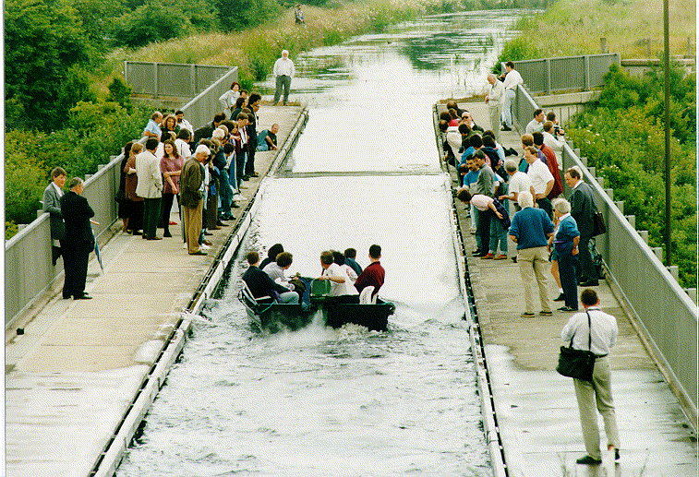
Photo of canal soliton http://www.ma.hw.ac.uk/solitons/
Some links:
Website – http://www.ma.hw.ac.uk/solitons/
Notes:
Historic realization of the soliton wave in a channel.

Slide 28
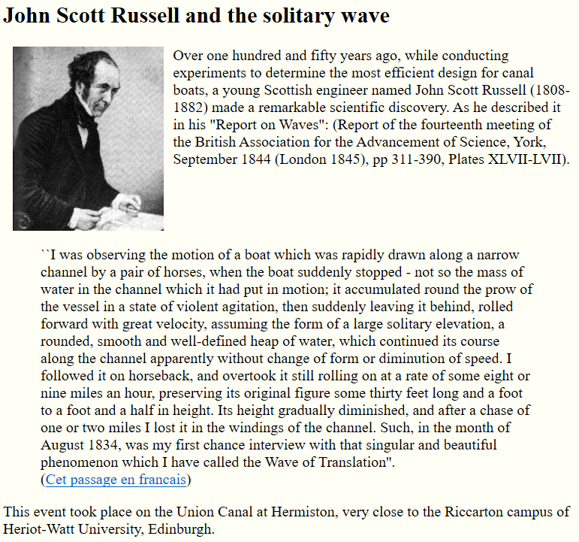
https://www.macs.hw.ac.uk/~chris/scott_russell.html
Notes:
First observer of the soliton phenomenon.

