Slide 1
PHY 711 Classical Mechanics and Mathematical Methods
10-10:50 AM MWF online
Plan for Lecture 36: Chap. 11 in F & W
Heat conduction
Basic equations
Boundary value problems
Notes:
In today’s lecture we will take a quick look at heat transfer following Chapter 11 of your textbook.

Slide 2
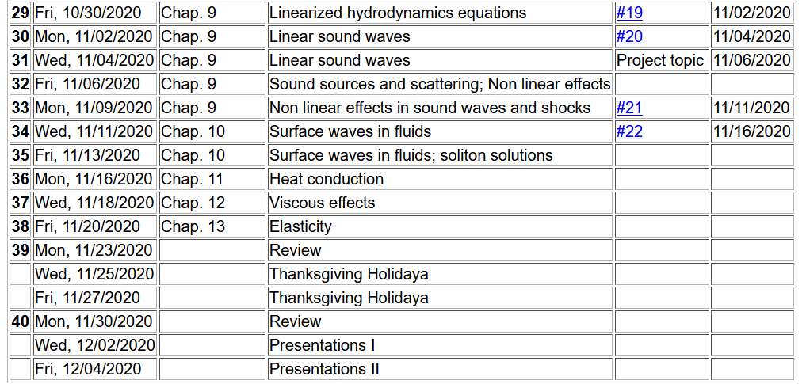
b
Notes:
Schedule.

Slide 3
Conduction of heat
T(r,t)
j_{h}
Notes:
Enthalpy as a measure of heat of a system at constant pressure in terms of the heat capacity of the material.

Slide 4
Note that in this treatment we are considering a system at constant pressure p
More generally, note that c_{p} can depend on T; we are assuming that dependence to be trivial.
Notes:
Some notations and concepts from thermodynamics.

Slide 5
Conduction of heat -- continued
heat flux
heat source
Notes:
Now consider how the enthalpy of a system may change in time. The temperature may change, there may be heat flux, and there may be a source or sink for heat flow.

Slide 6
Conduction of heat -- continued
thermal diffusivity
https://www.engineersedge.com/heat_transfer/thermal_diffusivity_table_13953.htm
Typical values (m²/s)
Air 2x10⁻⁵
Water 1x10⁻⁷
Copper 1x10⁻⁴
Notes:
In order to relate these quantities, we need to know how enthalpy is related to temperature and we will use the empirical relations based on observation that heat flux is proportional to the gradient of temperature. The Thermal diffusivity coefficient is highly dependent on the material as seen in this short list taken from the internet.

Slide 7
Boundary value problems for heat conduction
T₀
c
b
x
a
Notes:
Example boundary value problem which we will solve in the case that the source term is zero.

Slide 8
Boundary value problems for heat conduction
T₀
c
b
x
a
Assuming thermally insulated boundaries
Notes:
Using separation of variables to solve the problem.

Slide 9
Boundary value problems for heat conduction
T₀
c
b
a
x
Notes:
Some details for this case.

Slide 10
Boundary value problems for heat conduction
T₀
c
b
x
a
Notes:
More details.

Slide 11
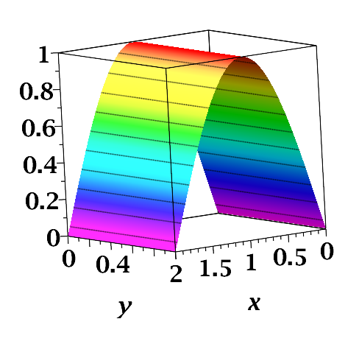
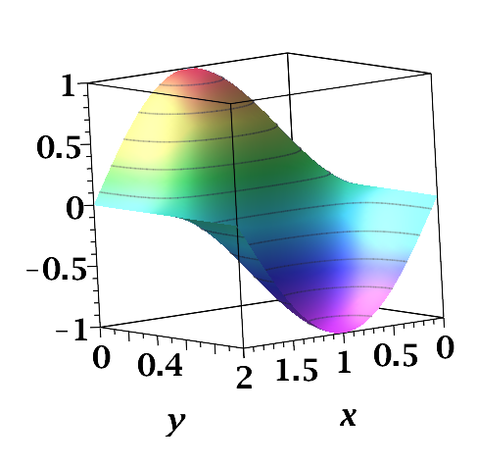
/b
/a
/a
/b

Slide 12
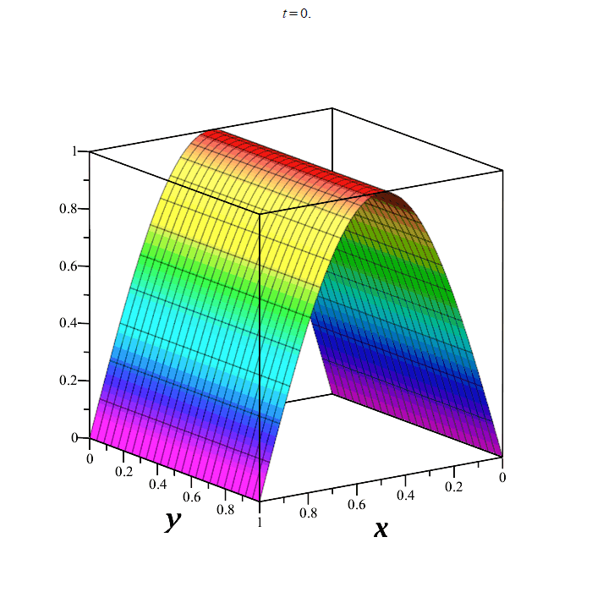
Notes:
Visualization of the time evolution.

Slide 13
Oscillatory thermal behavior
z=0
z
Notes:
Now consider an oscillatory solutions.

Slide 14
Oscillatory thermal behavior -- continued
z=0
z
Notes:
Analysis of solution.

Slide 15
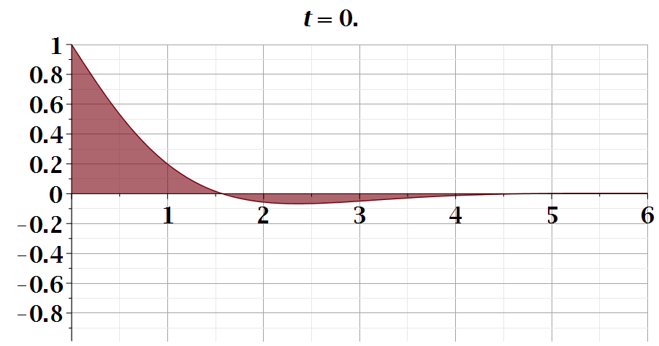
z
Notes:
Animation of solution.

Slide 16
Initial value problem in an infinite domain; Fourier transform
Notes:
Now consider an initial value problem.

Slide 17
Initial value problem in an infinite domain; Fourier transform
Notes:
Using Green’s functions to analyze the results.

Slide 18
Initial value problem in an infinite domain; Fourier transform
Notes:
Some details.

Slide 19
Heat equation in half-space
Notes:
For half space boundary.

Slide 20
Heat equation in half-space -- continued
Notes:
Some details.

Slide 21
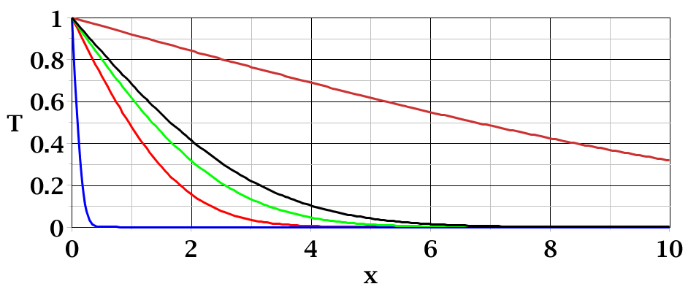
t=50
_
T₀
t=3
t=0.01
Notes:
Plots of solution at various times.

Slide 22
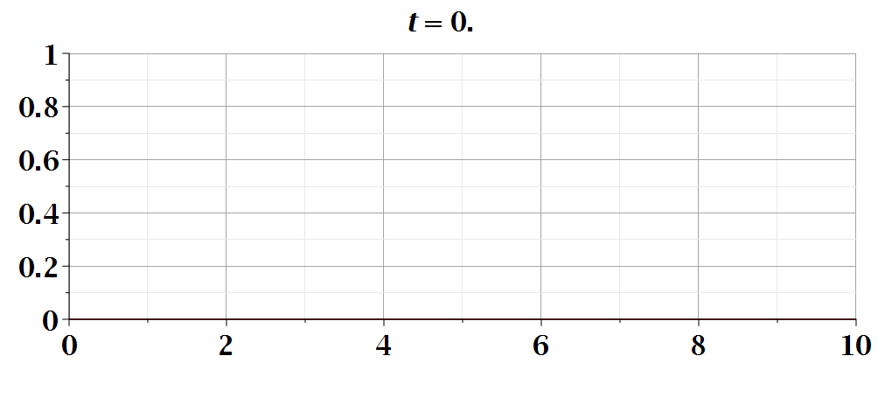
Temperature profile
Notes:
Animation.

