Slide 1
PHY 711 Classical Mechanics and Mathematical Methods
10-10:50 AM MWF online
Plan for Lecture 39
Review
  Comments on presentation and exam
  Mathematical methods
  Classical mechanics concepts

Slide 2
Modified schedule for holiday 11/25/2020-11/27/2020
Schedule for weekly one-on-one meetings (EST)
Nick – 11 AM Monday – 11/23
Tim –9 AM Tuesday – 11/24
Gao – 9 PM Tuesday -- 11/24 (11/25 in China)
Jeanette – 11 AM Friday – ??
Derek – 12 PM Friday – ??

Slide 3
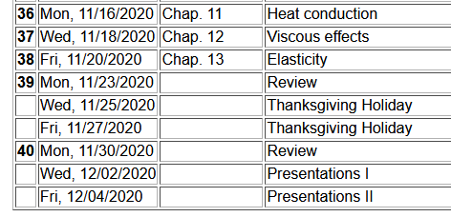
3

Slide 4
Comments on your project and presentation.
Presumably, you have all made good progress your project. Please let me know if I can help in any way. Nevertheless, just to remind –
The purpose of this assignment is to provide an opportunity for you to study a topic of your choice in greater depth. The general guideline for your choice of project is that it should have something to do with classical mechanics, and there should be some degree of analytical or numerical computation associated with the project. The completed project will include a presentation to the class (~20 min + 5 min for questions). After completing your presentation, please turn in a copy of your presentation slides plus any notes and references.

Slide 5
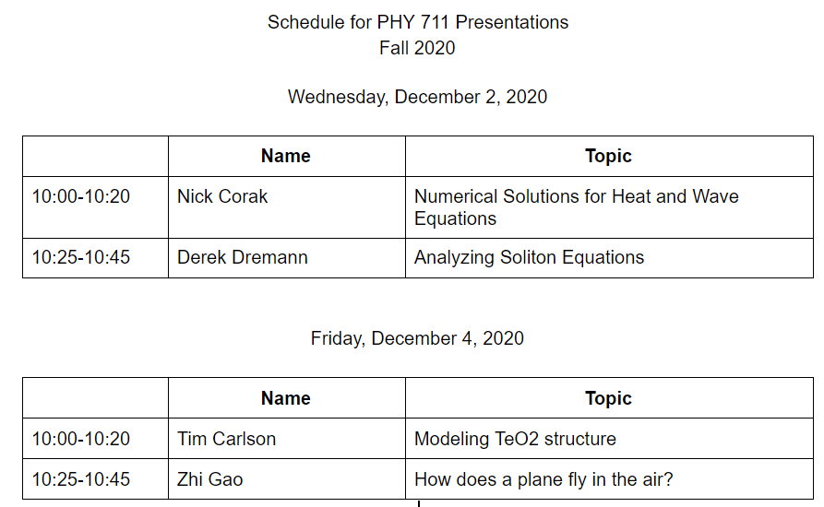

Slide 6
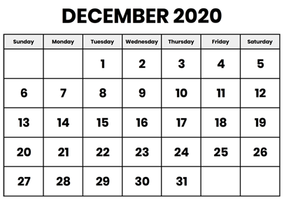
Comments on take-home final –
Similar to mid-term in form
Available: Mon. Dec. 7, 2020
Due before: Mon. Dec. 14, 2020 before 11 AM

Slide 7
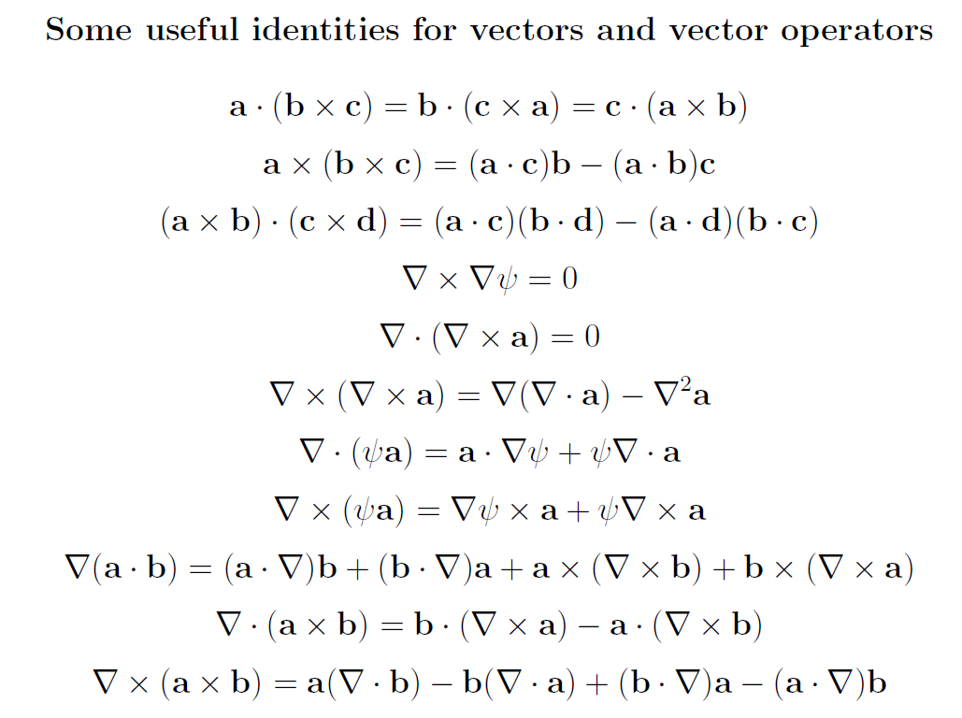
Review of mathematical methods

Slide 8
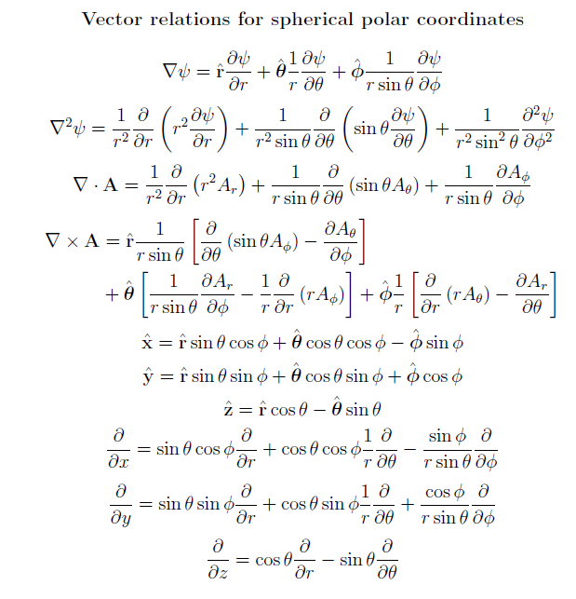

Slide 9
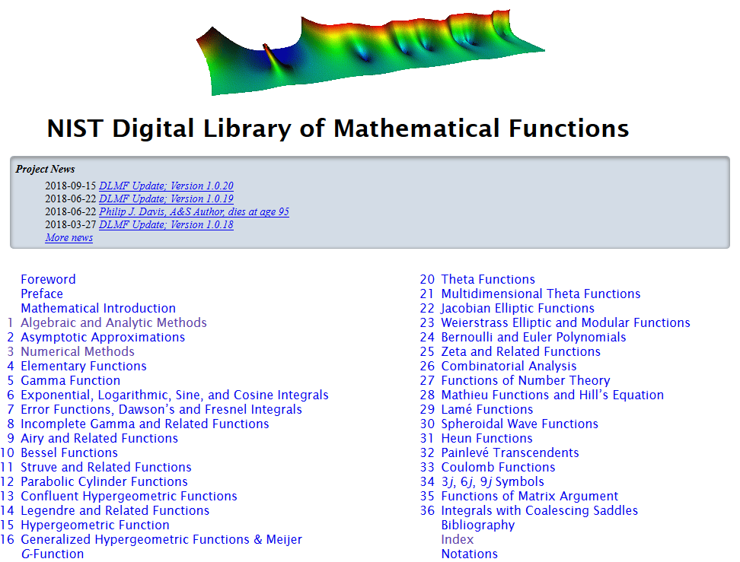
https://dlmf.nist.gov/

Slide 10
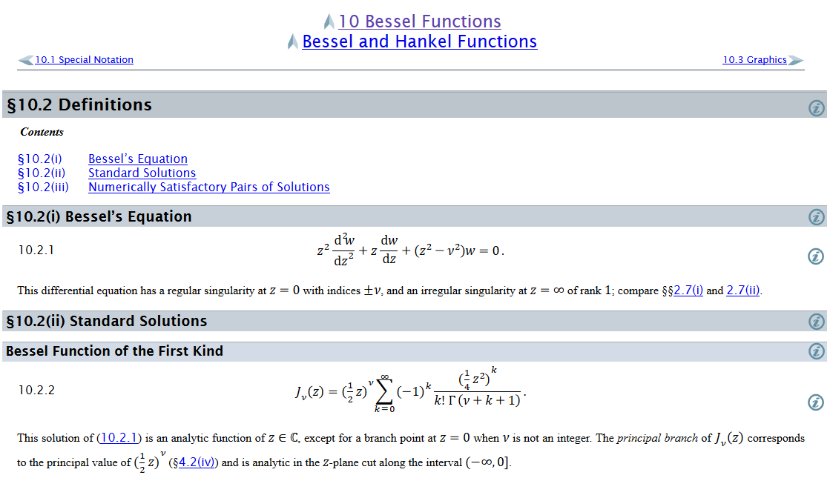
Example – special functions

Slide 11
Complex numbers
Functions of complex variables
Derivatives:
Cauchy-Riemann equations

Slide 12
Analytic function
➔A closed integral of an analytic function is zero.
However:

Slide 13
Contour integration methods --
No contribution
C

Slide 15
Fourier transforms --
Note: The location of the 2π factor varies among texts.

Slide 17
Doubly discrete Fourier Transforms
➔Fast Fourier Transforms (FFT)

Slide 18
Notions of eigenvalues and eigenvectors
In the context of linear algebra --
In the context of Sturm-Liouville differential equations --

Slide 19
Notions of eigenvalues and eigenvectors -- continued

Slide 20
Calculus of variation – a method to find a function (y(x)) which optimizes a particular integral relationship.
Euler-Lagrange equation

Slide 21
Mechanics topics
  Scattering theory
  Lagrangian mechanics
  Hamiltonian mechanics
  Liouville theorem
  Rigid body motion
  Normal modes of oscillation about equilibrium
  Wave motion
  Fluid mechanics (ideal or including viscosity; linear and nonlinear)
  Heat conduction
  Elasticity
Note: The following review slides are necessarily brief. Please refer to the original “Extra” lecture slides for details. Please email: natalie@wfu.edu with any corrections/suggestions

Slide 22
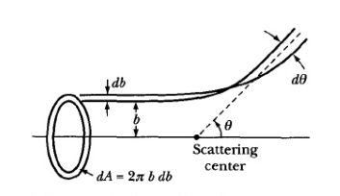
Scattering theory
Note: The notion of cross section is common to many areas of physics including classical mechanics, quantum mechanics, optics, etc. Only in the classical mechanics can we calculate it from a knowledge of the particle trajectory as it relates to the scattering geometry.
b
Figure from Marion & Thorton, Classical Dynamics
Note: We are assuming that the process is isotropic in φ

Slide 23
Lagrangian mechanics

Slide 24
Recipe for constructing the Hamiltonian and analyzing the equations of motion

Slide 25
Question – When can you bypass the 5 step derivation process and directly write the Hamiltonian of the system as
Only when Natalie Holzwarth is not looking
When you have a simple system that has no explicit velocity and/or time dependence
Usually

Slide 26
Important tool for analyzing Lagrangian and/or Hamiltonian systems -- finding constants of the motion
In Lagrangian formulation --

Slide 27
Constants of the motion in the Hamiltonian formulation

Slide 28
Question – Why use this fancy formalism when simple conservation of energy or momentum intuitively apply?
You should use your intuition whenever possible.
You should never trust your intuition.
The equations should be consistent with correct intuitive solutions and also reveal additional solutions (perhaps beyond intuition)

Slide 29
Liouville’s Theorem (1838)
The density of representative points in phase space corresponding to the motion of a system of particles remains constant during the motion.

Slide 30
Rigid body motion
In a reference frame attached to the object, there are 3 moments of inertia and 3 distinct principal axes
Representation of rotational kinetic energy:

Slide 31
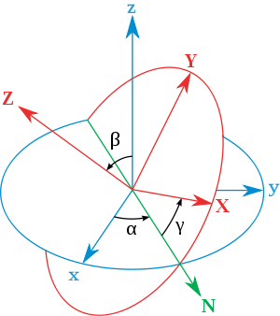
Euler’s transformation between body fixed and inertial reference frames
x
y
y
x

Slide 32

Normal modes of vibration -- potential in 2 and more dimensions
V(x,y)

Slide 33
Example – normal modes of a system with the symmetry of an equilateral triangle -- continued
3
u₃
u₂
1
2
u₁

Slide 34
Example – normal modes of a system with the symmetry of an equilateral triangle -- continued

Slide 35
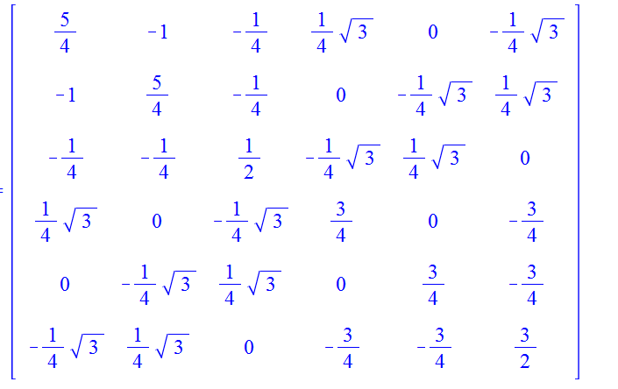
Example – normal modes of a system with the symmetry of an equilateral triangle -- continued
= ω²

Slide 36
Discrete particle interactions → continuous media →
The wave equation

Slide 37
Mechanical motion of fluids
Newton’s equations for fluids
  Use Euler formulation; following “particles” of fluid
Viscosity contributions

Slide 38
Fluid mechanics of incompressible fluid plus surface
Non-linear effects in surface waves:
p₀
ζ
z
h
y
z=0
x

Slide 39
To be continued Mon. Nov. 30, 2020
Topics ?

