Slide 1
PHY 711 Classical Mechanics and Mathematical Methods
10-10:50 AM MWF Online or (occasionally) in Olin 103
Discussion notes for Lecture 3
Scattering theory;
Center of mass and laboratory coordinate frames
Notes:
This lecture will continue the discussion of scattering theory. After discussing a little bit more of the background and motivation, we will jump into the geometry of the process. Typical “lab” experiments are hard to analyze directly. However, scattering in the center of mass frame of reference is much more amenable to detailed analysis. In this lecture we will discuss how we can relate the results in the two frames of reference. Next time, we will analyze the center of mass scattering for a few examples.

Slide 2
Schedule for weekly one-on-one meetings
Nick – 11 AM Monday (ED/ST)
Tim – 9 AM Tuesday
Bamidele – 7 PM Tuesday
Zhi – 9 PM Tuesday
Jeanette – 11 AM Friday
Derek – 12 PM Friday

Slide 3
Your questions –
From Jeanette
Why do we start with scattering? I'm just curious, I don't think scattering was specifically addressed in my undergrad course.
Slide #6 Last sentence - What is the function b(theta)? Is it simply referring to solving that equation for b?
Slide 19 - Is the whole yellow boxed equation for elastic scattering or only the far-right term?
From Nick
What is \varphi representing? Is it the angle of a sector of the beam?
Why does b(\theta)=Dsin(\pi/2 - \theta/2)? I'm not sure I follow that.
Can we spend some time going over the geometry of the center of mass frame?
From Tim
For Assignment #2 are we assuming the larger mass, M is at rest or does it have an initial velocity?
From Derek
Assignment #2 says that the total energy of the system in the problem is V0 but shouldn't it be V0 plus the kinetic energy of the moving particle?

Slide 4
From Zhi–
About the lecture 3. I have a question: What is laboratory reference frame' strong points compared to center of mass reference frame when studying scattering?

Slide 5
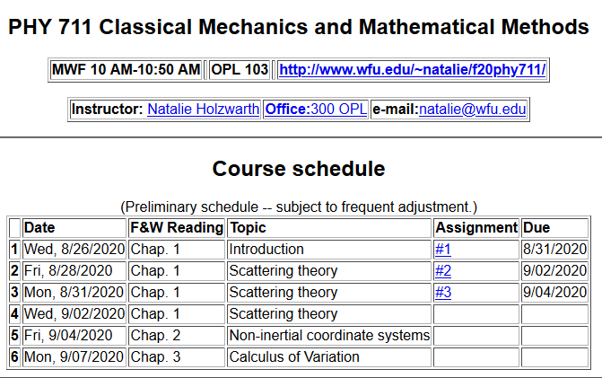
Notes:
This is the schedule posted on the webpage.

Slide 6
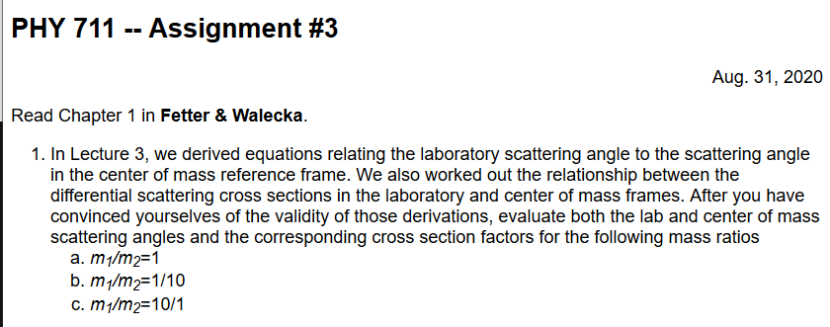
Notes:
This is the homework problem posted for this lecture.

Slide 7
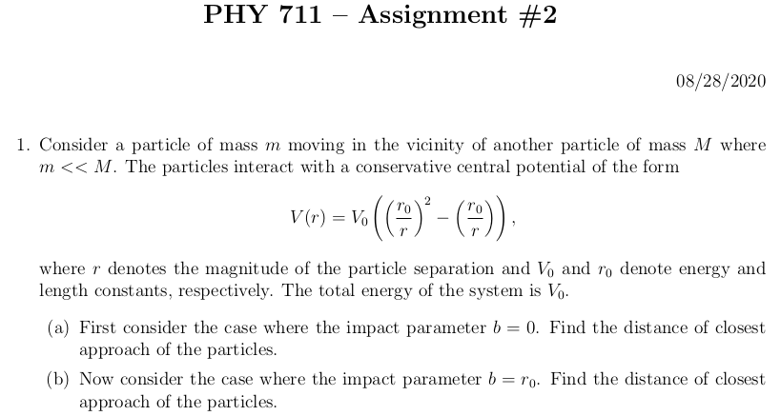
From your questions -- About homework #2
For Assignment #2 are we assuming the larger mass, M is at rest or does it have an initial velocity?
Assignment #2 says that the total energy of the system in the problem is V0 but shouldn't it be V0 plus the kinetic energy of the moving particle?
The total energy of the system is a given constant and V₀ happens to a particular energy value (that hopefully makes the algebra of the problem somewhat convenient.).
Assume particle M is at rest.

Slide 8
Your question -- Why do we start with scattering? I'm just curious, I don't think scattering was specifically addressed in my undergrad course.
Comment – Short answer – Fetter and Walecka chose scattering as the first chapter, so I thought that we should play along. Longer answer – scattering ideas come up a lot in physics in different contexts. In fact, the analysis for classical mechanics is especially rewarding (at least in principle). This is because the particle trajectory can be directly related to the scattering behavior. More generally, cross section analysis is a standard way to compare “theory” and experiment.

Slide 9
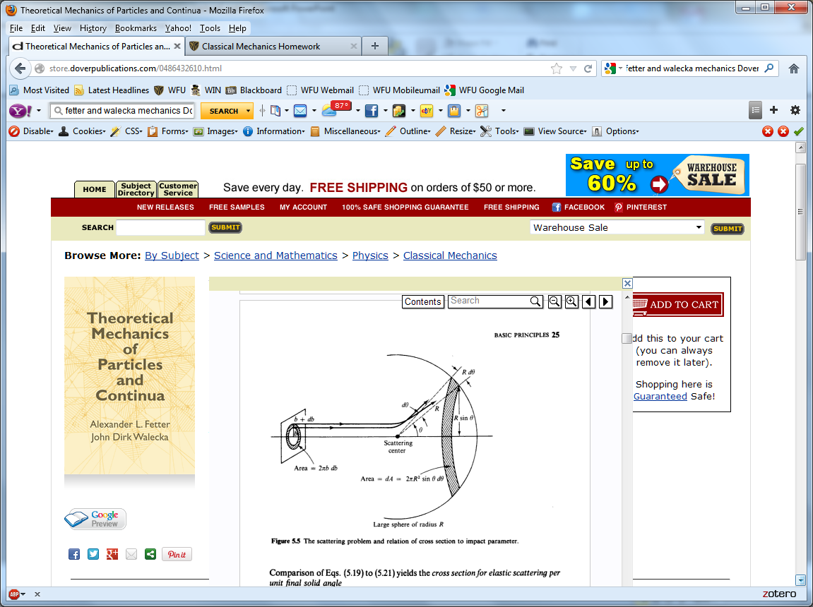
Scattering theory:
detector
Notes:
This is the image of the ideal scattering geometry that is in your textbook. Later in the lecture we will reference this diagram as the “lab” frame of reference. The target
particle (#2) is assumed to be initially at rest, while the scattering particle (#1) is moving at constant velocity toward the target (when it is far from the target). As the scattering particle approaches the target, it is deflected as shown and ends up in the detector place at the scattering angle theta.

Slide 10
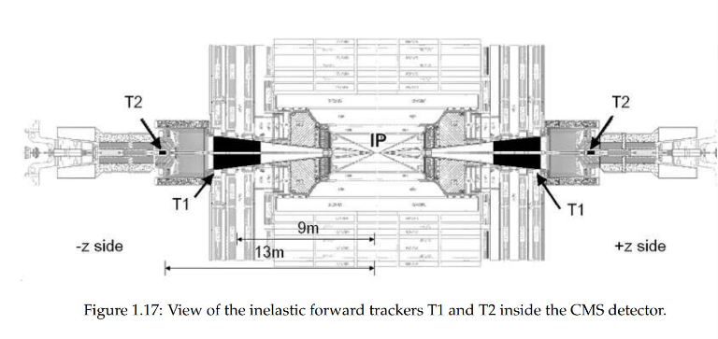
Can you think of examples of such an experimental setup?
Other experimental designs –
At CERN https://home.cern/science/experiments/totem the study of highly energetic proton-proton scattering is designed in the center of mass frame of reference by accelerating two proton beams focused to collide head on in the Large Hadron Collider LHC facility.
Figure from CERN website
Notes:
Think about some situations you know about where such a laboratory experiment has been carried out. Of course, the stationary target arrangement is not always the case. This slide mentions a particular experiment at CERN where the experiment is actually designed to be in the center of mass frame. This is a special arrangement and the physics under consideration goes far beyond classical mechanics. In fact, it is a highly inelastic collision.

Slide 11
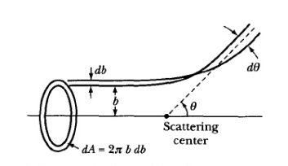
b
Figure from Marion & Thorton, Classical Dynamics
Notes:
For the normal (stationary target) setup, it is very useful to standardize the measurement of scattering in terms of a “cross section”. Furthermore, for classical mechanics, where we can analyze the particle trajectories in detail, we can calculate the cross section in terms of particle parameters. While our analysis will consider a single particle in the vicinity of the target, actual experiments are performed with many such particles in a beam. All beam particles are initially moving toward the target with a given initial kinetic energy. Within the beam of particles, there will be a distribution of “impact parameters” b defined in the diagram. As we will see, the impact parameter of the particple will determine its scattering angle theta. From geometry, the function b(theta) determines the differential cross section from the expression given on this slide.

Slide 12
Your questions -- Slide #6 Last sentence - What is the function b(theta)? Is it simply referring to solving that equation for b? What is \varphi representing? Is it the angle of a sector of the beam?
Comment -- We imagine that the beam of particles has a cylindrical geometry and that the physics is totally uniform in the azimuthal direction. The cross section of the beam is a circle.
⬅This piece of the beam scatters into the detector at angle θ
b
This logic leads to the notion that b is a function of theta and we will try to find b(θ) for various cases.

Slide 13
Note: The notion of cross section is common to many areas of physics including classical mechanics, quantum mechanics, optics, etc. Only in the classical mechanics can we calculate it from a knowledge of the particle trajectory as it relates to the scattering geometry.
b
Figure from Marion & Thorton, Classical Dynamics
Note: We are assuming that the process is isotropic in φ
Notes:
This slide shows a little more detail of the same ideas.

Slide 14
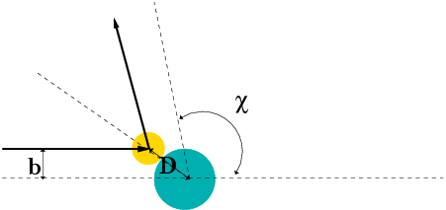
Simple example – collision of hard spheres
Microscopic view:
Notes:
Here we show the example for the case that the scattering particle and the target interact as ideal hard spheres, assuming the target particle is stationary and infinitely massive. In this case the cross section depends on the distance of closest approach D.

Slide 15
Your question -- Why does b(\theta)=Dsin(\pi/2 - \theta/2)? I'm not sure I follow that.
D
b

Slide 16
Simple example – collision of hard spheres -- continued
Hard sphere:
Notes:
Additional comments on the differential and total cross sections.

Slide 17
Now consider the more general case of particle interactions and the corresponding scattering analysis.

Slide 18
Relationship of scattering cross-section to particle interactions --
Classical mechanics of a conservative 2-particle system.
1
2
Notes:
This is the general diagram we showed last time. We will assume that there are no additional forces acting on the system and that the forces are entirely conservative so that energy E (sum of kinetic and potential) is conserved

Slide 19
Typical two-particle interactions –
Scattering theory can help us analyze the interaction potential V(r). First we need to simply the number of variables.
Notes:
We will assume that the potential depends only on the particle distance and has no angular dependence.

Slide 20
Relationship between center of mass and laboratory frames of reference. At and time t, the following relationships apply --
Notes:
It is convenient to transform our coordinate system from particle 1 and particle 2 to instead the center of mass coordinate and the relative coordinate.

Slide 21
Classical mechanics of a conservative 2-particle system -- continued
Notes:
If there are no external forces on this system, the kinetic energy of the center of mass is constant. Additionally, for the central interaction potential , the relative angular momentum is also conserved. The last equation shows that the important physics of the system is determined by the total energy of the relative system.

Slide 22
constants
vary in time
For scattering analysis only need to know trajectory before and after
the collision.
Notes:
Here we highlight the last result. The green arrows point to the relative coordinate terms that will be the focus of our analysis. For the scattering process, only the before and after processes directly enter the analysis. Of course the after parameters depend on the before parameters and the intermediate trajectory.

Slide 23
Note: The following analysis will be carried out in the center of mass frame of reference.
In laboratory frame: In center-of-mass frame:
V₁
v₁
μ
m₁
r
origin
v_{CM}
m_{target}
Also note: We are assuming that the interaction between particle and target V(r) conserves energy and angular momentum.
Notes:
In the next several slides we will consider the scattering geometry and the relationships between the two coordinate systems.

Slide 24
Your question – What is laboratory reference frame' strong points compared to center of mass reference frame when studying scattering?
Comment -- Typically, the laboratory frame is where the data is taken, but the center of mass frame is where the analysis is most straightforward.
constant
relative coordinate system; visualize as “in” CM frame

Slide 25
It is often convenient to analyze the scattering cross section in the center of mass reference frame.
Relationship between normal laboratory reference and center of mass:
Laboratory reference frame:
Before After
m₁
m₂
u₁
v₁
u₂=0
θ
ζ
v₂
Center of mass reference frame:
Before After
m₁
m₂
V₁
U₁
U₂
ψ
ψ
V₂
Notes:
Here we define the notation, keep theta as the scattering angle measured in the lab frame.

Slide 26
Relationship between center of mass and laboratory frames of reference -- continued
Notes:
u and U denote before the collision and v and V denote after the collision. Lower case references the lab frame and upper case references the center of mass frame.

Slide 27
Relationship between center of mass and laboratory frames of reference for the scattering particle 1
V_{CM}
V₁
v₁
ψ
θ
For elastic
scattering
Notes:
Focusing on the variables describing particle 1 after the collision.

Slide 28
Your question – Slide 19 - Is the whole yellow boxed equation for elastic scattering or only the far-right term?
General case
Special case of elastic scattering

Slide 29
Digression – elastic scattering
Also note:

Slide 30
Relationship between center of mass and laboratory frames of reference – continued (elastic scattering)
V_{CM}
V₁
v₁
ψ
θ
Notes:
After some algebra.

Slide 31
Differential cross sections in different reference frames
Notes:
More steps.

Slide 32
Differential cross sections in different reference frames – continued:
Notes:
Summary of results

Slide 33
Example: suppose m₁ = m₂

Slide 34
Summary --
Differential cross sections in different reference frames – continued:
For elastic scattering

Slide 35
Hard sphere example – continued
m₁=m₂
Center of mass frame
Lab frame

Slide 36
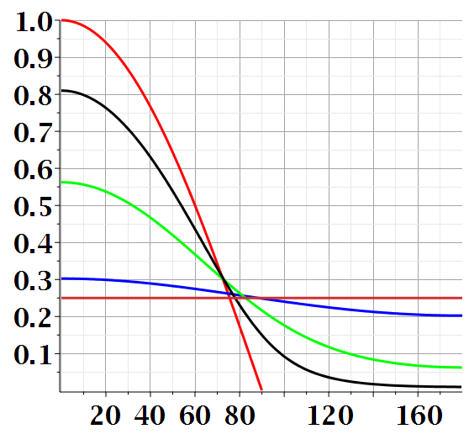
Scattering cross section for hard sphere in lab frame for various mass ratios:
Notes:
Plot of the lab cross sections for various mass ratios.

Slide 37
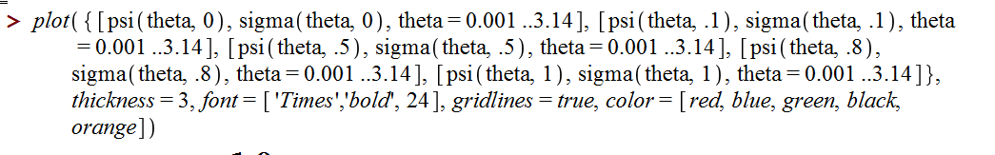
Maple syntax:

Slide 38
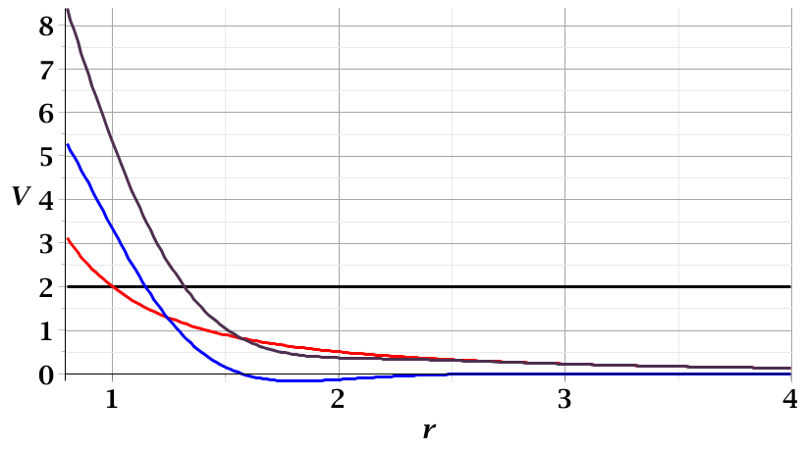
For a continuous potential interaction in center of mass reference frame:
Need to relate these parameters to differential cross section
E_{rel}
r_{min}
Notes:
Diagram for the relative coordinates

Slide 39
Focusing on the center of mass frame of reference:
Typical two-particle interactions –
X
⬅
Notes:
We will consider this next time.

