Slide 1
PHY 711 Classical Mechanics and Mathematical Methods
10-10:50 AM MWF online
Plan for Lecture 40
Review -- continued
Euler angles of rotation
Normal modes of vibration
Aspects of fluid mechanics
Questionnaire --

Slide 2
Modified schedule for last week of classes 11/30/2020-12/04/2020
Schedule for weekly one-on-one meetings (EST)
Nick – 11 AM Monday – 11/30
Tim –9 AM Tuesday – 12/01
Gao – 9 PM Tuesday -- 12/01 (12/02 in China)
Jeanette – 11 AM Friday – ??
Derek – 12 PM Friday – ??

Slide 3
3

Slide 5
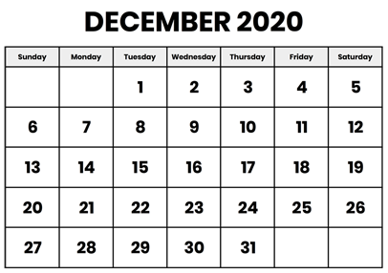
Comments on take-home final –
Similar to mid-term in form
Available: Mon. Dec. 7, 2020
Due before: Mon. Dec. 14, 2020 before 11 AM

Slide 6
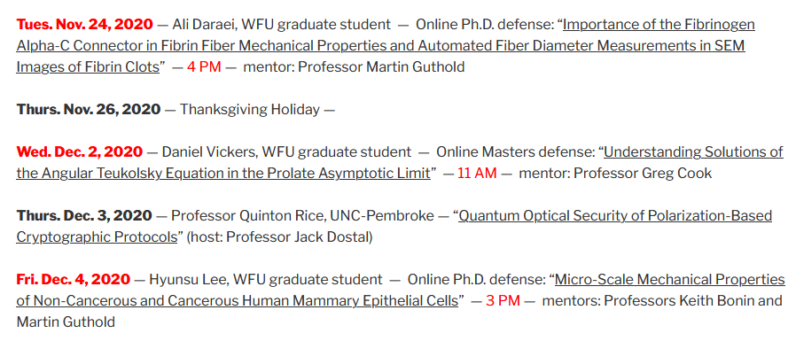
Upcoming Physics colloquia and theses defenses
https://www.physics.wfu.edu/wfu-phy-news/seminars-2020-fall/

Slide 7
Thursday, Dec. 3, 2020
4 PM

Slide 8
Rigid body motion
In a reference frame attached to the object “body fixed frame”, there are 3 moments of inertia (I₁, I₂, I₃) and 3 corresponding axes. We use three Euler angles to transform between the body fixed and inertial frames so that (for example) we can write the rotational kinetic energy:

Slide 9
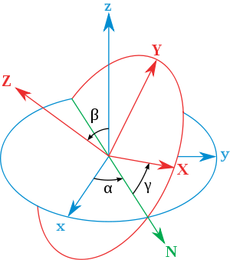
Transformation between body-fixed and inertial coordinate systems – Euler angles
inertial
body
x
y
y
x
http://en.wikipedia.org/wiki/Euler_angles
Notes:
In addition to the dynamic transformation needed for rigid body mechanics, this formalism is more generally useful when relating coordinate systems of different orientations.

Slide 10
Need to express all components in body-fixed frame:
Euler found 3 convenient axes to define the general rotations
x
y
y
x
➔ Need transform Euler’s convenient axes to the body-fixed axes.
Notes:
Euler said that the transformation of body-fixed → inertial frames can be accomplished in 3 steps and the corresponding angles are alpha, beta, and gamma. In this case, we want to express all results in the body fixed frame.

Slide 11
x
y
y
x
Notes:
We can express the angular velocities in terms of the time rate of change of the alpha, beta, and gamma Euler angles. We can also express the rotation axes in terms of the instantaneous Euler angles as well. Here is the transformation of the middle axis.

Slide 12
x
y
y
x
Notes:
Here is the transformation of the inertial 3 axis.

Slide 13
Notes:
Putting all of the transformations together, we now have expressions for the angular velocity components referenced to the body fixed frame.

Slide 14
x
y
y
x
Notes:
Result to remember.

Slide 15
Rotational kinetic energy
Notes:
General expression of the rotational kinetic energy and the special case of the symmetric top.

Slide 16
General transformation between rotated coordinates – Euler angles
initial
inertial
final
body
x
y
y
x
http://en.wikipedia.org/wiki/Euler_angles
Notes:
In general any transformation can be expressed in terms of the three Euler angles.

Slide 17
Example -- rotate by φ about the z-axis
z
y
V
V’
φ
x

Slide 18
Another example --

Slide 19
Note: It is not always convenient to use the Euler axes. For example, suppose you wanted to rotate by 120º about the x+y+z axis?
➔
z
y
x
z
y
x

Slide 20
Normal modes of vibration about equilibrium
Example with 2 dimensions and 3 minima:
V(x,y)

Slide 21
Example – normal modes of a system with the symmetry of an equilateral triangle based on stretching nearest neighbor bonds with spring constant k:
3
u₃
u₂
1
2
u₁

Slide 22
Example – normal modes of a system with the symmetry of an equilateral triangle -- continued

Slide 23
Example – normal modes of a system with the symmetry of an equilateral triangle -- continued
= ω²

Slide 24
Example – normal modes of a system with the symmetry of an equilateral triangle -- continued
With help from Maple
3
u₃
m
k
k
u₂
1
2
u₁
k
m
m
Note that this is a simplified result; a more realistic model may include additional restoring forces such as for maintaining the bond angles as well as lengths.

Slide 25
Example – linear molecule
m₁
m₂
m₃

Slide 26
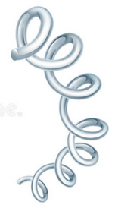
More complete model – finding non-trivial motion in y and z directions
k’
https://www.chem.purdue.edu/jmol/vibs/co2.html

Slide 27
Discrete particle interactions → continuous media →
The wave equation
Note – this is a traveling wave solution; we also discussed standing waves –

Slide 28
Mechanical motion of fluids
Newton’s equations for fluids
Use Euler formulation; following “particles” of fluid
Viscosity contributions

Slide 29
Fluid mechanics of incompressible fluid plus surface
Non-linear effects in surface waves:
p₀
ζ
z
h
y
z=0
x

