Slide 1
PHY 711 Classical Mechanics and Mathematical Methods
10-10:50 AM MWF Online or (occasionally) in Olin 103
Discussion notes for Lecture 4
Scattering analysis in the center of mass frame.
Summary of what we have learned so far
Analytical evaluation of the differential scattering cross section in general and for Rutherford scattering (in center of mass frame)
Notes:
In this lecture, we will focus on the analysis in the center of mass frame which contains the basic physics of the interparticle interaction. The main example will be that of the famous Rutherford scattering experiment.

Slide 2
Physics colloquium Thursday at 4 PM –
https://www.physics.wfu.edu/
Notes:
This week the colloquium series will be starting. The information is posted on our website

Slide 3
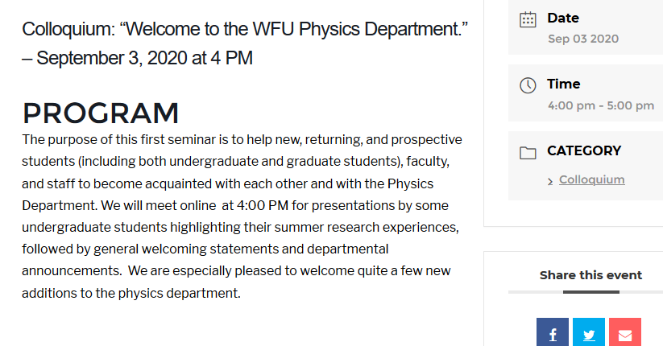
You will need a link to the video conference which you should receive if you are registered for PHY 601 or you can request to be on the mailing list -- contact Kittye McBride mcbridek@wfu.edu.
Notes:
Here we see the details for the first colloquium which will introduce you to the department and various important announcements.

Slide 4
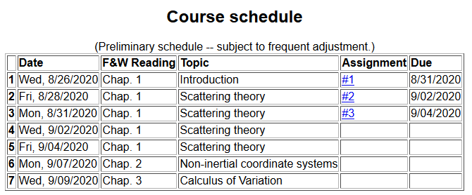
Note that there is no new assigned homework for this lecture. Friday’s lecture will review scattering theory and answer your remaining questions. After today’s lecture and before 7 AM Friday, continue to send me your questions on this material and on Chapter 1 of F&W.
Notes:
Here is a snapshot of the lecture and homework schedule. From your discussion, I slowed the pace a bit, scheduling one more session on scattering so that we can summarize and digest. There is no new homework, so that by Friday, we will hopefully be all caught up.

Slide 5
Your questions –
From Tim
So if you want your scattered particles to appear at a certain angle (theta), then you should play with the input parameter b until your particles are being picked up by your fixed detector? I guess the Erel could also be played with to vary K in the equation.
From Jeanette
In E = E_CM + E _rel, what does rel mean? Relative?
Slide 16 - E_rel only has one term, but in slide 14 it had 3 terms. What happened to the other 2 terms?
From Gao
1. For defined interparticle potential the trajectory of a scattering particle is defined. So what physical meanings is the differential cross section?

Slide 6
From Nick
What is meant by solid angle? .
The book and slides have slightly different formulations and I'm trying to rectify the two. Can you go over again how we get , what it represents, and why it's significant? In particular, why is from the slides and from the text?
Can you clarify the solid angle from lab vs. CM frames.
Where does the 4pi come from on lecture 3 extra, slide 35?
Just to clarify, \phi and \varphi are the same thing right?
The last line on slide 20 of lecture 4...can you clarify?
From Derek
1. On slide 14, does the large curve that r(phi) points to represent the trajectory of the scattering particle in the center of mass frame? I'm having difficulty understanding what is being illustrated on that slide.

Slide 7
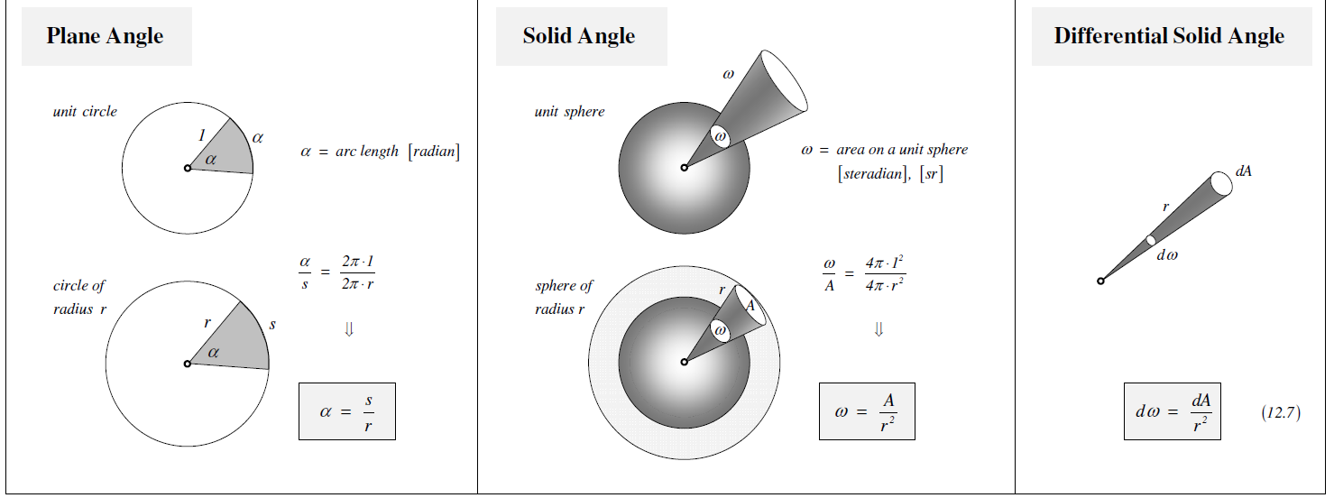
Your question – What is meant by solid angle? . Can you clarify the solid angle from lab vs. CM frames.
This is geometric construct that is useful especially to scattering theory. The same construct applies to lab or CM frames.
From the webpage --https://www.et.byu.edu/~vps/ME340/TABLES/12.0.pdf

Slide 8
Your question -- For defined interparticle potential the trajectory of a scattering particle is defined. So what physical meanings is the differential cross section?
Comment – The notion of cross section is motivated largely by the desire to compare experiment and theory. The theory gives us a trajectory and the experiment gives us data from the detector which we can standardize.

Slide 9
Figure from F&W:
detector
Notes:
This and the next several slides summarize the experimental scattering geometry.

Slide 10
b
Figure from Marion & Thorton, Classical Dynamics
Notes:
More review.

Slide 11
Note: Notion of cross section is common to many areas of physics including classical mechanics, quantum mechanics, optics, etc. Only in the classical mechanics can we calculate it using geometric considerations
b
Figure from Marion & Thorton, Classical Dynamics
Note: We are assuming that the process is isotropic in φ
Notes:
More review.

Slide 12
Note in the above slides θ is the scattering angle in the lab frame and φ is the azimuthal angle measured in the plane perpendicular to the slide. Unfortunately the textbook and the notes have some deviations in this notation

Slide 13
Transformation between center-of-mass and laboratory reference frames:
(assuming that energy is conserved)
V_{CM}
V₁
v₁
ψ
θ

Slide 14
Differential cross sections in different reference frames –
For elastic scattering:
Notes:
Review of equations relating cross section results in center of mass frame to that in the laboratory experiment.

Slide 15
Focusing on the center of mass frame of reference:
Typical two-particle interactions –
X
⬅
Notes:
Now we will focus our attention on the analysis of the event in the center of mass frame of reference and particularly consider the Coulomb interaction (which also has the same functional form as the gravitional interaction.

Slide 16
constants
vary in time
For scattering analysis only need to know trajectory before and after
the collision.
Notes:
Recall that the system of interest can be expressed in terms of constants and the particle separation r(t).

Slide 17
Your question -- In E = E_CM + E _rel, what does rel mean? Relative?
Comment -- Yes

Slide 18
Focus of analysis

Slide 19
Comment on HW #2

Slide 20
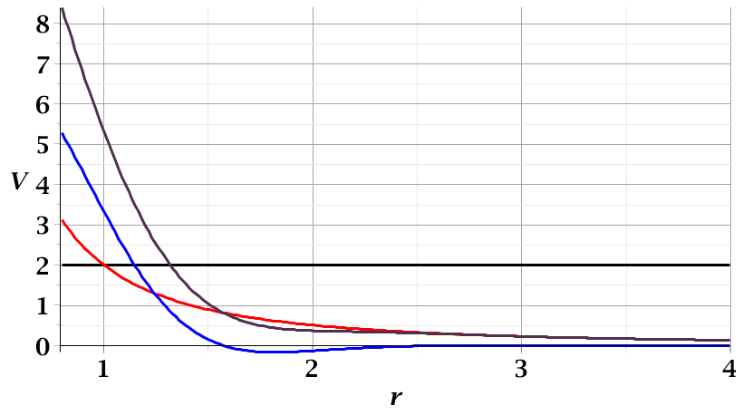
For a continuous potential interaction in center of mass reference frame:
Need to relate these parameters to differential cross section
E_{rel}
r_{min}

Slide 21
Your question -- So if you want your scattered particles to appear at a certain angle (theta), then you should play with the input parameter b until your particles are being picked up by your fixed detector? I guess the Erel could also be played with to vary K in the equation.
Comment – This is a very good question concerning what are the variables we have control over and which are fixed by the physics. In general whatever variables are fixed in the lab frame translates into particular variables in the center of mass frame. From that viewpoint, if you prepare a beam of particles with a given energy, that will fix E_{rel .} Typically the interaction parameters are fixed by the physics. The impact parameter b does vary throughout the beam profile and depending on the particle trajectories will result in various detector signals as a function of scattering angle.

Slide 22
Figure from F&W:
detector
Notes:
This and the next several slides summarize the experimental scattering geometry.

Slide 23
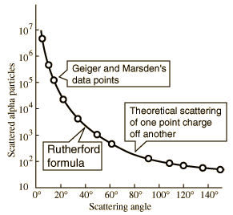
Example of data from Rutherford experiment
From webpage: http://hyperphysics.phy-astr.gsu.edu/hbase/nuclear/rutsca2.html#c3
Notes:
Reconstructed data taken from the web.

Slide 24
➔Need to find an equation for r(φ)
φ
Note the φ is used to denote the trajectory angle where φ=0 at r_{min}
r_{min}
center of scattering.
r(φ)

Slide 25
Your question -- On slide 14, does the large curve that r(phi) points to represent the trajectory of the scattering particle in the center of mass frame? I'm having difficulty understanding what is being illustrated on that slide.
Comment – My apologies for the figure and the notation. The intention was to relate to figures in your textbook such as Fig. 5.3 where now φ is an angle associated with the trajectory r(φ). The point is, while we can analyze the details of the full trajectory from the equations, for scattering theory we only need to know what happens before and after the particle gets close to the target.

Slide 27
r(t)
r_{min}
Notes:
Relating the constants of the problems to values determined when the particles are very far apart.

Slide 28
Notes:
Up to now we are expressing the trajectory as a function of time t. For this analysis however, we would like to find the trajectory as a function of the angle \phi. The relationship of the constant angular momentum to the \phi and time variables allows us to find r(\phi).

Slide 29
Notes:
Lots of algebra ….

Slide 30
Notes:
This shows the relationship of the analysis of r(\phi) to the scattering event. The insert is a diagram from the textbook.

Slide 31
Notes:
The scattering process involves the aspects of the trajectory at large separations.

Slide 32
Notes:
When r=rmin, \phi=0. \phi increases to a maximum value.

Slide 33
Relationship between φ_{max} and θ:
Using the diagram from your text, θ represents the scattering angle in the center of mass frame.
Notes:
Problem with consistent notation. Here we are using the textbook’s definition of theta which is OK if the target mass is infinite.

Slide 34
Notes:
The last equation is a convenient change of variables.

Slide 35
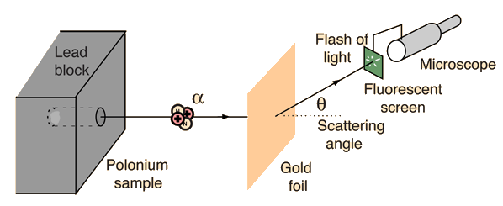
Example: Diagram of Rutherford scattering experiment
http://hyperphysics.phy-astr.gsu.edu/hbase/rutsca.html
Notes:
Here we use a diagram from the web about the Rutherford geometry.

Slide 36
Notes:
Summary of all of the equations and then specializing to the Coulomb interaction form.

Slide 37
Notes:
In this case, the integrals can all be evaluated analytically and simplify to this famous result.

Slide 38
What happens as
θ →0?
From webpage: http://hyperphysics.phy-astr.gsu.edu/hbase/nuclear/rutsca2.html#c3
Notes:
Reconstructed data taken from the web.

Slide 39
Original experiment performed with α particles on gold
Notes:
Evaluation of constant for this case.

Slide 40
Recap of equations for scattering cross section in the center of mass frame of reference
Notes:
Recap of the equations. This equation allows us to fine b(theta).

Slide 41
In preparation for Friday’s lecture, please continue to review these slides and pose your questions (before 7 AM on Friday). Based on your questions and where we have arrived in today’s lecture, hopefully we can help you have some understanding of scattering theory.

