Slide 1
PHY 711 Classical Mechanics and Mathematical Methods
10-10:50 AM MWF Online or (occasionally) in Olin 103
Plan for Lecture 4 -- Chapter 1 F&W
Summary of what we have learned so far
Analytical evaluation of the differential scattering cross section in general and for Rutherford scattering (in center of mass frame)
Notes:
In this lecture, we will focus on the analysis in the center of mass frame which contains the basic physics of the interparticle interaction. The main example will be that of the famous Rutherford scattering experiment.

Slide 2
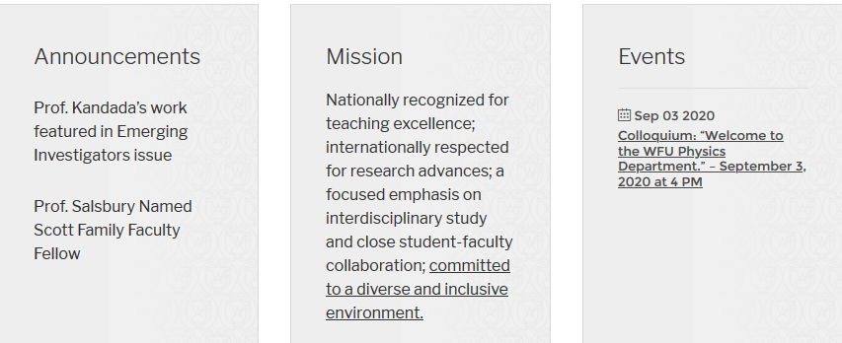
Physics colloquium Thursday at 4 PM –
https://www.physics.wfu.edu/
Notes:
This week the colloquium series will be starting. The information is posted on our website

Slide 3
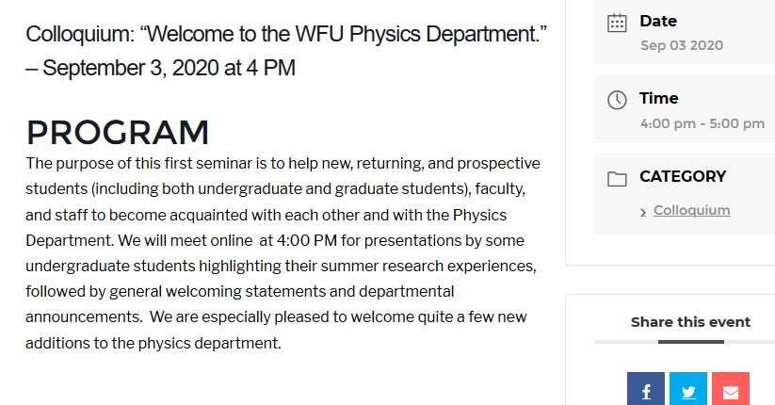
Notes:
Here we see the details for the first colloquium which will introduce you to the department and various important announcements.

Slide 4
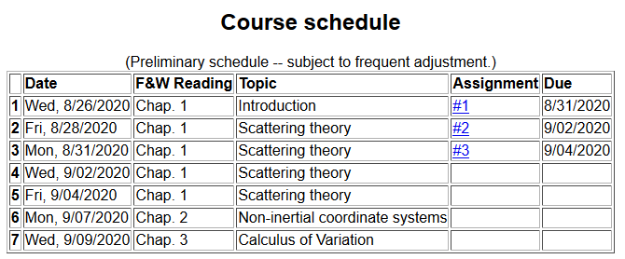
Notes:
Here is a snapshot of the lecture and homework schedule. From your discussion, I slowed the pace a bit, scheduling one more session on scattering so that we can summarize and digest. There is no new homework, so that by Friday, we will hopefully be all caught up.

Slide 5
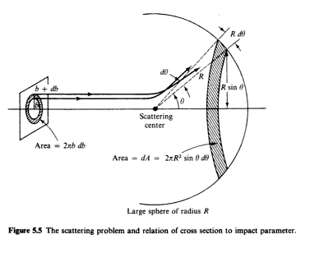
Scattering theory:
detector
Notes:
This and the next several slides summarize the experimental scattering geometry.

Slide 6
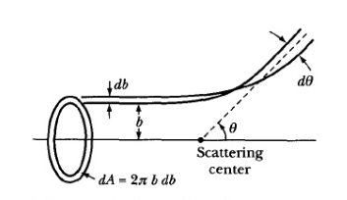
b
Figure from Marion & Thorton, Classical Dynamics
Notes:
More review.

Slide 7
Note: Notion of cross section is common to many areas of physics including classical mechanics, quantum mechanics, optics, etc. Only in the classical mechanics can we calculate it using geometric considerations
b
Figure from Marion & Thorton, Classical Dynamics
Note: We are assuming that the process is isotropic in φ
Notes:
More review.

Slide 8
Transformation between center-of-mass and laboratory reference frames:
(assuming that energy is conserved)
V_{CM}
V₁
v₁
ψ
θ

Slide 9
Differential cross sections in different reference frames –
For elastic scattering:
Notes:
Review of equations relating cross section results in center of mass frame to that in the laboratory experiment.

Slide 10
Focusing on the center of mass frame of reference:
Typical two-particle interactions –
X
⬅
Notes:
Now we will focus our attention on the analysis of the event in the center of mass frame of reference and particularly consider the Coulomb interaction (which also has the same functional form as the gravitional interaction.

Slide 11
constants
vary in time
For scattering analysis only need to know trajectory before and after
the collision.
Notes:
Recall that the system of interest can be expressed in terms of constants and the particle separation r(t).

Slide 12
Focus of analysis

Slide 13
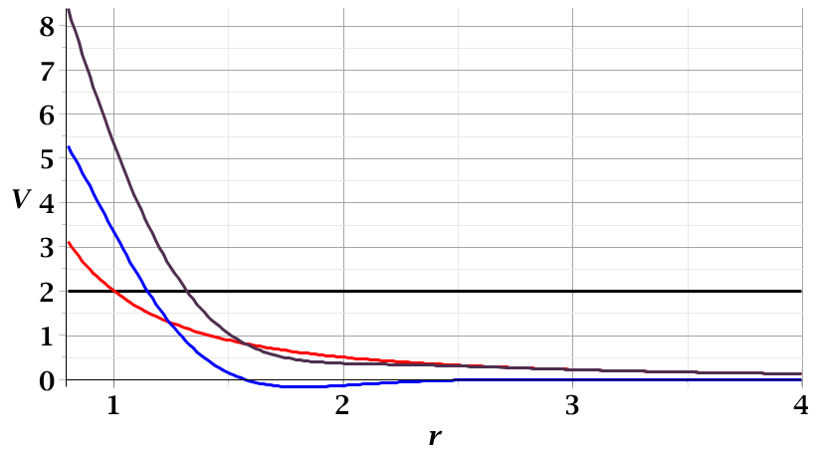
For a continuous potential interaction in center of mass reference frame:
Need to relate these parameters to differential cross section
E_{rel}
r_{min}

Slide 14
➔Need to find an equation for r(φ)
φ
Note the φ is used to denote the trajectory angle where φ=0 at r_{min}
r_{min}
center of scattering.
r(φ)

Slide 16
r(t)
r_{min}
Notes:
Relating the constants of the problems to values determined when the particles are very far apart.

Slide 17
Notes:
Up to now we are expressing the trajectory as a function of time t. For this analysis however, we would like to find the trajectory as a function of the angle \phi. The relationship of the constant angular momentum to the \phi and time variables allows us to find r(\phi).

Slide 18
Notes:
Lots of algebra ….

Slide 19
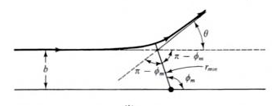
Notes:
This shows the relationship of the analysis of r(\phi) to the scattering event. The insert is a diagram from the textbook.

Slide 20
Notes:
The scattering process involves the aspects of the trajectory at large separations.

Slide 21
Notes:
When r=rmin, \phi=0. \phi increases to a maximum value.

Slide 22
Relationship between φ_{max} and θ:
Using the diagram from your text, θ represents the scattering angle in the center of mass frame.
Notes:
Problem with consistent notation. Here we are using the textbook’s definition of theta which is OK if the target mass is infinite.

Slide 23
Notes:
The last equation is a convenient change of variables.

Slide 24
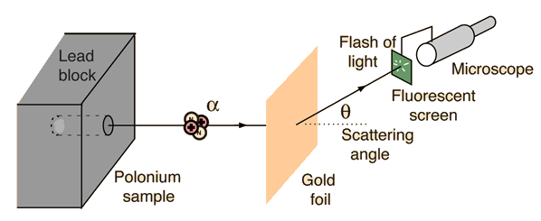
Example: Diagram of Rutherford scattering experiment
http://hyperphysics.phy-astr.gsu.edu/hbase/rutsca.html
Notes:
Here we use a diagram from the web about the Rutherford geometry.

Slide 25
Notes:
Summary of all of the equations and then specializing to the Coulomb interaction form.

Slide 26
Notes:
In this case, the integrals can all be evaluated analytically and simplify to this famous result.

Slide 27
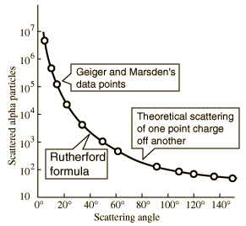
What happens as
θ →0?
From webpage: http://hyperphysics.phy-astr.gsu.edu/hbase/nuclear/rutsca2.html#c3
Notes:
Reconstructed data taken from the web.

Slide 28
Original experiment performed with α particles on gold
Notes:
Evaluation of constant for this case.

Slide 29
Recap of equations for scattering cross section in the center of mass frame of reference
Notes:
Recap of the equations. This equation allows us to fine b(theta).

