Slide 1
PHY 711 Classical Mechanics and Mathematical Methods
10-10:50 AM MWF Online or (occasionally) in Olin 103
Discussion notes for Lecture 5
Wrap up of scattering analysis – Chap 1 F&W
Summary of equations in the center of mass frame.
In center of mass frame, analytical evaluation of the differential scattering cross section in general and for Rutherford scattering.
Summary of results including transformation to lab frame.
Notes:
In this lecture, we will focus on the analysis in the center of mass frame which contains the basic physics of the interparticle interaction. The main example will be that of the famous Rutherford scattering experiment.

Slide 2
Schedule for weekly one-on-one meetings
Nick – 11 AM Monday (ED/ST)
Tim – 9 AM Tuesday
Bamidele – 7 PM Tuesday
Zhi – 9 PM Tuesday
Jeanette – 11 AM Friday
Derek – 12 PM Friday

Slide 3
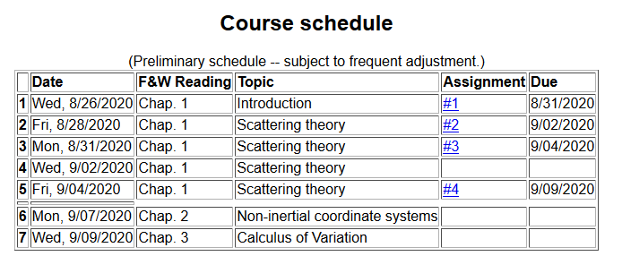
For Monday, please read the annotated lecture notes for Lecture 6 (available <7 AM on 9/6/2020). There will be no homework for Monday’s lecture, leaving more time for HW #4.

Slide 5
Your questions –
From Tim & Nick
Questions about HW #3
From Jeanette
In E = E_CM + E _rel, what does rel mean? Relative?
Slide 16 - E_rel only has one term, but in slide 14 it had 3 terms. What happened to the other 2 terms?
From Bamidele
Slide 13: What conditions made the m2 become ½ μ|v1−v2|2 ; μ=m1m2/(m1+m2)
Slide 14: Where does the term for the kinetic energy from angular momentum come from.

Slide 6
From Nick
The last line on slide 20 of lecture 4...can you clarify?
From Derek
1. On slide 14, does the large curve that r(phi) points to represent the trajectory of the scattering particle in the center of mass frame? I'm having difficulty understanding what is being illustrated on that slide.

Slide 7
Reviewing – scattering in the laboratory
Figure from F&W:
detector
Notes:
This and the next several slides summarize the experimental scattering geometry.

Slide 8
b
Figure from Marion & Thorton, Classical Dynamics
Notes:
More review.

Slide 9
constants
vary in time
For scattering analysis only need to know trajectory before and after
the collision.
Notes:
Recall that the system of interest can be expressed in terms of constants and the particle separation r(t).

Slide 10
Some details --
Relationship between center of mass and laboratory frames of reference. At and time t, the following relationships apply --

Slide 11
More details
Since r(t) represents motion in a plane, we will analyze the system in that plane and use polar coordinates.

Slide 12
➔

Slide 13
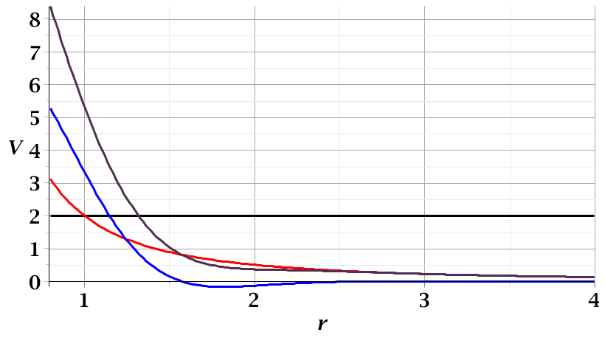
For a continuous potential interaction in center of mass reference frame:
Need to relate these parameters to differential cross section
E_{rel}
r_{min}

Slide 14
r(φ)
φ_{m}
φ
➔Need to find an equation for r(φ)
r_{min}
center of scattering.

Slide 15
How is this related to scattering?
➔
φ_{max}
φ_{max}
θ
Note that here θ is used for the scattering angle

Slide 17
Evaluation of constants far from scattering center --
r(t)
r_{min}
Notes:
Relating the constants of the problems to values determined when the particles are very far apart.

Slide 18
Notes:
Up to now we are expressing the trajectory as a function of time t. For this analysis however, we would like to find the trajectory as a function of the angle \phi. The relationship of the constant angular momentum to the \phi and time variables allows us to find r(\phi).

Slide 19
Notes:
Lots of algebra ….

Slide 20
Notes:
This shows the relationship of the analysis of r(\phi) to the scattering event. The insert is a diagram from the textbook.

Slide 21
Notes:
The scattering process involves the aspects of the trajectory at large separations.

Slide 22
Notes:
When r=rmin, \phi=0. \phi increases to a maximum value.

Slide 23
Relationship between φ_{max} and θ:
Using the diagram from your text, θ represents the scattering angle in the center of mass frame.
Notes:
Problem with consistent notation. Here we are using the textbook’s definition of theta which is OK if the target mass is infinite.

Slide 24
Notes:
The last equation is a convenient change of variables.

Slide 25
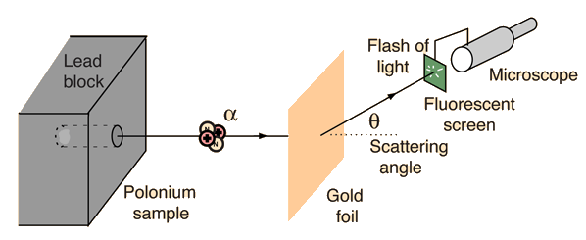
Example: Diagram of Rutherford scattering experiment
http://hyperphysics.phy-astr.gsu.edu/hbase/rutsca.html
Notes:
Here we use a diagram from the web about the Rutherford geometry.

Slide 26
Notes:
Summary of all of the equations and then specializing to the Coulomb interaction form.

Slide 27
Notes:
In this case, the integrals can all be evaluated analytically and simplify to this famous result.

Slide 28
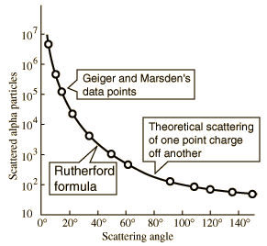
What happens as
θ →0?
From webpage: http://hyperphysics.phy-astr.gsu.edu/hbase/nuclear/rutsca2.html#c3
Notes:
Reconstructed data taken from the web.

Slide 29
Original experiment performed with α particles on gold
Question –
What do you think happens for θ →0?
Big trouble; need to make sure experiment is designed to avoid that case.
No problem
Physics is altered in that case and nothing explodes.
Rare event and rarely causes trouble.
Notes:
Evaluation of constant for this case.

Slide 30
Recap of equations for scattering cross section in the center of mass frame of reference
Notes:
Recap of the equations. This equation allows us to fine b(theta).

Slide 31
Digression– In general, it is possible to determine the trajectory r(φ) --

Slide 32
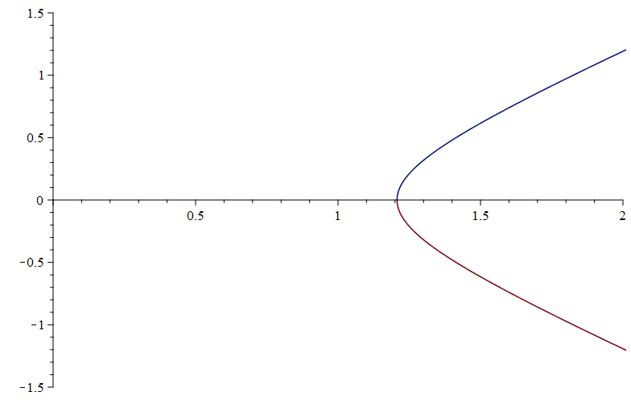
For the Rutherford case --

Slide 33
PHY 711 -- Assignment #3
Aug. 31, 2020
Read Chapter 1 in Fetter & Walecka.
In Lecture 3, we derived equations relating the laboratory scattering angle to the scattering angle in the center of mass reference frame. We also worked out the relationship between the differential scattering cross sections in the laboratory and center of mass frames. After you have convinced yourselves of the validity of those derivations, evaluate both the lab and center of mass scattering angles and the corresponding cross section factors for the following mass ratios
m₁/m₂=1
m₁/m₂=1/10
m₁/m₂=10/1

Slide 34
Transformation between center-of-mass and laboratory reference frames:
(assuming that energy is conserved)
V_{CM}
V₁
v₁
ψ
θ

Slide 35
Differential cross sections in different reference frames –
For elastic scattering:
Notes:
Review of equations relating cross section results in center of mass frame to that in the laboratory experiment.

Slide 36
Want to calculate

Slide 37
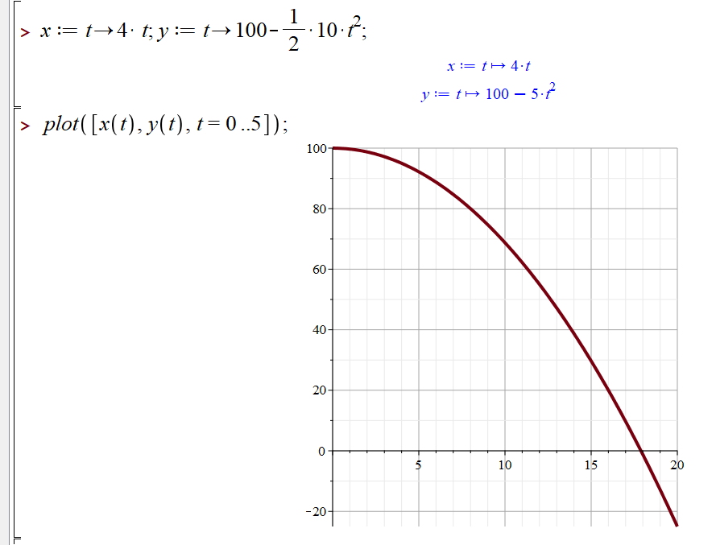
Syntax for parametric plot in maple

Slide 38
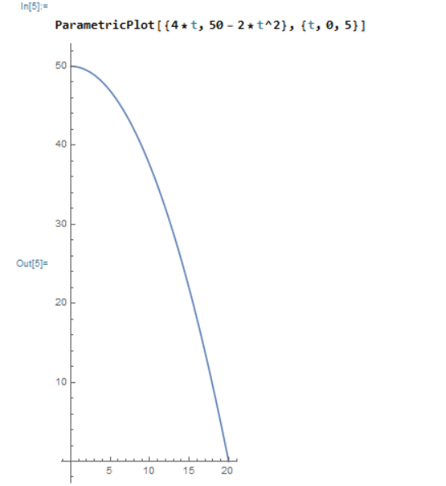
Syntax for parametric plot in mathematica

