Slide 1
PHY 711 Classical Mechanics and Mathematical Methods
10-10:50 AM MWF Online or (occasionally) in Olin103
Discussion for Lecture 7
Chapter 3.17 of F&W
Introduction to the calculus of variations
Mathematical construction
Practical use
Examples
Example problems
Notes:
The topic of “calculus of variation” is covered in Chapter 3, Section 17 of your textbook. We will study the mathematical formalism first before showing how it is useful for studying mechanical systems.

Slide 2
Colloquium on Thursday --
Thursday, Sept. 10, 2020
4 PM

Slide 3
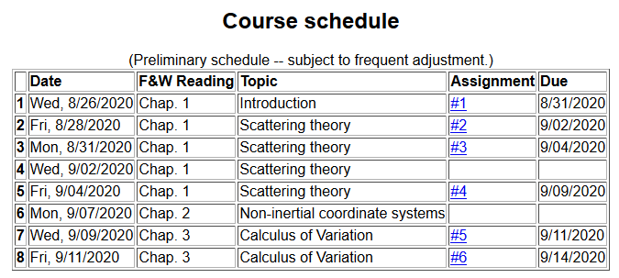
Notes:
There is a short problem on this subject that will be do on Friday.

Slide 4
Your questions –
From Tim
When you say a well-defined function in slide 11, what does that mean? Also why does the first term in slide 12 go to zero when the second term does not? Aren't both terms in that equation equivalent?
From Gao
About lecture 7, Why use caculus of variations to find the function y(x)? I think it is abstract.
From Nick
1. Can you explain what we mean by a well-defined function?
2. I'm getting lost in the notation starting around slide 9. Hopefully we can go over that tomorrow. In particular, I'm not sure I'm following the \delta notation.

Slide 5
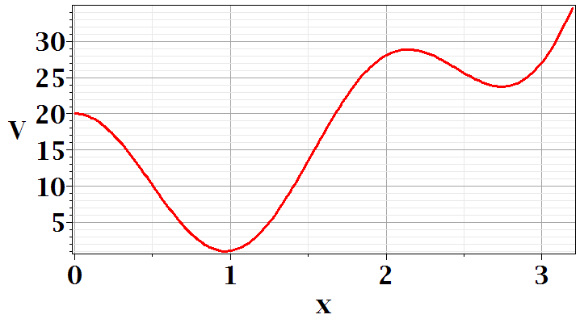
In Chapter 3, the notion of Lagrangian dynamics is developed; reformulating Newton’s laws in terms of minimization of related functions. In preparation, we need to develop a mathematical tool known as “the calculus of variation”.
Minimization of a simple function
local minimum
global minimum
Notes:
First we should review the notion of a minimum in a continuous function. Here is a plot of V(x) showing two different minima at two different points x.

Slide 6
Minimization of a simple function
local minimum
global minimum
Notes:
We see from this plot that a conduction for a function to have a minimum at a point is that its derivative is zero at that point. You see in this example another point where dV/dx, but there is not a minimum. So we say the dV/dx is a necessary but not sufficient condition on having a minimum.

Slide 7
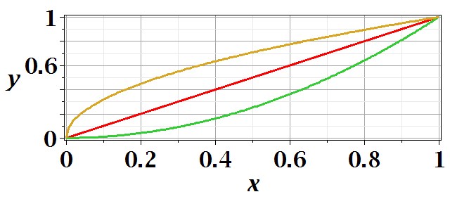
Functional minimization
Notes:
The calculus of variation also searches for minima, but instead of finding a point where a function has a minimum, we search for a functional form that minimizes an integral.

Slide 8
Difference between minimization of a function V(x) and the minimization in the calculus of variation.
Minimization of a function
➔Know V(x) ➔Find x₀ such that V(x₀) is a minimum.
Calculus of variation
Notes:
Comparison

Slide 9
Functional minimization
Notes:
The calculus of variation involves consideration of a function of a function. Here we use L to denote such a function.

Slide 10
Notes:
For this example we can write the distance along a curve between two points x=0,y=0 and x=1,y=1 as a normal integral over x as shown.

Slide 11
Calculus of variation example for a pure integral functions

Slide 12
Comment about notation concerning functional dependence and partial derivatives

Slide 13
After some derivations, we find
Note that this is a
“total” derivative
Notes:
Using calculus to simplify the integral.

Slide 14
“Some” derivations --
*
Notes:
Some details.

Slide 15
*
Note that the construction of this system is that

Slide 17
“Some” derivations (continued)--

Slide 18
Your question – Why does this term go to zero?

Slide 19
Recap --
Here we conclude that the integrand has to vanish at every argument in order for the integral to be zero
Necessary?
Overkill?

Slide 20
Notes:
Your homework problem is very similar to this.

Slide 21
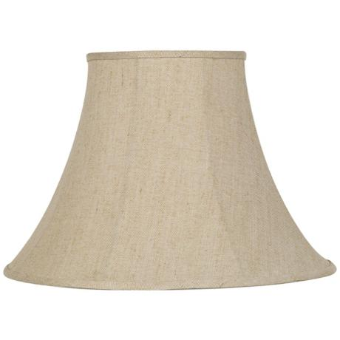
Lamp shade shape y(x)
y
x_{i} y_{i}
x
x_{f} y_{f}
Notes:
Here is another example of the use of calculus of variation.

Slide 22
Notes:
After these steps, the solution is found up to some constants.

Slide 23
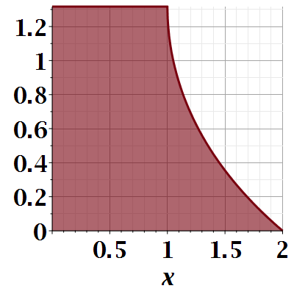

Slide 24
Notes:
Evaluating results for particular boundary values.

Slide 25
Another example:
(Courtesy of F. B. Hildebrand, Methods of Applied Mathematics)
Notes:
Another example.

Slide 26
Euler-Lagrange equation
Alternate Euler-Lagrange equation
Notes:
Summary and extension.

Slide 27
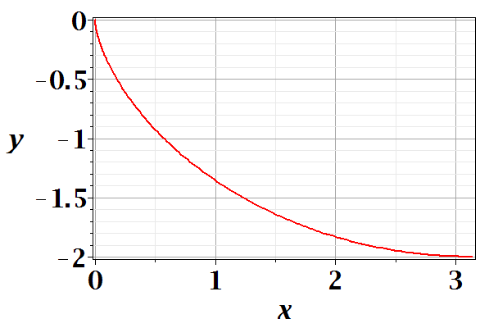
Brachistochrone problem: (solved by Newton in 1696)
http://mathworld.wolfram.com/BrachistochroneProblem.html
A particle of weight mg travels frictionlessly down a path of shape y(x). What is the shape of the path y(x) that minimizes the travel time from
y(0)=0 to y(π)=-2 ?
Notes:
Prelude to what we will cover next time.

Slide 28
Notes:
Some details.

Slide 29
Notes:
More details.

Slide 30
Parametric equations for Brachistochrone:

Slide 31
Parametric plot --
plot([theta-sin(theta), cos(theta)-1, theta = 0 .. Pi])
y
x

