Slide 1
PHY 711 Classical Mechanics and Mathematical Methods
10-10:50 AM MWF Online or (occasionally) in Olin 103
Discussion on Lecture 8 – Chap. 3 F & W
Calculus of variation
Brachistochrone problem
Calculus of variation with constraints
Application to classical mechanics
Notes:
In this lecture, we will continue to develop notions of the calculations of variation and to start to show how they may be applied to classical mechanics.

Slide 2
Schedule for weekly one-on-one meetings
Nick – 11 AM Monday (ED/ST)
Tim – 9 AM Tuesday
Bamidele – 7 PM Tuesday
Zhi– 9 PM Tuesday
Jeanette – 11 AM Friday
Derek – 12 PM Friday

Slide 3
Your questions
From Nick –
1. Can you go over the directions for the next assignment? I'm a bit confused as to what you're asking for in parts a,b. 2. Can you discuss a little more the setup for the T= integral equation at the top of slide 7? Why are we integrating ds/v?
3. Also, in the development of the alternative Euler-Lagrange, we get this relationship: Please explain.
From Tim –
On slide 8 you give the quantity inside the brackets as equal to K = 2a. Did you just do this to make it easier, because in the previous process it would have turned out to be 1/k^2.
From Gao –
1. About lecture #8, what does W=E+λL stand for (15th page of note)? Thank you.

Slide 4
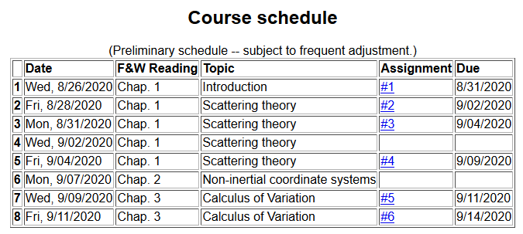
Notes:
There is one homework problem for this lecture.

Slide 5
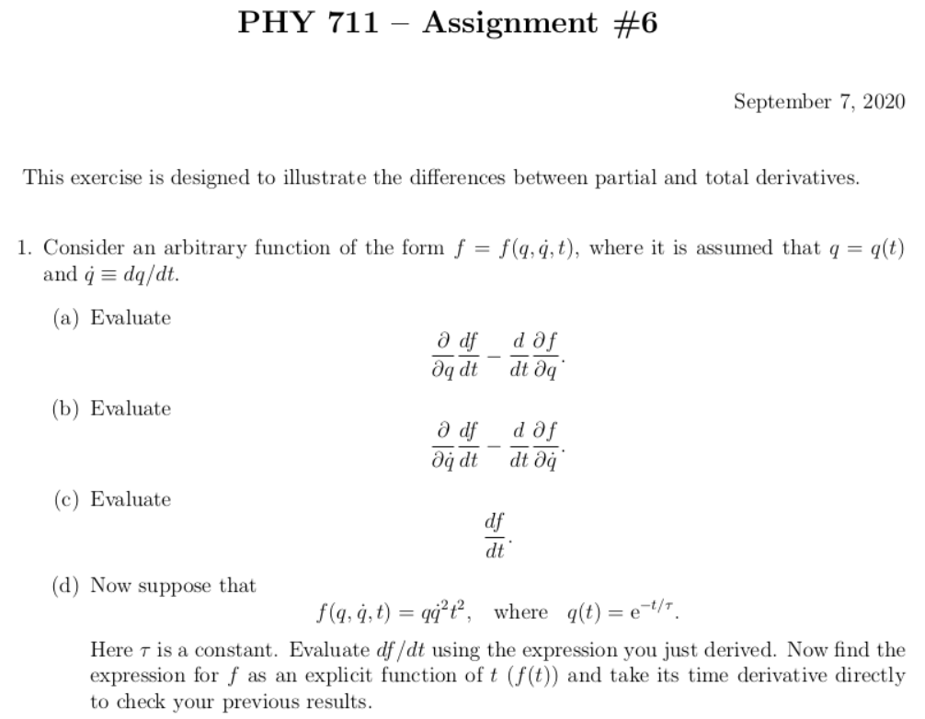
Notes:
It might be useful to evaluate part (c) first.

Slide 6
Your question -- please explain HW 6 a little better.

Slide 7
Euler-Lagrange equation
Alternate Euler-Lagrange equation
Notes:
Summary of the equations we worked out last time.

Slide 8
Your question – Also, in the development of the alternative Euler-Lagrange, we get this relationship:
Please explain.

Slide 9
A few more steps --

Slide 10
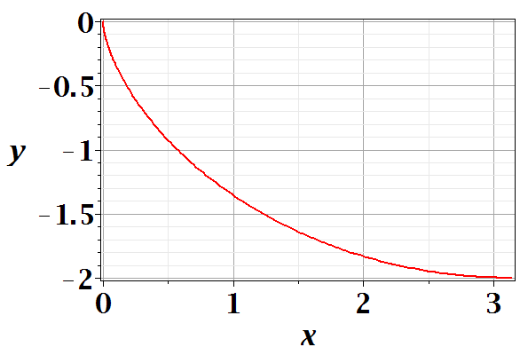
Brachistochrone problem: (solved by Newton in 1696)
http://mathworld.wolfram.com/BrachistochroneProblem.html
A particle of weight mg travels frictionlessly down a path of shape y(x). What is the shape of the path y(x) that minimizes the travel time from
y(0)=0 to y(π)=-2 ?
Notes:
This is the famous problem.

Slide 11
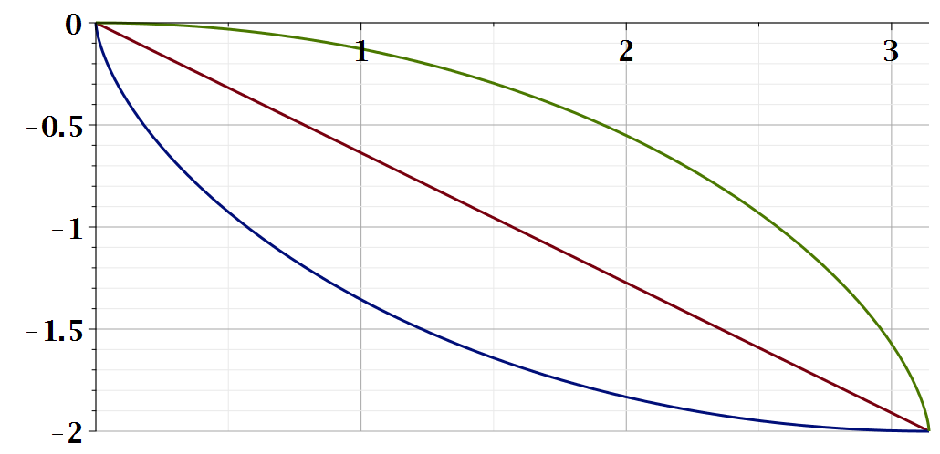
Vote for your favorite path
x
y
Which gives the shortest time?
Green
Red
Blue
Notes:
What curve will win the race?

Slide 12
Notes:
Some details of the Euler-Lagrange equations. The green equations look harder.

Slide 13
Question – why this choice?
Answer – because the answer will be more beautiful. (Be sure that was not my cleverness.)
Notes:
Calling the integration 2a is very convenient.

Slide 14
Parametric equations for Brachistochrone:
Notes:
Very clever mathematics.

Slide 15
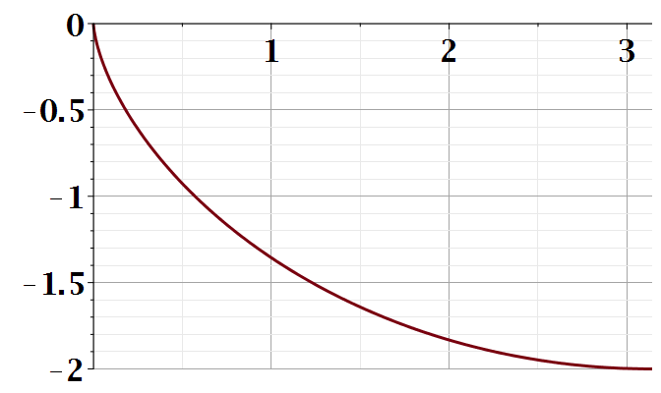
Parametric plot --
plot([theta-sin(theta), cos(theta)-1, theta = 0 .. Pi])
y
x
Notes:
Visualization of the result.

Slide 16
Checking the results
T=infinite
T=5.2668
T=4.4429
Notes:
How did you do with your bet?

Slide 17
Summary of the method of calculus of variation --
Notes:
Summary of equations to use.

Slide 18
Notes:
It is a good idea to remember these equations.

Slide 19
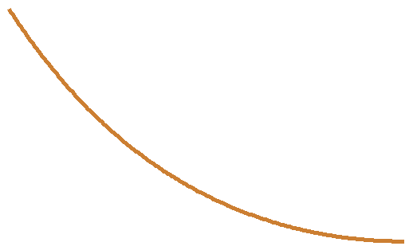
Another example optimization problem:
Determine the shape y(x) of a rope of length L and mass density ρ hanging between two points
x₁ y₁
x₂ y₂
Notes:
Another example needing extra information.

Slide 20
Example from internet --

Slide 21
Lagrange multiplier
Notes:
How to minimize with a constraint.

Slide 22
Your question -- what does W=E+λL stand for?
Comment -- W does not have an obvious physical interpretation

Slide 23
Notes:
Applying the equations.

Slide 25
Notes:
The solutions in (almost) convenient form.

Slide 26
Summary of results
Notes:
Summary again.

Slide 27
Application to particle dynamics
Notes:
We will now start to apply this mathematics to the physics of motion. Here we map the variables that will apply. A is called “action”. L is called “Lagrangian”.

Slide 28
Application to particle dynamics
Hamilton’s principle states that the dynamical trajectory of a system is given by the path that extremizes the action integral
Simple example: vertical trajectory of particle of mass m subject to constant downward acceleration a=-g.
Notes:
Here we will show how Newton’s laws can be written in terms of the Lagrangian formalism.

Slide 29
http://www-history.mcs.st-and.ac.uk/Biographies/Hamilton.html
Notes:
In addition to Euler and Lagrange, we need to thank Hamilton as well.

Slide 30
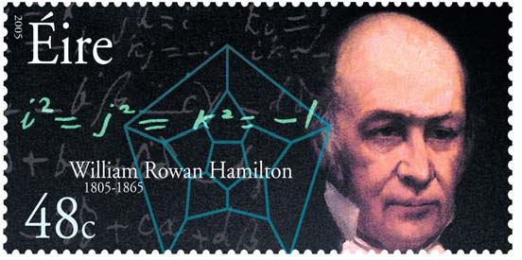
https://irishpostalheritagegpo.wordpress.com/2017/06/08/william-rowan-hamilton-irish-mathematician-and-scientist/

Slide 31
Potential energy
Kinetic energy
Notes:
First we will show that it works with these relationships and then we will justify how this might work.

Slide 32
Notes:
Action is sometimes A and sometimes S.

Slide 33
Notes:
Checking the minimization.

