Slide 1
PHY 711 Classical Mechanics and Mathematical Methods
10-10:50 AM MWF Online or (occasionally) in Olin 103
Discussion of Lecture 9 – Chap. 3&6 in F&W
Lagrangian mechanics
D’Alembert’s principle
Lagrange’s equation in generalized coordinates
Examples, including Lagrangian for electromagnetic interactions.
Notes:
In this lecture we will continue to examine how the calculus of variation can be used to analyze the physical mechanics of particle motion. This material follows your textbook in both Chapter 3 and Chapter 6.

Slide 2
Schedule for weekly one-on-one meetings
Nick – 11 AM Monday (ED/ST)
Tim – 9 AM Tuesday
Bamidele – 7 PM Tuesday
Zhi– 9 PM Tuesday
Jeanette – 11 AM Friday
Derek – 12 PM Friday

Slide 3
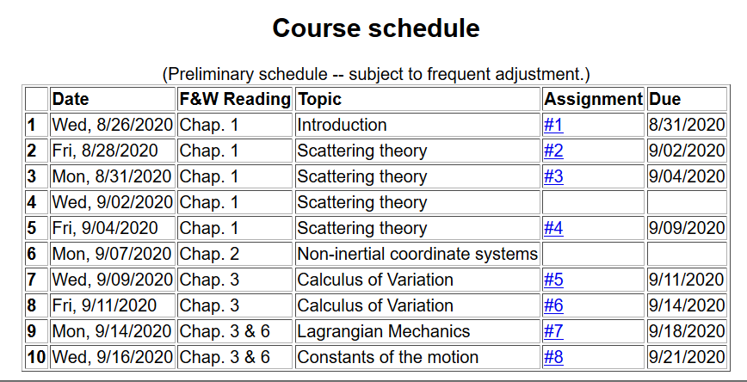
Notes:
Here is the updated schedule. Note that HW 7 which will be covered in today’s lecture will be due on Friday.

Slide 4
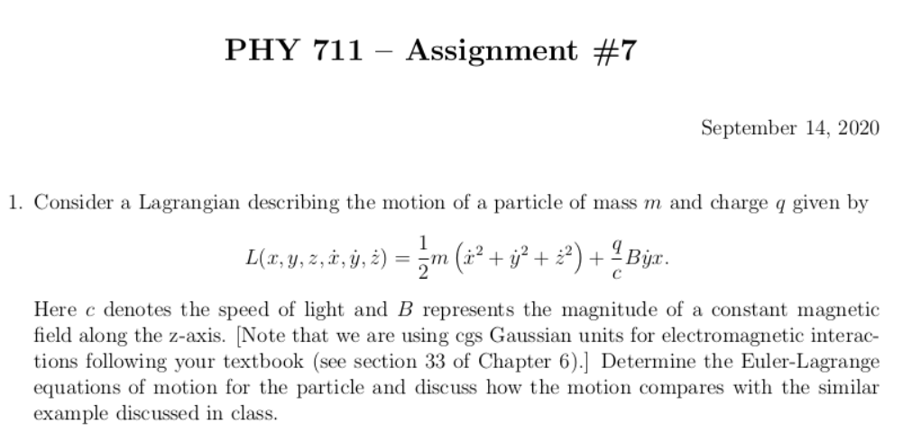
Notes:
Homework problem due on Friday.

Slide 5
Your questions –
From Tim –
What is the meaning of sigma in the slides? Is it like the same as i and so is an indice. Does it have any special meaning in terms of Langrangian mechanics?
From Nick –
1. Slide 7: Can you go over the differential (dx) term and its pieces? What exactly does the differential $\delta q$ mean?
2. Slide 8: is the expansion a reorganization from the product rule?
3. By about slide 11, I started getting tripped up with some of the algebra/calculus. Hopefully, I can clarify tomorrow.
From Derek –
1. I wasn't able to finish assignment #6 because I'm still confused on how we're supposed to evaluate parts a), b), and c). If you could discuss the assignment more, that would be helpful.

Slide 6
Your questions – continued
From Gao –
1. How many kinds of forces are velocity– dependent, except for Lorentz forces?
From Jeanette –
1. slide #9 - I don't follow the proof for the first claim.
2. slide #14 - where did the equation for L come from? Is the equation given or the situation given and L determined from there?
3. slide #18 - is the switch back to cartesian just convenient or is that necessary for Lorentz forces?

Slide 7
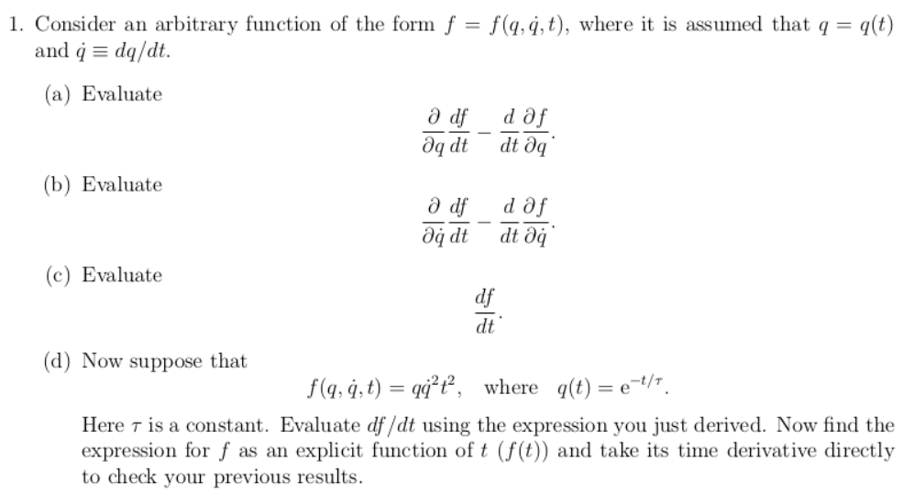
More details about HW 6

Slide 8
More details about HW 6
From previous lecture:

Slide 9
On the topic of today’s lecture and adapting calculus of variation tools to the analysis of particle motion
Why would we want to reformulate Newton’s laws anyway?
Because we can and it makes us feel good.
Because we can make the analysis more complicated.
Because we can make the analysis less complicated.
All of the above.
Other.

Slide 10
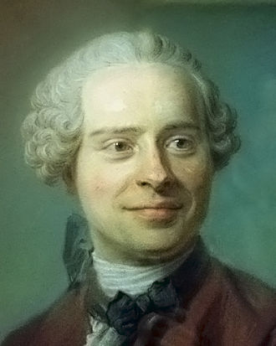
Jean d’Alembert 1717-1783
French mathematician and philosopher
“Deriving” Lagrangian mechanics from Newton’s laws.
Notes:
Previously we introduced the Lagrangian function without justification. Here we follow a “derivation” attributed to d’Alembert.

Slide 11
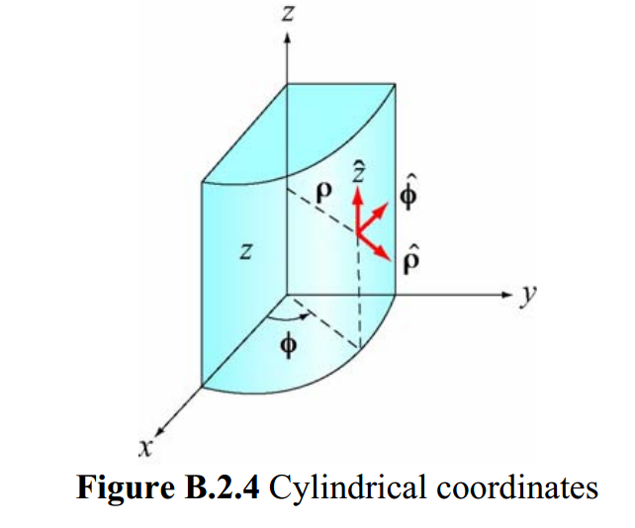
Cylindrical coordinates
(Figure taken from 8.02 handout from MIT.)
Notes:
The derivation is based on the notion of “generalized” coordinates which can be Cartesian coordinates or one of the many transformed coordinates, or even more “general” coordinates.

Slide 12
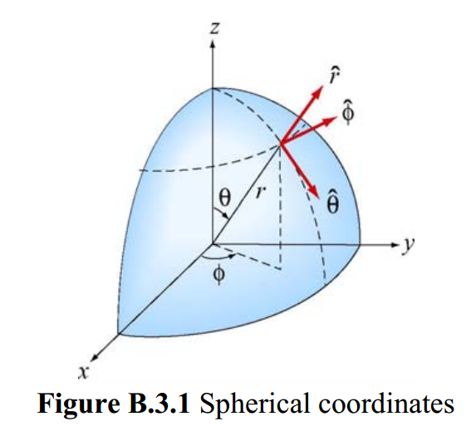
Spherical coordinates
(Figure taken from 8.02 handout from MIT.)
Notes:
Another example of transformed coordinates.

Slide 13
D’Alembert’s principle:
Notes:
Here we start the derivation following D’Alembert’s arguments. x_{i} denotes the cartesian coordinate while q denotes the “generalized” coordinate. In this slide we consider the potential energy terms.

Slide 14
Your question –
Can you go over the differential (dx) term and its pieces? What exactly does the differential $\delta q$ mean?

Slide 15
Summary up to now --

Slide 16
Notes:
Continuing the derivations we consider the kinetic energy contributions.

Slide 17
Some details
You may be wondering why we need to introduce “generalized” coordinates when cartesian coordinates are an example. What the generalized coordinates allow us to show is that

Slide 18
Notes:
Continuing the derivation.

Slide 19
Notes:
Summary of results from D’Alembert’s analysis.

Slide 20
Notes:
Form of derived Lagrangian provided that the potential does not depend on velocity.

Slide 21
➔Hamilton’s principle from the “backwards” application of the Euler-Lagrange equations to
Notes:
Having shown that the Euler-Lagrangian equations are consistent with Newton’s equations of motion, we can then infer that the integral of the Lagrangian is optimized as is consistent with Hamilton’s principle.

Slide 22
Example:
d
θ
Notes:
Example of using the Lagrangian formalism for a simple pendulum.

Slide 23
Notes:
Another example of Lagrangian formalism that we will encounter when we examine rigid body motion.

Slide 24
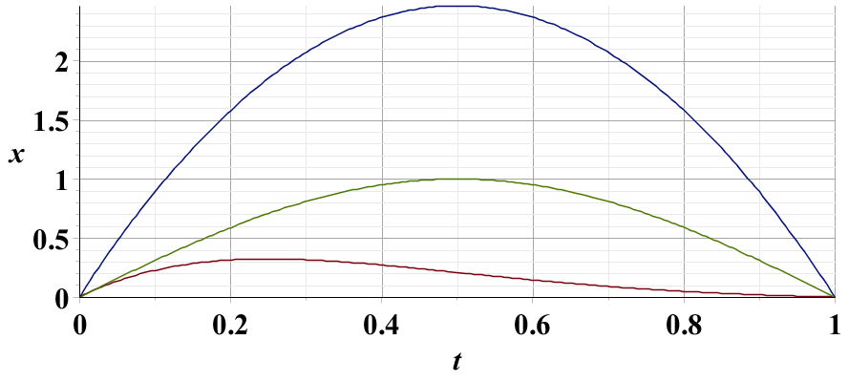
Example – simple harmonic oscillator
x₁
x₂
x₃
Notes:
Harmonic oscillator example. Here we again demonstrate the physical trajectory has the smallest “action”.

Slide 25
Summary –
Hamilton’s principle:
Notes:
Recipe for Lagrangian mechanics.

Slide 26
Note: in “proof” of Hamilton’s principle:
Why do we need velocity dependent forces?
Friction is sometimes represented as a velocity dependent force. (difficult to treat with Lagrangian mechanics.)
Lorentz force on a moving charged particle in the presence of a magnetic field.
Notes:
Important restriction.

Slide 27
Lorentz forces:
Note: Here we are using cartesian coordinates for convenience.
Notes:
While Lagrangian mechanics cannot treat all velocity dependent forces, it is possible to extend the analysis for the case of the Lorentz force. This material is treated in Chapter 6, Section 33 of your textbook. We are following the textbook’s units of cgs Gaussian units.

Slide 28
Lorentz forces, continued:
Notes:
Very clever mathematicians figured out how to incorporate Lorentz into the Lagrangian formalism. Here we are assuming their result and showing that it is consistent.

Slide 29
Lorentz forces, continued:
Notes:
More derivations.

Slide 30
Lorentz forces, continued:
Notes:
Summary of results.

Slide 31
Example Lorentz force
Notes:
Example for a magnetic field in the z direction.

Slide 32
Example Lorentz force -- continued
Notes:
Finding the Euler-Lagrange equations.

Slide 33
Example Lorentz force -- continued
Notes:
Summary from previous slides.

Slide 34
Example Lorentz force -- continued
Notes:
This is the same magnetic field, but an equivalent vector potential.

Slide 35
Example Lorentz force -- continued
Notes:
We get the same motion for this case.

