Slide 1
PHY 711 Classical Mechanics and Mathematical Methods
10-10:50 AM MWF Online or (occasionally) in Olin 103
Plan for Lecture 9 – Chap. 3&6 in F&W
Lagrangian mechanics
D’Alembert’s principle
Hamilton’s principle
Lagrange’s equation in generalized coordinates
Notes:
In this lecture we will continue to examine how the calculus of variation can be used to analyze the physical mechanics of particle motion. This material follows your textbook in both Chapter 3 and Chapter 6.

Slide 2
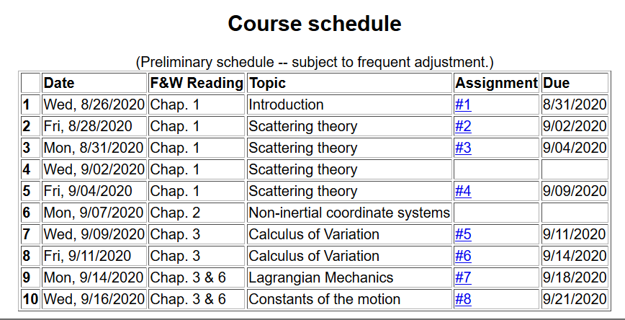
Notes:
Here is the updated schedule. Note that HW 7 which will be covered in today’s lecture will be due on Friday.

Slide 3
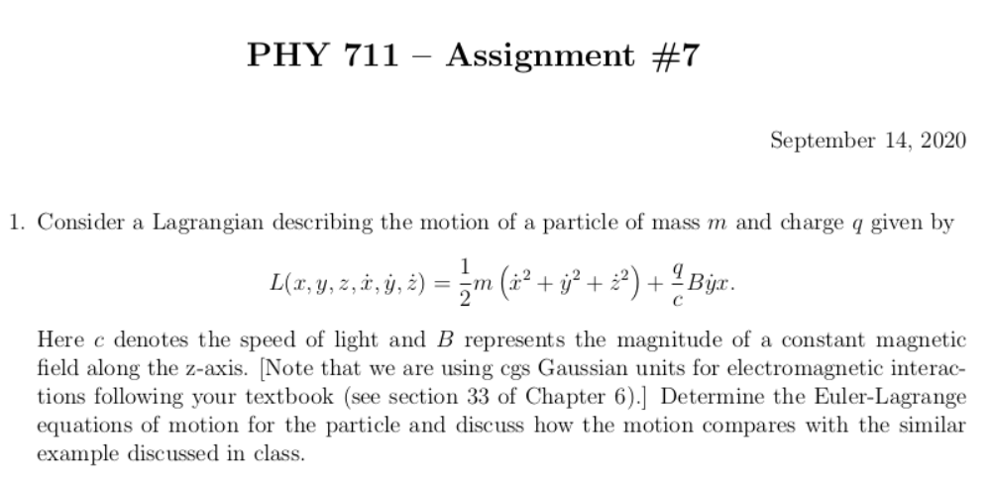
Notes:
Homework problem due on Friday.

Slide 4
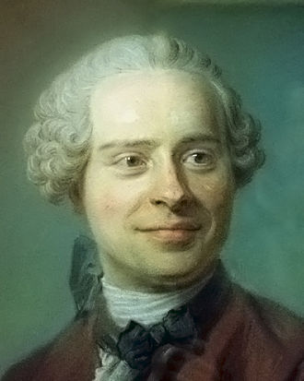
Jean d’Alembert 1717-1783
French mathematician and philosopher
“Deriving” Lagrangian mechanics from Newton’s laws.
Notes:
Previously we introduced the Lagrangian function without justification. Here we follow a “derivation” attributed to d’Alembert.

Slide 5
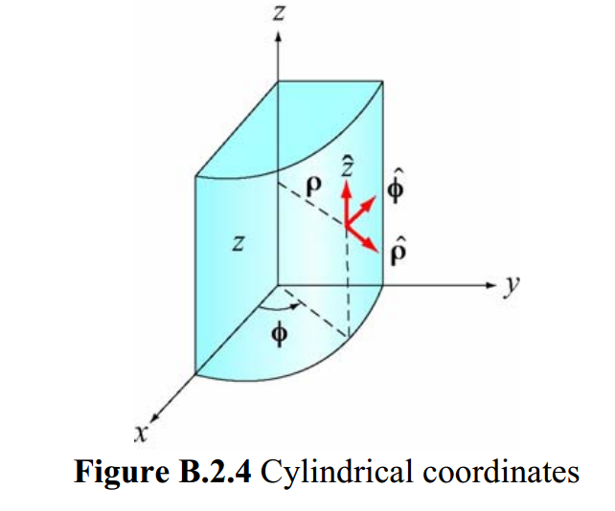
Cylindrical coordinates
(Figure taken from 8.02 handout from MIT.)
Notes:
The derivation is based on the notion of “generalized” coordinates which can be Cartesian coordinates or one of the many transformed coordinates, or even more “general” coordinates.

Slide 6
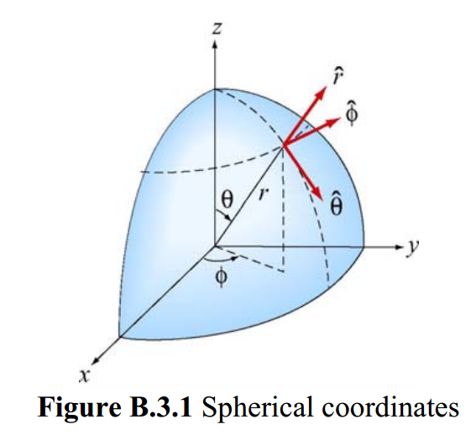
Spherical coordinates
(Figure taken from 8.02 handout from MIT.)
Notes:
Another example of transformed coordinates.

Slide 7
D’Alembert’s principle:
Notes:
Here we start the derivation following D’Alembert’s arguments. x_{i} denotes the cartesian coordinate while q denotes the “generalized” coordinate. In this slide we consider the potential energy terms.

Slide 8
Notes:
Continuing the derivations we consider the kinetic energy contributions.

Slide 9
Notes:
Continuing the derivation.

Slide 10
Notes:
Summary of results from D’Alembert’s analysis.

Slide 11
Notes:
Form of derived Lagrangian provided that the potential does not depend on velocity.

Slide 12
➔Hamilton’s principle
Notes:
Having shown that the Euler-Lagrangian equations are consistent with Newton’s equations of motion, we can then infer that the integral of the Lagrangian is optimized as is consistent with Hamilton’s principle.

Slide 13
Example:
d
θ
Notes:
Example of using the Lagrangian formalism for a simple pendulum.

Slide 14
Notes:
Another example of Lagrangian formalism that we will encounter when we examine rigid body motion.

Slide 15
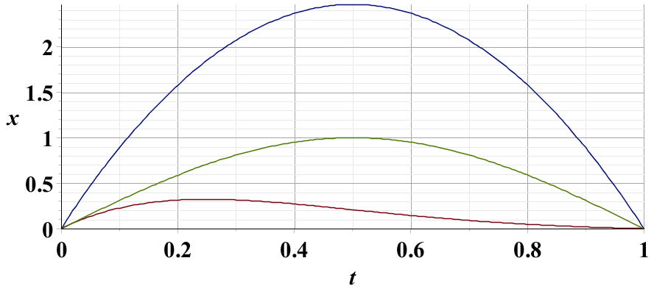
Example – simple harmonic oscillator
x₁
x₂
x₃
Notes:
Harmonic oscillator example. Here we again demonstrate the physical trajectory has the smallest “action”.

Slide 16
Summary –
Hamilton’s principle:
Notes:
Recipe for Lagrangian mechanics.

Slide 17
Note: in “proof” of Hamilton’s principle:
Notes:
Important restriction.

Slide 18
Lorentz forces:
Notes:
While Lagrangian mechanics cannot treat all velocity dependent forces, it is possible to extend the analysis for the case of the Lorentz force. This material is treated in Chapter 6, Section 33 of your textbook. We are following the textbook’s units of cgs Gaussian units.

Slide 19
Lorentz forces, continued:
Notes:
Very clever mathematicians figured out how to incorporate Lorentz into the Lagrangian formalism. Here we are assuming their result and showing that it is consistent.

Slide 20
Lorentz forces, continued:
Notes:
More derivations.

Slide 21
Lorentz forces, continued:
Notes:
Summary of results.

Slide 22
Example Lorentz force
Notes:
Example for a magnetic field in the z direction.

Slide 23
Example Lorentz force -- continued
Notes:
Finding the Euler-Lagrange equations.

Slide 24
Example Lorentz force -- continued
Notes:
Summary from previous slides.

Slide 25
Example Lorentz force -- continued
Notes:
This is the same magnetic field, but an equivalent vector potential.

Slide 26
Example Lorentz force -- continued
Notes:
We get the same motion for this case.

