Slide 1
PHY 711 Classical Mechanics and Mathematical Methods
10-10:50 AM MWF Olin 103
Welcome & overview
Class structure & announcements
Introduction to algebraic manipulation software – Maple and Mathematica
Start reading Chap. 1 for next time

Slide 2
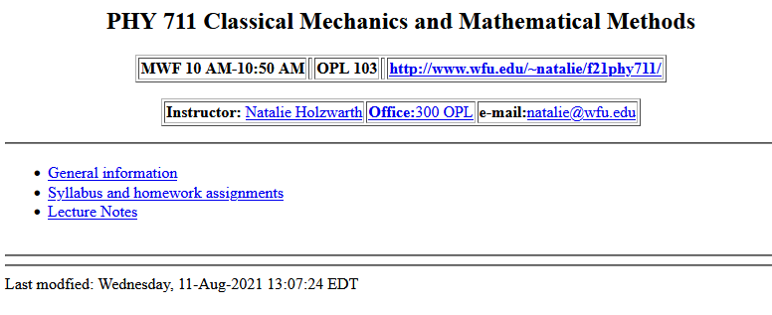
Course webpage -- http://users.wfu.edu/natalie/f21phy711/

Slide 3
Course content –
Classical Mechanics and Mathematical Methods
Comment – Classical Mechanics is not Dead!
While the topic of classical mechanics was well established by 1920 and much earlier, it forms the foundation of modern investigations, and its extensions can be found in many current research areas.
Examples:
  Scattering theory/experiment – detailed interactions between a few particles
  Rocket science/astrophysics
  Limiting results of quantum mechanics
  Atomistic simulations of materials – “molecular dynamics”
  Mechanics of continua

Slide 4
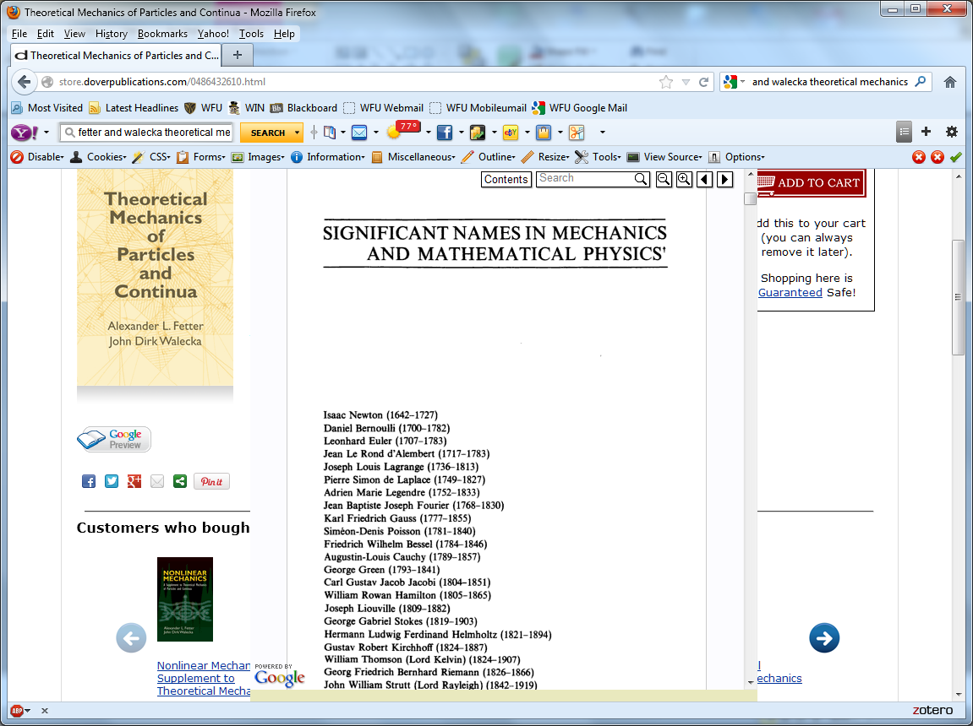

Textbook:

Slide 5
Topics
Classical Mechanics
Scattering theory
Accelerated reference frames
Calculus of variation
Lagrangian formalism
Hamiltonian formalism
Oscillations about equilibrium
Wave equations
Rigid rotation; moments of inertia
Physics of fluids
Sound waves in fluids and solids
Surface waves
Heat conduction
Viscous fluids
Elastic continua
Math Methods
Use of Maple and/or Mathematica
Solutions methods for differential equations
Green’s function methods
Special functions
Matrix properties; eigenvalues and eigenvectors
Fourier transforms
Laplace transforms
Contour integration

Slide 6
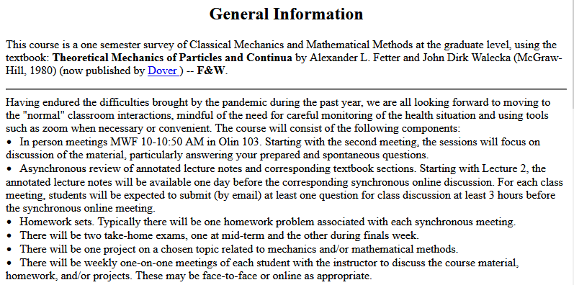
Course structure -- continuously adjusting --
http://users.wfu.edu/natalie/f21phy711/info/

Slide 7
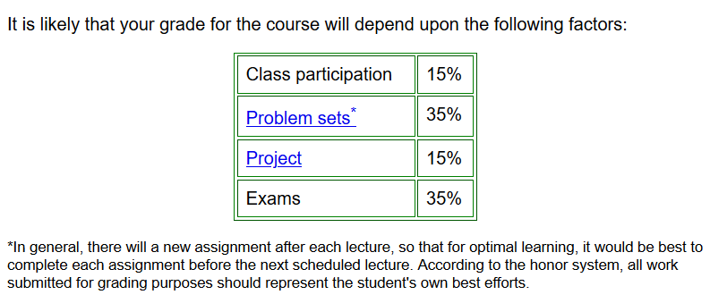
Course structure -- continuously adjusting --
http://users.wfu.edu/natalie/f21phy711/info/

Slide 8
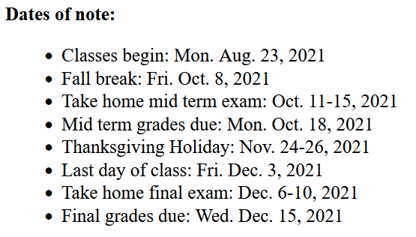
Projected course dates --

Slide 9
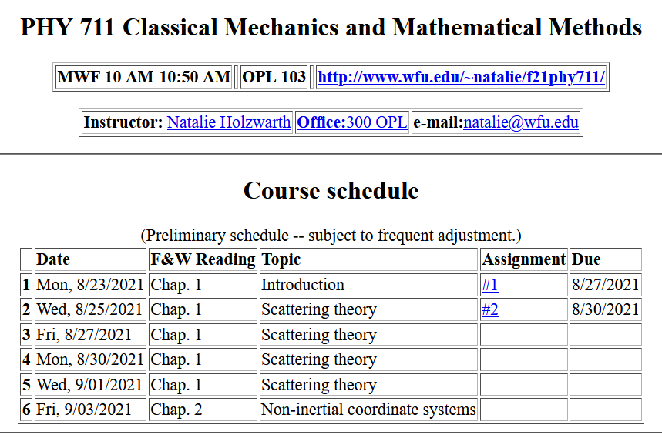
Course structure -- continuously adjusting --
http://users.wfu.edu/natalie/f21phy711/homework/

Slide 10
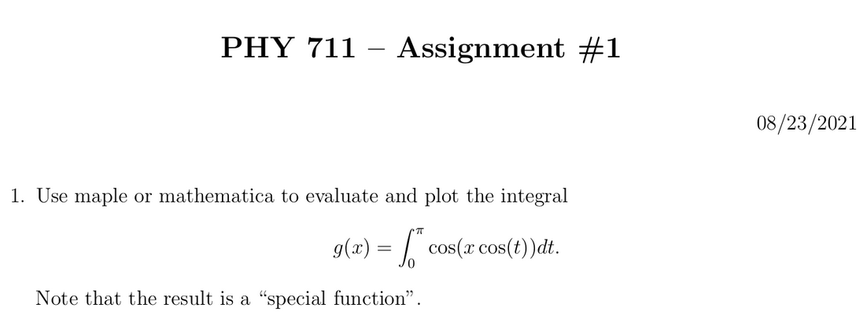
First assignment

Slide 11
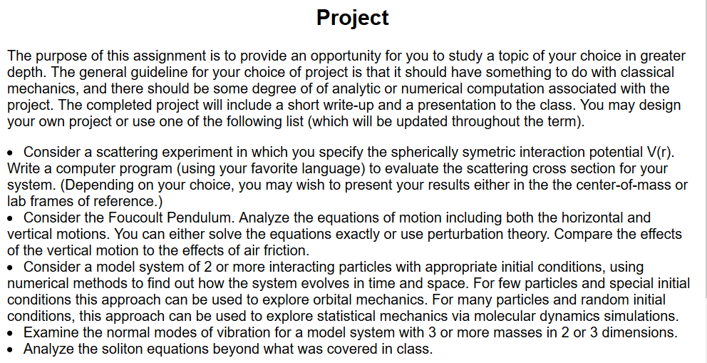
Course structure -- continuously adjusting --
http://users.wfu.edu/natalie/f21phy711/info/computational.html

Slide 12
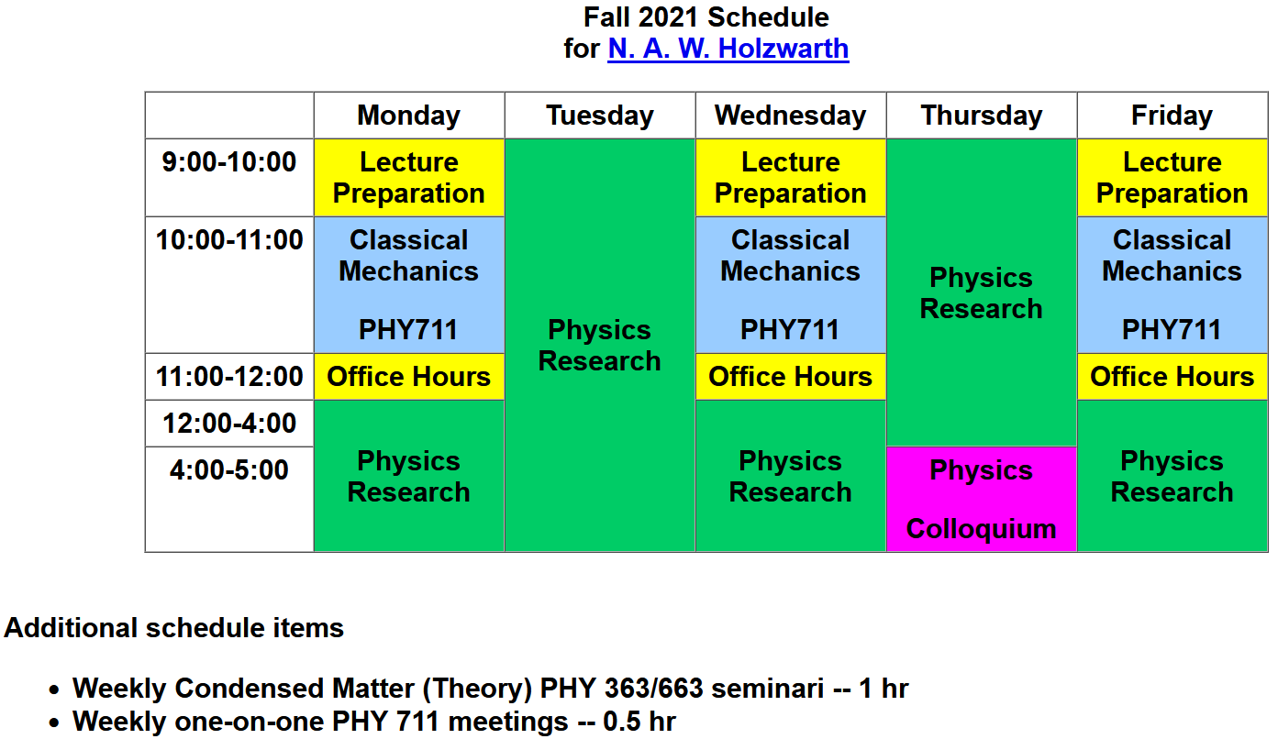
Note – Colloquium starts next week.

Slide 13
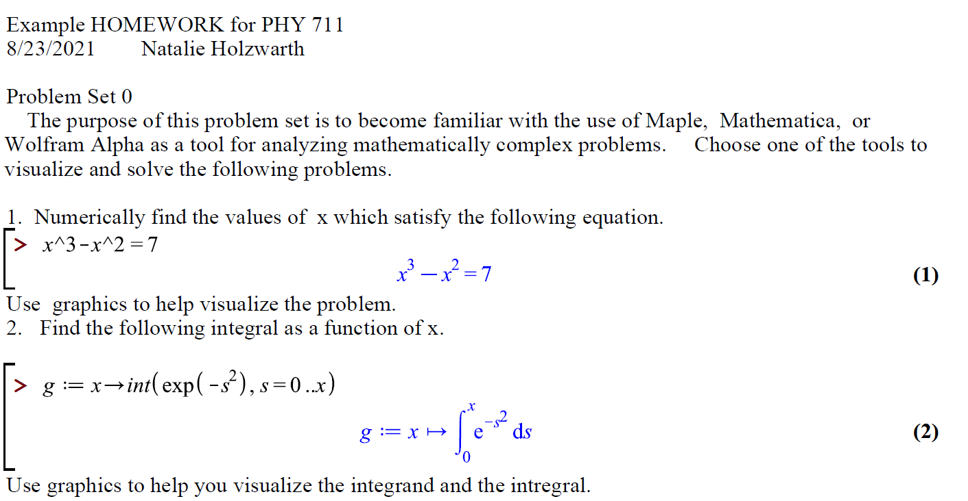
What is the best way to turn in homework?
1. On paper including maple or mathematica results
Email your annotated maple or mathematica output converted to pdf form.
Email scan or photo of written work.

Slide 14
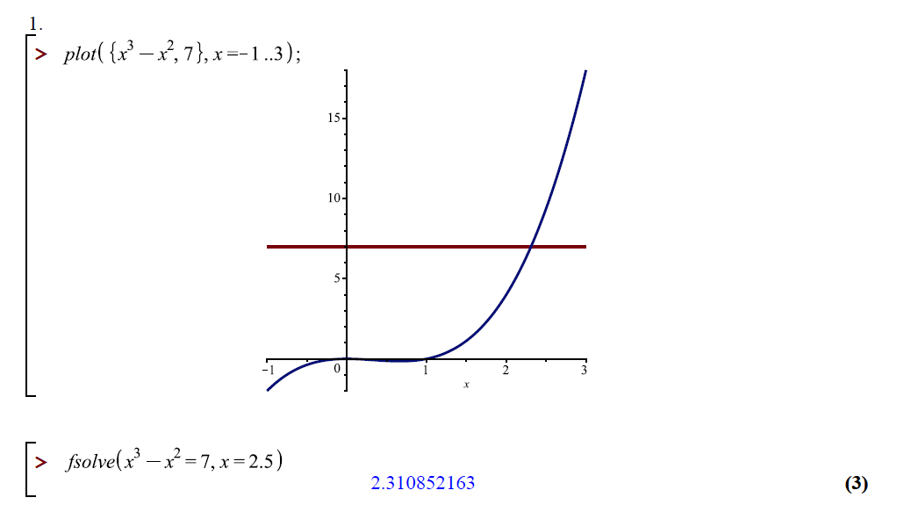
Problem Set #0 continued

Slide 15
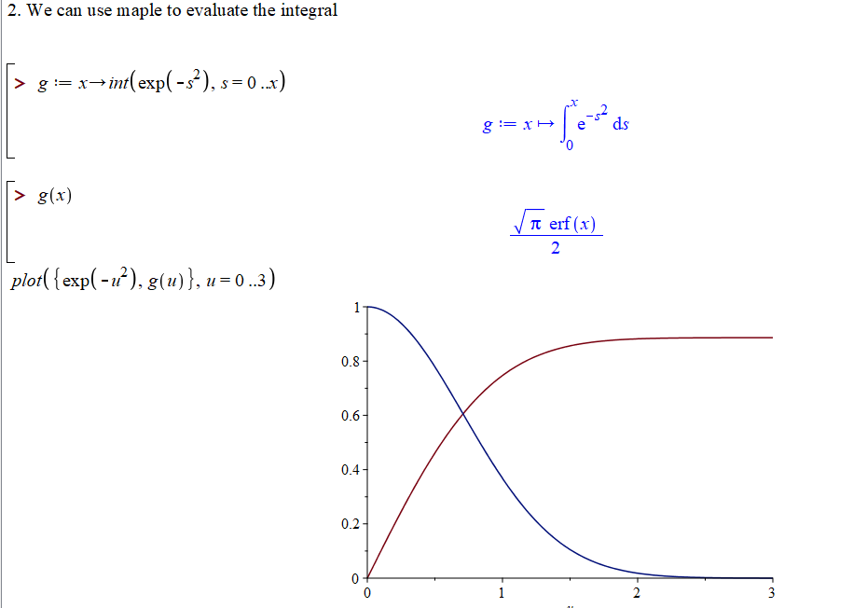
special function

Slide 16
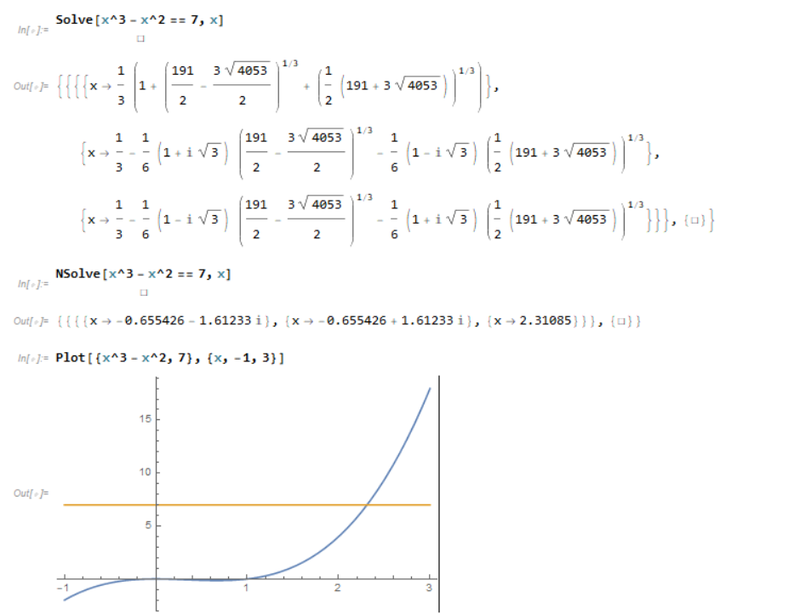
Results using Mathematica --

Slide 17
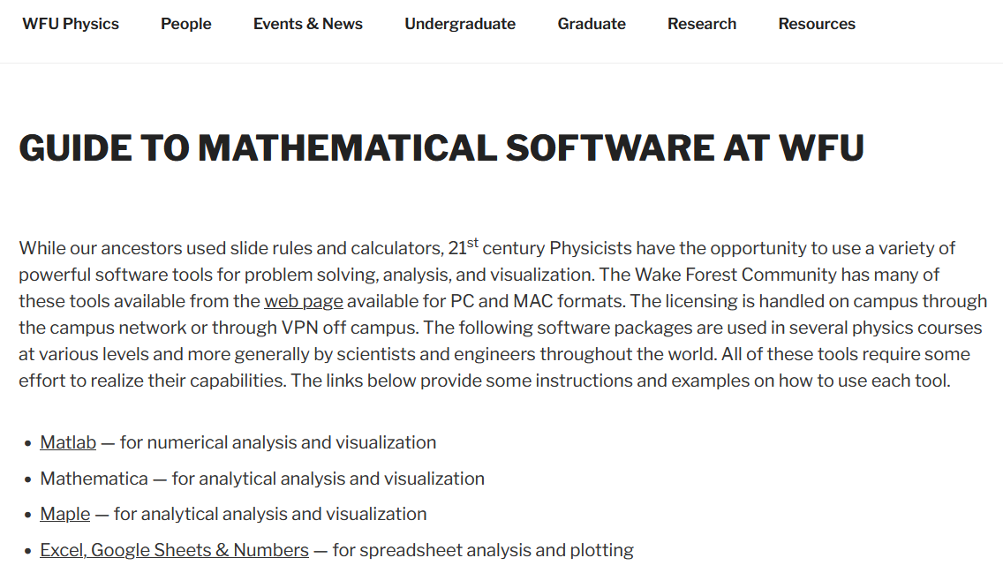
Additional help with mathematical software –
https://www.physics.wfu.edu/resources/education-resources/

Slide 18

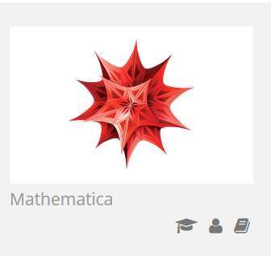

Comment on software useful for this course
https://software.wfu.edu/
Installation straightforward; takes a while ..
Please contact me or yipcw@wfu.edu if you have trouble.

Slide 19

Other possibilities –
http://www.wolframalpha.com/

Slide 20
Advice for preparing for Wednesday’s meeting –
Start reading Chapter 1 of F&W. The annotated lecture notes will be available by 9 AM (Winston-Salem time) on August 24th. While reading, formulate your questions and discussion points.
Email (natalie@wfu.edu) your discussion questions by 7 AM on August 25th.
Decide which algebraic manipulation software you prefer. As appropriate, install it on your computer and become familiar with it.
Email (natalie@wfu.edu) with your preferences for weekly (or more) one-on-one meetings. Face to face or zoom meetings are possible as appropriate.
Brief assessment exercise.

