Slide 1
PHY 711 Classical Mechanics and Mathematical Methods
10-10:50 AM MWF in Olin 103
Discussion of Lecture 10 – Chap. 3&6 in F&W
    Lagrangian mechanics
      Lagrange’s equations in the presence of velocity dependent potentials – such as electromagnetic interactions.
      Effects of constraints
Notes:
This material follows your textbook in both Chapter 3 and Chapter 6.

Slide 2
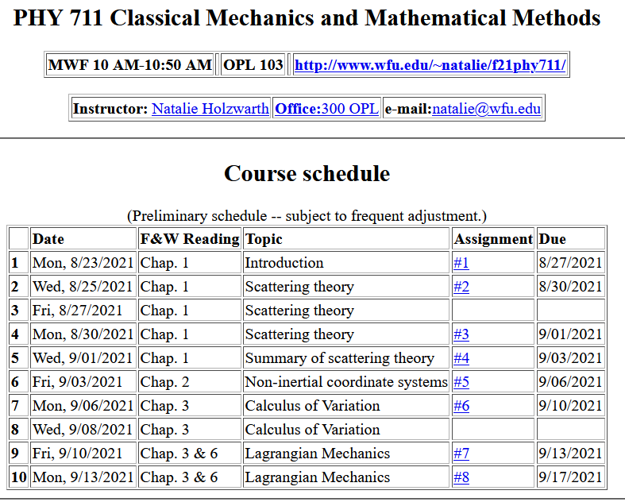
Notes:
Here is the updated schedule. Note that HW 7 which will be covered in today’s lecture will be due on Friday.

Slide 3
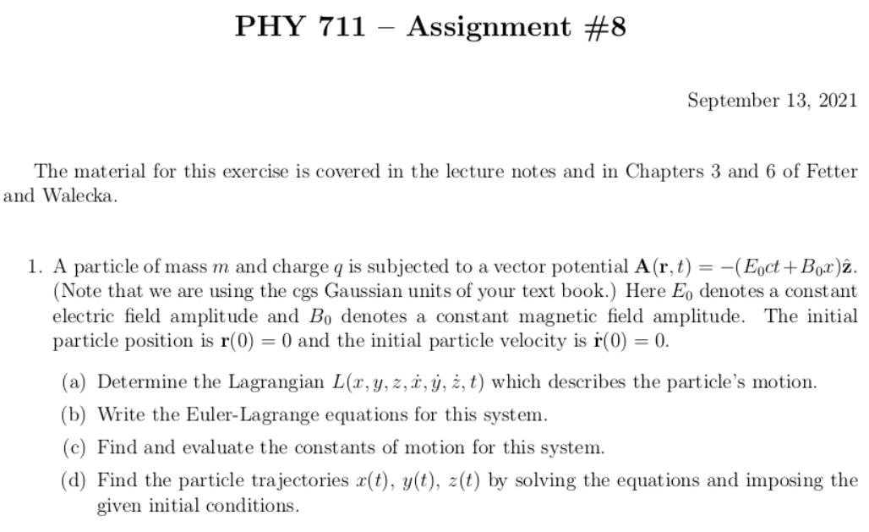
Notes:
Homework problem due on Friday.

Slide 4
Previously derived form for the Lagrangian --
Notes:
Form of derived Lagrangian provided that the potential does not depend on velocity.

Slide 5
➔Hamilton’s principle from the “backwards” application of the Euler-Lagrange equations to
Notes:
Having shown that the Euler-Lagrangian equations are consistent with Newton’s equations of motion, we can then infer that the integral of the Lagrangian is optimized as is consistent with Hamilton’s principle.

Slide 6
Summary –
Hamilton’s principle:
Notes:
Recipe for Lagrangian mechanics.

Slide 7
Note: in “proof” of Hamilton’s principle:
Why do we need velocity dependent forces?
  Friction is sometimes represented as a velocity dependent force. (difficult to treat with Lagrangian mechanics.)
  Lorentz force on a moving charged particle in the presence of a magnetic field.
Notes:
Important restriction.

Slide 8
Lorentz forces:
Note: Here we are using cartesian coordinates for convenience.
Notes:
While Lagrangian mechanics cannot treat all velocity dependent forces, it is possible to extend the analysis for the case of the Lorentz force. This material is treated in Chapter 6, Section 33 of your textbook. We are following the textbook’s units of cgs Gaussian units.

Slide 9
Lorentz forces, continued:
Notes:
Very clever mathematicians figured out how to incorporate Lorentz into the Lagrangian formalism. Here we are assuming their result and showing that it is consistent.

Slide 10
Lorentz forces, continued:
Notes:
More derivations.

Slide 11
Some details on last step:
Notes:
More derivations.

Slide 12
Lorentz forces, continued:
Notes:
Summary of results.

Slide 13
Example Lorentz force
Notes:
Example for a magnetic field in the z direction.

Slide 14
Example Lorentz force -- continued
Notes:
Finding the Euler-Lagrange equations.

Slide 15
Example Lorentz force -- continued
Notes:
Summary from previous slides.

Slide 16
Example Lorentz force -- continued
Notes:
We get the same motion for this case.

Slide 17
Example Lorentz force -- continued
Does it surprise you that the same equations of motion are obtained with a different Gauge?
Notes:
This is the same magnetic field, but an equivalent vector potential.

Slide 18
Now consider formulation of motion with constraints --
Comments on generalized coordinates:
Here we have assumed that the generalized coordinates
q_{σ} are independent. Now consider the possibility that the coordinates are related through constraint equations of the form:
Lagrange
multipliers
Notes:
Shifting topics, we now consider examples where the generalized coordinates are related by some constraints.

Slide 19
Simple example:
u
θ
y
x
θ
Notes:
Here is a simple example of an inclined plane. If we were so silly as to treat the x and y motions separately, we would have use a constraint equation as shown.

Slide 20
Which method would you use to solve the problem?
  Case 1
  Case 2
Force of constraint;
normal to incline
Notes:
In this case we see that the constraint is related to the normal force which can be considered as a force of constraint.

Slide 21
Rational for Lagrange multipliers
Notes:
Here we justify the use of Lagrange multipliers in a similar way that we used them when discussing the calculus of variation.

Slide 22
Euler-Lagrange equations with constraints:
Example:
r
θ
mg
Notes:
Another example of constrained motion.

Slide 23
Example continued:
Notes:
Continued analysis of pendulum motion

Slide 24
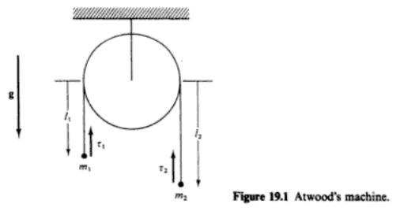
Another example:
Notes:
Example of Atwood’s machine with two masses and a pulley.

