Slide 1
PHY 711 Classical Mechanics and Mathematical Methods
10-10:50 AM MWF in Olin 103
Discussion of Lecture 11-- Chap. 3 & 6 (F &W)
Details and extensions of Lagrangian mechanics
      Constants of the motion
      Conserved quantities
      Legendre transformations
Notes:
In this lecture we will continue to explore the mathematical and physical properties of the Lagrangian formalism.

Slide 2
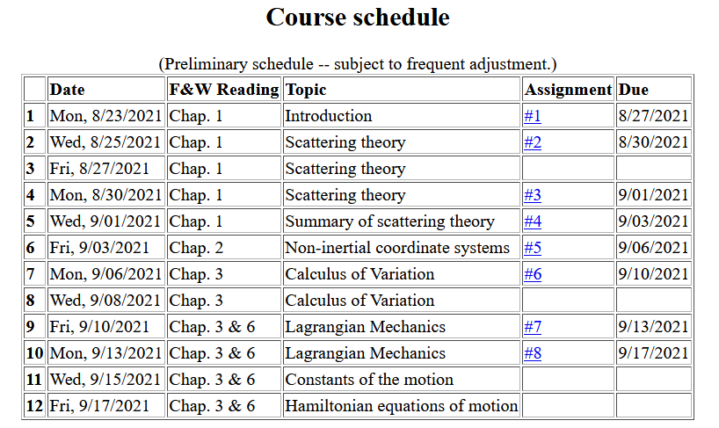
Notes:
Updated schedule. Home work from Lecture 10 due Monday.

Slide 3
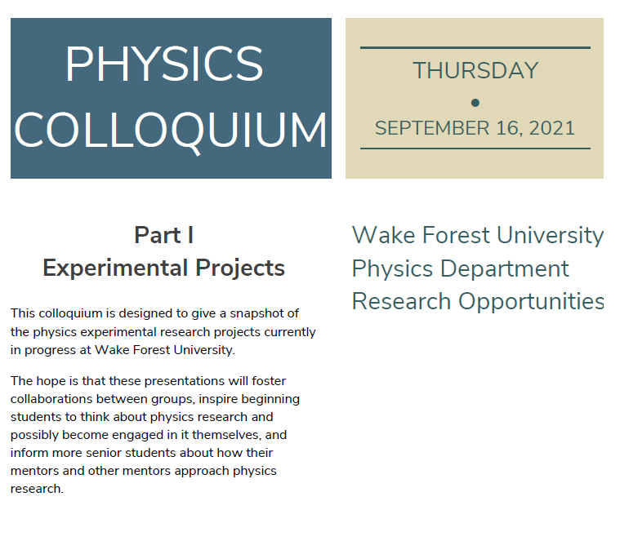
4PM in Olin 101 and by zoom

Slide 4
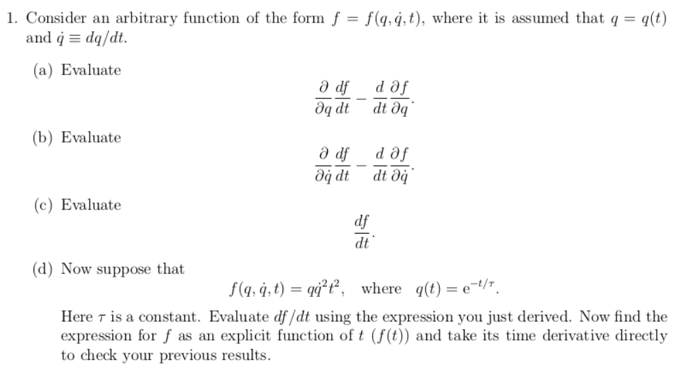
More details about HW 7

Slide 5
More details about HW 7

Slide 6
More details about HW 7

Slide 7
Summary of Lagrangian formalism (without constraints)
Notes:
Review of the Euler-Lagrange equations with a focus on finding constants of the motion.

Slide 8
Examples of constants of the motion:
Notes:
Simple example.

Slide 9
Examples of constants of the motion:
Notes:
Another example using different coordinates.

Slide 10
Recall alternative form of Euler-Lagrange equations:
Notes:
Reviewing “alternative” form of Euler-Lagrange equations.

Slide 11
Additional constant of the motion:
Notes:
New constant of the motion found from the Lagrangian analysis.

Slide 12
➔3 variable functions
➔1 variable function
Why might this be useful?

Slide 13
Additional constant of the motion -- continued:
➔2 variable functions
➔1 variable function
Notes:
Another example.

Slide 14
Other examples
Notes:
Non-trivial example with constant magnetic field.

Slide 15
Other examples
Notes:
Another example with a constant magnetic field.

Slide 16
Lagrangian picture
Switching variables – Legendre transformation
Notes:
Noting that the Lagrangian analysis generally results in second order differential equations. We now explore the possibility of alternative formulations.

Slide 17
Mathematical transformations for continuous functions of several variables & Legendre transforms:
Simple change of variables:
Assuming dz=0.
Notes:
Digression on relationships between alternative coordinate formulations.

Slide 18
Note on notation for partial derivatives
hold y fixed.
hold x fixed.

Slide 19
Simple change of variables -- continued:
Notes:
Relationships for changing variables of general functionsl

Slide 20

Simple change of variables -- continued:
?
?
Notes:
Some examples.

Slide 21
Now that we see that these transformations are possible, we should ask the question why we might want to do this?
An example comes from thermodynamics where we have various interdependent variables such as temperature T, pressure P, volume V, etc. etc. Often a measurable property can be specified as a function of two of those, while the other variables are also dependent on those two. For example we might specify T and P while the volume will be V(T,P). Or we might specify T and V while the pressure will be P(T,V).

Slide 22
Other examples from thermo --
For thermodynamic functions:
Notes:
Examples from thermodynamic functions

Slide 23
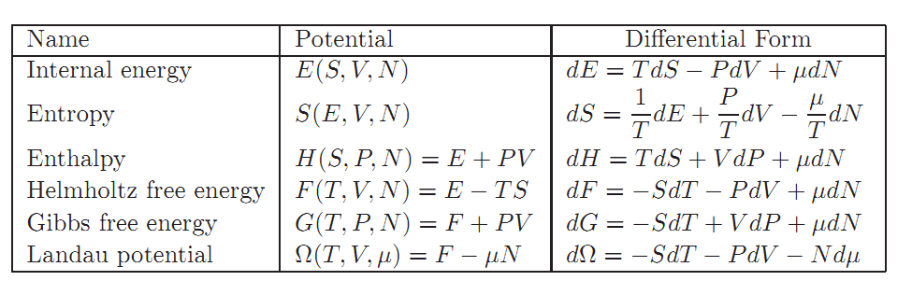
Notes:
Common thermodynamic energy functiosn.

Slide 24
Mathematical transformations for continuous functions of several variables & Legendre transforms continued:
Notes:
Relationships between the old and new variables.

Slide 25
Lagrangian picture
Switching variables – Legendre transformation
Notes:
Applying the ideas of variable change to the Lagrangian formulation.

Slide 26
Hamiltonian picture – continued
Notes:
Transforming from the Lagrangian to Hamiltonian formulation of mechanics. We will continue this discussion on Friday.

