Slide 1
PHY 711 Classical Mechanics and Mathematical Methods
10-10:50 AM MWF in Olin 103
Discussion of Lecture 12 – Chap. 3&6 (F&W)
      Constructing the Hamiltonian
      Hamilton’s canonical equation
      Examples
Notes:
This lecture shows how to “derive” the Hamiltonian formalism from the Lagrangian.

Slide 2
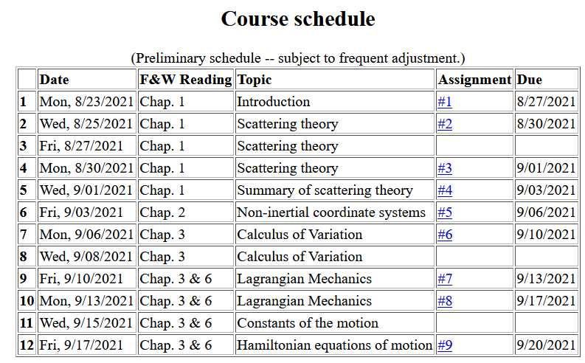
Notes:
There is a homework problem due Monday.

Slide 3
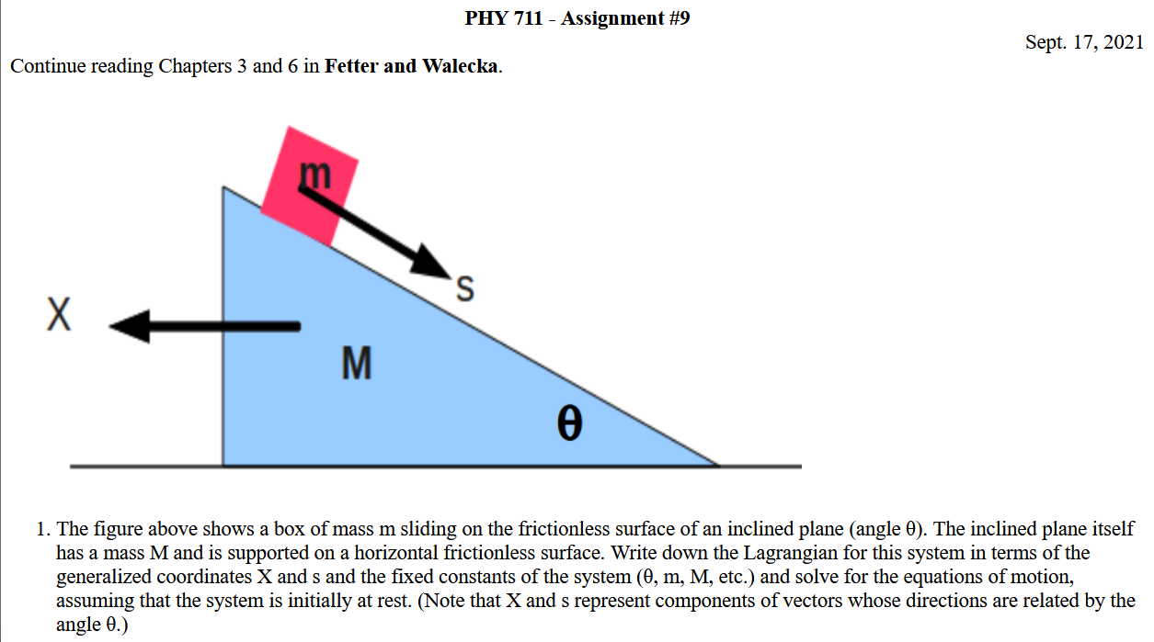
Notes:
Homework due Monday.

Slide 4
Lagrangian picture
Switching variables – Legendre transformation
Notes:
Starting with the Lagrangian and then performing a Legendre transformation.

Slide 5
The analysis on the following slides is a generalization to multiple dimensions q_{σ} and p_{σ} ….

Slide 6
Hamiltonian picture – continued
Notes:
Finding the Hamiltonian equations of motion.

Slide 7
Direct application of Hamiltonian’s principle using the Hamiltonian function --
Notes:
Showing that Hamilton’s principle can be formulated with the Hamiltonian formulation.

Slide 8
Hamilton’s principle continued:
Canonical equations
0
Notes:
So called “Canonical” equations.

Slide 9
More comments about “details”
Vanishes because
δq(t_{f})=δq(t_{i}) due to
the premise of
Hamilton’s principle.

Slide 10
In the Hamiltonian formulation --
Why are these equations known as the “canonical equations”?
  Because they are beautiful.
  The term is meant to elevate their importance to the level of the music of J. S. Bach
  To help you remember them
  No good reason; it is just a name

Slide 11
Recipe for constructing the Hamiltonian and analyzing the equations of motion
Notes:
Important recipe. Tape this to your wall!!!

Slide 12
What happens when you miss a step in the recipe?
  No big deal
  Big deal – can lead to shame and humiliation (or at least wrong analysis)
Lagrangian picture
Hamiltonian picture

Slide 13
Constants of the motion in Hamiltonian formalism
Notes:
Finding constants of the motion within the Hamiltonian formalism.

Slide 14
What is the physical meaning of a constant H?
Comment -- Whenever you find a constant of the motion, it is helpful for analyzing the trajectory. In this case, H often represents the mechanical energy of the system so that constant H implies that energy is conserved.

Slide 15
Notes:
Example.

Slide 16
Notes:
Another example

Slide 17
Other examples
Notes:
Another example

Slide 18
Other examples
Notes:
Example with magnetic field.

Slide 19
Canonical equations of motion for constant magnetic field:
Notes:
Working out the equations of motion.

Slide 20
Canonical equations of motion for constant magnetic field -- continued:
Notes:
More evaluation of the equations of motion.

Slide 21
Are these results equivalent to the results of the Lagrangian analysis?
a. Yes
b. No

Slide 22
Notes:
Recap of treatment of electromagnetic interactions in the Lagrangian and Hamiltonian formulations.

Slide 23
Canonical form
Notes:
Continued.

Slide 24
Other properties of Hamiltonian formalism –
Poisson brackets:
Notes:
Now a interesting addition property of the Hamiltonian formulation.

Slide 25
Poisson brackets -- continued:
Notes:
Poisson bracket continued.

Slide 26
Poisson brackets -- continued:
Liouville theorem
For next time
Notes:
Example.

