Slide 1
PHY 711 Classical Mechanics and Mathematical Methods
10-10:50 AM MWF in Olin 103
Notes on Lecture 14 -- Chap. 6 (F & W)
Extensions of Hamiltonian formalism
Virial theorem
Canonical transformations
Hamilton-Jacobi formalism
Notes:
In this lecture we will discuss a variety of identities and methods and historically important ideas related to Hamiltonian and Lagrangian mechanics.

Slide 2
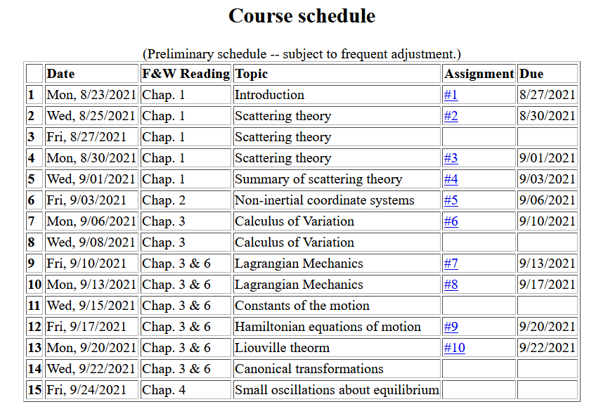
Notes:
Note that the schedule shows that this lecture will wrap up Chapters 3 and 6. There is no new homework assignment. On Monday we will start discussing Chap. 4 and apply Lagrangian and Hamiltonian mechanics to small oscillations.

Slide 3
Virial theorem (Rudolf Clausius ~ 1870)
Note that this implies that the motion is periodic or bounded (not for all systems).
When it is true --
Notes:
The “virial theorem” is a useful identity for studying some mechanical systems.

Slide 4
Examples of the Virial Theorem
Premise true because of periodicity.
Notes:
Examples.

Slide 5
Examples of the Virial Theorem
centripetal acceleration
gravitational force
Premise true because of periodicity.
Notes:
Another example.

Slide 6
Hamiltonian formalism and the canonical equations of motion:
In the next slides we will consider finding different coordinates and momenta that can also describe the system. Why?
Because we can
Because it might be useful
Notes:
Review for a general Hamiltonian system. The question is what would happen if we change coordinates?

Slide 7
Notion of “Canonical” generalized coordinate transformations
Note that because of the way we set up the problem we can always add such a term.
Notes:
Thinking about changing the coordinates – indicated with lower case and larger case symbols.

Slide 8
Some details --
Notes:
Some details.

Slide 9
Some relations between old and new variables:
Notes:
More details.

Slide 10
Notes:
Relationship between new Hamiltonian and original Hamiltonian.

Slide 11
Note that it is conceivable that if we were extraordinarily clever, we could find all of the constants of the motion!
Possible solution – Hamilton-Jacobi theory:
Notes:
Focusing on finding the constants of motion.

Slide 12
Notes:
Deriving equations for identifying constants of motion.

Slide 13
0
0
0
Notes:
Details of derivation.

Slide 14
0
0
0
Notes:
More details.

Slide 15
Differential equation for S:
Does this look familiar?
Notes:
Hamilton-Jacobi using harmonic oscillator example.

Slide 16
Continued:
Notes:
Hamilton-Jacobi equations for harmonic oscillator.

Slide 17
Continued:
Notes:
Continued.

Slide 18
Another example of Hamilton Jacobi equations
Notes:
Another example of using the Hamilton-Jacobi equations.

Slide 19
Notes:
Continued.

Slide 20
Check action:
Agrees with Hamilton-Jacobi analysis.
Notes:
More details.

Slide 22
What do you think of Hamilton-Jacobi method
Historically important
Hysterical
Painful
Might be useful
The next 3 slides contain important equations that you will hopefully remember for this material contained in Chapters 3 & 6 of Fetter and Walecka. On Friday we will start with Chapter 4 and discuss one of the many applications of these ideas – the case of small oscillations near equilibrium.

Slide 23
Recap --
Lagrangian picture
Hamiltonian picture
Notes:
Summary of what we have learned.

Slide 24
Notes:
More summary.

Slide 25
Recipe for constructing the Hamiltonian and analyzing the equations of motion
Notes:
Recipe to remember.

