Slide 1
PHY 711 Classical Mechanics and Mathematical Methods
10-10:50 AM MWF in Olin 103
Discussion for Lecture 15 – Chap. 4 (F & W)
Analysis of motion near equilibrium
Small oscillations about equilibrium
Normal modes of vibration
Notes:
In this lecture we will analyze systems near equilibrium. This system represents a lot of physical systems and has a rich toolbox of mathematical formalisms.

Slide 2
Your questions –
From Can -- If we know the eigenvector and eigenvalue, can we find the original matrix? What exactly are their relationships?
Short answer – If we know all of the eigenvalues and eigenvectors, we can reconstruct the matrix.
From Wells -- Do normal modes correspond to resonance frequencies of the system?
Short answer – Yes. If a harmonic force at a natural frequency is applied, resonance occurs.
From Owen -- The molecule on slide six looks like H2O. How do the results of numerical integration (molecular dynamics) compare to the analytical results from the eigenvalue problem? (Comparing the "experimental" vs theoretical omega values for different vibrational modes)
Short answer – The example is a linear molecule like CO₂ – depending on the spring constant k, the agreement can be reasonable…

Slide 3
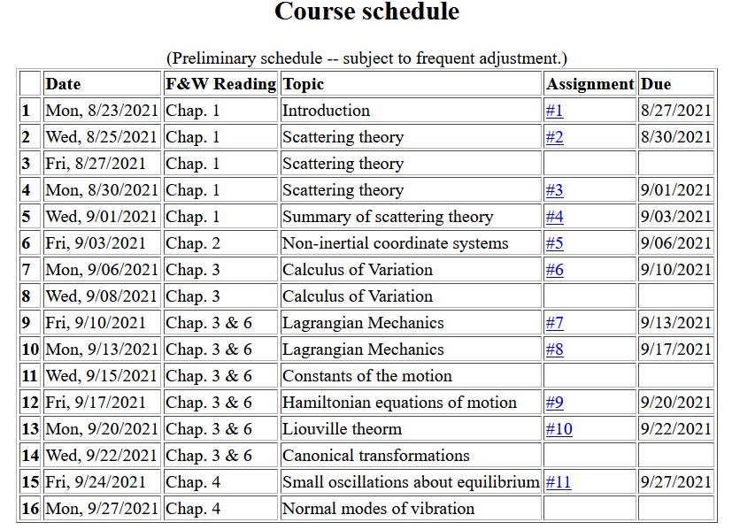
Notes:
We are starting the material covered in Chap. 4. The assigned homework is due on Friday.

Slide 4
Notes:
This is the homework problem.

Slide 5
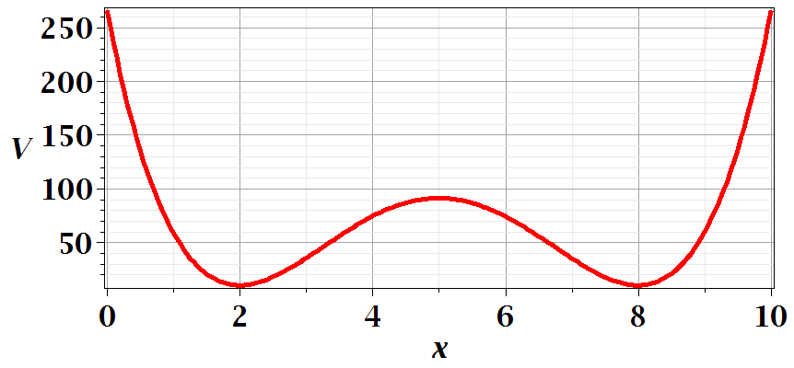
Motivation for studying small oscillations – many interacting systems have stable and meta-stable configurations which are well approximated by:
Notes:
This is a plot for an arbitrary one dimensional potential function showing two stable equilibria near x=2 and x=8.

Slide 6
Notes:
Lagrangian analysis and general solution.

Slide 7
Example – linear molecule
m₁
m₂
m₃
Notes:
A more complicated example with 3 masses connected with springs.

Slide 8
Notes:
Analyzing the equations of motion.

Slide 9
Notes:
Coupled differential equation and tricks for solution.

Slide 10
Notes:
Resulting linear equations also written in matrix form.

Slide 11
Notes:
The original equations are not symmetric. With this transformation, we can make the equations take a symmetric form.

Slide 12
Digression:
Notes:
Digression on linear algebra theory.

Slide 13
Digression on matrices -- continued
Eigenvalues of a matrix are “invariant” under a similarity transformation
Notes:
Similarity transformations used to analyze our system.

Slide 14
Example of transformation:
Notes:
Details for our case..

Slide 15
Notes:
More details for our case.

Slide 17
m₁
m₂
m₃
m₁
m₂
m₃
m₁
m₂
m₃
Notes:
Visualization of the solution for our case.

Slide 18
Notes:
The general solution will depend on initial values or boundary values.

Slide 19
Comment on solving for eigenvalues and eigenvectors – while it is reasonable to find these analytically for 2x2 or 3x3 matrices, it is prudent to use Maple or Mathematica for larger systems.
Maple example
Mathematica example

Slide 20
Additional digression on matrix properties
Singular value decomposition
Notes:
An unrelated digression that may be useful – singular value decomposition.

Slide 21
Singular value decomposition -- continued
Notes:
Digression continued.

Slide 22
Consider an extended system of masses and springs:
m
m
m
Notes:
Another example; this one is in your textbook.

Slide 23
Notes:
Details for N masses.

Slide 24
Can solve as an eigenvalue problem --
Notes:
Form of matrix equations. Remaining slides will be discussed on Monday.

Slide 25
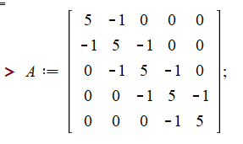
Notes:
Finding eigenvalues with Maple.

Slide 26
This example also has an algebraic solution --
Notes:
Analytic methods for this highly symmetric case.

Slide 27
Notes:
Setting the boundary values.

Slide 28
Notes:
Boundary conditions continued.

Slide 29
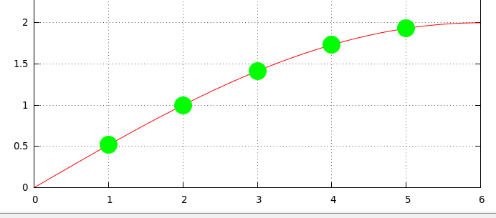
Notes:
Plot of the results.

