Slide 1
PHY 711 Classical Mechanics and Mathematical Methods
10-10:50 AM MWF in Olin 103
Notes for Lecture 16: Chap. 4 (F&W)
    Analysis of motion near equilibrium –
    Normal Mode Analysis
      Normal modes of vibration for simple systems
      Some concepts of linear algebra
      Normal modes of vibration for more complicated systems
Notes:
In this lecture, we will review the normal mode analysis and discuss some general aspects of linear algebra.

Slide 2
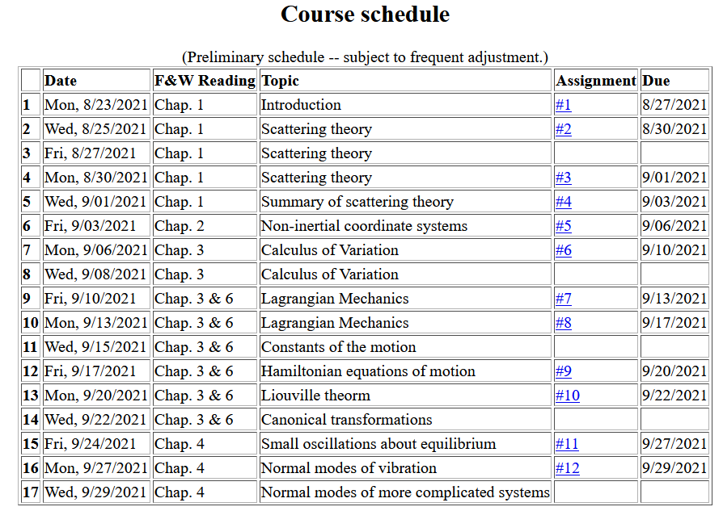

Slide 3
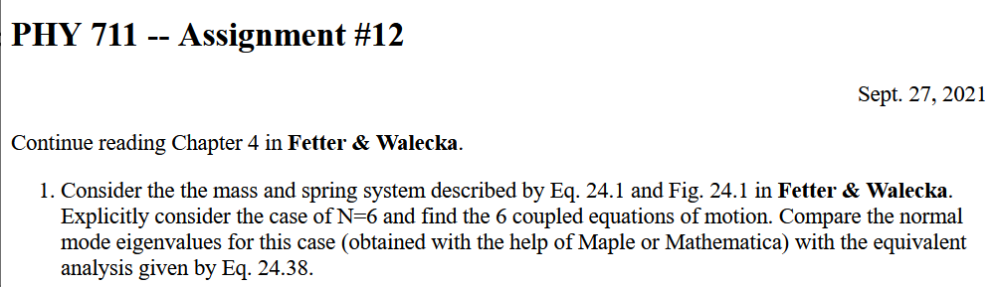
Notes:
Homework due Wedesday.

Slide 4

Schedule
Fall break
Take-home exam
Notes:
Reminder about dates.

Slide 5
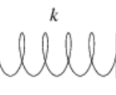
Example – linear molecule
m₁
m₂
m₃
Notes:
Back to the discussion of one-dimensional motion of masses and springs.

Slide 6
Notes:
More review.

Slide 10
m₁
m₂
m₃
m₁
m₂
m₃
m₁
m₂
m₃
Notes:
Reviewing results for example isolated molecule.

Slide 11
(with help from Maple)
N,N’ are normalization constants.

Slide 13
Note that the normalization of the eigenvector is arbitrary.

Slide 14
Digression on matrices -- continued
Eigenvalues of a matrix are “invariant” under a similarity transformation
This means that if a matrix is “similar” to a Hermitian matrix,
it has the same eigenvalues. The corresponding eigenvectors of M and M’ are not the same but

Slide 15
Example of a similarity transformation:
Note that this matrix is not symmetric
Note that this matrix is symmetric

Slide 16
Note, here we have defined S as a transformation matrix (often called a similarity transformation matrix)
How can you find a unitary transformation that also diagonalizes a matrix?

Slide 17
Note that this “trick” is special for 2x2 matrices, but numerical extensions based on the trick are possible.

Slide 18
Note that transformations using unitary matrices are often
convenient and they can be easily constructed from the
eigenvalues of a matrix.

Slide 19
Consider an extended system of masses and springs:
m
m
m
Notes:
Example of one dimensional system with fixed boundary values.

Slide 20
Notes:
Review of detailed equations.

Slide 21
Can solve as an eigenvalue problem –
  (Why did we not have to transform the equations as we did in the previous example?)

Slide 22
Because of its very regular form, this example also has an algebraic solution --
Is this treatment cheating?
  Yes.
  No cheating, but we are not done.

Slide 23
Notes:
Boundary conditions.

Slide 25
Notes:
Full solution.

Slide 26
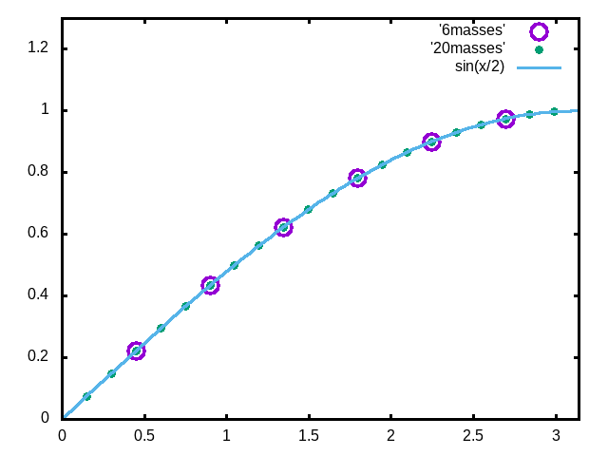
Examples
Note that solution form remains correct for N→∞
Notes:
Plot for example. Now consider the case where N is very large.

Slide 27
For extended chain without boundaries:
m
m
…
…
m
Note that we are assuming that all masses and springs are identical here.
Notes:
Now consider the case where N is infinite so that there are an infinite number of solutions parameterized by qa as a continuous variable.

Slide 28
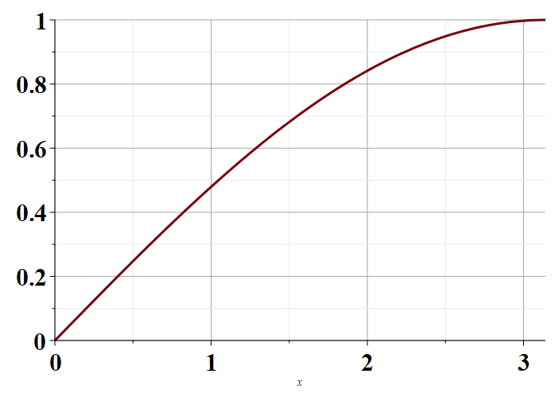
Plot of distinct values of ω_{ν}(q)
π
Notes:
Distinct solutions occur for qa in the range of 0-pi as shown in the plot.

Slide 29
Next time – we will extend this analysis to more complicated systems, including those with different masses or different springs and those in two and three dimensions.

