Slide 1
PHY 711 Classical Mechanics and Mathematical Methods
10-10:50 AM MWF in Olin 103
Discussion on Lecture 16: Chap. 4 (F&W)
Analysis of motion near equilibrium –
Normal Mode Analysis
Normal modes of vibration for simple systems
Some concepts of linear algebra
Normal modes of vibration for more complicated systems
Notes:
In this lecture, we will review the normal mode analysis and discuss some general aspects of linear algebra.

Slide 2
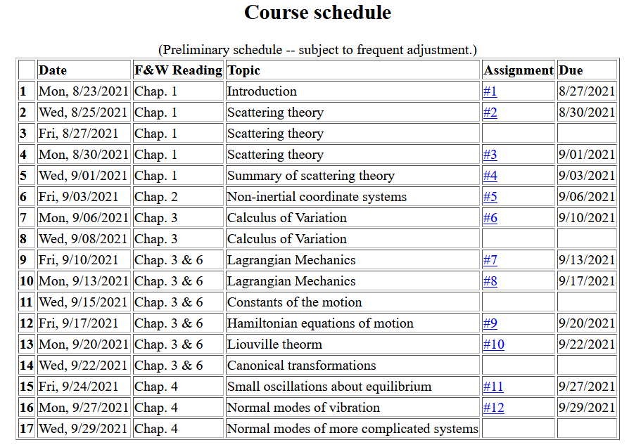

Slide 3
Notes:
Homework due Wedesday.

Slide 4
Schedule
Fall break
Take-home exam
Notes:
Reminder about dates.

Slide 5
Your questions –
From Wells -- What exactly does it mean for matrices to be similar? Is the only requirement that they have the same eigenvalues?
Comment – We will go over that point in this lecture ….

Slide 6
Example – linear molecule
m₁
m₂
m₃
Notes:
Back to the discussion of one-dimensional motion of masses and springs.

Slide 7
Notes:
More review.

Slide 11
m₁
m₂
m₃
m₁
m₂
m₃
m₁
m₂
m₃
Notes:
Reviewing results for example isolated molecule.

Slide 12
(with help from Maple)
N,N’ are normalization constants.

Slide 14
Note that the normalization of the eigenvector is arbitrary.

Slide 15
Digression on matrices -- continued
Eigenvalues of a matrix are “invariant” under a similarity transformation
This means that if a matrix is “similar” to a Hermitian matrix,
it has the same eigenvalues. The corresponding eigenvectors of M and M’ are not the same but

Slide 16
Example of a similarity transformation:
Note that this matrix is not symmetric
Note that this matrix is symmetric

Slide 17
Note, here we have defined S as a transformation matrix (often called a similarity transformation matrix)
How can you find a unitary transformation that also diagonalizes a matrix?

Slide 18
Note that this “trick” is special for 2x2 matrices, but numerical extensions based on the trick are possible.

Slide 19
Note that transformations using unitary matrices are often
convenient and they can be easily constructed from the
eigenvalues of a matrix.

Slide 20
Consider an extended system of masses and springs:
m
m
m
Notes:
Example of one dimensional system with fixed boundary values.

Slide 21
Notes:
Review of detailed equations.

Slide 22
Can solve as an eigenvalue problem –
(Why did we not have to transform the equations as we did in the previous example?)

Slide 23
Because of its very regular form, this example also has an algebraic solution --
Is this treatment cheating?
Yes.
No cheating, but we are not done.

Slide 24
Notes:
Boundary conditions.

Slide 26
Notes:
Full solution.

Slide 27
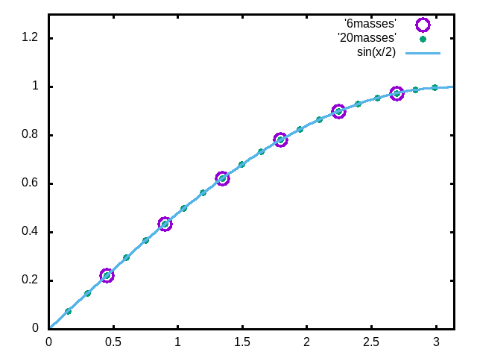
Examples
N=6
N=20
Note that solution form remains correct for N→∞
Notes:
Plot for example. Now consider the case where N is very large.

Slide 28
For extended chain without boundaries:
m
m
…
…
m
Note that we are assuming that all masses and springs are identical here.
Notes:
Now consider the case where N is infinite so that there are an infinite number of solutions parameterized by qa as a continuous variable.

Slide 29
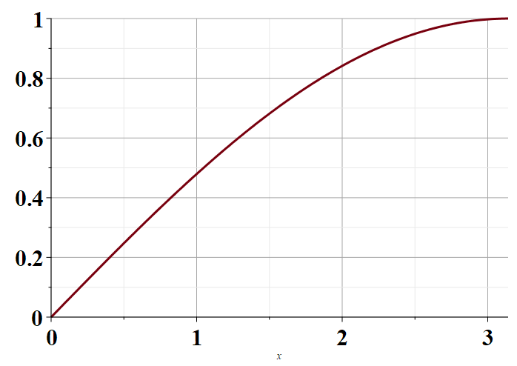
Plot of distinct values of ω_{ν}(q)
π
Note that for N→ ∞ , q becomes a continuous variable within the range 0 < qa < π.
Notes:
Distinct solutions occur for qa in the range of 0-pi as shown in the plot.

Slide 30
Next time – we will extend this analysis to more complicated systems, including those with different masses or different springs and those in two and three dimensions.

