Slide 1
PHY 711 Classical Mechanics and Mathematical Methods
10-10:50 AM MWF in Olin 103
Discussion on Lecture 17: Chap. 4 (F&W)
Normal Mode Analysis
Normal modes for extended one-dimensional systems
Normal modes for 2 and 3 dimensional systems
Notes:
In this lecture, we will extend our normal mode analysis to more complicated systems, including infinite periodic systems and beyond one dimension.

Slide 3
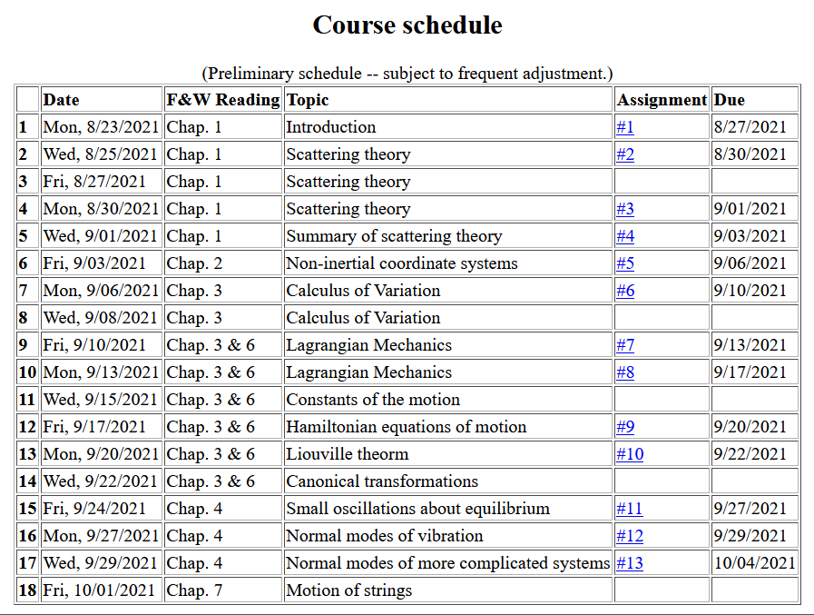
Notes:
This is the last lecture for Chap. 4. On Friday we will continue to discuss vibrations in extended one dimensional motion as covered in Chap. 7.

Slide 4
Notes:
Homework due Monday.

Slide 5
Your questions –
From Owen -- If a spring system were undergoing chaotic motion, would the eigenvalue/eigenvector formalism we are discussing still apply? Can one know in advance whether a system will behave chaotically or not?
Comment – In the present treatment we are focusing on the linearized equations of motion. In this case, while the motion can be complicated (superposition of several modes for example), the chaotic behavior does not occur. Mathematically, chaotic behavior may occur in the presence of non-linear contributions. Physically, non-linear contributions tend to be important when the system has large deviations from equilibrium.

Slide 6
Consider an extended system of masses and springs:
m
m
m
Notes:
Example of one dimensional system with fixed boundary values.

Slide 7
Notes:
Review of detailed equations.

Slide 8
Notes:
Review of solutions discussed on Wednesday.

Slide 9
Notes:
Review of boundary conditions.

Slide 11
Notes:
Review of full solution.

Slide 12
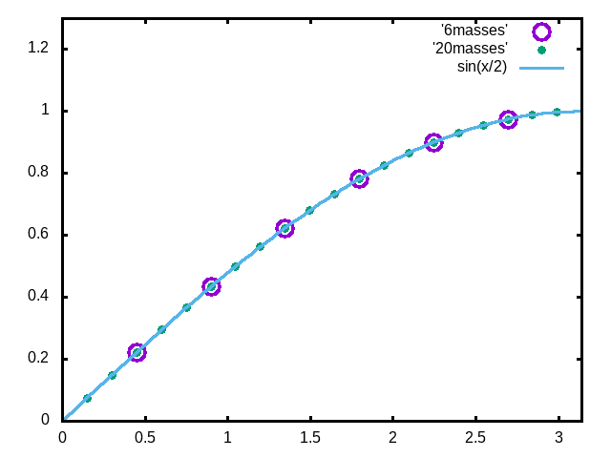
Examples
Note that solution form remains correct for N→∞
Notes:
Plot for example. Now consider the case where N is very large.

Slide 13
For extended chain without boundaries:
m
m
…
…
m
Note that we are assuming that all masses and springs are identical here.
Notes:
Now consider the case where N is infinite so that there are an infinite number of solutions parameterized by qa as a continuous varable.

Slide 14
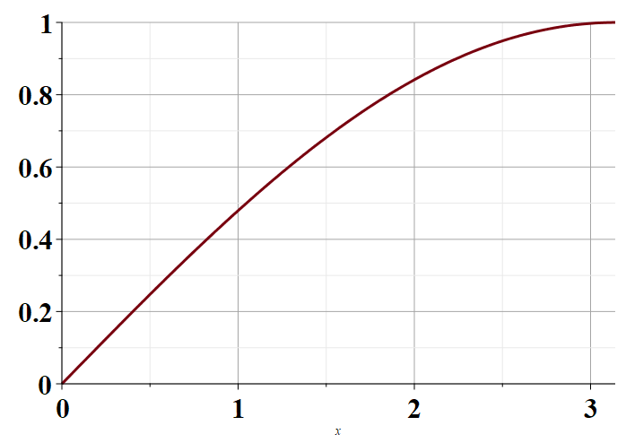
Plot of frequencies in scaled units as a function qa
π
Notes:
Distinct solutions occur for qa in the range of 0-pi as shown in the plot.

Slide 15
Consider an infinite system of masses and springs now with two kinds of masses:
m
M
m
M
m
m
Notes:
Now consider a slight modification of the previous example where masses are alternately m and M with labels x and y.

Slide 16
Note that 2qa is an unknown parameter.
Does this form seem reasonable?
Notes:
In this case, we can analyze the system by considering different amplitudes for the m and M masses. The resulting coupled equations can be written in matrix form.

Slide 17
Comment on notation --
m
M
m
M
m
m
Using 2qa as our unknown parameter is a convenient choice so that we can easily relate our solution to the m=M case.

Slide 18
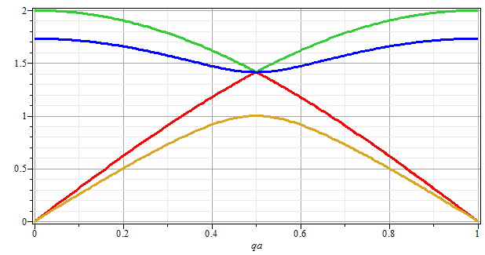
Note that for m=M, we obtain the same normal modes as before. Is this reassuring?
No
Yes
ω
qa/π
Notes:
Plotting the solutions for the frequencies as a function of qa.

Slide 19
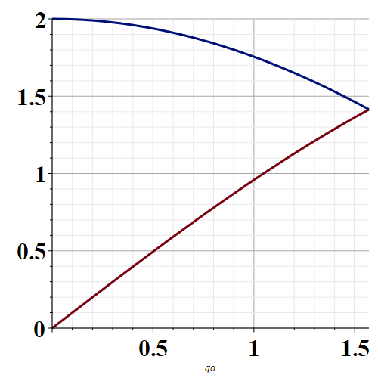
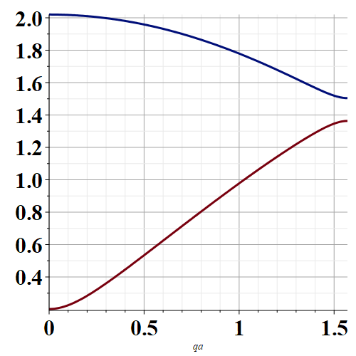
Note that for every qa, there are 2 modes.
m=M
m≠M
qa
qa
Plotting only distinct frequencies 0< qa < π/2

Slide 20
Eigenvectors:
Notes:
Some details about the solutions.

Slide 21
Potential in 2 and more dimensions
V(x,y)
Notes:
Returning to the finite systems, consider equilibria in two dimensions as shown.

Slide 22
Example – normal modes of a system with the symmetry of an equilateral triangle
3
u₃
m
k
k
u₂
1
2
u₁
k
m
m
Notes:
Specifically, we will consider 3 masses in an equilateral triangle configuration as shown.

Slide 23
Example – normal modes of a system with the symmetry of an equilateral triangle -- continued
3
u₃
u₂
1
2
u₁
Notes:
We need to consider displacements from equilibrium in the x-y plane. Keeping only linear terms in the displacements we wind up with a simple relationship to analyze.

Slide 24
Note that this analysis of the leading term is true in 1, 2, and 3 dimensions.

Slide 25
Example – normal modes of a system with the symmetry of an equilateral triangle -- continued
3
u₃
u₂
1
2
u₁
Notes:
We need to consider displacements from equilibrium in the x-y plane. Keeping only linear terms in the displacements we wind up with a simple relationship to analyze.

Slide 26
Example – normal modes of a system with the symmetry of an equilateral triangle -- continued
Notes:
Analyzing the 3 displacements for the equilateral triangle geometry, we find these equations.

Slide 27
Example – normal modes of a system with the symmetry of an equilateral triangle -- continued
= ω²
Notes:
The results is a 6x6 matrix problem to find eigenvalues and eigenvectors.

Slide 28
Example – normal modes of a system with the symmetry of an equilateral triangle -- continued
With help from Maple
3
u₃
m
k
k
u₂
1
2
u₁
k
m
m
Notes:
Results from Maple. We have 6 eigenvalues and 3 non-zero modes for this case.

Slide 29
3
u₃
What can you say about the 3 zero frequency modes?
m
k
k
u₂
1
2
What can you say about the 3 non-zero frequency modes?
u₁
k
m
m

Slide 30
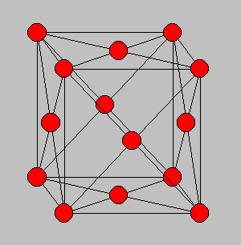
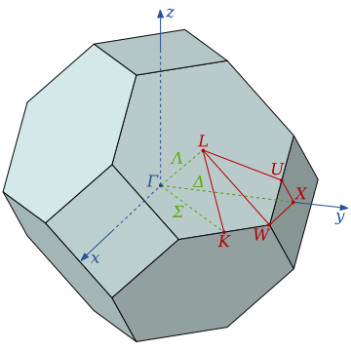
3-dimensional periodic lattices
Example – face-centered-cubic unit cell (Al or Ni)
Diagram of atom positions
Diagram of q-space ν(q)
Notes:
Interesting extensions to a 3-dimensional crystalline system.

Slide 31
From: PRB 59 3395 (1999); Mishin et. al. ν(q)
Note that for each q, there are 3 frequencies.
Notes:
Results of normal modes from experiment and simulations for face centered cubic Al (left) and Ni (right). Interestingly, the phonon frequency patterns are similar for these very different materials.

Slide 32
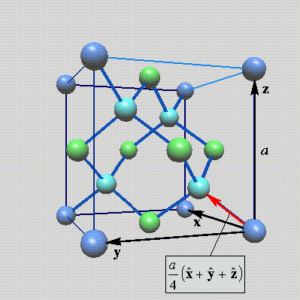
Lattice vibrations for 3-dimensional lattice
Example: diamond lattice
Ref: http://phycomp.technion.ac.il/~nika/diamond_structure.html
Notes:
Another example – diamond.

Slide 33
Notes:
Some equations for extended systems.

Slide 34
Notes:
More euqations.

Slide 35
Notes:
More equations.

Slide 36
B. P. Pandy and B. Dayal, J. Phys. C. Solid State Phys. 6 2943 (1973)
Notes:
Results for diamond from simulation and experiment.

Slide 37
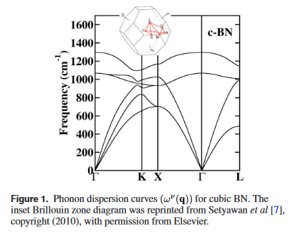
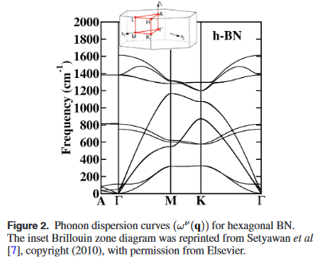
Examples of phonon spectra of two forms of boron nitride
Cubic structure
Hexagonal structure

