Slide 1
PHY 711 Classical Mechanics and Mathematical Methods
10-10:50 AM MWF in Olin 103
Discussion for Lecture 18: Chap. 7 (F&W)
    Mechanical motion of a continuous string
      Masses coupled by springs ⬅➔masses coupled by string
      Mechanics one-dimensional continuous system
      The wave equation
      Comments on linear vs. non-linear equations
Notes:
The one dimensional motion of a large number masses interconnected with springs provides a model of longitudinal motions of a continuous elastic spring and related topics covered in Chapter 7 of your textbook

Slide 2
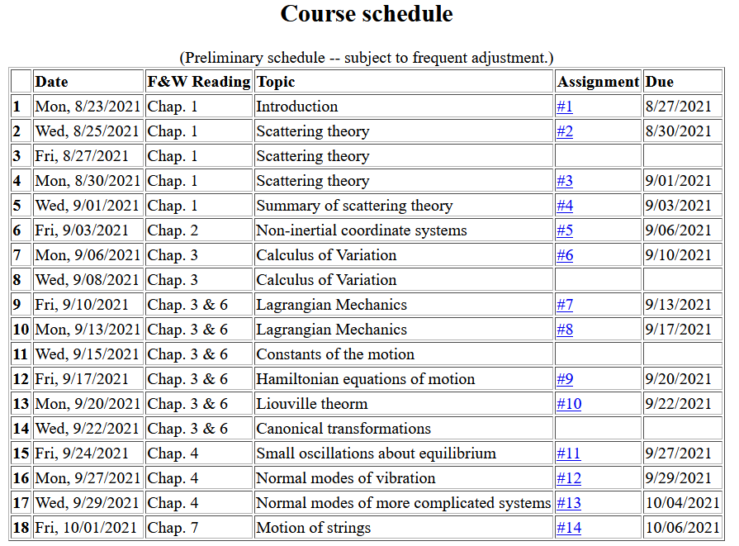
Notes:
Start reading Chapter 7. The homework problem concerns one dimensional wave motion using methods discussed in this lecture.

Slide 3
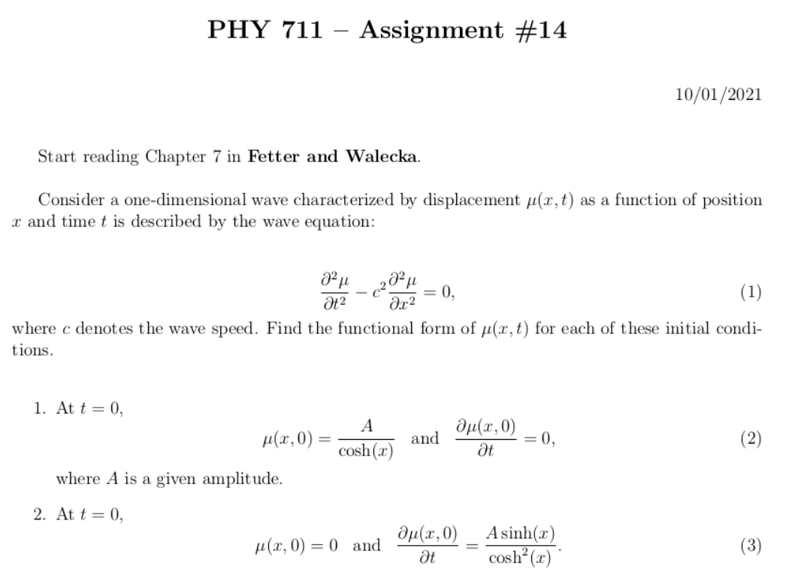
Notes:
Homework problem is due Wednesday.

Slide 4
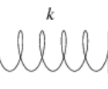
Longitudinal case: a system of masses and springs:
m
m
m
Notes:
Showing how the case of the infinite mass and spring system approximates the continuous elastic string.

Slide 5
system parameter with units of (velocity)²
Notes:
Regrouping constants in terms of spring constant times increment of length and mass per unit length which combine to give a squared velocity for the longitudinal case. For the transverse case, string tension is involved.

Slide 6
More details

Slide 7
More details
Transverse case
τ₁
θ₁
y+Δy
θ₂
y
τ₂
x
x+Δx

Slide 8
Transverse displacement:
τ
μ(x,t)
Notes:
The diagram shows how the y component of the net tension contributes to the transverse motion.

Slide 9
Notes:
It is possible to adapt the Lagrangian formalism to this continuous system.

Slide 10
Notes:
The continuum version of the Euler-Lagrange equations result in the wave equation for this example.

Slide 11
Note that this is an example of a partial differential equation
Notes:
In the next several slides we will discuss solutions to the wave equation. Note that the one dimensional wave equation has some special properties.

Slide 12
These functions would be given
Notes:
This method by D’Alembert is based on the special property of the wave equation.

Slide 13
Notes:
D’Alembert’s method continued.

Slide 14
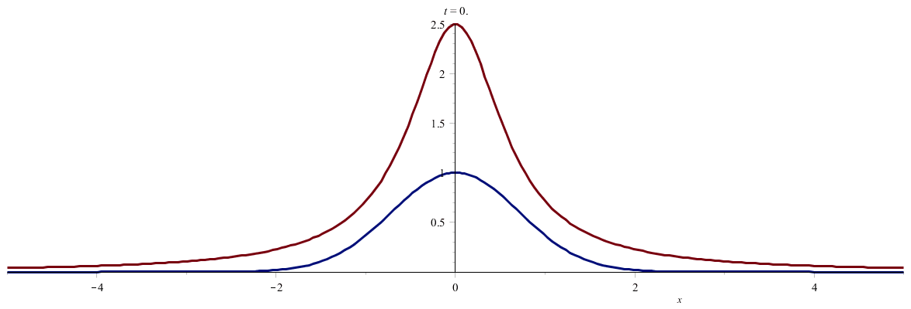
Notes:
An example. (Use slide show to see animation.)

Slide 15
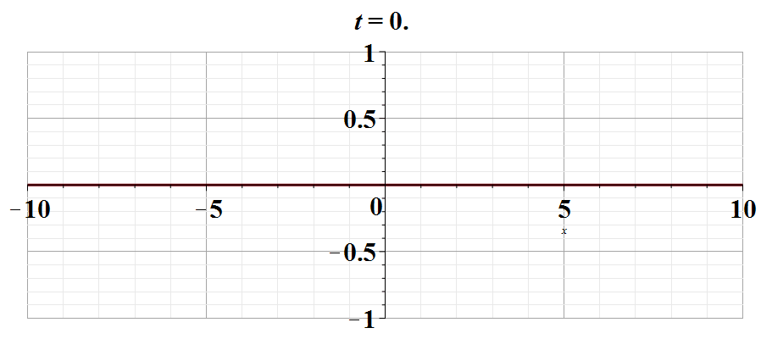
Notes:
Another example. Use slide show to see animation.

Slide 16
Digression – comment on linear vs non-linear equations
Notes:
Digression on the special properties of linear equations in contrast to complications for non-linear equations.

Slide 17
Notes:
An example of the effects of non-linearity.

Slide 18
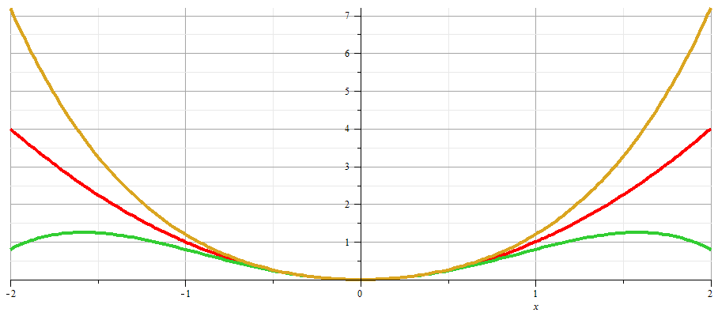
x
Notes:
Plot of nonlinear potentials.

Slide 19
Notes:
Approximate solution to example non-linear equation.

Slide 20
Notes:
Non-linear equation continued.

Slide 21
Notes:
More details.

Slide 22
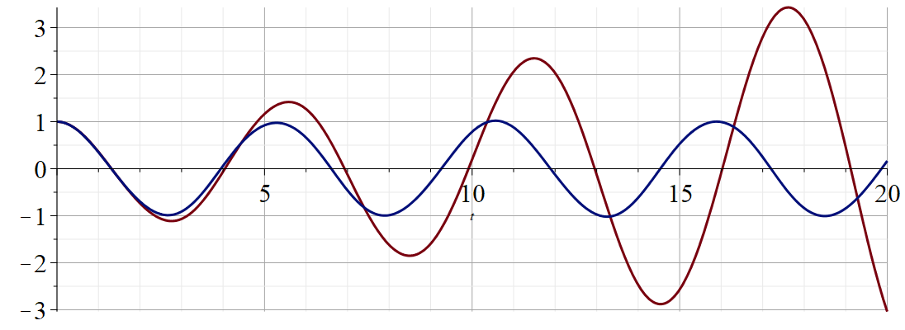
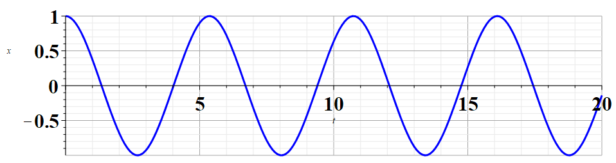
Regrouped expansion
x
t
Original perturbation expansion
Numerical solution according to Maple
Notes:
Plot of results.

