Slide 1
PHY 711 Classical Mechanics and Mathematical Methods
10-10:50 AM MWF in Olin 103
Lecture 2
Two particle interactions
and scattering theory
Notes:
In this lecture, we will review the basic physics of two interacting particles. When the particles are not in a bound orbit, their motion may be assessed in terms of scattering. Scattering is a very powerful analysis tool that often allows for the comparison of theory and experiment.

Slide 2
Schedule for weekly one-on-one meetings?

Slide 3
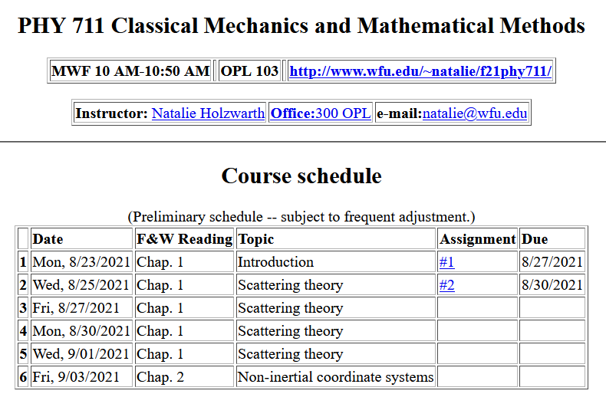
Notes:
This is an image of the webpage with the schedule and the homework assignment.

Slide 4
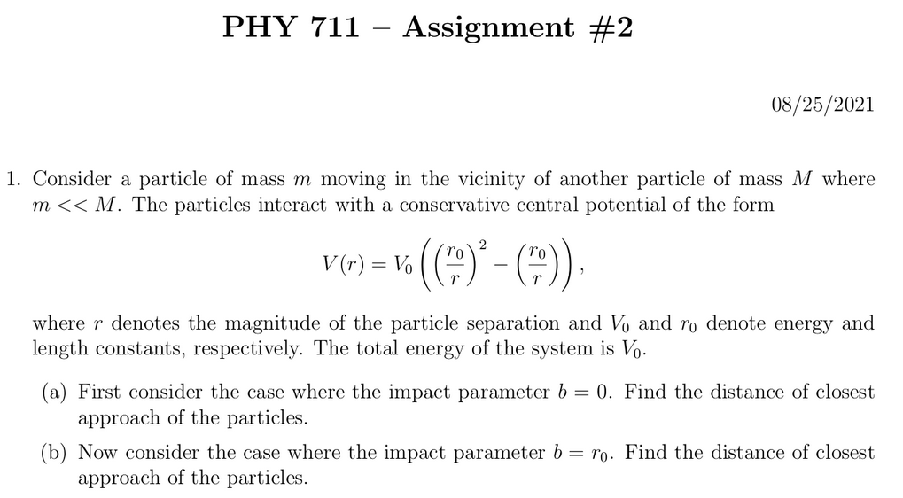
Notes:
This assignment reviews some of the basic concepts of conservative potentials, conservation of energy, and conservation of momentum. The potential form is not physically motivated, but the solutions can be determined by simple analysis, and the qualitative results are illustrative of the particle interactions.

Slide 5
Comment on quiz questions
1.
3.
Notes:
These are solutions to the “assessment” exercise. It will help us figure out which mathematical methods should be usefully reviewed in this class. Most of you had particular trouble with the geometric series. It may be one of those things that you will want to remember to look up when you need it, rather than an important concept.

Slide 6
First consider fundamental picture of particle interactions
Classical mechanics of a conservative 2-particle system.
1
2
r₁
r₂
For this discussion, we will assume that V(r)=V(r) (a central potential).
Notes:
First consider the basic particle interactions which govern their motion.

Slide 7
Energy is conserved:
1
2
r₁
r₂
For a central potential V(r)=V(r), angular momentum is conserved.
For the moment we also make the simplifying assumption that m₂>>m₁ so that particle 1 dominates the motion.
Notes:
The last assumption is being made for convenience. We will consider the center of mass and relative motion much more carefully later.

Slide 8
Typical two-particle interactions –
Notes:
These represent typical particle interactions. Only the Coulomb or gravitational forms are precisely found in nature. The others serve as convenient models.

Slide 9
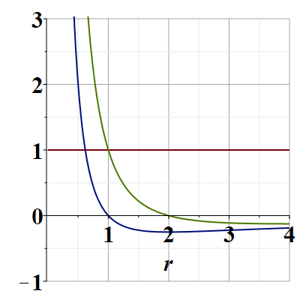
Representative plot of V(r)
V(r)
E/V₀
Note that particles are not bound; can reach infinite separation
Distances of closest approach
Notes:
Potential energy diagram showing important aspects of the particle trajectory.

Slide 10
Some more details --
r(t₁)
θ(t₁)
r(t₂)

Slide 11
Comments continued --
V_{eff}(r)

Slide 12
Which of the following are true:
The particle moves in a plane.
For any interparticle potential the trajectory can be determined/calculated.
Only for a few special interparticle potential forms can the trajectory be determined.
Why should we care about this?
We shouldn’t really care.
It is only of academic interest
It is of academic interest but can be measured.
Many experiments can be analyzed in terms of the particle trajectory.
Notes:
What do you think about these?

Slide 13
Scattering theory:
detector
Notes:
This is the ideal configuration of a scattering experiment.

Slide 14
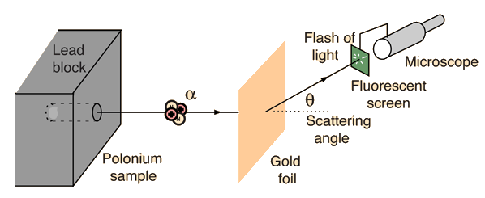
Example: Diagram of Rutherford scattering experiment
http://hyperphysics.phy-astr.gsu.edu/hbase/rutsca.html
Notes:
This illustrates the setup of the famous Rutherford scattering experiment.

Slide 15
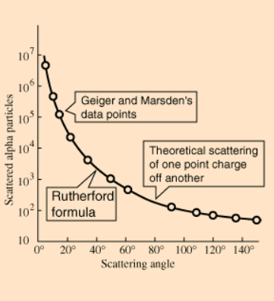
Graph of data from scattering experiment
From website: http://hyperphysics.phy-astr.gsu.edu/hbase/Nuclear/rutsca2.html
Notes:
Reconstruction experimental data from the Rutherford experiment.

Slide 16
Standardization of scattering experiments --
Impact parameter: b
b
Figure from Marion & Thorton, Classical Dynamics
Notes:
Some details of scattering geometry and analysis.

Slide 17
Note: The notion of cross section is common to many areas of physics including classical mechanics, quantum mechanics, optics, etc. Only in the classical mechanics can we calculate it from a knowledge of the particle trajectory as it relates to the scattering geometry.
b
Figure from Marion & Thorton, Classical Dynamics
Note: We are assuming that the process is isotropic in ϕ
Notes:
More details.

Slide 18
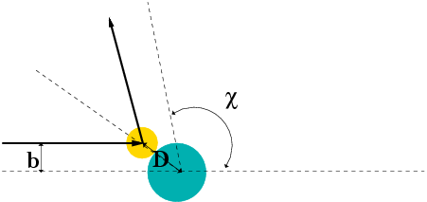
Simple example – collision of hard spheres having mutual radius D; very large target mass
Microscopic view:
Notes:
Illustration of the analysis for the scattering of a hard sphere on a massive hard sphere.

Slide 19
Simple example – collision of hard spheres -- continued
Hard sphere:
Notes:
Total cross section versus partical cross section.

Slide 20
More details of hard sphere scattering –
Hidden in the analysis are assumptions about the scattering process such as:
No external forces ➔ linear momentum is conserved
No dissipative phenomena ➔ energy is conserved
No torque on the system ➔ angular momentum is conserved
Target particle is much more massive than scattering particle
Other assumptions??
Note that for quantum mechanical hard spheres at low energy the total cross section is 4 times as large.
Notes:
Some questions and comments. The discussion of scattering theory will be continued next time.

