Slide 1
PHY 711 Classical Mechanics and Mathematical Methods
10-10:50 AM MWF in Olin 103
Notes on Lecture 21 – Chap. 7 (F&W)
Solutions of differential equations
Green’s function solution methods based on eigenfunction expansions
Green’s function solution methods based on solutions of the homogeneous equations
Notes:
In this lecture, we will continue our discussion of one dimensional ordinary differential equations.

Slide 2
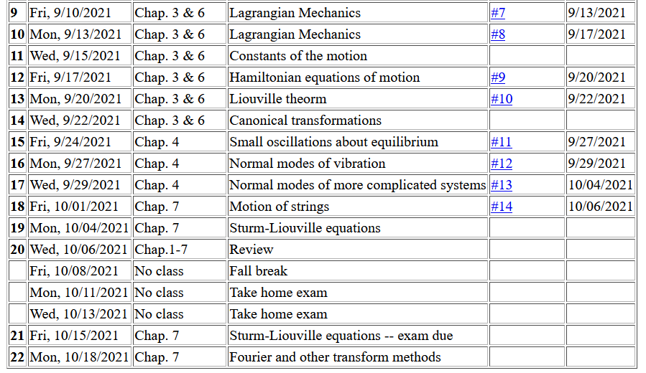
Notes:
The schedule continues to cover material in Chap. 7

Slide 3
Review – Sturm-Liouville equations defined over a range of x.
Note that, because Sturm-Liouville operator is Hermitian, the eigenvalues are real and the eigenfunctions are orthogonal. In the last lecture, we argued that the eigenfunctions form a “complete” set over the range of x defined for the particular system.
Notes:
Review of the class problems considered.

Slide 4
Eigenvalues and eigenfunctions of Sturm-Liouville equations
Notes:
General properties.

Slide 5
Variation approximation to lowest eigenvalue
In general, there are several techniques to determine the eigenvalues λ_{n} and eigenfunctions f_{n}(x). When it is not possible to find the ``exact'' functions, there are several powerful approximation techniques. For example, the lowest eigenvalue can be approximated by minimizing the function
where is a variable function which satisfies the
correct boundary values. The ``proof'' of this inequality is
based on the notion that can in principle be expanded
in terms of the (unknown) exact eigenfunctions f_{n}(x):
where the coefficients C_{n} can be
assumed to be real.
Notes:
Comment on the Raleigh-Ritz approximation for the lowest eigenvalues.

Slide 6
Estimation of the lowest eigenvalue – continued:
From the eigenfunction equation, we know that
It follows that:
Notes:
Proof of the Rayleigh-Ritz theorem.

Slide 7
Rayleigh-Ritz method of estimating the lowest eigenvalue
Notes:
Review of example from last lecture.

Slide 8
Rayleigh-Ritz method of estimating the lowest eigenvalue
Another example – this time with a variable parameter
Notes:
Another example.

Slide 9
Recap -- Rayleigh-Ritz method of estimating the lowest eigenvalue
Exact answer
Do you think that there is a reason for getting the correct answer from this method?
Chance only
Skill
Notes:
In this case, the minimization process yield’s the exact answer.

Slide 10
Solution to inhomogeneous problem by using Green’s functions
Solution to homogeneous problem
Notes:
From a knowledge of the Green’s function we can find solutions of related inhomogeneous equations.

Slide 11
Solution to homogeneous problem
Your question -- On slide 17, what is the homogeneous equation psi_0(x)?
In this lecture, we will discuss several methods of finding this Green’s function. This topic will also
appear in PHY 712

Slide 12
Your question -- How do we arrive at the formal solution on slide 11?

Slide 13
Recall:
By construction
Notes:
The following slides present solution methods for differential equations involving the use of eigenvalues.

Slide 14
Example Sturm-Liouville problem:
Notes:
Example.

Slide 15
Notes:
Solution using eigenfunctions appropriate for this example.

Slide 16
Notes:
Continued.

Slide 17
Notes:
In this case, the solution simplifies.

Slide 18
(Actually the algebra is painful). But, hurray! Same result as before.
Notes:
Another method of finding a Green’s function.

Slide 19
More details on the general method of constructing Green’s functions using homogeneous solution
Notes:
Green’s function based on homogeneous solutions (not eigenfuntions).

Slide 20
Notes:
Some details.

Slide 21
Note that the integral has to be performed in two parts. While the eigenfunction expansion method can be generalized to 2 and 3 dimensions, this method only works for one dimension.
Notes:
More details.

Slide 22
Notes:
Another example, this time taken from electrostatics.

Slide 23
Notes:
Solutions for a particular charge distribution.

Slide 24
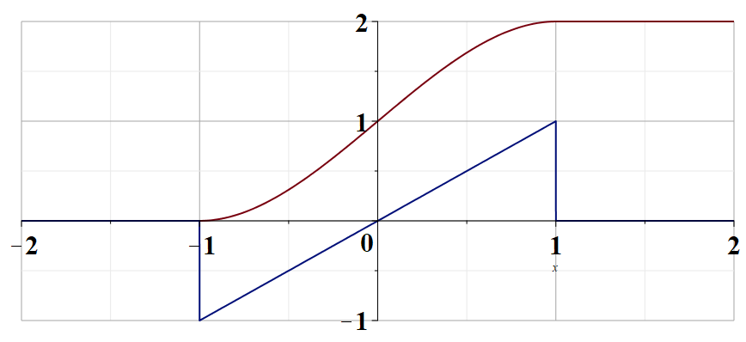
Notes:
Plot of the change distribution and of the electrostatic potential.

