Slide 1
PHY 711 Classical Mechanics and Mathematical Methods
10-10:50 AM MWF in Olin 103
Discussion for Lecture 22: Chap. 7
& App. A-D (F&W)
Generalization of the one dimensional wave equation ➔ various mathematical problems and techniques including:
Fourier transforms
Laplace transforms
Complex variables
Contour integrals
Notes:
In this lecture we will start to cover various useful mathematical techniques.

Slide 2
Schedule for this week
Note that Yan Li will also give a regular physics colloquium on Nov. 4th

Slide 3
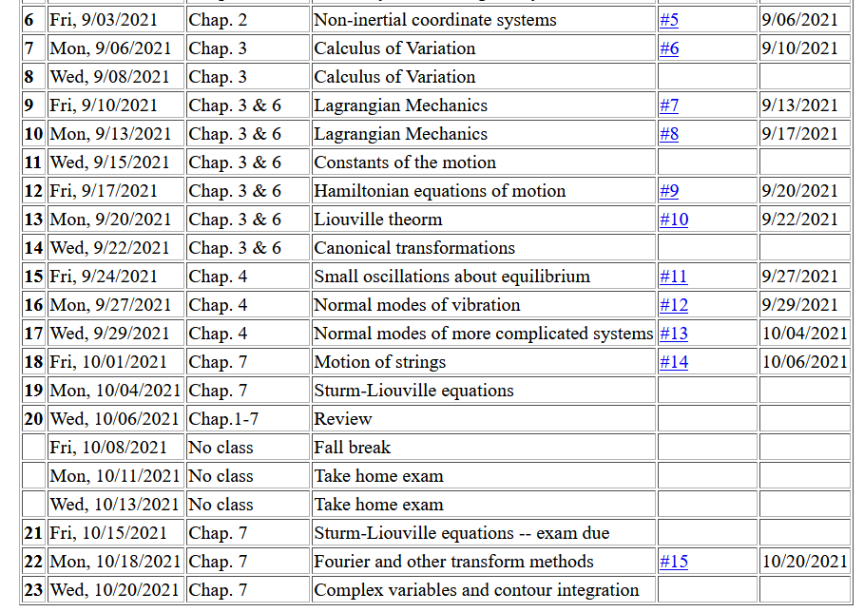
Notes:
This is the schedule. You will receive an email containing the mid term exam. It will be due next Monday.

Slide 4
This assignment covers material from Friday’s lecture --

Slide 5
Review – Sturm-Liouville equations defined over a range of x.
Note that, because Sturm-Liouville operator is Hermitian, the eigenvalues are real and the eigenfunctions are orthogonal. In the last lecture, we argued that the eigenfunctions form a “complete” set over the range of x defined for the particular system.
Notes:
Review of the Sturm Liouville equations.

Slide 6
Notes:
Specializing to the simplest case.

Slide 7
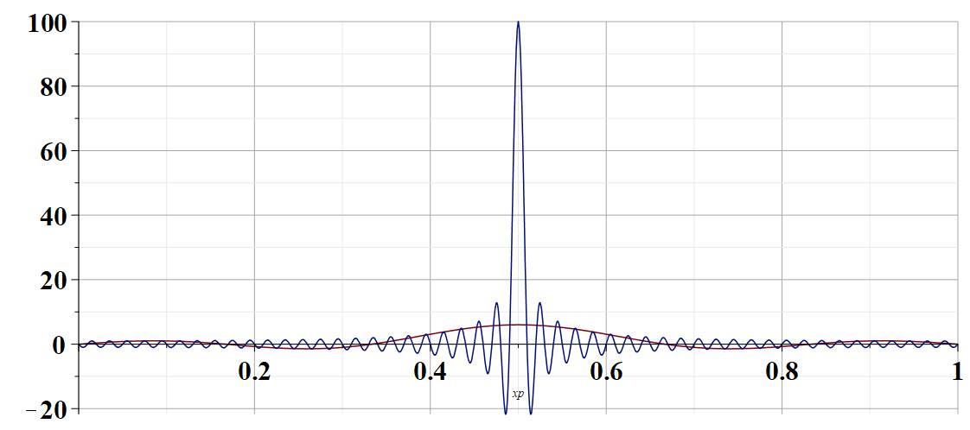
←sum with 100 terms
←sum with 5 terms
x’ for x=0.5 →
Notes:
Visualizing the completeness condition.

Slide 8
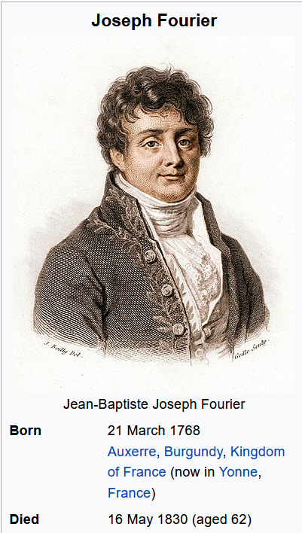

Slide 9
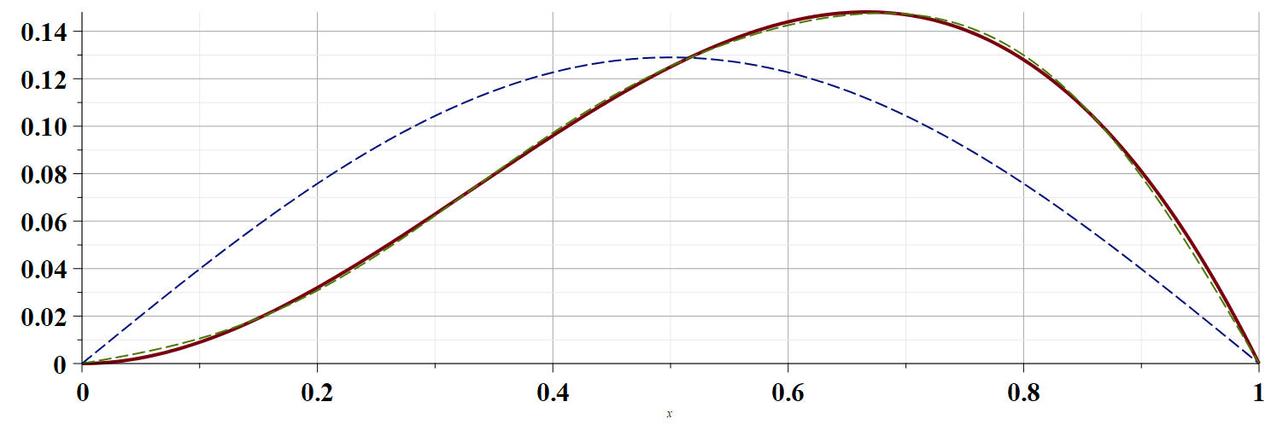
Example h(x)=x²(1-x)
←5 terms
1 term →
Notes:
Numerical evaluation of an example.

Slide 10
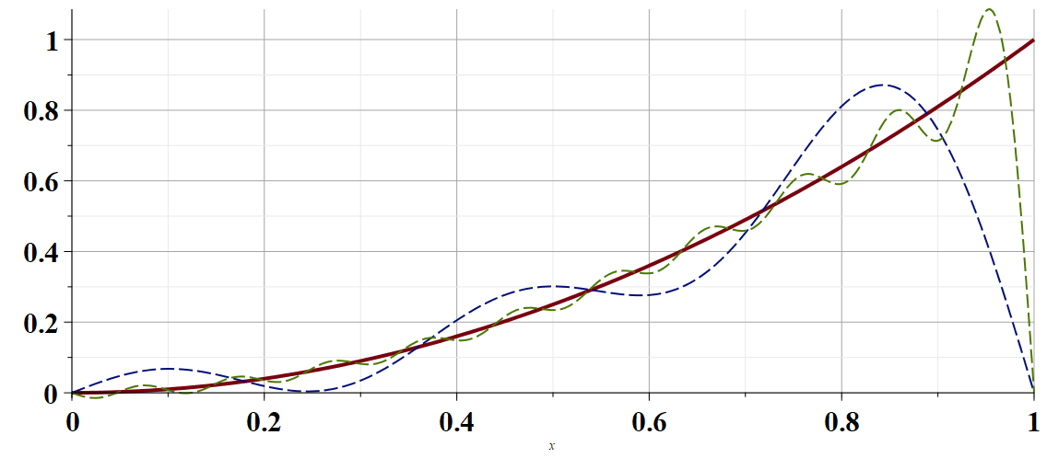
Convergence of the Fourier series
20 terms →
Example h(x)=x²
5 terms →
Notes:
Numerical evaluation of less convergent example.

Slide 11
Using Fourier series to solve the wave equation.
Notes:
Using Fourier methods to solve the wave equation.

Slide 12
Using Fourier series to solve the wave equation -- continued. The general solution can be formed by taking a linear combination of the eigenfunction results.
Notes:
Setting the boundary and initial conditions.

Slide 13
Using Fourier series to solve the wave equation -- continued. Finding the constants from the eigenfunction (Fourier) expansion.
Notes:
Determining the constants.

Slide 14
Are these two solutions
Identical
Equivalent
Totally different
Notes:
Interesting question.

Slide 15
Fourier series and Fourier transforms are useful for solving and analyzing a wide variety of functions, also beyond the Sturm-Liouville context.
In the next several slides we will consider a related concept – the Laplace transform.
Notes:
We now consider another technique that is uses to solve initial value equations.

Slide 16
Notes:
A quick introduction to Laplace transform methods.

Slide 17
Notes:
An example.

Slide 18
Notes:
Some details.

Slide 19
Does this result look familiar?
Yes
No
Notes:
More details.

Slide 20
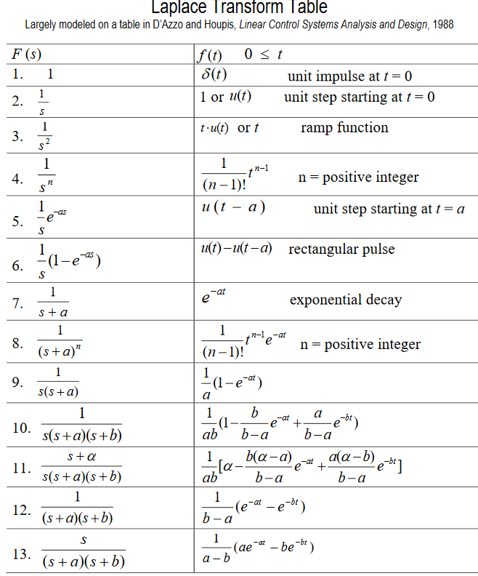
Table of Laplace transforms
https://www.dartmouth.edu/~sullivan/22files/New%20Laplace%20Transform%20Table.pdf
Notes:
Table of transforms for simple functions.

Slide 21
In order to evaluate these integrals, we need to use complex analysis.
Notes:
Mathematical treatment of general case.

Slide 22
Complex numbers
Functions of complex variables
Derivatives:
Cauchy-Riemann equations
Notes:
Introduction to properties of complex numbers.

Slide 23
Analytic function
Notes:
Notion of analytic function. Some of these functions are not analytic.

Slide 24
Some details
Notes:
Some details. To be continued.

