Slide 1
PHY 711 Classical Mechanics and Mathematical Methods
10-10:50 AM MWF in Olin 103
Discussion for Lecture 22: Chap. 7
& App. A-D (F&W)
    Generalization of the one dimensional wave equation ➔ various mathematical problems and techniques including:
            Fourier transforms
            Laplace transforms
            Complex variables
            Contour integrals
Notes:
In this lecture we will start to cover various useful mathematical techniques.

Slide 2
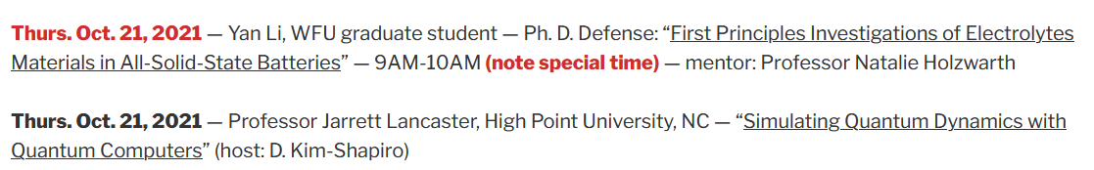
Schedule for this week
Note that Yan Li will also give a regular physics colloquium on Nov. 4th

Slide 3
Your questions –
From Owen -- Does the number of terms in the summation for the Fourier series to converge depend on the type of function being analyzed?

Slide 4
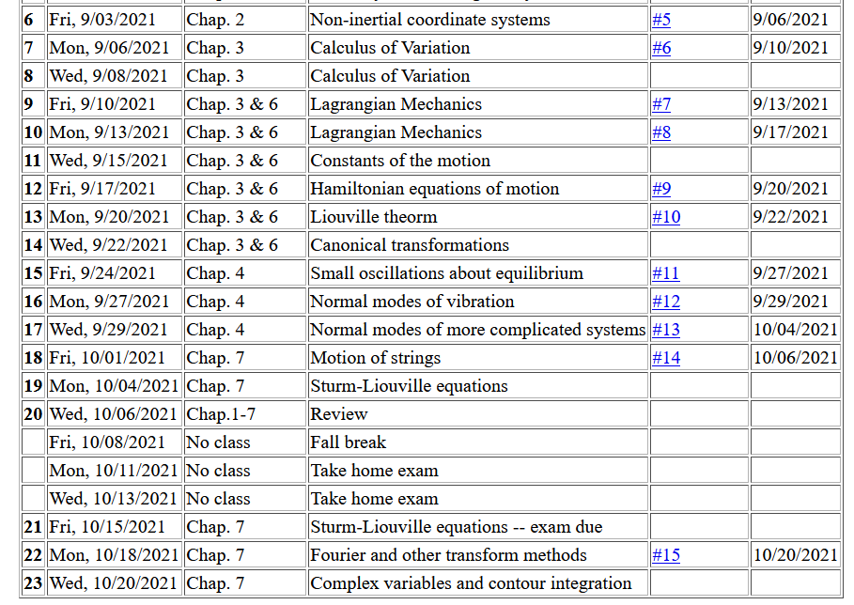
Notes:
This is the schedule. You will receive an email containing the mid term exam. It will be due next Monday.

Slide 5
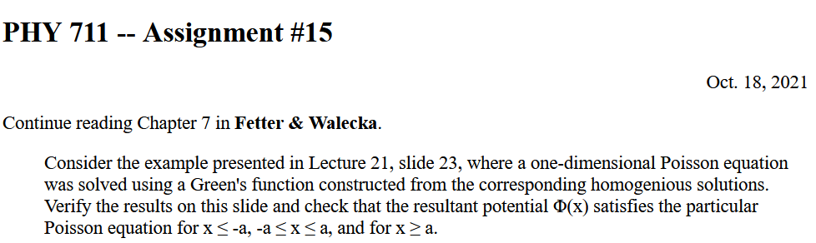
This assignment covers material from Friday’s lecture --

Slide 6
Review – Sturm-Liouville equations defined over a range of x.
Note that, because Sturm-Liouville operator is Hermitian, the eigenvalues are real and the eigenfunctions are orthogonal. In the last lecture, we argued that the eigenfunctions form a “complete” set over the range of x defined for the particular system.
Notes:
Review of the Sturm Liouville equations.

Slide 7
Notes:
Specializing to the simplest case.

Slide 8
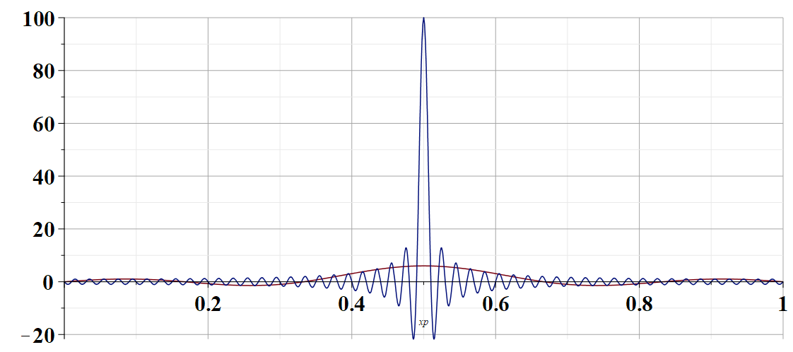
←sum with 100 terms
←sum with 5 terms
x’ for x=0.5 →
Notes:
Visualizing the completeness condition.

Slide 9
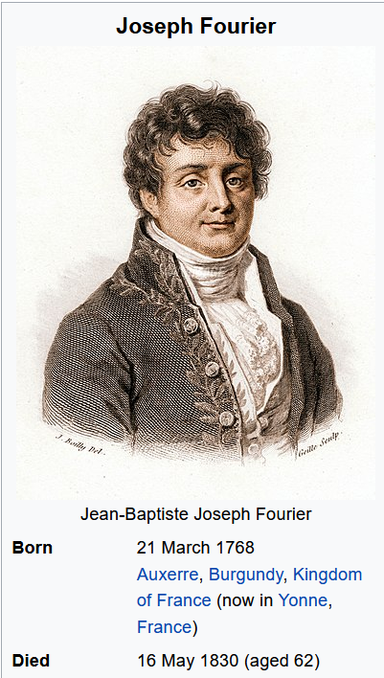

Slide 10
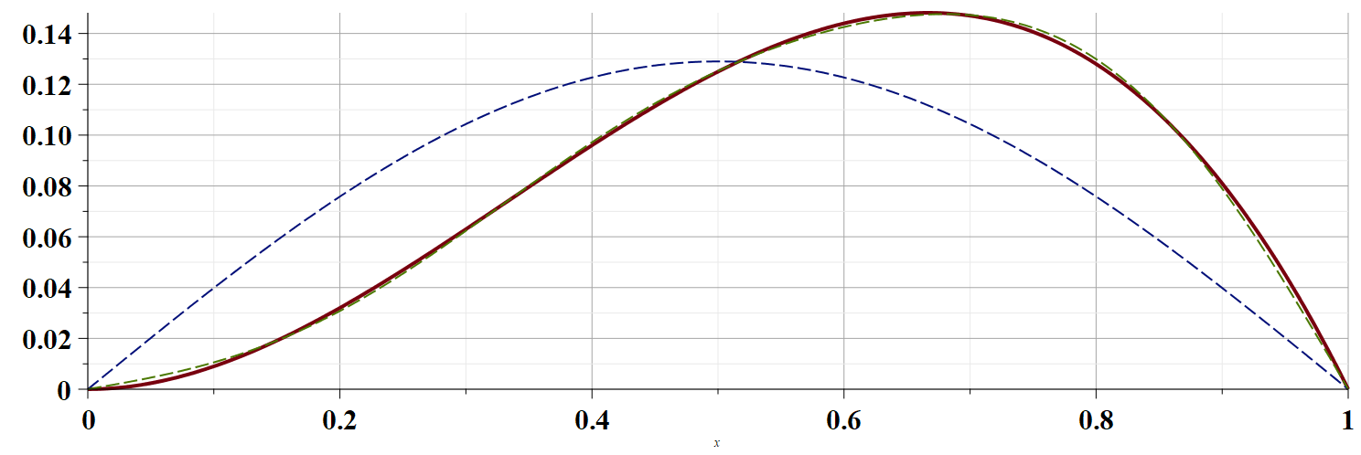
Example h(x)=x²(1-x)
←5 terms
1 term →
Notes:
Numerical evaluation of an example.

Slide 11
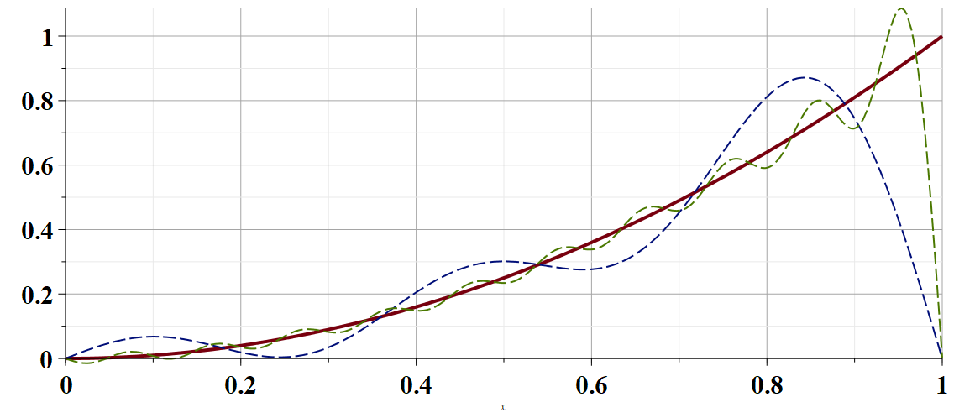
Convergence of the Fourier series
20 terms →
Example h(x)=x²
5 terms →
Notes:
Numerical evaluation of less convergent example.

Slide 12
From your question -- Does the number of terms in the summation for the Fourier series to converge depend on the type of function being analyzed?

Slide 13
Using Fourier series to solve the wave equation.
Notes:
Using Fourier methods to solve the wave equation.

Slide 14
Using Fourier series to solve the wave equation -- continued. The general solution can be formed by taking a linear combination of the eigenfunction results.
Notes:
Setting the boundary and initial conditions.

Slide 15
Using Fourier series to solve the wave equation -- continued. Finding the constants from the eigenfunction (Fourier) expansion.
Notes:
Determining the constants.

Slide 16
Are these two solutions
  Identical
  Equivalent
  Totally different
Notes:
Interesting question.

Slide 17
Fourier series and Fourier transforms are useful for solving and analyzing a wide variety of functions, also beyond the Sturm-Liouville context.
In the next several slides we will consider a related concept – the Laplace transform.
Notes:
We now consider another technique that is uses to solve initial value equations.

Slide 18
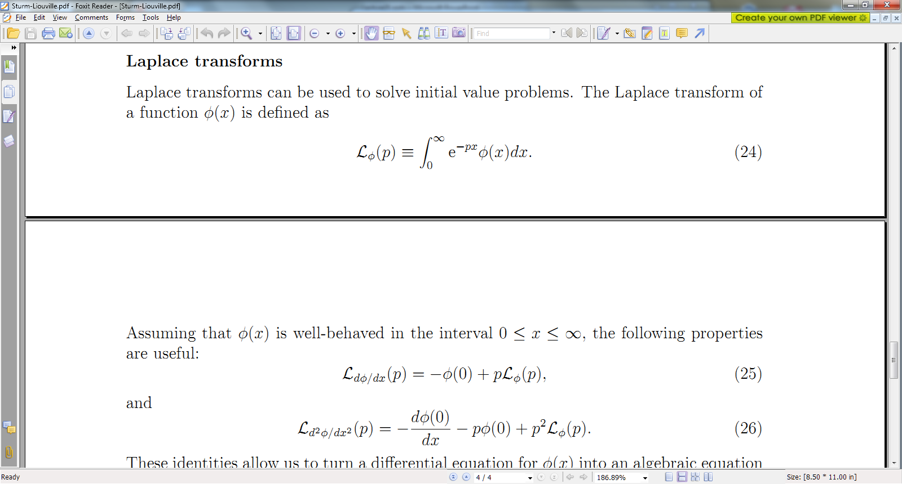
Notes:
A quick introduction to Laplace transform methods.

Slide 19
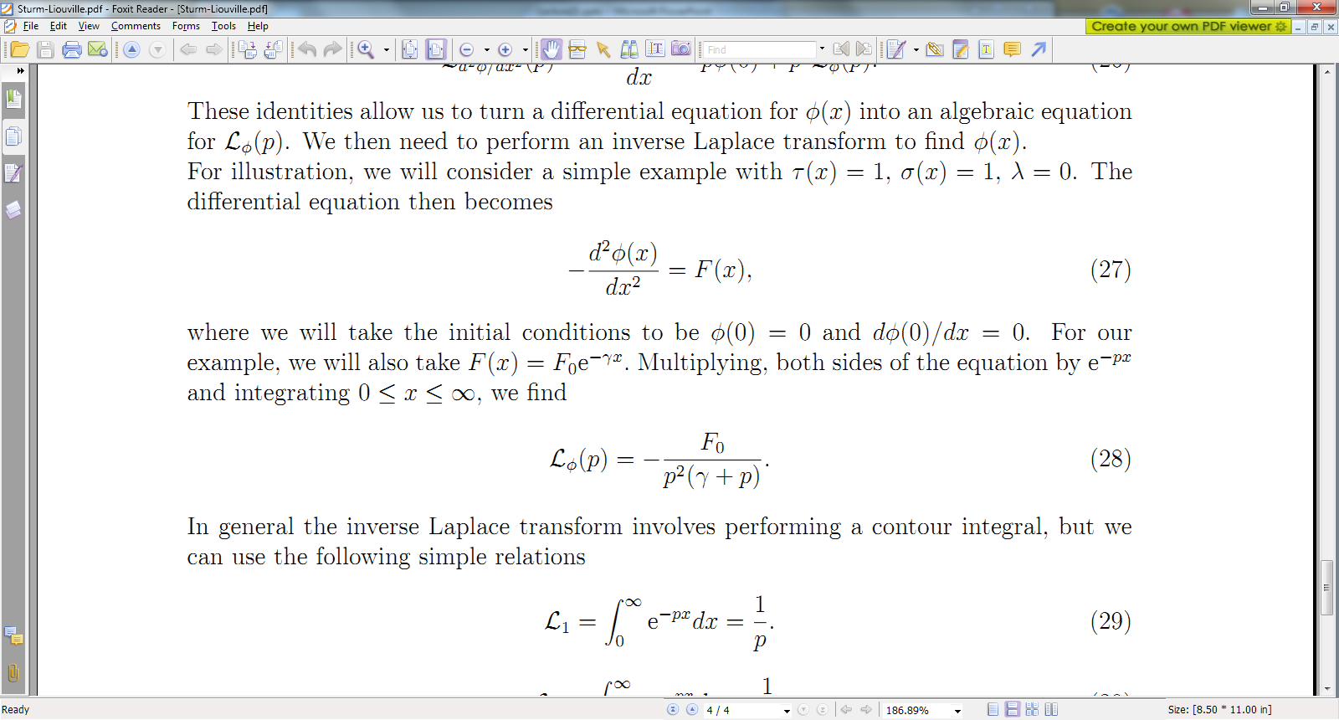
Notes:
An example.

Slide 20
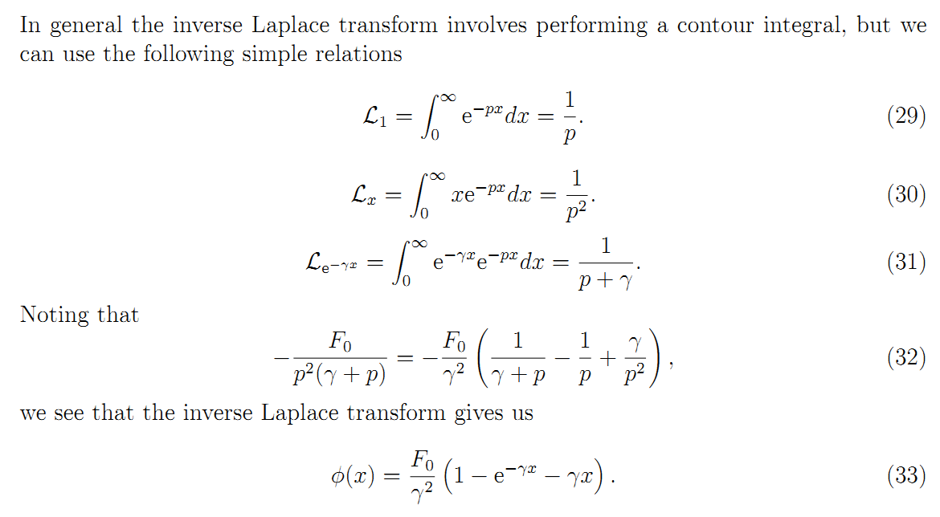
Notes:
Some details.

Slide 21
Does this result look familiar?
Yes
No
Notes:
More details.

Slide 22
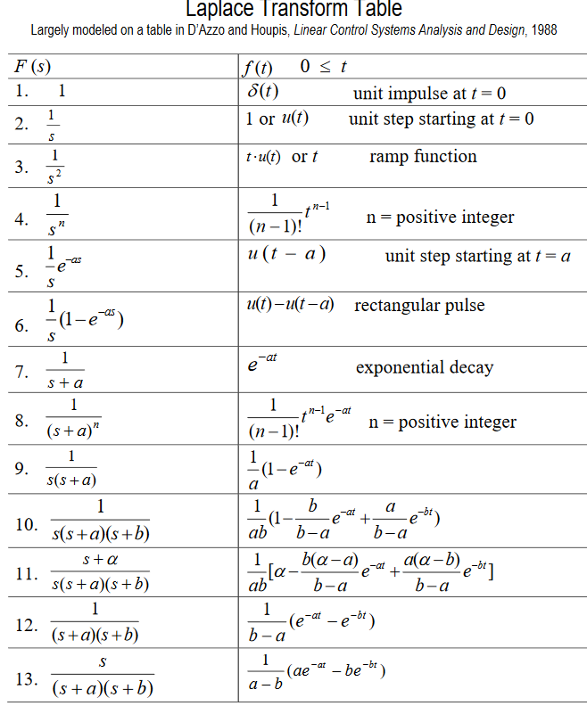
Table of Laplace transforms
https://www.dartmouth.edu/~sullivan/22files/New%20Laplace%20Transform%20Table.pdf
Notes:
Table of transforms for simple functions.

Slide 23
In order to evaluate these integrals, we need to use complex analysis.
Notes:
Mathematical treatment of general case.

Slide 24
Complex numbers
Functions of complex variables
Derivatives:
Cauchy-Riemann equations
Notes:
Introduction to properties of complex numbers.

Slide 25
Analytic function
Notes:
Notion of analytic function. Some of these functions are not analytic.

Slide 26
Some details
Notes:
Some details. To be continued.

