Slide 1
PHY 711 Classical Mechanics and Mathematical Methods
10-10:50 AM MWF in Olin 103
Notes for Lecture 23: Chap. 7
& App. A-D (F&W)
    Generalization of the one dimensional wave equation ➔ various mathematical problems and techniques including:
            Fourier transforms
            Laplace transforms
            Complex variables
            Contour integrals
Notes:
In this lecture, we will focus on the mathematics of complex variables.

Slide 2
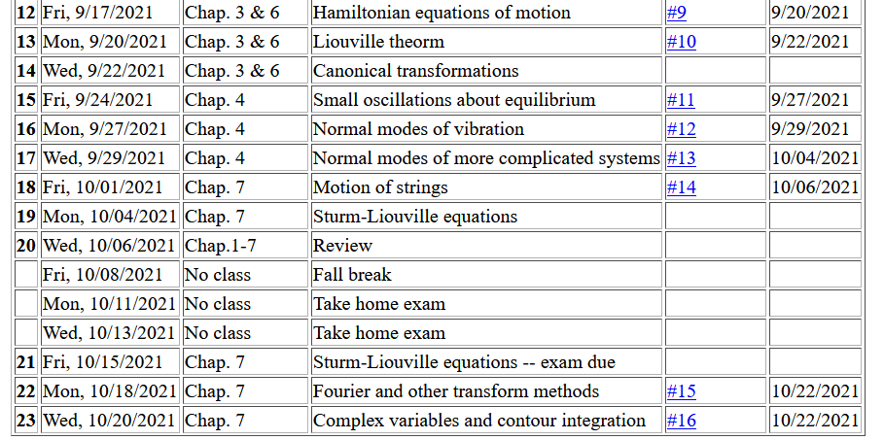
Notes:
No new homework while working on mid term exam.

Slide 3
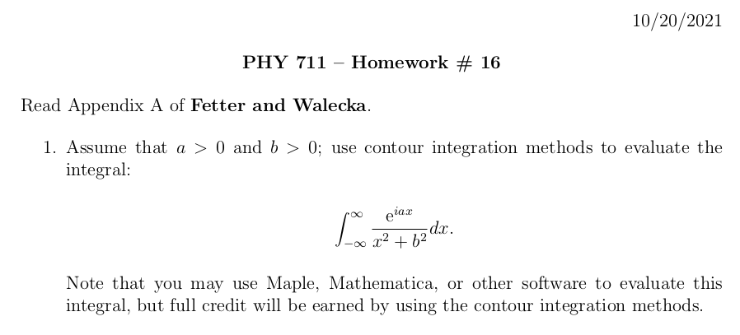

Slide 4
Schedule for Thursday 10/21/2021 --
ZSR auditorium and via zoom
(reception following defense ~ 11:15 AM in Olin Lobby)
4 PM in Olin 101 and via zoom
(reception prior to colloquium at 3:30 PM in Olin Lobby)

Slide 5
Introduction to complex variables
  Basic properties
  Notion of an analytic complex function
  Cauchy integral theory
  Analytic functions and functions with poles
  Evaluating integrals of functions in the complex plane
Notes:
We will review/introduce the basic ideas associated with complex variables.

Slide 6
Complex numbers
Functions of complex variables
Derivatives:
Cauchy-Riemann equations
Notes:
First we consider the basic definitions and representations of a complex number. Then we consider a function of complex numbers. The Cauchy relationships follow from the notion that a function that is differentiable in the complex plane must have consistent partial derivatives along the real and imaginary axes.

Slide 7

Analytic function
Examples of analytic functions
Notes:
Notion of an analytic function and an example that satisfies the conditions.

Slide 8
Examples of non-analytic functions
Notes:
Examples of non-analytic functions. Special property of contour integrals about a function with a simple “pole”.

Slide 9
Integration does not include z_{p}
Integration does include z_{p}

Slide 10
No contribution
C
Notes:
Contributions to a closed contour from various contributions.

Slide 11
In the following examples m=1
Notes:
Residue theorem

Slide 12
Example:
Im(z)
Re(z)
Note:
m=1
Notes:
Example of a contour integral using the residue theorem.

Slide 13
Some details:
Question – Could we have chosen the contour in the lower half plane?
  a. Yes b. No
Notes:
Some details.

Slide 14
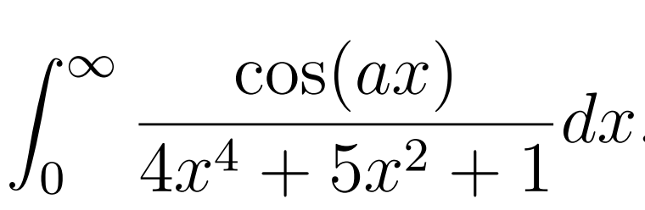
Another example:
Note:
m=1
Im(z)
Re(z)
Notes:
Another example.

Slide 15
Question – Could we have chosen the contour in the lower half plane?
  a. Yes b. No
Notes:
Some details.

Slide 16
Another example:
Im(z)
ia
Re(z)
10/30/2017
PHY 711 Fall 2017 -- Lecture 25
16
Notes:
Another example

Slide 17
Notes:
More details.

Slide 18
Im(z)
Re(z)

Slide 19
Notes:
Another example from the Drude model.

Slide 20
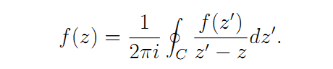
Cauchy integral theorem for analytic function f(z):
Notes:
Another useful theorem from Cauchy.

Slide 21
Example
Im(z)
Re(z)
Notes:
Considering real and imaginary parts.

Slide 22
Example -- continued
Im(z)
Re(z)
Notes:
Real and imaginary parts for Cauchy’s integral relation.

Slide 23
Example -- continued
Im(z’)
x
Re(z’)
Notes:
Detail of how to evaluate the point x=x’ in terms of the principal parts integral.

Slide 24
Im(z’)
x
Re(z’)
Notes:
Some details.

Slide 25
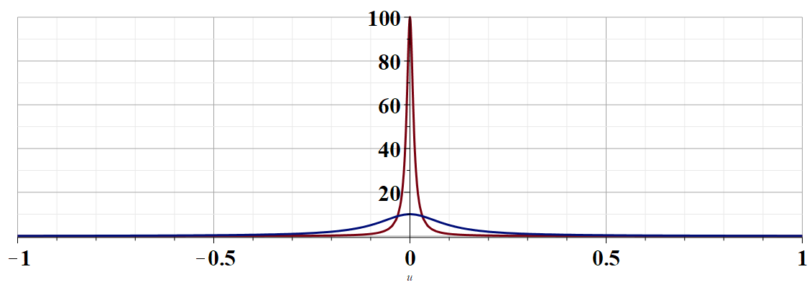
More details --
u
Notes:
Justification of the delta function result.

Slide 26
Example -- continued
Kramers-Kronig relationships
Notes:
Final result relating real and imaginary parts of complex function.

Slide 27
Comment on evaluating principal parts integrals
y’
x’
Notes:
Some details.

Slide 28
b(x’)
-2L
-L
L
2L
x’
Notes:
Simple example for complex function.

Slide 29
Notes:
For given imaginary function, this is the form of the real function.

Slide 30
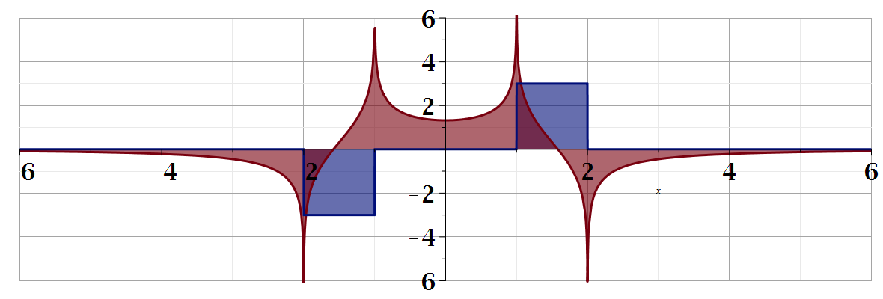
For our example:
b(x)
a(x)
Notes:
Summary of results.

Slide 31
Summary
?
Notes:
Summary.

Slide 32
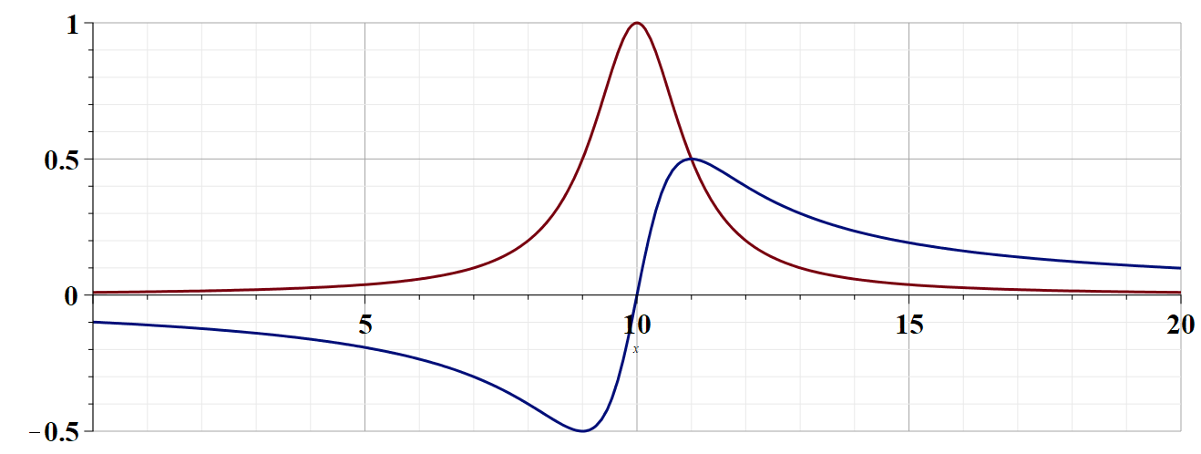

Slide 33
Continued:

