Slide 1
PHY 711 Classical Mechanics and Mathematical Methods
10-10:50 AM MWF in Olin 103
Discussion for Lecture 27 – Chap. 9 in F & W
    Introduction to hydrodynamics
      Motivation for topic
      Newton’s laws for fluids
      Conservation relations
Notes:
In this lecture we will begin an introductory treatment of the mechanics of fluis.

Slide 2
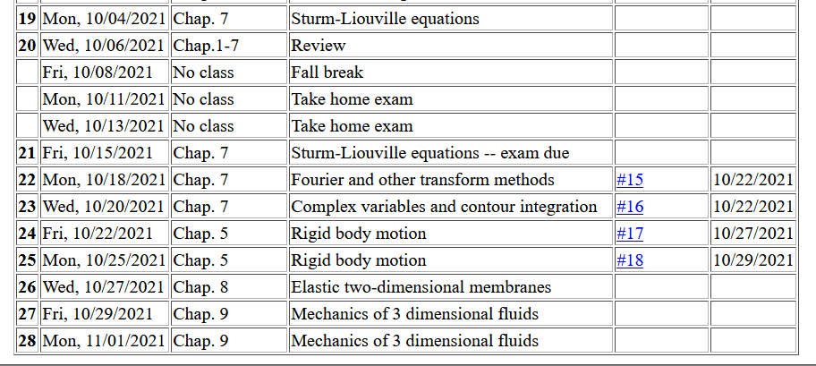

Slide 3
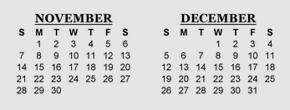
Now is a good time to start thinking about your projects --
bb
1 2 3 4
Presentations?
Last day of class
Take home final
Presentations?

Slide 4
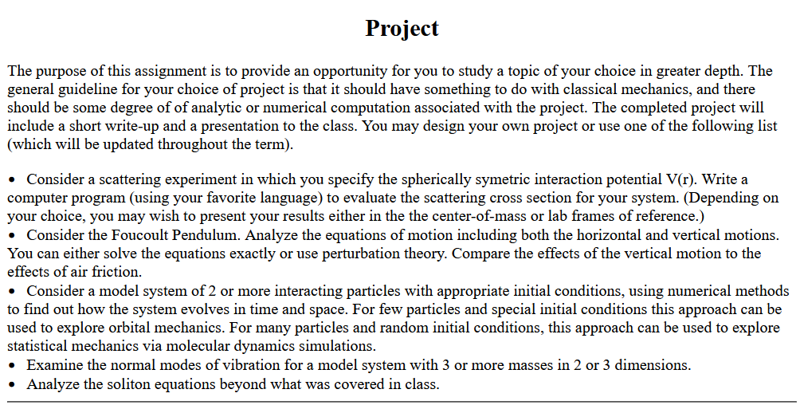

Slide 5
Hydrodynamic analysis
Motivation
  Natural progression from strings, membranes, fluids; description of 1, 2, and 3 dimensional continua
  Interesting and technologically important phenomena associated with fluids
Plan
  Newton’s laws for fluids
  Continuity equation
  Stress tensor
  Energy relations
  Bernoulli’s theorem
  Various examples
  Sound waves
Notes:
Here is a list of topics that will be covered in the next few lectures.

Slide 6
Newton’s equations for fluids
  Use Euler formulation; following “particles” of fluid
Notes:
Newton’s laws need to be adapted to describe the physics of fluids. Here pressure is important and more generally, the functions used to describe fluids depend on position and time.

Slide 7
p(x)
p(x+dx)
Notes:
Pressure acts in all directions. Here we argue that the spatial derivative of the pressure applies a force to a volume of fluid.

Slide 8
Newton’s equations for fluids -- continued
Notes:
It is convenient to write Newton’s law in terms of the mass density, velocity, and pressure of the fluid.

Slide 9
Notes:
Because of the continuous nature of the velocity, the total time derivative of the fluid velocity depends both or the partial derivates with respect to space and with respect to time as derived here.

Slide 10
Newton’s equations for fluids -- continued
Notes:
Some alternative expressions for the velocity terms.

Slide 11
Your question – What is irrotational flow?

Slide 12
Solution of Euler’s equation for fluids
Notes:
The restricted equations have some interesting properties.

Slide 13
Bernoulli’s integral of Euler’s equation for irrotational and incompressible fluid
Notes:
This result is known as Bernoulli’s equation

Slide 14
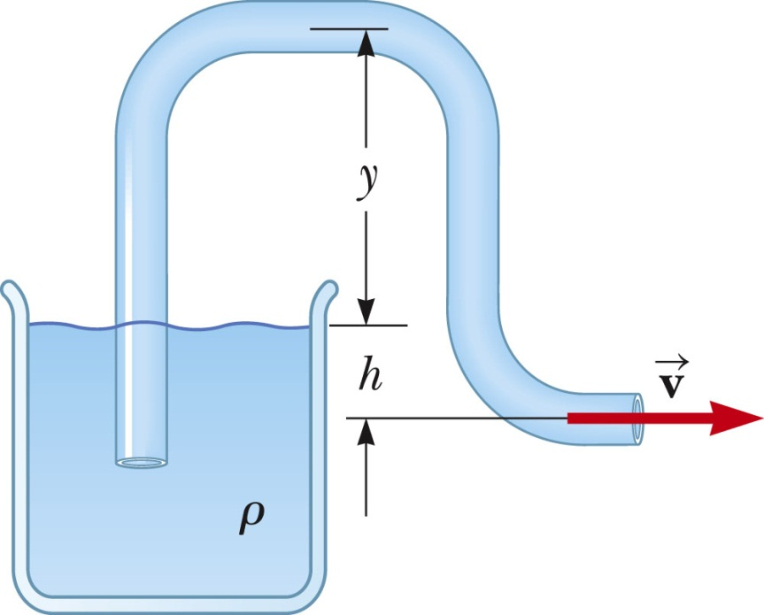
Examples of Bernoulli’s theorem
1
2
Notes:
This is a problem illustrating Bernoulli’s equation as a syphon.

Slide 15
Examples of Bernoulli’s theorem -- continued
1
2
Notes:
This example is taken from the PHY 114 textbook

Slide 16
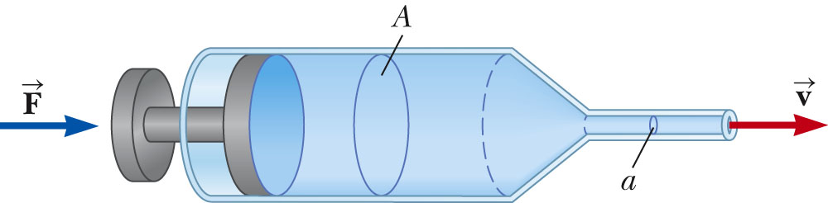
Examples of Bernoulli’s theorem -- continued
2
1
Notes:
Another ezample of Bernoulli’s equation for a syringe.

Slide 17
Examples of Bernoulli’s theorem -- continued
2
1
Notes:
Syringe fluid continued.

Slide 18
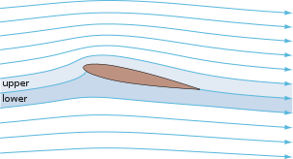
Examples of Bernoulli’s theorem – continued
Approximate explanation of airplane lift
Cross section view of airplane wing
http://en.wikipedia.org/wiki/Lift_%28force%29
1
2
Notes:
This example of Bernoulli’s equation is oversimplified. It appeared in most of the old textbook, but seems now to be deemphasized. It is given here since it shows some aspects of fluid flow, although apparently not good enough.

Slide 19
Your question -- What aspects do over simplified Bernoulli's equation not include in studying fluid dynamics?
According to a Scientific American article, the conclusion that v₂>v₁ because of the shape of the airplane wing is not quite true. Numerical modeling reveal a more complicated picture.
https://www.scientificamerican.com/article/no-one-can-explain-why-planes-stay-in-the-air/

Slide 20
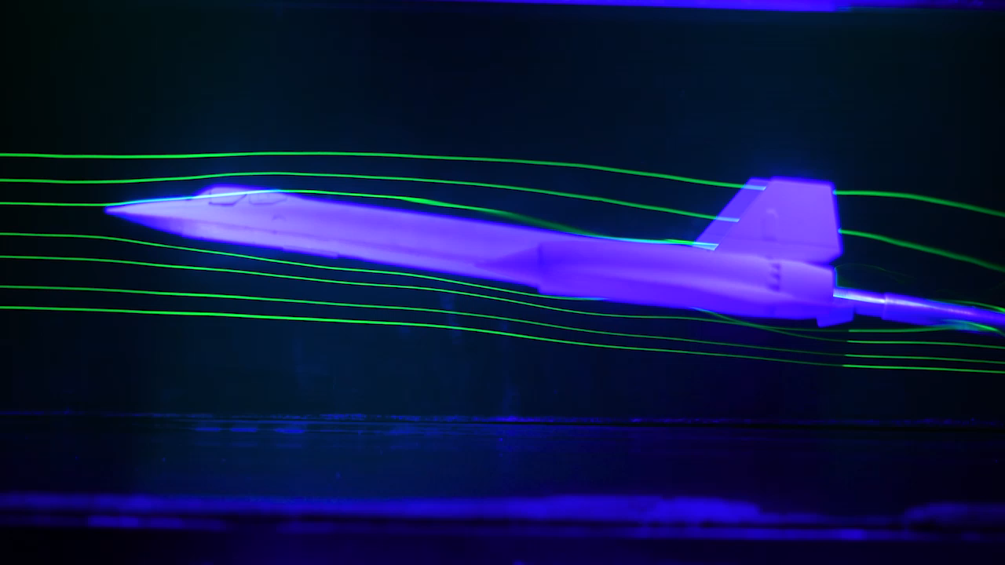
At NASA Ames Fluid Mechanics Laboratory, streamlines of dye in a water channel interact with a model airplane. Credit: Ian Allen
(copied from Scientific American page mentioned above).

Slide 21
Continuity equation connecting fluid density and velocity:
Notes:
The continuity equation is an important aspect of fluid flow.

Slide 22
Some details on the velocity potential
Notes:
For an incompressible and irrotational fluid, it is mathematically convenient to express the velocity field in terms of a velocity potential field.

Slide 23
Example – uniform flow
b
a
z
Notes:
For a uniformly fluid flowing along the z direction, the velocity potential and velocity field are easily written as shown.

Slide 24
Example – flow around a long cylinder (oriented in the Y direction)
^
X
^
v₀ Z
r=a
^
θ
v₀ Z
^
Z
Notes:
Now consider the uniform fluid in the presence of an impediment. In the is case we consider a cylindrical log.

Slide 25
Notes:
We need to consider solutions of the Laplace equation.

Slide 26
Notes:
Particular equations for this geometry and the application of the boundary values.

Slide 27
to be continued …
Notes:
More details.

