Slide 1
PHY 711 Classical Mechanics and Mathematical Methods
10-10:50 AM MWF in Olin 103
Notes on Lecture 28 -- Chap. 9 in F & W
    Introduction to hydrodynamics
      Newton’s laws for fluids and the continuity equation
      Irrotational and incompressible fluids
      Irrotational and isentropic fluids
      Approximate solutions in the linear limit – next time
Notes:
In this lecture, we will continue our discussion of hydrodynamics which is presented in Chapter 9 of your textbook.

Slide 2
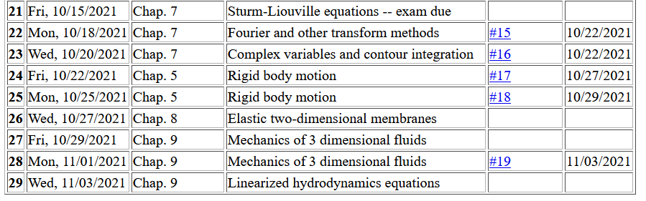
Notes:
Homework 18 is due Friday.

Slide 3
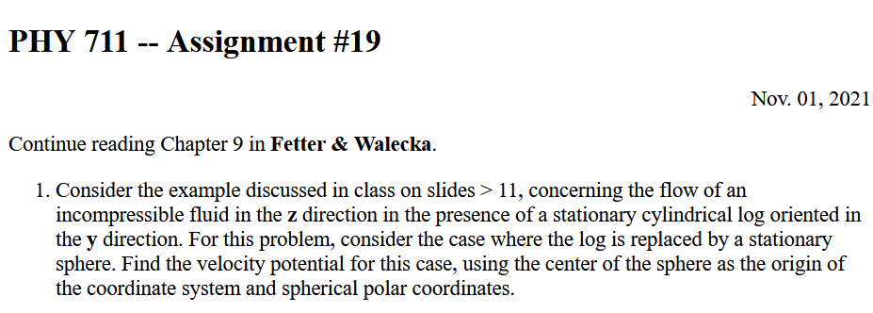

Slide 4
Newton’s equations for fluids
  Use Euler formulation; properties described in terms of
  stationary spatial grid
t’
t
Notes:
Resuming our discussion of Newton’s equations for fluids. For reference, this approach is named for Euler and is based on the continuous fluid being represented within an infinitesimal volume.

Slide 5
Euler analysis -- continued
It can be shown that:
Notes:
While the infinitesimal volume moves from t to t’, the spatial position moves from r to r+v δt

Slide 8
The notion of the continuity is a common feature of continuous closed systems. Here we assume that there are no mechanisms for creation or destruction of the fluid.

Slide 9
velocity potential
Notes:
Another aspect of the fluid is the continuity equation. This simplifies to a velocity field which has zero divergence.
For irrotational flow the velocity field has zero curl and therefore can be written in terms of the velocity potential. Irrotational flow of an incompressible fluid satisfies the Laplace equation.

Slide 10
Checking --

Slide 11
Example – uniform flow
b
a
z
Notes:
Consider an example of irrotational flow of an incompressible fluid. In this case the fluid is flowing uniformly along the z axis.

Slide 12
Example – flow around a long cylinder (oriented in the Y direction)
^
X
^
v₀ Z
r=a
^
θ
v₀ Z
^
Z
Notes:
Now imagine the there is a log that distorts the flow. Here the long axis of the log is in the direction perpendicular to the screen. At the boundary of the log, the radial velocity is 0.

Slide 13
Notes:
Setting up and solving the boundary value problem.

Slide 14
Notes:
Some details.

Slide 15
^
X
^
v₀ Z
r=a
^
θ
v₀ Z
^
Z
Notes:
Full solution and simplified behavior far from the log.

Slide 16
Now consider the case of your homework problem --

Slide 17
Spherical system continued:
(Continue analysis for homework)

Slide 18
Solution of Euler’s equation for fluids
Notes:
Consider a more complicated situation where there is a pressure gradient and applied potential. Specializing to the case of irrotational flow and arriving at the Bernoulli equation.

Slide 19
For incompressible fluid
Bernoulli’s integral of Euler’s equation for constant ρ

Slide 20
Not all fluids are compressible, but with additional work we can consider fluids at constant entropy (no heat transfer).
Under what circumstances can there be no heat transfer?

Slide 21
Solution of Euler’s equation for fluids -- isentropic
Notes:
Now consider generalizing this result to a possibly compressible fluid under the condition of zero heat transfer (isentropic).

Slide 22
Solution of Euler’s equation for fluids – isentropic (continued)
Notes:
Here we need to introduce the so called first law of thermodynamics. This condition finds a general expression for ratio of the pressure and density in terms of the density derivative of the internal energy density.

Slide 23
Solution of Euler’s equation for fluids – isentropic (continued)
Is this useful?
a. Yes
b. No
Notes:
This can be rearranged in terms of the gradient of the pressure divided by the density.

Slide 24
Solution of Euler’s equation for fluids – isentropic (continued)
Notes:
Finally we arrive at a Bernoulli relation for irrotational flow of an isentropic material.

Slide 25
Summary of Bernoulli’s results
For incompressible fluid
For isentropic fluid with internal energy density ε
Here ε is the internal energy of the fluid per unit mass. For an ideal gas fluid, it has a relatively simple form.
Notes:
Summary of results.

