Slide 1
PHY 711 Classical Mechanics and Mathematical Methods
10-10:50 AM MWF in Olin 103
Discussion for Lecture 29 -- Chap. 9 in F & W
    Introduction to hydrodynamics
      Newton’s laws for fluids and the continuity equation
      Approximate solutions in the linear limit
Notes:
In this lecture, we will continue our discussion of hydrodynamics which is presented in Chapter 9 of your textbook. The focus will be on treating the equations in the linear regime.

Slide 2

4 PM Olin 101

Slide 3
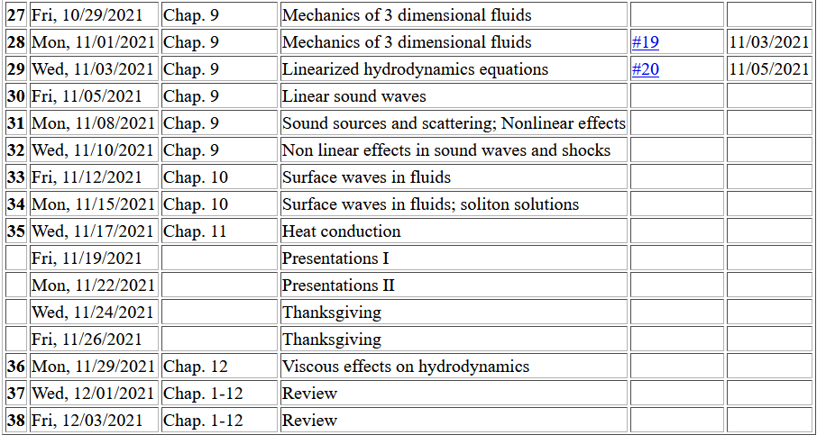
Tentative schedule --
Notes:
Updated schedule

Slide 4
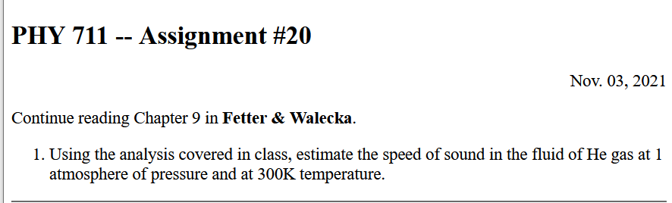

Slide 5

Question about Spring 2022 schedule –
Current schedule –
PHY 712 Electrodynamics 10-10:50 MWF
PHY 742 Quantum II 12-12:50 MWF
Proposed new schedule –
PHY 712 Electrodynamics 11- 11:50 MWF
PHY 742 Quantum II 12-12:50 MWF

Slide 6
Recall the basic equations of hydrodynamics
+ relationships among the variables due to principles of thermodynamics due to the particular fluid (In fact, we will focus on an ideal gas.)
Notes:
Review of the basic equations of hydrodynamics.

Slide 7
Solution of Euler’s equation for fluids -- isentropic
Additional relationships among the variables apply, depending on the fluid material and on thermodynamics
At the moment we are interested in the case where there is no heat exchange.
Here W == work
V == volume

Slide 8
Solution of Euler’s equation for fluids – isentropic (continued)
Internal energy per unit mass

Slide 9
Solution of Euler’s equation for fluids – isentropic (continued)
Note: Under conditions of constant entropy, we assume e can be expressed in terms of the density alone.

Slide 10
Solution of Euler’s equation for fluids – isentropic (continued)
if
➔
For isentropic irrotation fluid.

Slide 11
Summary: For isentropic and irrotational fluid with internal energy per unit mass ε:
Here ε is the internal energy of the fluid per unit mass. For an ideal gas fluid, it has a relatively simple form.

Slide 12
Now consider the fluid to be air near equilibrium
Notes:
Now consider air as the fluid near equilibrium with small fluctuations represented by the delta notation

Slide 13
Notes:
Coupled equations.

Slide 14
Notes:
Decoupling the equations in the velocity potential and the density fluctuation.

Slide 15
Notes:
The decoupled equation is a wave equation in the velocity potential, density fluctuation, and pressure fluctuation variables.

Slide 16
Analysis of wave velocity in an ideal gas:
Notes:
Estimating the wave velocity for air assuming that it is an ideal gas.

Slide 17
Notes:
Using the ideal gas law with f representing the degrees of freedom. It is convenient to replace the f with the gamma factor which can be measured experimentally.

Slide 18
Digression
 | f | γ
Spherical atom | 3 | 1.66667
Diatomic molecule | 5 | 1.40000

Slide 19
Notes:
Using the ideal gas law under isentropic conditions to derive the speed of sound.

Slide 20
Analysis of wave velocity in an ideal gas:
Notes:
Another analysis of the speed of sound.

Slide 21
Notes:
Some details of the analysis reveal that beyond the linear approximation, the velocity of sound is highly non-linear.

Slide 22
Summary of linearized hydrodynamic equations for isentropic fluid

