Slide 1
PHY 711 Classical Mechanics and Mathematical Methods
10-10:50 AM MWF in Olin 103
Lecture 2
Two particle interactions
and scattering theory
Notes:
In this lecture, we will review the basic physics of two interacting particles. When the particles are not in a bound orbit, their motion may be assessed in terms of scattering. Scattering is a very powerful analysis tool that often allows for the comparison of theory and experiment.

Slide 2

Schedule for weekly one-on-one meetings?
Wells – Thursday at 3:15 PM (OK for this week)
Owen – Office hours

Slide 3
Your questions –
b
From Owen –
1. For what different physical systems do the four two-particle interaction terms (V(r)) listed in the lecture notes apply?
2. Can a point particle have rotational energy? (More simply, can it rotate?)
3. Can classical scattering be used to analyze the internal structure of an object or does it require quantum mechanics? (For example, x-ray crystallography).
From Manikanta --
I have [questions] in the effective potential section. Its mentioned that centrifugal barrier is l^2/2mr^2, May I know more details of it ?
[What does the impact] parameter mean in assignment2.
bbb
From Can --
Question about details of quiz question #1.
From Ramesh –
1. We usually present an analogy between classical mechanics and quantum mechanics for any given phenomenon. In classical mechanics, the scattering results from the physical contact between two objects while in quantum mechanics the scattering is the result of the interaction of wavefunctions. To what extent, these classical scattering principles hold in quantum cases?

Slide 4
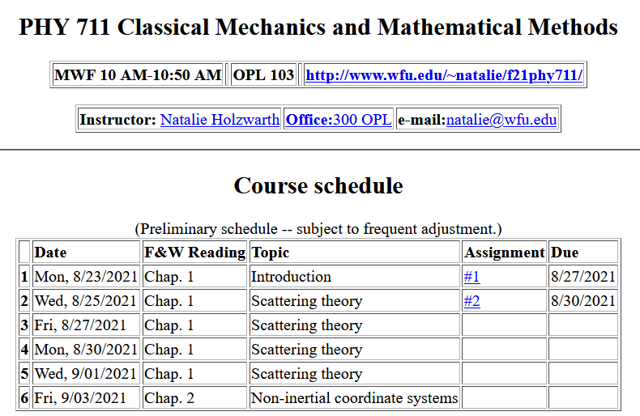
Notes:
This is an image of the webpage with the schedule and the homework assignment.

Slide 5
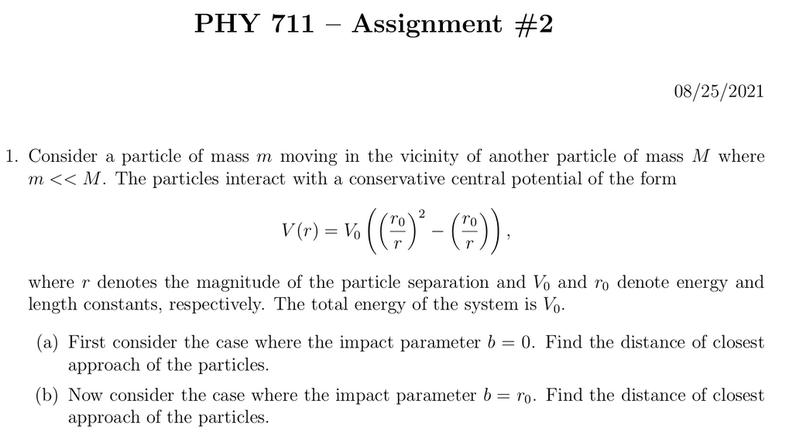
Notes:
This assignment reviews some of the basic concepts of conservative potentials, conservation of energy, and conservation of momentum. The potential form is not physically motivated, but the solutions can be determined by simple analysis, and the qualitative results are illustrative of the particle interactions.

Slide 6
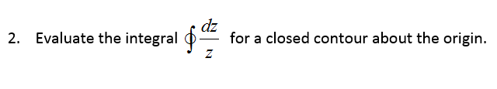
Comment on quiz questions
1.
3.
Notes:
These are solutions to the “assessment” exercise. It will help us figure out which mathematical methods should be usefully reviewed in this class. Most of you had particular trouble with the geometric series. It may be one of those things that you will want to remember to look up when you need it, rather than an important concept.

Slide 8
First consider fundamental picture of particle interactions
Classical mechanics of a conservative 2-particle system.
1
2
r₁
r₂
For this discussion, we will assume that V(r)=V(r) (a central potential).
Notes:
First consider the basic particle interactions which govern their motion.

Slide 9
Energy is conserved:
1
2
r₁
r₂
For a central potential V(r)=V(r), angular momentum is conserved.
For the moment we also make the simplifying assumption that m₂>>m₁ so that particle 1 dominates the motion.
Notes:
The last assumption is being made for convenience. We will consider the center of mass and relative motion much more carefully later.

Slide 10
Typical two-particle interactions –
Notes:
These represent typical particle interactions. Only the Coulomb or gravitational forms are precisely found in nature. The others serve as convenient models.

Slide 11
More details of two particle interaction potentials
This means that the interaction only depends on the distance between the particles and not on the angle between them. This would typically be true of the particles are infinitesimal points without any internal structure such as two infinitesimal charged particles or two infinitesimal masses separated by a distance r:
Example – Interaction between a proton and and an electron. Note we are treating the interactions with classical mechanics; in some cases, quantum effects are non-trivial.

Slide 12
Other examples of central potentials --
Example
Two marbles
Two Ar atoms
Note – not all systems are described by this form. Some counter examples:
  Molecules (internal degrees of freedom)
  Systems with more than two particles such as crystals

Slide 13
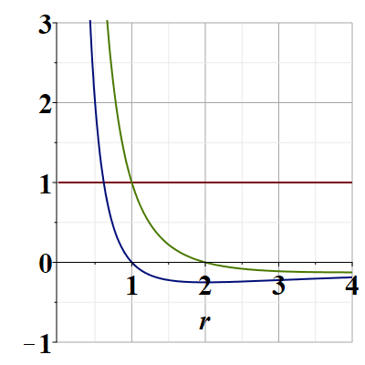
Representative plot of V(r)
V(r)
E/V₀
Note that particles are not bound; can reach infinite separation
Distances of closest approach
Notes:
Potential energy diagram showing important aspects of the particle trajectory.

Slide 14
Some more details --
r(t₁)
θ(t₁)

Slide 15
Comments continued --
V_{eff}(r)

Slide 16
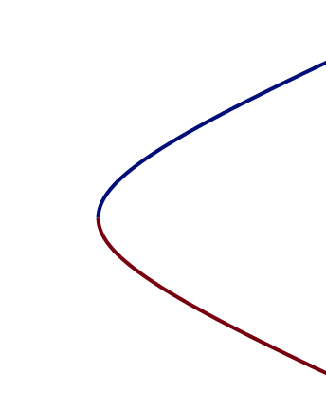
What is the impact parameter?
    Briefly, a convenient distance that depends on the conserved energy and angular momentum of the process.
b
b

Slide 17
Which of the following are true:
  The particle moves in a plane.
  For any interparticle potential the trajectory can be determined/calculated.
  Only for a few special interparticle potential forms can the trajectory be determined.
Why should we care about this?
  We shouldn’t really care.
  It is only of academic interest
  It is of academic interest but can be measured.
  Many experiments can be analyzed in terms of the particle trajectory.
Notes:
What do you think about these?

Slide 18
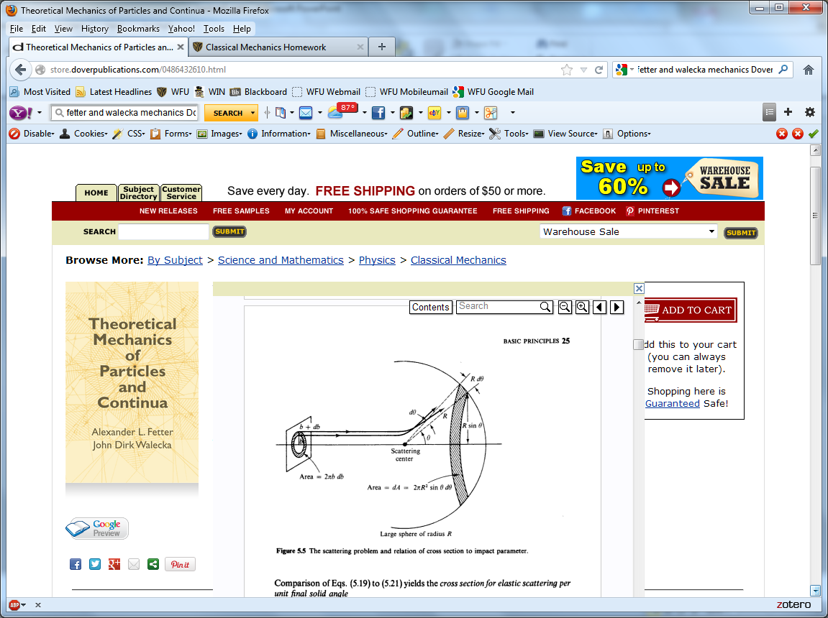
Scattering theory:
detector
Notes:
This is the ideal configuration of a scattering experiment.

Slide 19
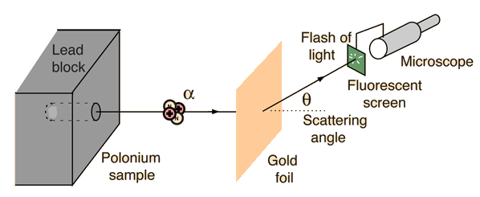
Example: Diagram of Rutherford scattering experiment
http://hyperphysics.phy-astr.gsu.edu/hbase/rutsca.html
Notes:
This illustrates the setup of the famous Rutherford scattering experiment.

Slide 20
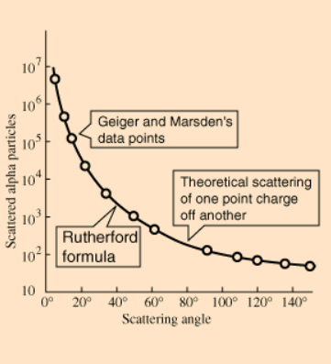
Graph of data from scattering experiment
From website: http://hyperphysics.phy-astr.gsu.edu/hbase/Nuclear/rutsca2.html
Notes:
Reconstruction experimental data from the Rutherford experiment.

Slide 21
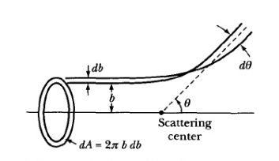
Standardization of scattering experiments --
Impact parameter: b
b
Figure from Marion & Thorton, Classical Dynamics
Notes:
Some details of scattering geometry and analysis.

Slide 22
Note: The notion of cross section is common to many areas of physics including classical mechanics, quantum mechanics, optics, etc. Only in the classical mechanics can we calculate it from a knowledge of the particle trajectory as it relates to the scattering geometry.
b
Figure from Marion & Thorton, Classical Dynamics
Note: We are assuming that the process is isotropic in ϕ
Notes:
More details.

Slide 23
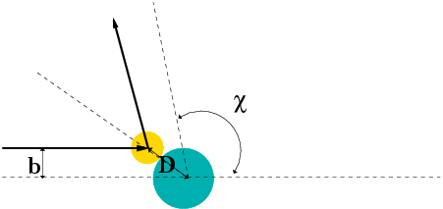
Simple example – collision of hard spheres having mutual radius D; very large target mass
Microscopic view:
Notes:
Illustration of the analysis for the scattering of a hard sphere on a massive hard sphere.

Slide 24
Simple example – collision of hard spheres -- continued
Hard sphere:
Notes:
Total cross section versus partical cross section.

Slide 25
More details of hard sphere scattering –
Hidden in the analysis are assumptions about the scattering process such as:
No external forces ➔ linear momentum is conserved
No dissipative phenomena ➔ energy is conserved
No torque on the system ➔ angular momentum is conserved
Target particle is much more massive than scattering particle
Other assumptions??
Note that for quantum mechanical hard spheres at low energy the total cross section is 4 times as large.
Notes:
Some questions and comments. The discussion of scattering theory will be continued next time.

