Slide 1
PHY 711 Classical Mechanics and Mathematical Methods
10-10:50 AM MWF in Olin 103
Discussion on Lecture 30 -- Chap. 9 of F&W
Wave equation for sound in linear approximation
Wave equations for sound
Plane wave solutions
Standing wave solutions
Notes:
In this lecture, we will consider some solutions to the linear sound wave equations.

Slide 2
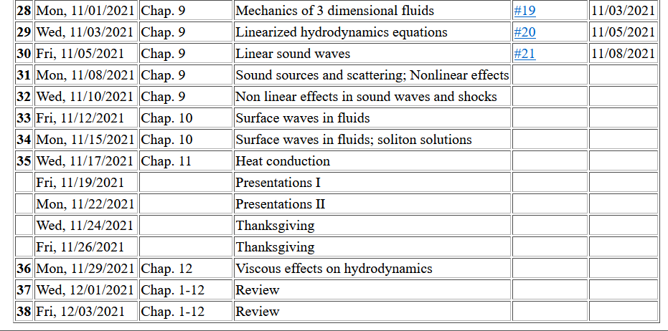
Tentative schedule --
No HW; work on “mini-projects”.
Notes:
Here is a tentative schedule for the next several weeks.

Slide 3
Notes:
Homework problem based on today’s lecture.

Slide 4
Your questions –
From Owen –
I have one question for class today. In a previous class, we saw a demonstration of a plate vibrating with sand on it. At different frequencies, the arrangement of the sand revealed the vibrational mode of the plate. These effects are present in many musical instruments, particularly stringed instruments which have their characteristic shape to take advantage of that effect. Must the vibrations of the solid container and the vibrations of the air within it (like in the slides) couple somehow?
Comment – Great question; we will try to have some demos about this a little later in the lecture.

Slide 5
Review –
Hydrodynamic equations for isentropic air + linearization about equilibrium → wave equation for air (sound waves)
Which of the following things correctly describe the wave equation for sound in air and the wave equation for elastic media?
The wave velocity is different for sound in air and waves in elastic media.
The wave motion in elastic media can be either transverse or longitudinal.
The wave motion for sound in air can be either transverse or longitudinal.

Slide 8
Notes:
Review of the equations we derived last time.

Slide 9
Solutions to wave equation:
Notes:
In general, we will be interested in time harmonic solutions to the wave equation, where omega denotes the pure frequency of the wave.

Slide 10
Time harmonic standing waves in a pipe
a
L
Notes:
For example, consider a pipe of length L and radius a. In this pipe, we are interested in the behavior of the air. Should you have such a piper at home, put your ear close to one end. What do you hear?

Slide 11
Notes:
Here we consider the equations of linear air within the paper. Cylindrical coordinates are the natural analysis tools for this case.

Slide 12
Notes:
The equation is separable in the radial, angular, z, and time variables. Because of the cylindrical geometry, the angular part takes the form of exp(I m phi), where m has to be an integer. We also are motivated to assume that the Z(z) function has a sinusoidal form with an unknown constant alpha. Finally, the equation for the radial equation now takes a familiar form.

Slide 13
Notes:
With certain assumptions, we can show that the radial solutions for the air motion, are Bessel functions of order m.

Slide 14
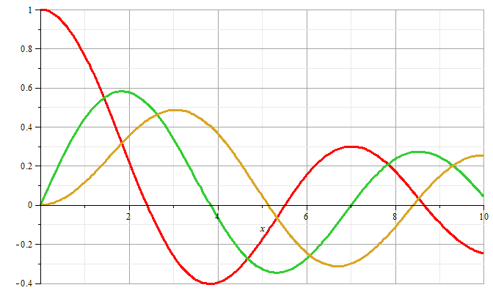
m=0
m=1
m=2
Notes:
Some plots of Bessel functions.

Slide 15
Now recall the boundary conditions
a
L
Notes:
Now consider the boundary conditions for the sound wave within the pipe, focusing on the radial direction.

Slide 16
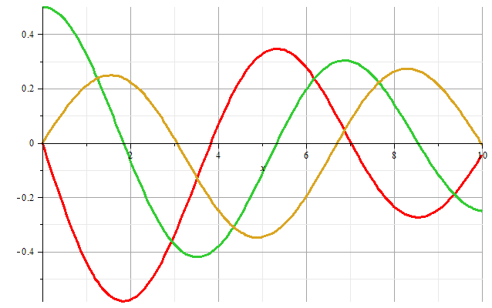
m=1
m=2
m=0
Zeros of derivatives: m=0: 0.00000, 3.83171, 7.01559
m=1: 1.84118, 5.33144, 8.53632
m=2: 3.05424, 6.70613, 9.96947
Notes:
Zeroes of the derivatives of Bessel functions.

Slide 17
Some details on the open pipe boundary conditions --
Comment --
1. Open pipe boundary condition
air in pipe
open ends in contact with atmospheric pressure

Slide 18
Boundary condition for z=0, z=L:
Notes:
We also need to consider the boundary conditions for the air motion in the z direction where the paper can be either open or closed. For the open, open pipe, we then find the resonant wavevectors.

Slide 19
Example
Notes:
More details.

Slide 20
Alternate boundary condition for z=0, z=L:
Notes:
Now consider other boundary conditions and their resonances.

Slide 21
The above analysis pertains to resonant air waves within a cylindrical pipe. As previously mentioned, you can hear these resonances if you put your ear close to such a pipe. The same phenomenon is the basis of several musical instruments such as organ pipes, recorders, flutes, clarinets, oboes, etc.
Question – what about a trumpet, trombone, French horn, etc?
a. Same idea?
b. Totally different?
But for musical instruments, you do not want to put your ear next to the device – additional considerations must apply. Basically, you want to couple these standing waves to produce traveling waves.

Slide 22
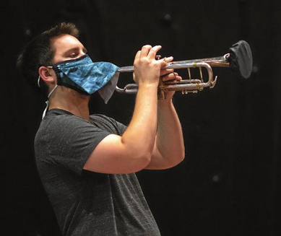
Modifications needed for the pandemic --
Image from the Winston-Salem Journal 11/1/2020

Slide 23
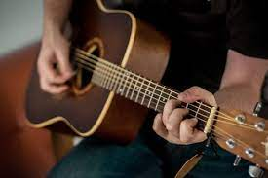
For other instruments, the resonance is initiated by another
resonant device which couples to air --

Slide 24
Simple model of a sound amplifier --
Wave equation with source:
z
y
x
Notes:
This is what we will consider on Monday.

