Slide 1
PHY 711 Classical Mechanics and Mathematical Methods
10-10:50 AM MWF in Olin 103
Notes on Lecture 31: Chap. 9 of F&W
    Wave equation for sound
      Linear approximation: sound generation
      Linear approximation: sound scattering
Notes:
In this lecture, we will consider traveling wave solutions to the linear sound wave equations and also consider non-linear effects.

Slide 2
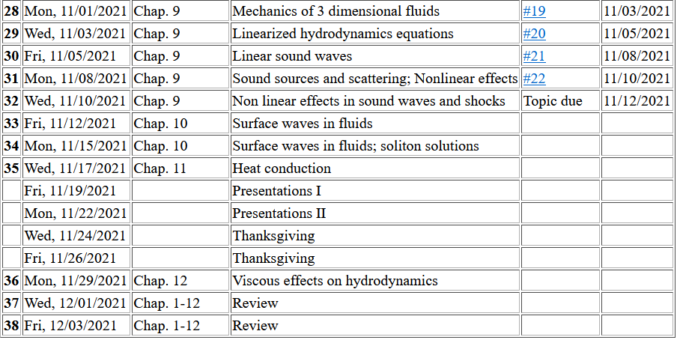
No HW; work on presentations
Notes:
Schedule.

Slide 3
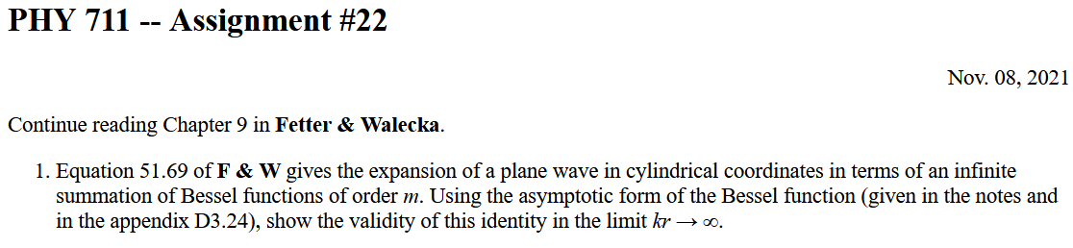

Slide 4
Comment about the units of sound frequency

Slide 5
Solutions to wave equation:
Notes:
Review wave equation and plane wave solutions.

Slide 6
Wave equation with source:
Notes:
Now think of wave equation with a source. The Green’s function is a very powerful tool for solving these problems. We will use similar techniques in solving the wave equation for electromagnetic waves.

Slide 7
Where does this force term come from?
In fact, in our example, the forcing term occurs at a boundary of our system and can be treated in terms of a boundary value.

Slide 8
Wave equation with source -- continued:
Notes:
Result that we will derive.

Slide 9
Derivation of Green’s function for wave equation
Notes:
First step of derivation using Fourier transform in the time domain.

Slide 10
Derivation of Green’s function for wave equation -- continued
Notes:
Spatial equation for Fourier amplitudes.

Slide 11
Derivation of Green’s function for wave equation -- continued
Notes:
Solution for isotropic system

Slide 12
Derivation of Green’s function for wave equation -- continued
Notes:
Isotropic solutions continued.

Slide 13
Derivation of Green’s function for wave equation – continued
need to find A and B.
Notes:
A special property of the Laplace operator.

Slide 14
Derivation of Green’s function for wave equation – continued
Notes:
Taking the inverse Fourier transform.

Slide 15
Derivation of Green’s function for wave equation – continued
Notes:
Details and final result.

Slide 16
➔In order to solve an inhomogenous wave equation with a time harmonic forcing or boundary term, we can use the corresponding Green’s function:
In fact, this Green’s function is appropriate for solving equations with boundary conditions at infinity. For solving problems with surface boundary conditions where we know the boundary values or their gradients, the Green’s function must be modified.
Notes:
It is convenient/important to use the Green’s function consistent with the boundary values of the particular system of interest.

Slide 17
Notes:
In order to motivate the use of Green’s functions, we consider the famous Green’s theorem. Note that these details/derivations will also be discussed when we consider mathematically similar situations for electrodynamic systems.

Slide 18
➔extra contributions from boundary
Notes:
Derivation continued.

Slide 19
Wave equation with source:
z
y
x
Notes:
Now consider a simplified model of a sound amplifier where the red cylinder moves up and down in the z direction at a particular frequency omega.

Slide 20
Treatment of boundary values for time-harmonic force:
Notes:
In this case, we need to use a modified Green’s function to satisfy the boundary condition at z=0.

Slide 21
Notes:
Some details.

Slide 22
Some details about the boundary values --
Note: The surface term is important when the analysis is performed in a confining volume. When the analysis involves an infinite volume and A vanishes at infinity, the surface term does not contribute.
A

Slide 23
Some more details --
Need this term to vanish at z’=0

Slide 24
Notes:
Changing to more convenient coordinates. Preparing to evaluate the expression far from the moving piston.

Slide 25
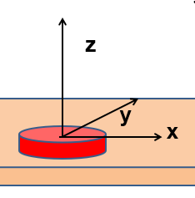
More details
r
θ

Slide 26
Notes:
Approximate solution continued. In this approximation, the integral can be evaluated in terms of Bessel functions.

Slide 27
Notes:
Estimating the power of the sound wave in this asymptotic regime.

Slide 28
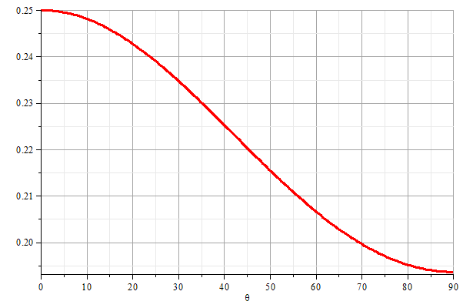
z
θ
y
x
Notes:
Graph of the power as a function of the polar angle theta.

Slide 29
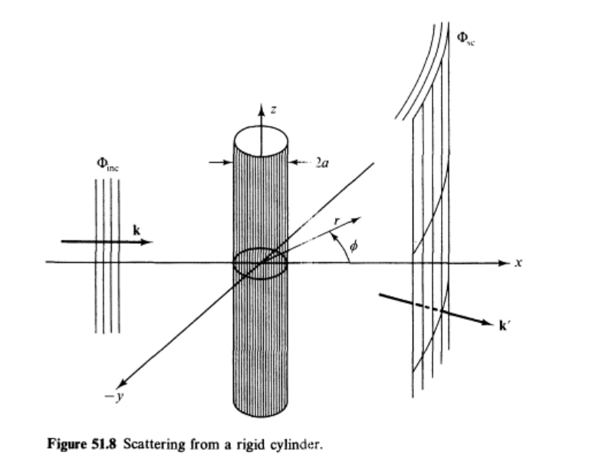
Scattering of sound waves –
for example, from a rigid cylinder
Figure from Fetter and Walecka pg. 337
Notes:
Now consider the case of a plane wave of sound, scattering off of a cylindrical object. Can you think of a physical situation for this model?

Slide 30
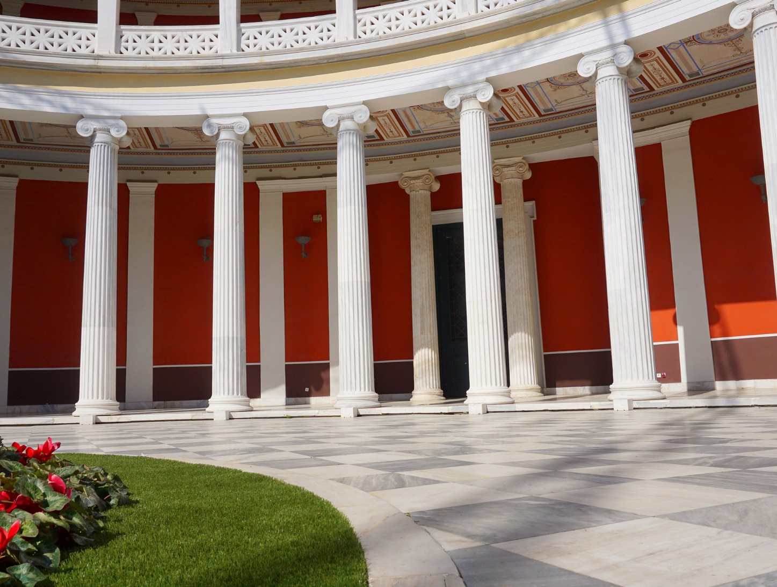
Example of cylindrical scattering objects --
Suppose a trumpeter is playing near the columns. Maximal scattering occurs when
a. Facing toward the column b. Facing away from the column.

Slide 31
Scattering of sound waves –
for example, from a rigid cylinder
Notes:
Analysis of the scattering wave using cylindrical coordinates.

Slide 32
Notes:
In this case we expect a cylindrical wave that can be represented in terms of Bessel and Neumann functions, or more conveniently in terms of Hankel functions H. Satisfying the boundary values on the surface of the scattering cylinder, we find the coefficients of the expression.

Slide 33
Notes:
Using the asymptotic form of the Hankel functions we can analyze the results further.

Slide 34
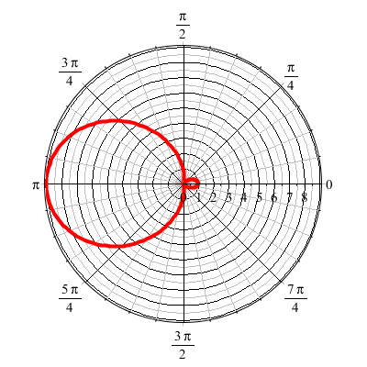
For ka << 1
Notes:
Defining the appropriate scattering cross section, we can analyze the results further. For ka<<1 (long wavelengths, low frequencies) we find that most of the sound is scattered backwards from the propagation direction.

