Slide 1
PHY 711 Classical Mechanics and Mathematical Methods
10-10:50 AM MWF in Olin 103
Notes on Lecture 32: Chap. 9 of F&W
    Non-linear effects
      Introduction to non-linear effects
      Analysis of instability – shock phenomena
Notes:
In this lecture, we will consider traveling wave solutions to the sound wave equations.

Slide 2
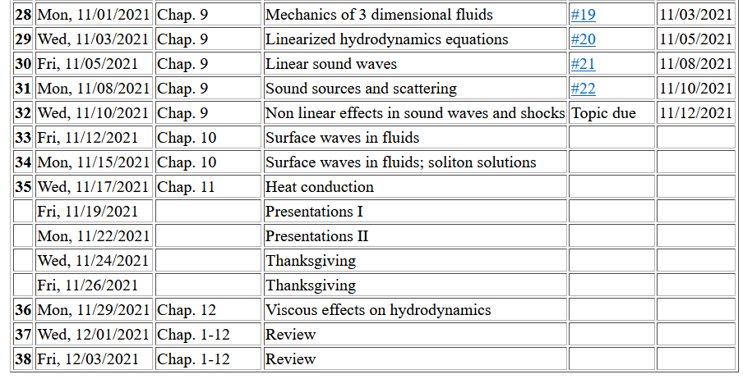
Notes:
Schedule.

Slide 3

4 PM Olin 101

Slide 4
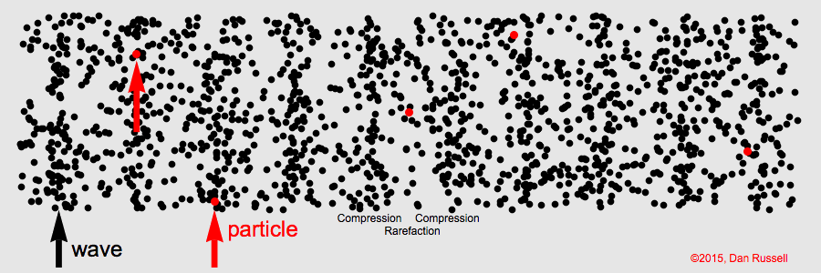
Visualization of longitudinal wave motion
From the website:
https://www.acs.psu.edu/drussell/Demos/waves/wavemotion.html
Now consider some non-linear effects

Slide 5
Effects of nonlinearities in fluid equations
-- one dimensional case
Notes:
Review of basic equations, specializing in one spatial dimension.

Slide 6
Notes:
Decoupling the variables.

Slide 7
Digression – What is gamma?

Slide 8
Notes:
More analysis.

Slide 9
Notes:
Further derivations.

Slide 10
Notes:
Using adiabatic relationships.

Slide 11
Notes:
Analysis of fluid velocity from a knowledge of the wave velocity.

Slide 12
Traveling wave solution:
Notes:
Analysis for a traveling wave.

Slide 13
Traveling wave solution -- continued:
Notes:
Checking the linear result

Slide 14
Some details

Slide 15
Traveling wave solution -- full non-linear case:
w
Notes:
Analysis of how to visualize the traveling wave solution.

Slide 16
Visualization continued:
Notes:
More details.

Slide 17
Summary
Notes:
Summary.

Slide 18
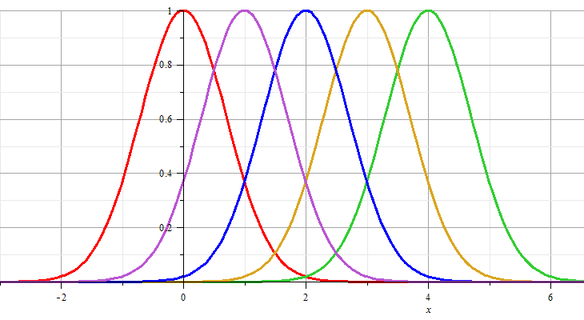
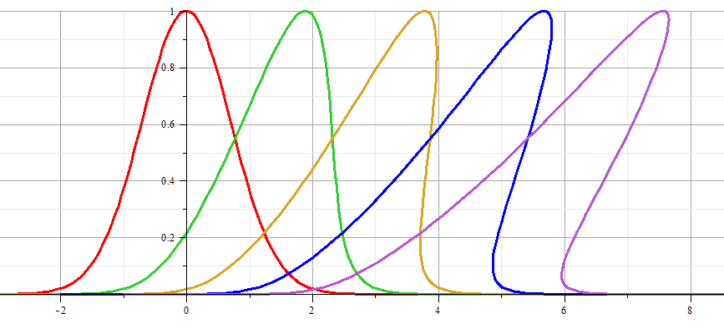
Linear wave:
Non-linear wave:
Notes:
Example visualization.

Slide 19
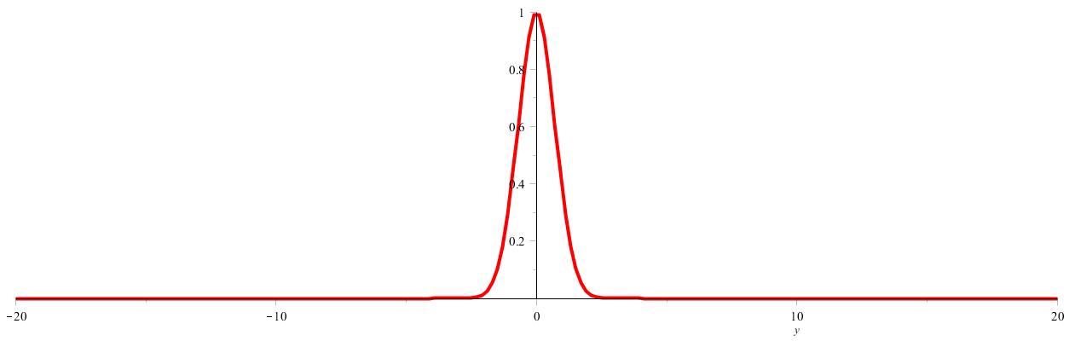
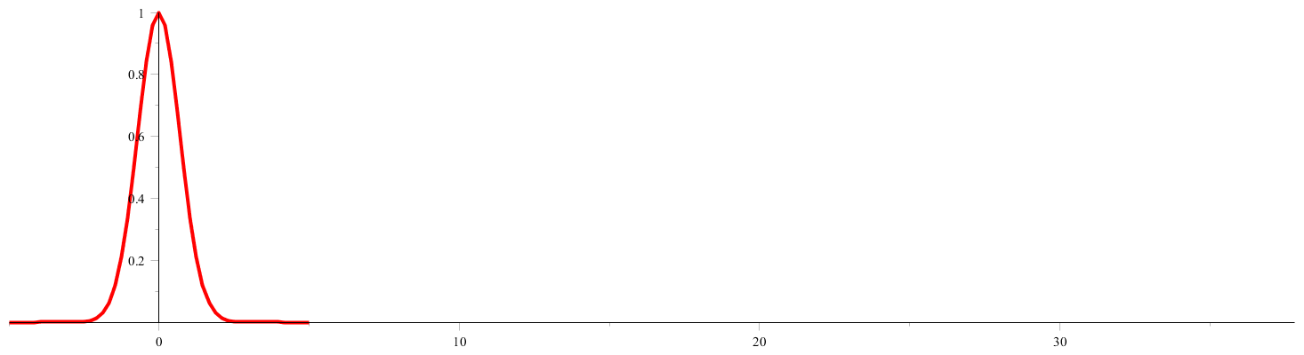
Linear wave
Non-linear wave
Notes:
Animations from Maple.

Slide 20
Analysis of shock wave
Plots of δρ
Solution becomes unphysical
shock
Notes:
Note that the vertical axis represents the longitudinal wave displacement. When this displacement becomes multivalued for a given coordinate x as shown, the solution becomes unphysical. At this point we need to consider the analysis in a different way.

Slide 21
Analysis of shock wave – assumed to moving at velocity u
After shock
t₂
δρ₂, δv₂, δp₂
Before shock
t₁
δρ₁, δv₁, δp₁
Shock front
x
u
Note that in this case u is assumed to be a given parameter of the system.
Notes:
Your textbook discusses the shock wave analysis. Here we assume that there is a region (blue) where the analysis fails, but assumes that we can properly analyze the physics before and after the shock. The notation given here is similar to that given in your text.

Slide 22
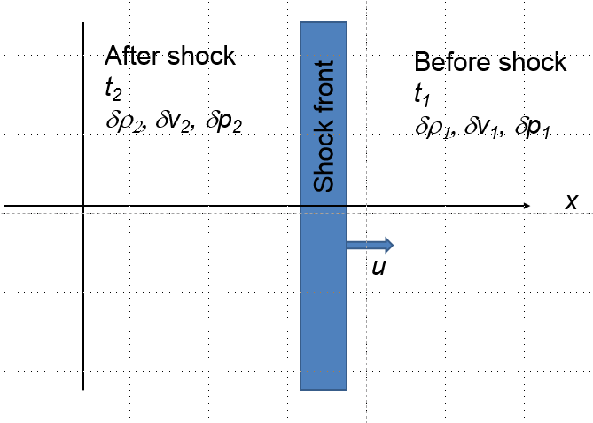
Analysis of shock wave – continued
  While analysis in the shock region is complicated, we can use conservation laws to analyze regions 1 and 2
Notes:
Some of the details of the analysis before and after the shock event.

Slide 23
Analysis of shock wave – continued
  While analysis in the shock region is complicated, we can use conservation laws to analyze regions 1 and 2
Notes:
Analyzing the equations.

Slide 24
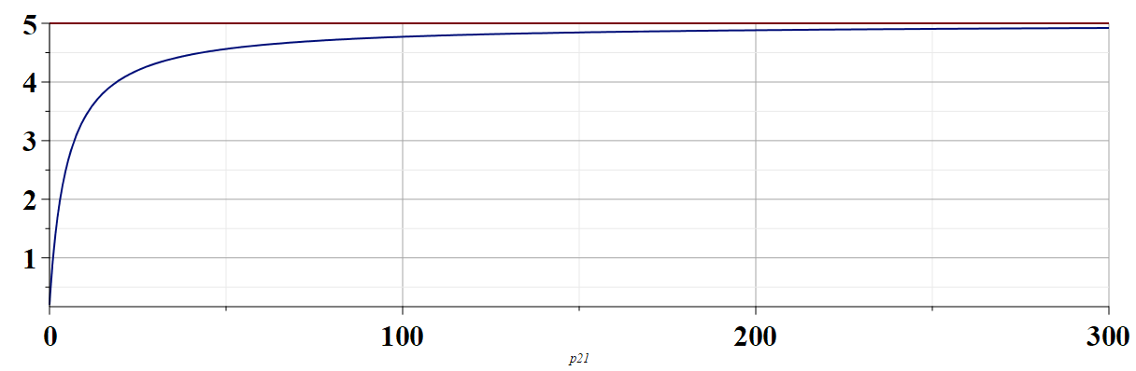
Analysis of shock wave – continued
  For adiabatic ideal gas, also considering energy and momentum conservation:
ρ₂/ρ₁
p₂/p₁
Notes:
Analyzing ratio of the density after and before the shock wave.

Slide 25
Analysis of shock wave – continued
  For adiabatic ideal gas, entropy considerations::
Notes:
Analyzing the entropy before and after the shock wave. In general, many more relationships can be analyzed. Consult your textbook for more details.

