Slide 1
PHY 711 Classical Mechanics and Mathematical Methods
10-10:50 AM MWF in Olin 103
Notes on Lecture 33:
    Chapter 10 in F & W: Surface waves
      Water waves in a channel
      Wave-like solutions; wave speed
Notes:
In today’s lecture we will investigate transverse waves at the surface of a channel of water.

Slide 2
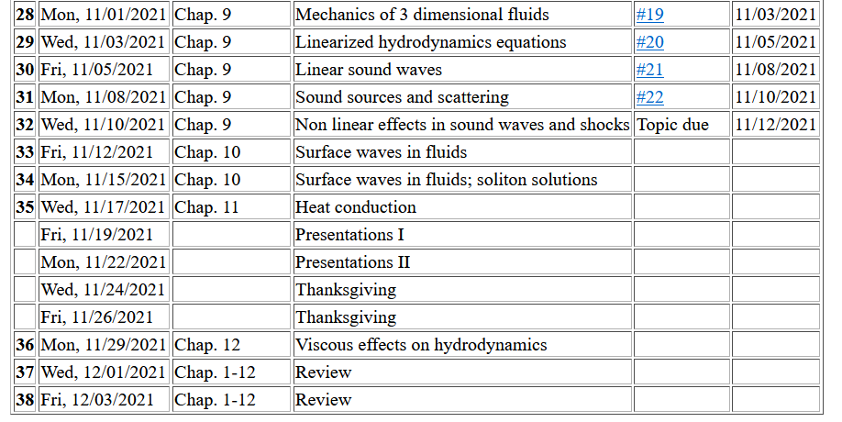
Notes:
Update to schedule including a homework dealing with today’s topic.

Slide 3

Reference: Chapter 10 of Fetter and Walecka
Physics of incompressible fluids and their surfaces

Slide 4
Consider a container of water with average height h and surface h+ζ(x,y,t); (h ⬅➔ z₀ on some of the slides)
p₀
ζ
z
h
y
x
Notes:
Defining the system and the notation.

Slide 5
Why do we not consider ρ_{air} in this analysis?
  Because it is a reasonable approximation
  Because it simplifies the analysis
  Both of the above

Slide 6
within the water
Notes:
Hydrodynamic equations for this case.

Slide 7
Consider a surface ζ(x,t) wave moving in the x-direction in a channel of width b(x) and height h(x):
ζ(x,t)
v(x,t)
v(x+dx,t)
h(x)
b(x)
dx
Notes:
Considering an increment along the propagation direction including the effects of the continuity equation.

Slide 8
Some details
ζ(x,t)
v(x,t)
v(x+dx,t)
h(x)
b(x)
dx
Here, we are assuming that ρ is constant

Slide 9
ζ(x,t)
v(x,t)
v(x+dx,t)
h(x)
b(x)
dx
Notes:
Some details for the homework problem which is a special case.

Slide 10
Example continued
Notes:
More details pertaining to the homework problem.

Slide 12
Example continued
Notes:
Continued.

Slide 13
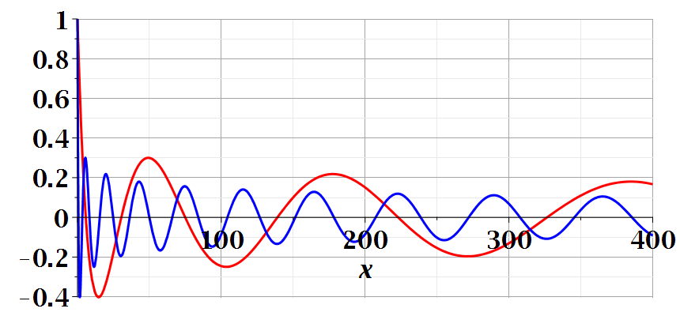
Notes:
Continued.

Slide 14

Imagine watching the waves at a beach – can you visualize the configuration for the surface wave pattern to approximation this situation?
  Long flat beach
  Beach in which average water level increases
  Beach in which average water level decreases

Slide 15
A simplier example:
ζ(x,t)
v(x,t)
v(x+dx,t)
h(x)
b(x)
dx
Special case, where b and h are constant --
Notes:
A simpler example.

Slide 16
Example with b and h constant -- continued
dζ(x,y,t)/dt
z₀
v(x,y,t)
v(x+dx,y+dy,t)
Notes:
Considering the surface height.

Slide 17
For uniform channel:
Notes:
For the simple case, we find the wave equation for the surface height. In the following slides, we will find a more complete solution depends on the wavelength the of surface wave.

Slide 18
More details: -- recall setup --
Consider a container of water with average height h and surface h+ζ(x,y,t)
p₀
ζ
z
h
y
x
Notes:
Some details for the more general case.

Slide 19
Equations describing fluid itself (without boundaries)
Notes:
Considering the case of irrotational flow.

Slide 20
p₀
ζ
z
h
y
x
(We have absorbed p₀ in “constant”)
Notes:
Considering the equations within the wave and at the surface.

Slide 21
Full equations:
(We have absorbed p₀ in “constant”)
Linearized equations:
Notes:
Taking the linear limit.

Slide 22
For simplicity, keep only linear terms and assume that horizontal variation is only along x:
Notes:
Solution for the linear equations.

Slide 23
For simplicity, keep only linear terms and assume that horizontal variation is only along x – continued:
Notes:
An expression for c.

Slide 24
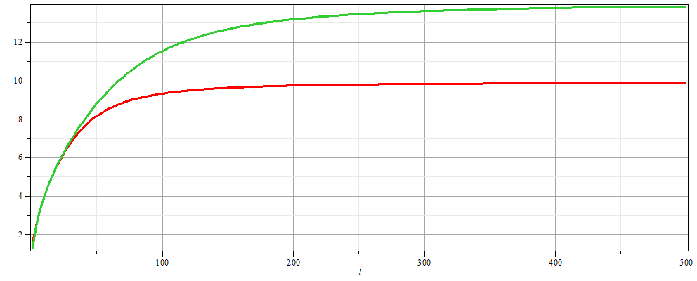
For simplicity, keep only linear terms and assume that horizontal variation is only along x – continued:
h=20 m
c
h=10 m
λ
Notes:
Evaluating c as a function of wavelength.

Slide 25
For simplicity, keep only linear terms and assume that horizontal variation is only along x – continued:
Notes:
Form of the surface wave form.

Slide 26
General problem
  including
  non-linearities
p₀
ζ
z
h
y
x
Notes:
Introducing the equations beyond the linear approximation that we will cover next time.

