Slide 1
PHY 711 Classical Mechanics and Mathematical Methods
10-10:50 AM MWF in Olin 103
Notes on Lecture 33:
Chapter 10 in F & W: Surface waves
Water waves in a channel
Wave-like solutions; wave speed
Notes:
In today’s lecture we will investigate transverse waves at the surface of a channel of water.

Slide 2
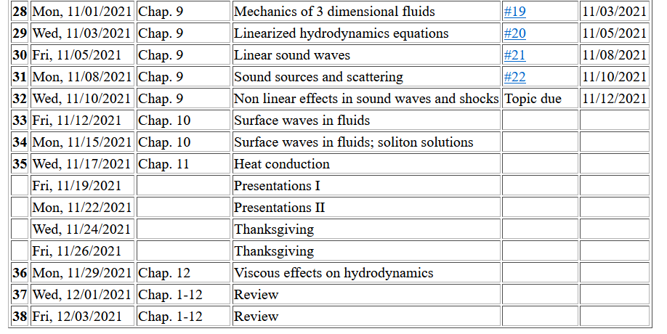
Notes:
Update to schedule including a homework dealing with today’s topic.

Slide 3
Comment on defunct HW 22 --

Slide 4
Your question –
From Owen –
How does the viscosity of the fluid tie into all of this? Is there some term or constant in the equations that represents it, or is it more complicated to model viscosity?
Comment – The generalization of the hydrodynamics equations that we have used so far, is the Navier-Stokes equation which is covered in Chapter 12 of your text book. This scheme inserts two viscosity parameters into the equations of motion with additional constraints to account for heat flow.

Slide 5
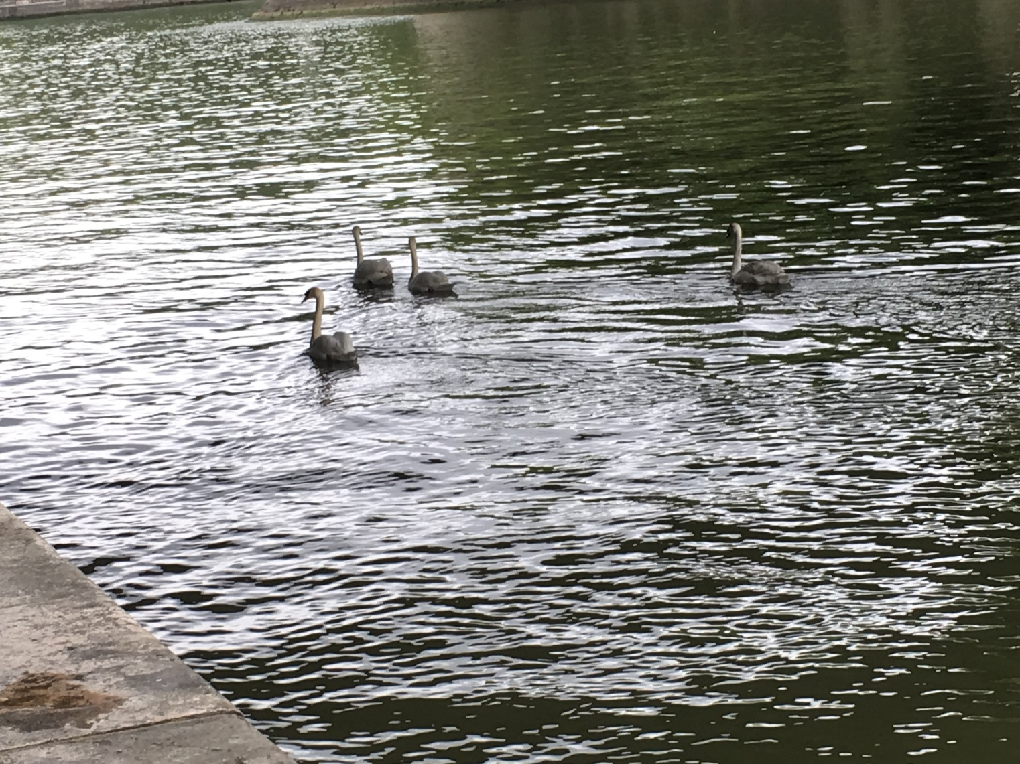
Reference: Chapter 10 of Fetter and Walecka
Physics of incompressible fluids and their surfaces

Slide 6
Consider a container of water with average height h and surface h+ζ(x,y,t); (h ⬅➔ z₀ on some of the slides)
p₀
ζ
z
h
y
x
Notes:
Defining the system and the notation.

Slide 7
Why do we not consider ρ_{air} in this analysis?
Because it is a reasonable approximation
Because it simplifies the analysis
Both of the above

Slide 8
within the water
Notes:
Hydrodynamic equations for this case.

Slide 9
Consider a surface ζ(x,t) wave moving in the x-direction in a channel of width b(x) and height h(x):
ζ(x,t)
v(x,t)
v(x+dx,t)
h(x)
b(x)
dx
Notes:
Considering an increment along the propagation direction including the effects of the continuity equation.

Slide 10
Some details
ζ(x,t)
v(x,t)
v(x+dx,t)
h(x)
b(x)
dx
Here, we are assuming that ρ is constant

Slide 11
ζ(x,t)
v(x,t)
v(x+dx,t)
h(x)
b(x)
dx
Notes:
Some details for the homework problem which is a special case.

Slide 12
Example continued
Notes:
More details pertaining to the homework problem.

Slide 14
Example continued
Notes:
Continued.

Slide 15
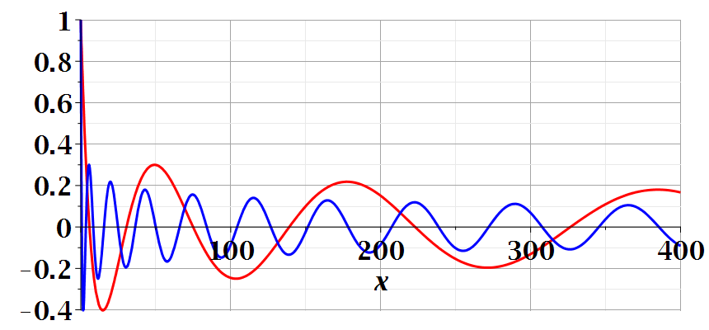
Notes:
Continued.

Slide 16
Imagine watching the waves at a beach – can you visualize the configuration for the surface wave pattern to approximation this situation?
Long flat beach
Beach in which average water level increases
Beach in which average water level decreases

Slide 17
A simplier example:
ζ(x,t)
v(x,t)
v(x+dx,t)
h(x)
b(x)
dx
Special case, where b and h are constant --
Notes:
A simpler example.

Slide 18
Example with b and h constant -- continued
dζ(x,y,t)/dt
z₀
v(x,y,t)
v(x+dx,y+dy,t)
Notes:
Considering the surface height.

Slide 19
For uniform channel:
Notes:
For the simple case, we find the wave equation for the surface height. In the following slides, we will find a more complete solution depends on the wavelength the of surface wave.

Slide 20
More details: -- recall setup --
Consider a container of water with average height h and surface h+ζ(x,y,t)
p₀
ζ
z
h
y
x
Notes:
Some details for the more general case.

Slide 21
Equations describing fluid itself (without boundaries)
Notes:
Considering the case of irrotational flow.

Slide 22
p₀
ζ
z
h
y
x
(We have absorbed p₀ in “constant”)
Notes:
Considering the equations within the wave and at the surface.

Slide 23
Full equations:
(We have absorbed p₀ in “constant”)
Linearized equations:
Notes:
Taking the linear limit.

Slide 24
For simplicity, keep only linear terms and assume that horizontal variation is only along x:
Notes:
Solution for the linear equations.

Slide 25
For simplicity, keep only linear terms and assume that horizontal variation is only along x – continued:
Notes:
An expression for c.

Slide 26
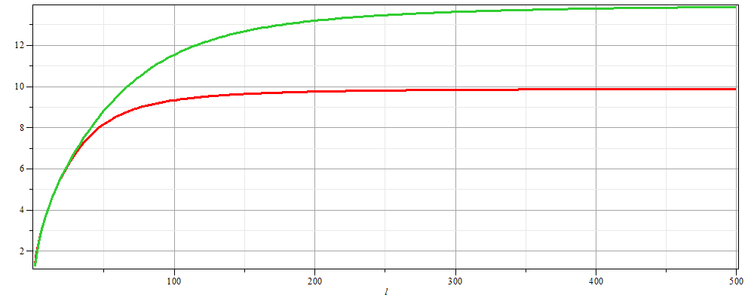
For simplicity, keep only linear terms and assume that horizontal variation is only along x – continued:
h=20 m
c
h=10 m
λ
Notes:
Evaluating c as a function of wavelength.

Slide 27
For simplicity, keep only linear terms and assume that horizontal variation is only along x – continued:
Notes:
Form of the surface wave form.

Slide 28
General problem
including
non-linearities
p₀
ζ
z
h
y
x
Notes:
Introducing the equations beyond the linear approximation that we will cover next time.

