Slide 1
PHY 711 Classical Mechanics and Mathematical Methods
10-10:50 AM MWF Olin 103
Notes on Lecture 35: Chap. 11 in F&W
    Heat conduction
    Basic equations
    Boundary value problems
Notes:
In today’s lecture we will take a quick look at heat transfer following Chapter 11 of your textbook.

Slide 2
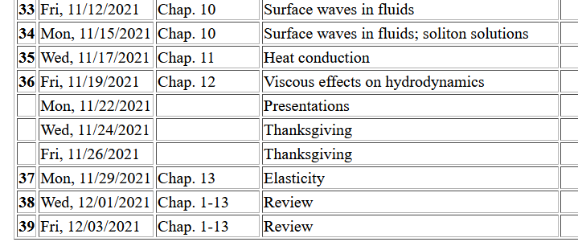
Notes:
Schedule.

Slide 3
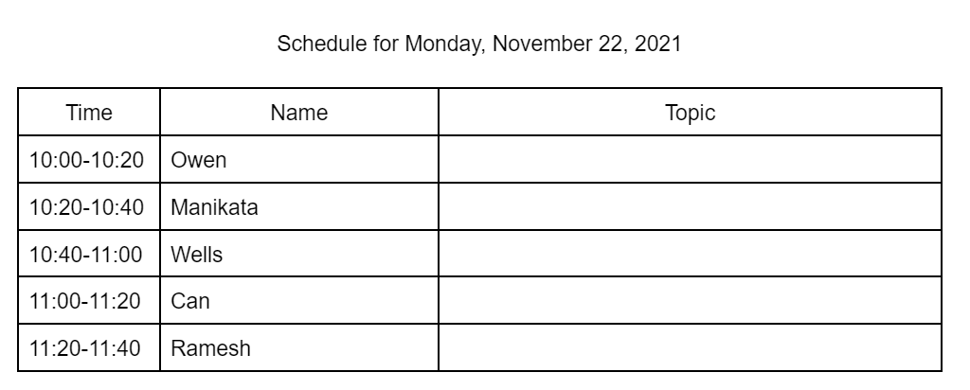
Fill in topic!

Slide 4
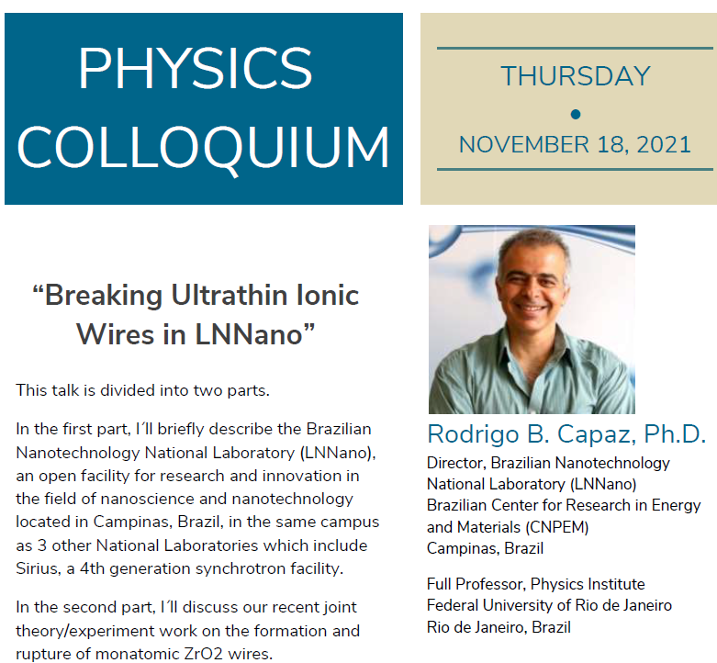
4 PM Olin 101 & zoom

Slide 5
Conduction of heat
T(r,t)
j_{h}
Notes:
Enthalpy as a measure of heat of a system at constant pressure in terms of the heat capacity of the material.

Slide 6
Note that in this treatment we are considering a system at constant pressure p
More generally, note that c_{p} can depend on T; we are assuming that dependence to be trivial.
Notes:
Some notations and concepts from thermodynamics.

Slide 7
Conduction of heat -- continued
heat flux
heat source
Notes:
Now consider how the enthalpy of a system may change in time. The temperature may change, there may be heat flux, and there may be a source or sink for heat flow.

Slide 8
Conduction of heat -- continued
thermal diffusivity
https://www.engineersedge.com/heat_transfer/thermal_diffusivity_table_13953.htm
Typical values (m²/s)
Air 2x10⁻⁵
Water 1x10⁻⁷
Copper 1x10⁻⁴
Notes:
In order to relate these quantities, we need to know how enthalpy is related to temperature and we will use the empirical relations based on observation that heat flux is proportional to the gradient of temperature. The Thermal diffusivity coefficient is highly dependent on the material as seen in this short list taken from the internet.

Slide 9
Boundary value problems for heat conduction
T₀
c
b
x
a
Notes:
Example boundary value problem which we will solve in the case that the source term is zero.

Slide 10
Have you ever encountered the following equation in other contexts and if so where?

Slide 11
Boundary value problems for heat conduction
T₀
c
b
x
a
Assuming thermally insulated boundaries
Notes:
Using separation of variables to solve the problem.

Slide 12
Boundary value problems for heat conduction
T₀
c
b
a
x
Notes:
Some details for this case.

Slide 13
Boundary value problems for heat conduction
T₀
c
b
x
a
Notes:
More details.

Slide 14
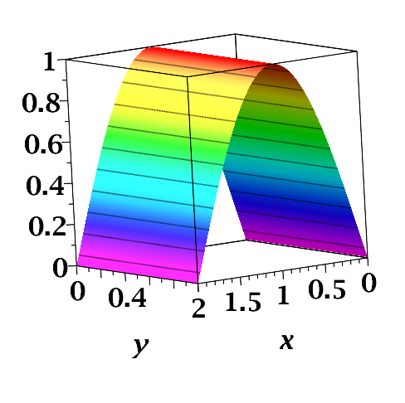
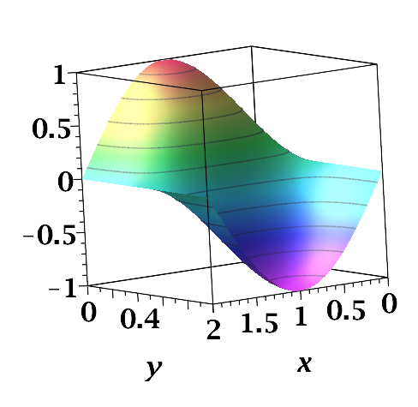
At t=0,z=0
/b
/a
/a
/b

Slide 15
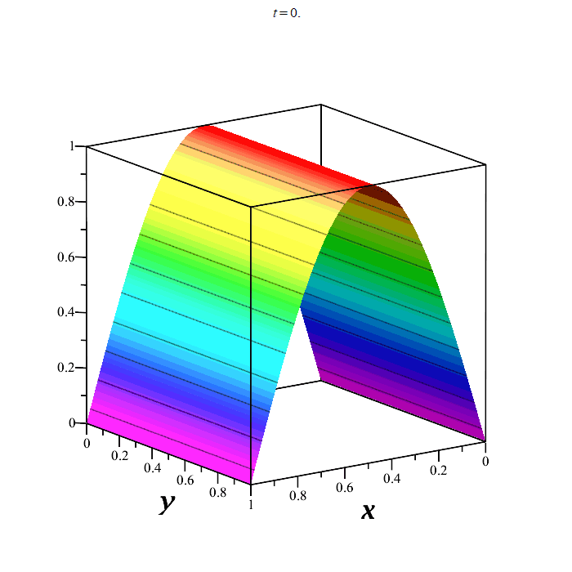
Time evolution
nmp=100
at z=0
Notes:
Visualization of the time evolution.

Slide 16
What real system could have such a temperature distribution?
Comment – While one can imagine that the boundary conditions can be readily realized, the single normal mode patterns are much harder. On the other hand, we see that the lowest values of lambda have the longest time constants.

Slide 17
Here we assume that the spatial variation is along z
Oscillatory thermal behavior
z=0
z
Notes:
Now consider an oscillatory solutions.

Slide 18
Oscillatory thermal behavior -- continued
z=0
z
Notes:
Analysis of solution.

Slide 19
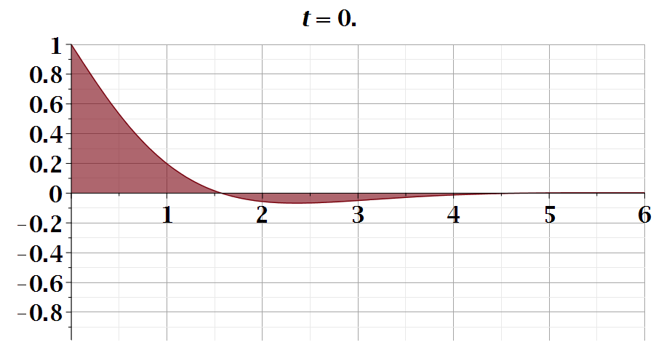
z
Notes:
Animation of solution.

Slide 20
Does this expression say the temperature transmits along the z axis?
Comment – In this case, our setup approximates trivial variation in the x-y plane so that all variation is along z. The spatial form along z with oscillating boundary condition at z=0 is a result of the form of the heat equation.

Slide 21
Initial value problem in an infinite domain; Fourier transform
Notes:
Now consider an initial value problem.

Slide 22
Initial value problem in an infinite domain; Fourier transform
Notes:
Using Green’s functions to analyze the results.

Slide 23
Initial value problem in an infinite domain; Fourier transform
Notes:
Some details.

Slide 24
Heat equation in half-space
Notes:
For half space boundary.

Slide 25
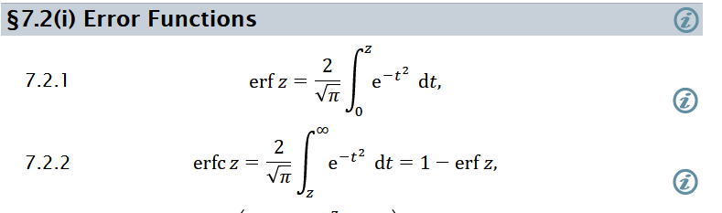
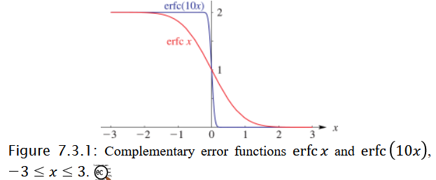
More details about the error function -- https://dlmf.nist.gov/7

Slide 26
Heat equation in half-space -- continued
Notes:
Some details.

Slide 27
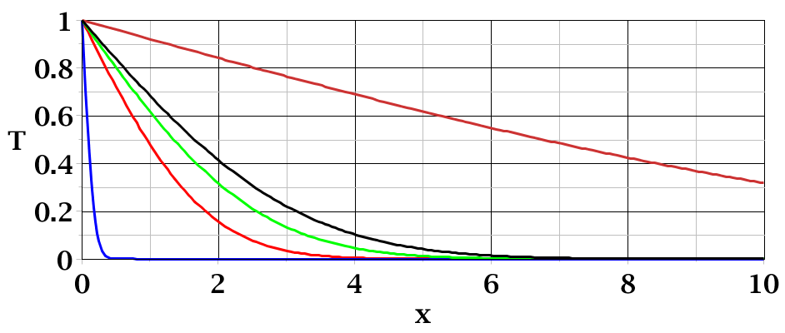
t=50
_
T₀
t=3
t=0.01
Notes:
Plots of solution at various times.

Slide 28
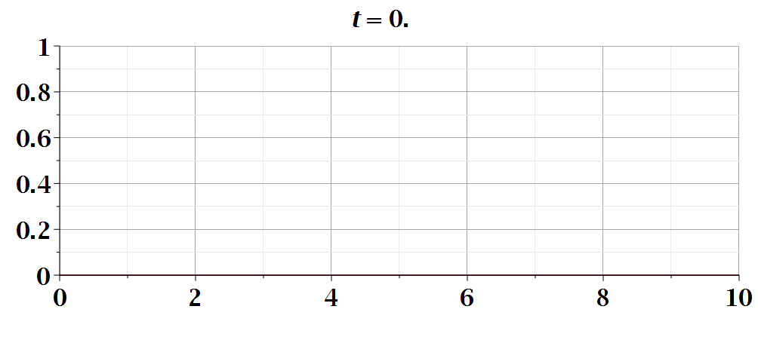
Temperature profile
Notes:
Animation.

