Slide 1
PHY 711 Classical Mechanics and Mathematical Methods
10-10:50 AM MWF in Olin 103
Discussion of Lecture 36: Chap. 12 in F & W
Viscous fluids
Viscous stress tensor
  Navier-Stokes equation
  Example for incompressible fluid – Stokes “law”
  Effects on linearize sound waves
Notes:
In this lecture, we will consider some effects of viscosity on the motion of fluids, following Chapter 12 of your textbook.

Slide 2
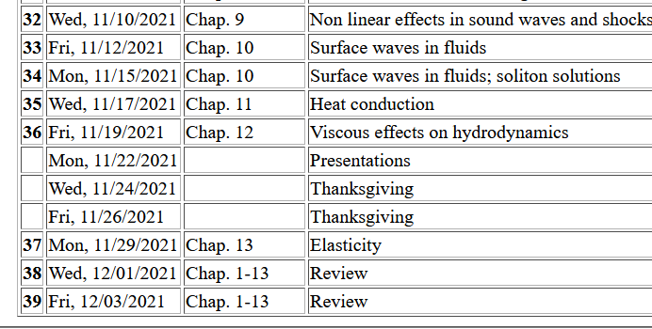
2
Notes:
Schedule.

Slide 3
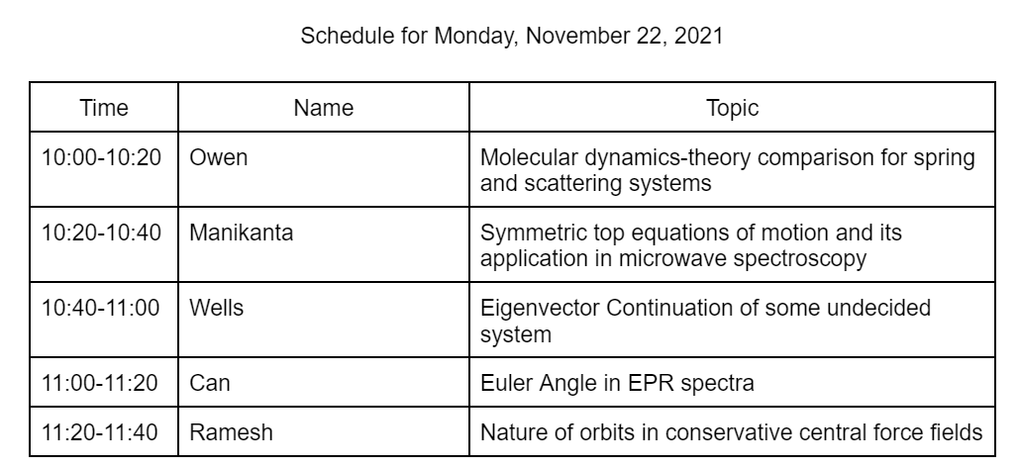
Notes:
Schedule for Monday --

Slide 4
Equations for motion of non-viscous fluid
Notes:
Reviewing the fluid equations that we have discussed previously, combining Newton’s equations with the continuity equation to find a new convenient form.

Slide 5
Equations for motion of non-viscous fluid -- continued
Notes:
Here we recognize terms that have the units of force/area and can be described as a stress tensor Tij.

Slide 6
Now consider the effects of viscosity
As an example of a viscous effect, consider --
A
F_{x}
y
v_{x}(y)
material dependent parameter
x
Notes:
The next step is to imagine that the additional effects of viscosity should/can be represented as a viscous stress tensor. The example of sheer force suggests that the viscous stress tensor involves derivatives of the velocity of the fluid.

Slide 7
Effects of viscosity
bulk viscosity
viscosity
Notes:
Imagining the most general form of the viscous tensor, we consider all derivatives of all components of fluid velocity, separating out the terms with zero trace, with the remaining terms proportional to the divergence of the velocity and representing the “bulk” viscosity.

Slide 8
Effects of viscosity -- continued
Notes:
Now we can write the fluid equations with the full stress tensor. The continuity equation still applies. The so-called Navier-Stokes equation summarizes the expected behavior of fluids in terms of the material dependent viscosity parameters eta and zera.

Slide 9
Newton-Euler equations for viscous fluids
Typical viscosities at 20º C and 1 atm:
Fluid | η/ρ (m²/s) | η (Pa s)
Water | 1.00 x 10⁻⁶ | 1 x 10⁻³
Air | 14.9 x 10⁻⁶ | 0.018 x 10⁻³
Ethyl alcohol | 1.52 x 10⁻⁶ | 1.2 x 10⁻³
Glycerine | 1183 x 10⁻⁶ | 1490 x 10⁻³
Notes:
Here is a list of some typical values of the viscosity parameter eta.

Slide 10
Example – steady flow of an incompressible fluid in a long pipe with a circular cross section of radius R
Notes:
Example of a measurement of viscosity for irrotational flow.

Slide 11
Example – steady flow of an incompressible fluid in a long pipe with a circular cross section of radius R -- continued
R
L
v(r)
(uniform pressure gradient)
Notes:
Continued analysis of simple viscous flowl

Slide 12
Example – steady flow of an incompressible fluid in a long pipe with a circular cross section of radius R -- continued
R
L
v(r)
Notes:
Solving for the velocity profile.

Slide 13
Comment on boundary condition
R
L
Fluid approximately stationary at boundary
v(r)
R

Slide 14
Example – steady flow of an incompressible fluid in a long pipe with a circular cross section of radius R -- continued
R
L
v(r)
Poiseuille formula;
➔Method for measuring η
Notes:
This analysis is useful for measuring eta.

Slide 15
Example – steady flow of an incompressible fluid in a long tube with a circular cross section of outer radius R and inner radius κR
R
κR
L
Notes:
Another related system with a cylindrical shell.

Slide 16
Example – steady flow of an incompressible fluid in a long tube with a circular cross section of outer radius R and inner radius κR -- continued
R
κR
L
Notes:
The final result again can be used to measure the viscosity.

Slide 17
More discussion of viscous effects in incompressible fluids
u
F_{D}
Plan:
Consider the general effects of viscosity on fluid equations
Consider the solution to the linearized equations for the case of steady-state flow of a sphere of radius R
Infer the drag force needed to maintain the steady-state flow
Notes:
Changing to an analysis of viscous flow as a drag force.

Slide 18
Have you ever encountered Stokes law in previous contexts?
Milliken oil drop experiment
A sphere falling due to gravity in a viscous fluid, reaching a terminal velocity
Other?

Slide 19
Typical kinematic viscosities at 20º C and 1 atm:
Fluid | ν (m²/s)
Water | 1.00 x 10⁻⁶
Air | 14.9 x 10⁻⁶
Ethyl alcohol | 1.52 x 10⁻⁶
Glycerine | 1183 x 10⁻⁶
Notes:
In this case, we will consider an incompressible fluid in which case eta/rho is the important parameter.

Slide 20
u
F
F_{D}
Notes:
Before deriving Stokes law of viscous drag, it is interesting to recall its effects.

Slide 21
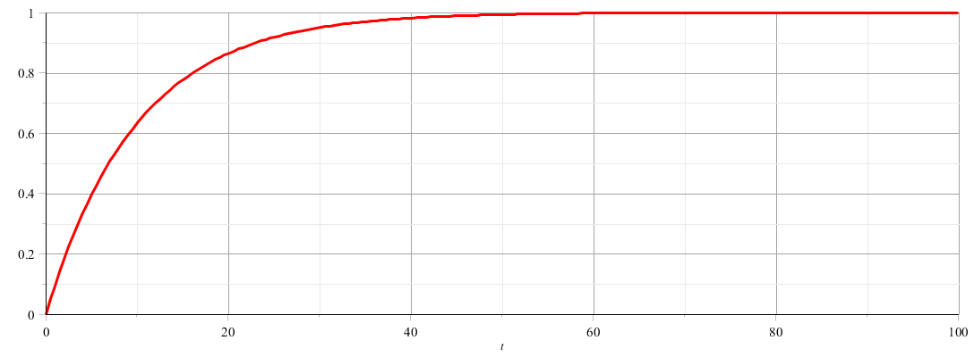
u
F
F_{D}
u
t
Notes:
Objects moving in the presence of the Stokes viscous drag, tend to read a steady “terminal” velocity.

Slide 22
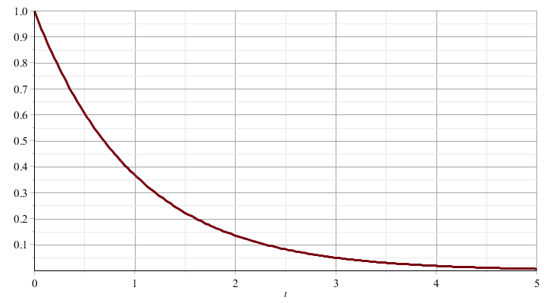
u
F_{D}
u
t
Notes:
Or the velocity decays to zero.

Slide 23
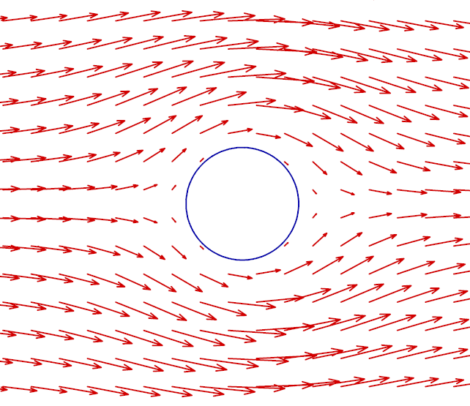
Recall: PHY 711 -- Assignment #19 Nov. 01, 2021
Determine the form of the velocity potential for an incompressible fluid representing uniform velocity in the z direction at large distances from a spherical obstruction of radius a. Find the form of the velocity potential and the velocity field for all r > a. Assume that for r = a, the velocity in the radial direction is 0 but the velocity in the azimuthal direction is not necessarily 0.
In the present viscous case, we will assume that v(a)=0.
Notes:
In previous discussions without viscosity, the velocity near the sphere is not necessarily zero. How will this be affected in the presence of viscosity?

Slide 24
Notes:
Here we keep the dominant terms, finding a relationship between the pressure and the velocity.

Slide 25
Notes:
This analysis follows the treatment of Landau and Lifshitz.

Slide 26
Your question – why assume
u
F_{D}

Slide 27
Digression
Notes:
Deducing the form of the velocity

Slide 28
Notes:
Here we find the most general form of the equation that satisfies the differential equation.

Slide 29
Notes:
Some details.

Slide 30
Notes:
Assume that the velocity achieves steady flue far from the sphere and is zero on the sphere boundary.

Slide 31
Notes:
Finding all the constants and solving for the pressure .

Slide 32
u
F_{D}
Notes:
Deducing the drag force from the solution to the differential equation.

Slide 33
Additional effects of viscosity – allowing for changes in entropy

Slide 34
Newton-Euler equations for viscous fluids

Slide 35
Newton-Euler equations for viscous fluids – effects on sound
Without viscosity terms:

Slide 36
Sound waves without viscosity -- continued
➔Pure longitudinal harmonic wave solutions

Slide 37
Newton-Euler equations for viscous fluids – effects on sound
Recall full equations:
viscosity causes heat transfer

Slide 38
Newton-Euler equations for viscous fluids – effects on sound
Note that pressure now depends both on density and entropy so that entropy must be coupled into the equations

Slide 39
Newton-Euler equations for viscous fluids – linearized equations

Slide 40
Newton-Euler equations for viscous fluids – linearized equations
heat capacity at constant volume

Slide 41
Newton-Euler equations for viscous fluids – linearized equations

Slide 42
Newton-Euler equations for viscous fluids – effects on sound
Linearized equations (with the help of various thermodynamic relationships):

Slide 43
Linearized hydrodynamic equations

Slide 44
Linearized hydrodynamic equations; plane wave solutions:
➔Entropy and mechanical modes are independent

Slide 45
Linearized hydrodynamic equations; full plane wave solutions:

Slide 46
Linearized hydrodynamic equations; full plane wave solutions:

Slide 47
Linearized hydrodynamic equations; full plane wave solutions:

