Slide 1
PHY 711 Classical Mechanics and Mathematical Methods
10-10:50 AM MWF in Olin 101
Discussion for Lecture 37: Chap. 13 in F & W
Physics of elastic continua –
  Stress and strain
  Waves in elastic media
Notes:
In this lecture we will explore some of the concepts of continuum elasticity discussed in Chapter 13 of your textbook. This is an old field and many overlapping notations.

Slide 2
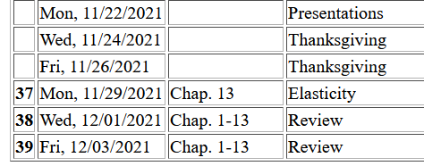
Tentative plan –
  Wed – systematic review and highlights (with your suggestions)
  Fri – Specific problem review – including mid-term exam
PHY 711 Fall 2013 -- Lecture 34
2
Notes:
Schedule.

Slide 3
Brief introduction to elastic continua
r₁
r₁’
r₂
r₂’
reference
deformation
Notes:
Visualization and quantification of deformation in terms of continuous deviation u(r).

Slide 4
Brief introduction to elastic continua -- continued
elastic strain tensor
rotation of material
Here we have in mind that the materials in our analysis are symmetric so that ε_{ij}=ε_{ji}.
Notes:
Analyzing continuous deformation and distinguishing it from rotational effects.

Slide 5
Brief introduction to elastic continua -- continued
X
Notes:
In general we are interested in physical deformations and not rotation. The divergence of u is related to the fractional volume change or fractional density change.

Slide 6
Brief introduction to elastic continua -- continued
r₁
r₁’
reference
deformation
Notes:
In addition to volumetric changes, there may be shape changes as well.

Slide 7
Deformation
b
b’
θ
θ’
a
a’
Notes:
Off diagonal components of the strain tensor are related to angular deformations.

Slide 8
Elastic stress tensor
Note: the elastic stress tensor is different from the stress tensor that we encountered in the hydrodynamic analysis!
Notes:
The generalization of Hooke’s law; relating stress and strain.

Slide 9
What is the difference between elastic stress tensor and the stress tensor in hydrodynamics?
Force per unit mass
This equation works both for the case of hydrodynamics and for elasticity. The stress tensor T_{kl} has the units of force/area.

Slide 10
Simularities:
Equation of motion:
Differences:
  For hydrodynamics, T represents stress due to motions of nearby fluid
  For elasticity, T represents restoring forces due to displacements from equilibrium

Slide 11
Elastic stress tensor relationships at equilibrium
Notes:
Various relationships between stress and strain.

Slide 12
Stress tensor -- continued
Notes:
Various parameters to describe elasticity.

Slide 14
Notes:
Uniaxial case and Young’s modulus.

Slide 15
Notes:
Shere modulus.

Slide 16
Notes:
Relationships between many parameters.

Slide 17
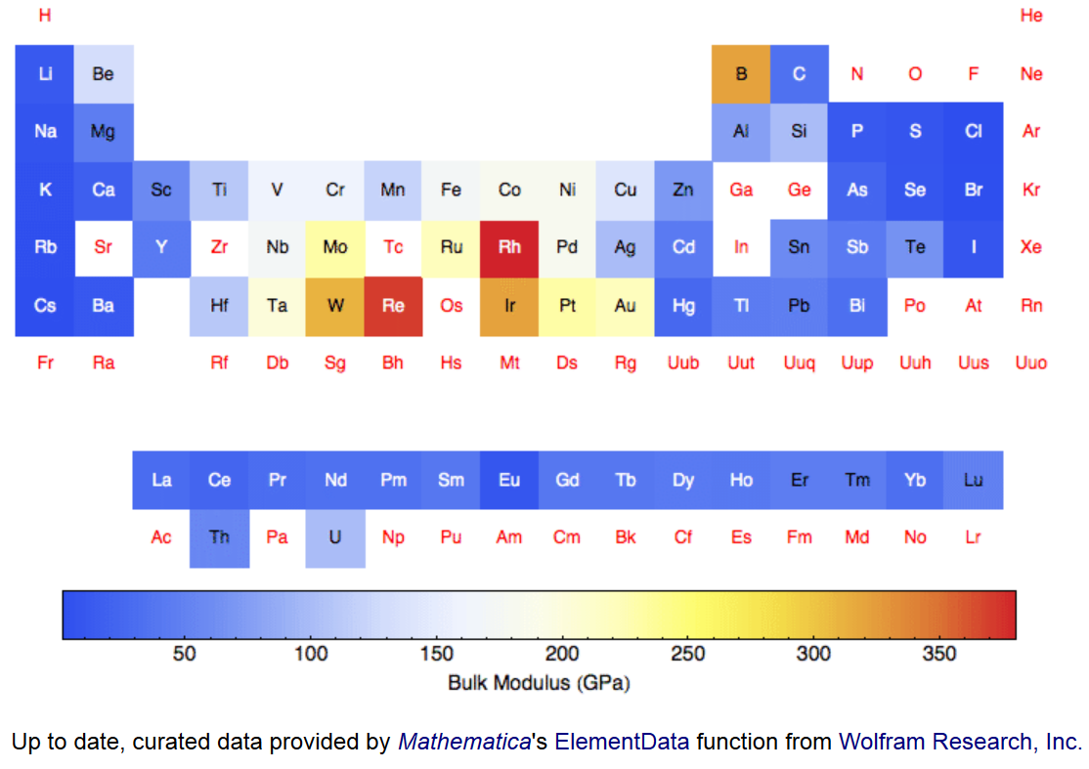
Values of bulk modulus K for elemental materials --
Notes:
Elemental values of bulk modulus from Mathematica.

Slide 18
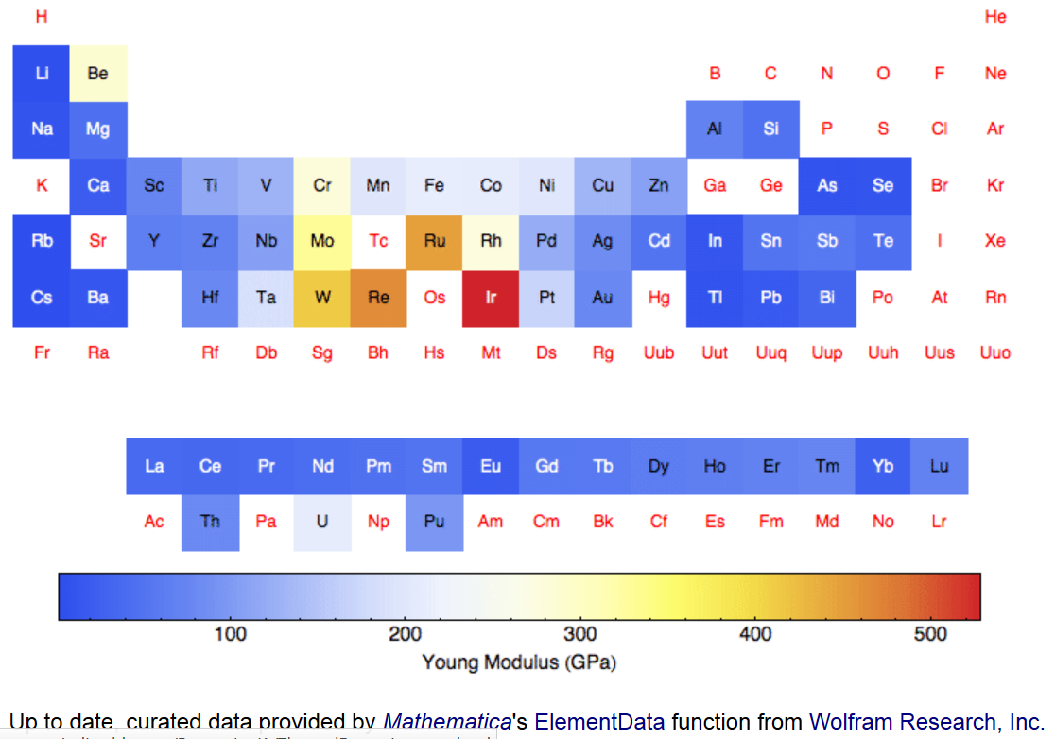
Values of Young’s modulus E for elemental materials --

Slide 19
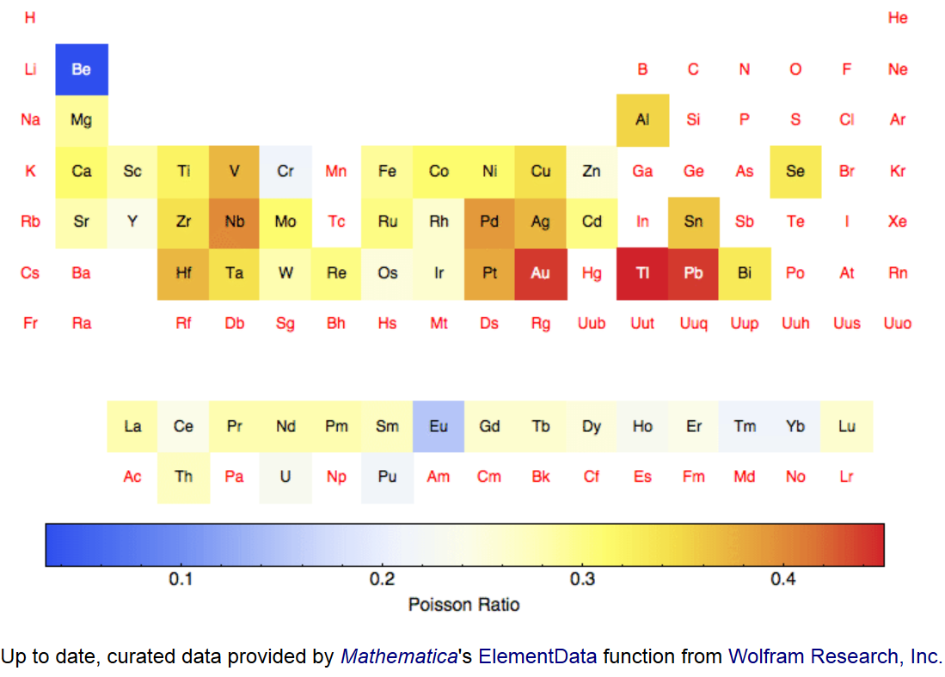
Values of Poisson ratio σ for elemental materials --
Notes:
Poisson ratio also from Mathematica.

Slide 20
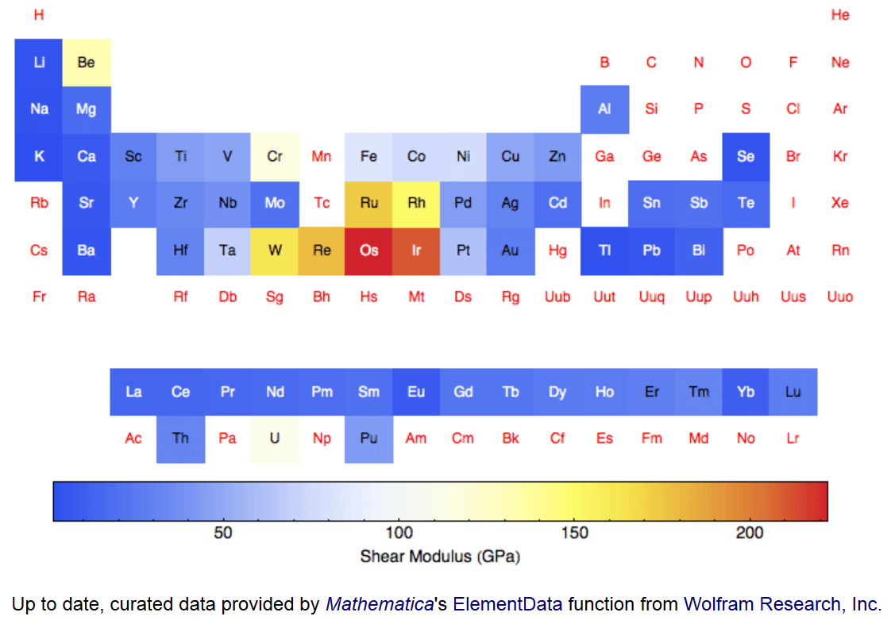
Values of shear modulus μ for elemental materials --
Notes:
Shear modulus.

Slide 21
Summary -- Elastic stress tensor
material-dependent empirical parameters
Notes:
Summary of relationships.

Slide 22
Strain
Stress
Notes:
More summary.

Slide 23
surface contribution
bulk contribution
Notes:
Work involved with distortion.

Slide 24
Notes:
Analysis of the elastic work using the Hooke’s law relationships.

Slide 25
Note that the two relations:
Notes:
More details.

Slide 26
Dynamical equations of motion
external force density
Notes:
Analyzing the time dependence of the elastic response in terms of Newton’s laws. While these equations look like the analysis in hydrodynamics, the stress tensor is quite different and nonlinear effects are more accurately ignored.

Slide 27
Notes:
Analyzing the equations of motion to linear order.

Slide 28
Dynamical equations of elastic continuum
Notes:
Considering longitudinal and transverse wave motion in elastic media.

Slide 29
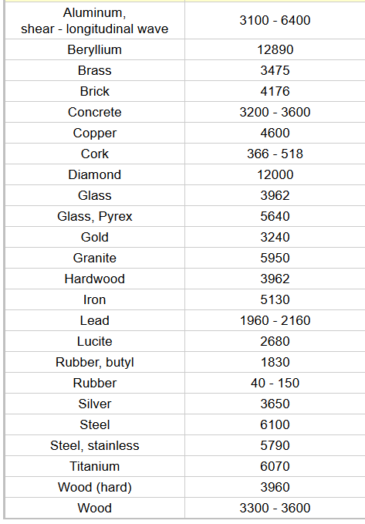
Typical velocities of
longitudinal sound waves
Material c_{l} (m/s)
http://www.engineeringtoolbox.com/sound-speed-solids-d_713.html
air: c_{l}=343 m/s
water: c_{l}=1433 m/s
Notes:
Longitudinal wave speeds in various media.

Slide 30
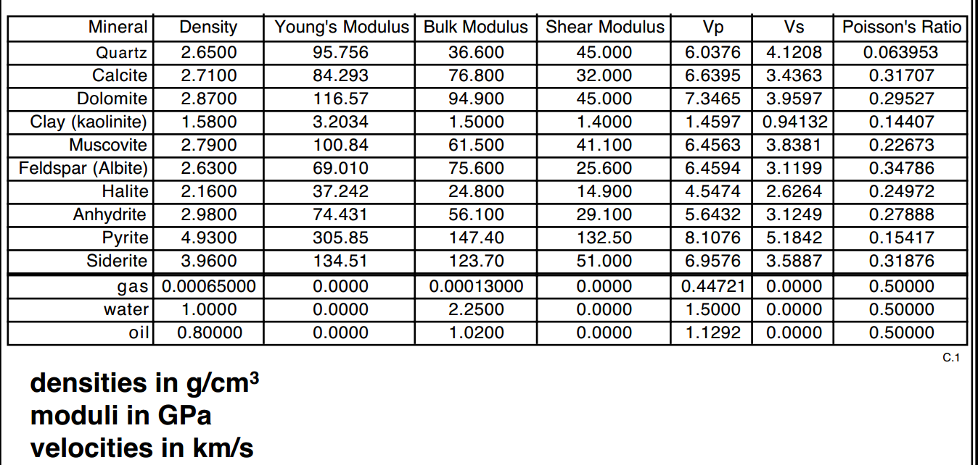
from: https://pangea.stanford.edu/courses/gp262/Notes/5.Elasticity.pdf
Notes:
More measured values of elasticity values for various materials.

Slide 31
Dynamical equations of elastic continuum
Notes:
Some more details.

Slide 32
Dynamical equations of elastic continuum
Transverse component:
Notes:
More details.

Slide 33
Dynamical equations of elastic continuum
Longitudinal component -- continued:
Transverse component:
Notes:
Summary.

Slide 34
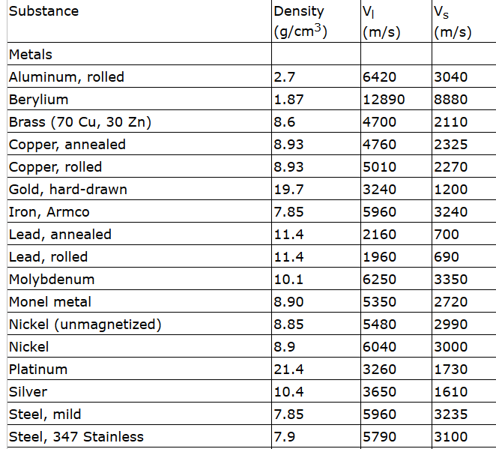

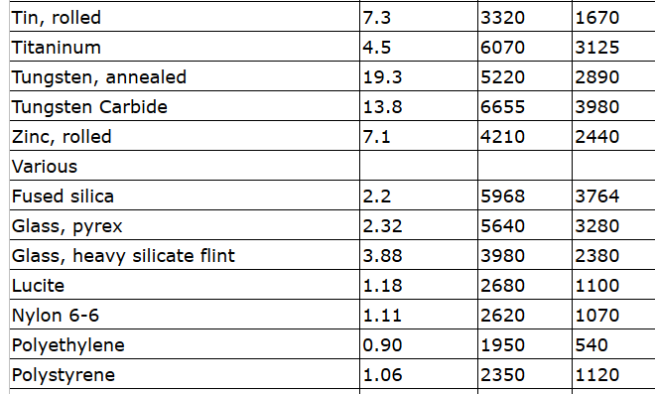
Some values:
Notes:
Sound velocities in various materials.

Slide 35
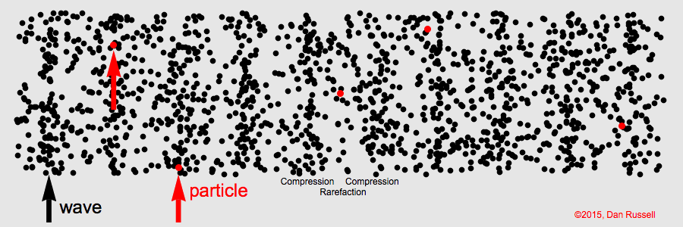
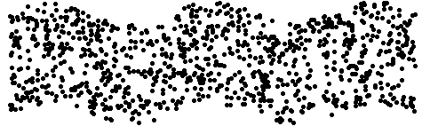
Animations from website:
https://www.acs.psu.edu/drussell/demos/waves/wavemotion.html
Longitudinal wave (p or “primary”)
Transverse wave (s or “secondary”)
Notes:
Visualization of longitudinal and transverse waves.

Slide 36
Elasticity in solids
z
y
x
vanishes at equilibrium
Notes:
Comment on elasticity in solids.

Slide 37
For the most general case c_{ijkl} have 21 distrinct terms, for a cube there are only 3 unique terms.
Notes:
More details.

Slide 38
Some typical values (Ref. Ashcroft and Mermin (1976))
 | C₁₁ (GPa) | C₁₂(GPa) | C₄₄(GPa)
Na | 7.0 | 6.1 | 4.5
Al | 107 | 61 | 28
Fe | 234 | 136 | 118
Si | 166 | 64 | 80
NaCl | 48.7 | 12.4 | 12.6
Notes:
Examples of stress coefficients for some materials.

