Slide 1
PHY 711 Classical Mechanics and Mathematical Methods
10-10:50 AM MWF in Olin 103
Plan for Lecture 38
Review
  Mathematical methods
  Classical mechanics concepts

Slide 2
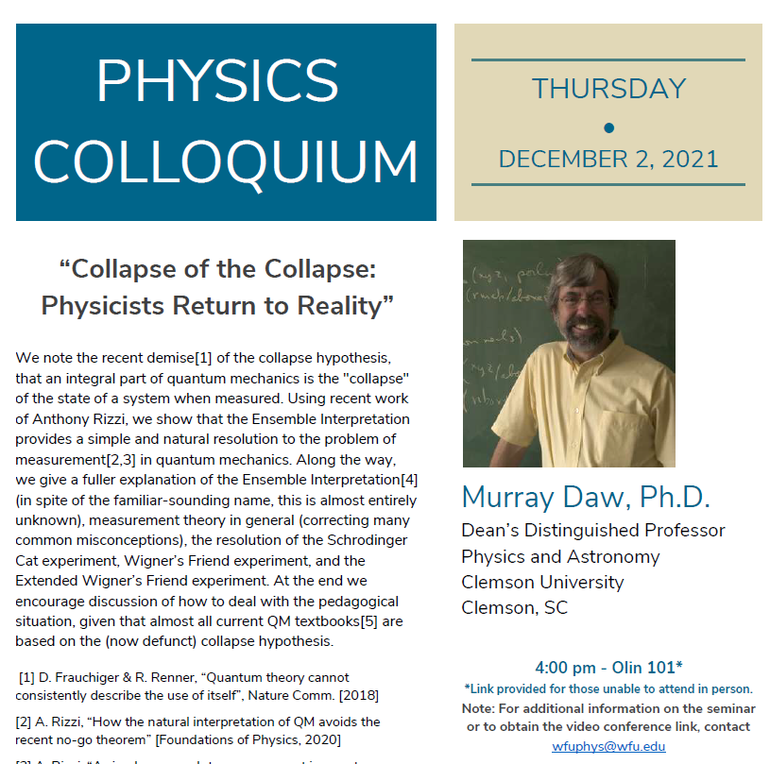

Slide 3
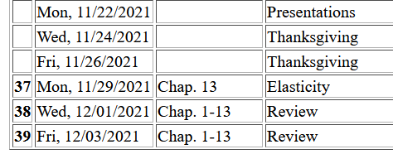
3

Slide 4
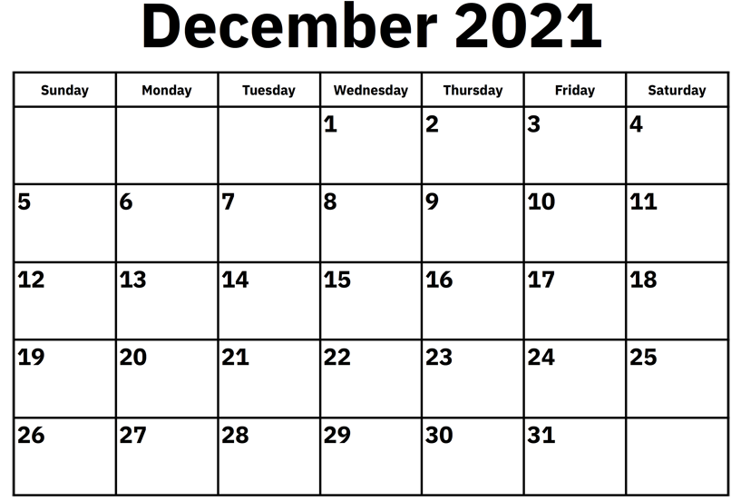
Comments on take-home final –
Similar to mid-term in form
Available: Mon. Dec. 6, 2021
Due before: Mon. Dec. 13, 2021 before 11 AM
(final grades are due 12/15/2021)

Slide 5
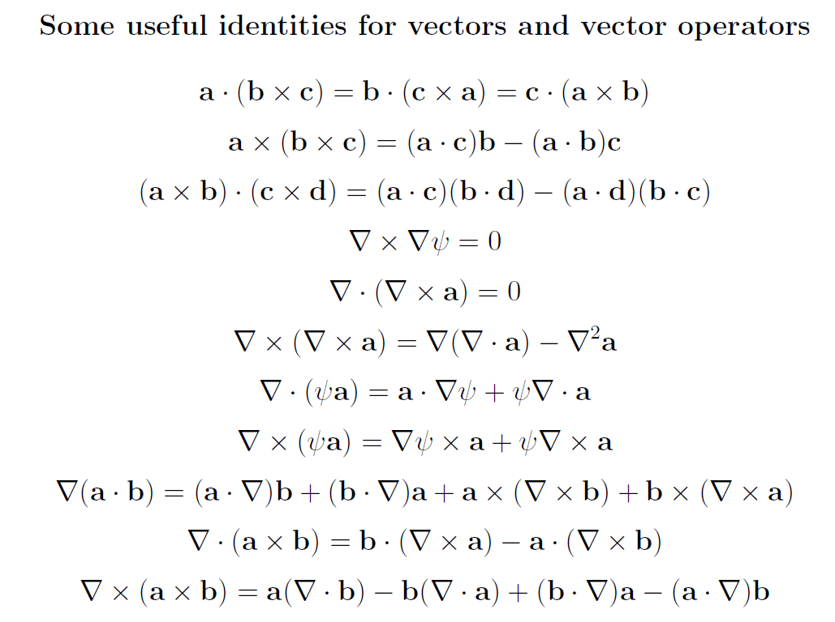
Review of mathematical methods

Slide 6
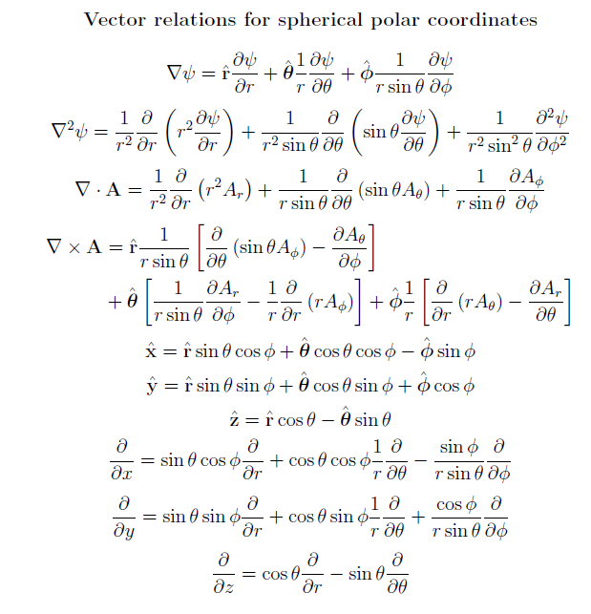

Slide 7
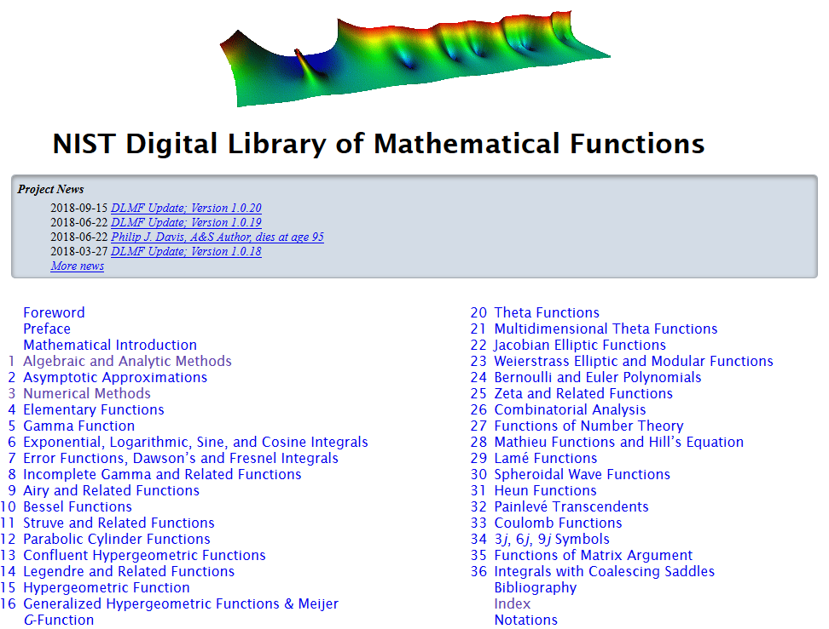
https://dlmf.nist.gov/

Slide 8
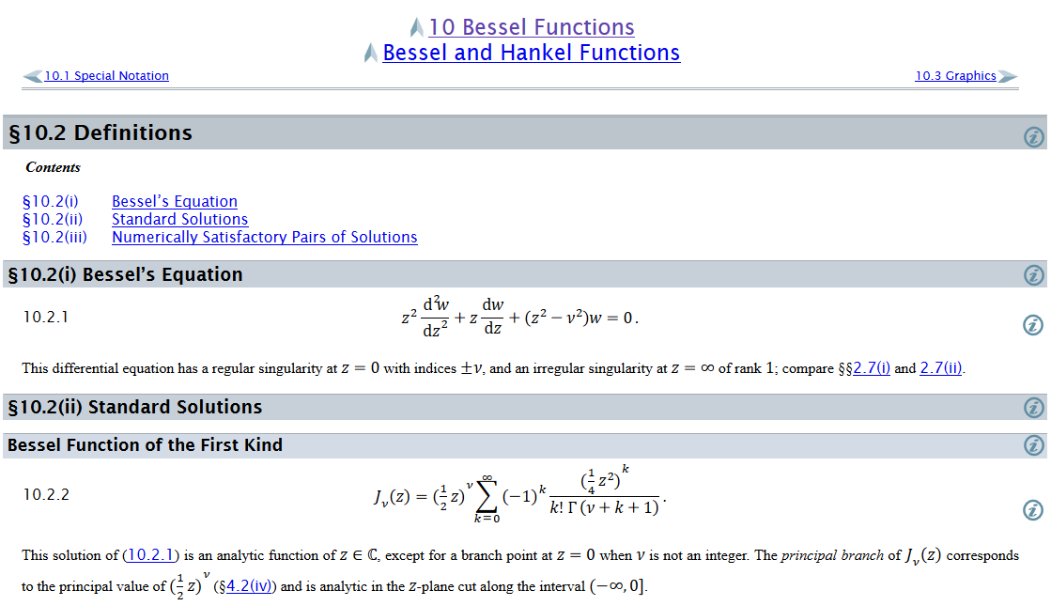
Example – special functions

Slide 9
Complex numbers
Functions of complex variables
Derivatives:
Cauchy-Riemann equations

Slide 10
Analytic function
➔A closed integral of an analytic function is zero.
However:

Slide 11
Contour integration methods --
No contribution
C

Slide 13
Fourier transforms --
Note: The location of the 2π factor varies among texts.

Slide 15
Doubly discrete Fourier Transforms
➔Fast Fourier Transforms (FFT)

Slide 16
Notions of eigenvalues and eigenvectors
In the context of linear algebra --
In the context of Sturm-Liouville differential equations --

Slide 17
Notions of eigenvalues and eigenvectors -- continued

Slide 18
Calculus of variation – a method to find a function (y(x)) which optimizes a particular integral relationship.
Euler-Lagrange equation

Slide 19
Lagrangian in the presence of electromagnetic forces

Slide 20
Recipe for constructing the Hamiltonian and analyzing the equations of motion
Note that the equations of motion should yield equivalent trajectories for the Lagrangian and Hamiltonian formulations.

Slide 21
Mechanics topics
  Scattering theory
  Lagrangian mechanics
  Hamiltonian mechanics
  Liouville theorem
  Rigid body motion
  Normal modes of oscillation about equilibrium
  Wave motion
  Fluid mechanics (ideal or including viscosity; linear and nonlinear)
  Heat conduction
  Elasticity
Note: The following review slides are necessarily brief. Please refer to the original “Extra” lecture slides for details. Please email: natalie@wfu.edu with any corrections/suggestions

Slide 22
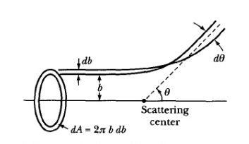
Scattering theory
Note: The notion of cross section is common to many areas of physics including classical mechanics, quantum mechanics, optics, etc. Only in the classical mechanics can we calculate it from a knowledge of the particle trajectory as it relates to the scattering geometry.
b
Figure from Marion & Thorton, Classical Dynamics
Note: We are assuming that the process is isotropic in φ

Slide 23
Lagrangian mechanics

Slide 24
Recipe for constructing the Hamiltonian and analyzing the equations of motion

Slide 25
Question – When can you bypass the 5 step derivation process and directly write the Hamiltonian of the system as
Only when Natalie Holzwarth is not looking
When you have a simple system that has no explicit velocity and/or time dependence
Usually

Slide 26
Important tool for analyzing Lagrangian and/or Hamiltonian systems -- finding constants of the motion
In Lagrangian formulation --

Slide 27
Constants of the motion in the Hamiltonian formulation

Slide 28
Question – Why use this fancy formalism when simple conservation of energy or momentum intuitively apply?
You should use your intuition whenever possible.
You should never trust your intuition.
The equations should be consistent with correct intuitive solutions and also reveal additional solutions (perhaps beyond intuition)

Slide 29
Liouville’s Theorem (1838)
The density of representative points in phase space corresponding to the motion of a system of particles remains constant during the motion.

Slide 30
Rigid body motion
In a reference frame attached to the object, there are 3 moments of inertia and 3 distinct principal axes
Representation of rotational kinetic energy:

Slide 31
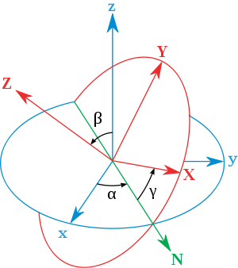
Euler’s transformation between body fixed and inertial reference frames
x
y
y
x

Slide 32

Normal modes of vibration -- potential in 2 and more dimensions
V(x,y)

Slide 33
Example – normal modes of a system with the symmetry of an equilateral triangle -- continued
3
u₃
u₂
1
2
u₁

Slide 34
Example – normal modes of a system with the symmetry of an equilateral triangle -- continued

Slide 35
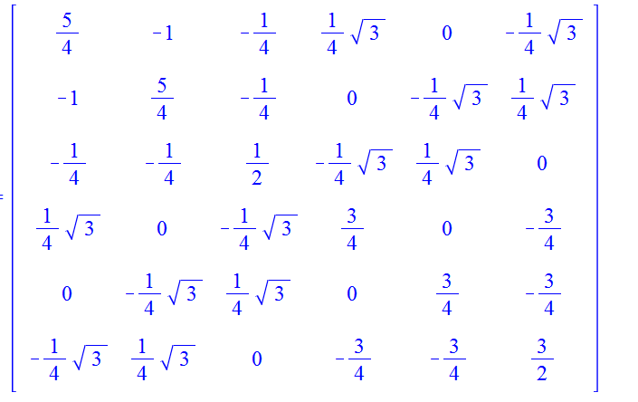
Example – normal modes of a system with the symmetry of an equilateral triangle -- continued
= ω²

Slide 36
Discrete particle interactions → continuous media →
The wave equation

Slide 37
Mechanical motion of fluids
Newton’s equations for fluids
  Use Euler formulation; following “particles” of fluid
Viscosity contributions

Slide 38
Fluid mechanics of incompressible fluid plus surface
Non-linear effects in surface waves:
p₀
ζ
z
h
y
z=0
x

Slide 39
Elements of elasticity theory -- Elastic stress tensor
material-dependent empirical parameters

Slide 40
Dynamical equations of elastic continuum

