Slide 1
PHY 711 Classical Mechanics and Mathematical Methods
10-10:50 AM MWF in Olin 103
Lecture notes for Lecture 4
Scattering analysis in the center of mass reference frame – Chap 1 F&W
Review of scattering ideas.
In center of mass frame, analytical evaluation of the differential scattering cross section in general and for Rutherford scattering.
Notes:
In this lecture, we will focus on the analysis in the center of mass frame which contains the basic physics of the interparticle interaction. The main example will be that of the famous Rutherford scattering experiment.

Slide 2
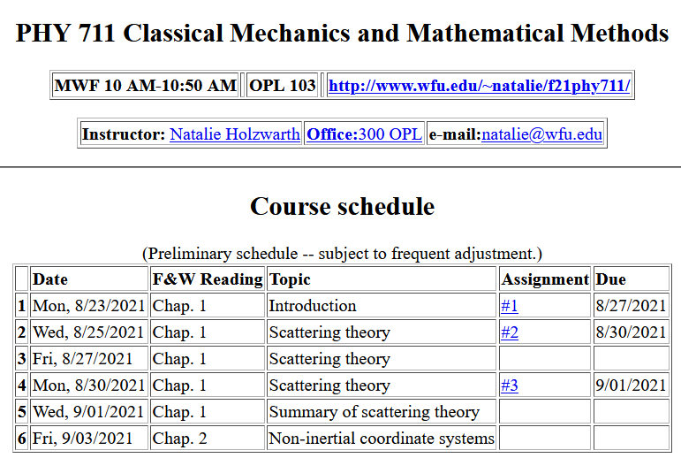

Slide 3
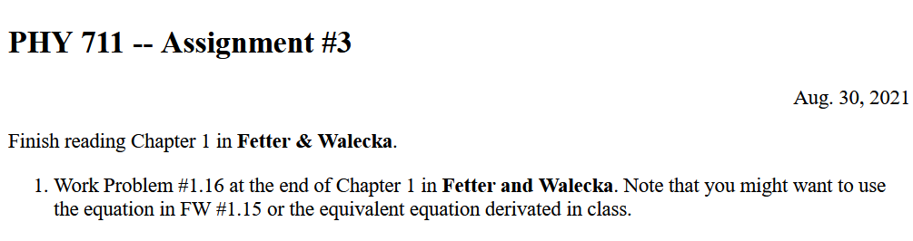

Slide 4
Your questions –
From Owen –
1. We have seen the parabolic trajectory of a light particle being deflected by a stationary heavy particle. If the second particle were lighter and allowed to move, how would it alter the trajectory of the first particle? Would it no longer be an ideal "conic section"?
Comment: Relationship between center of mass and laboratory frames of reference for the scattering particle 1. Here V₁ represents particle in center of mass frame and v₁ represents particle in lab frame. Both V₁ and v₁ change in time but V_{CM} remains constant.
V_{CM}
V₁
v₁
ψ
θ

Slide 5
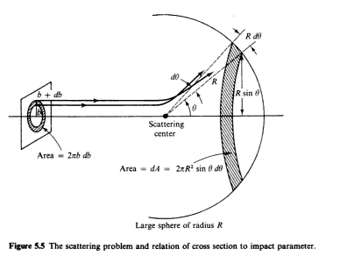
Reviewing – scattering in the laboratory
Figure from F&W:
detector
Notes:
This and the next several slides summarize the experimental scattering geometry.

Slide 6
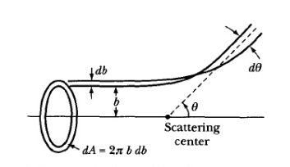
b
Figure from Marion & Thorton, Classical Dynamics
Note that the same formula applies to the center of mass analysis.
Notes:
More review.

Slide 7
constants
vary in time
For scattering analysis only need to know trajectory before and after
the collision.
Notes:
Recall that the system of interest can be expressed in terms of constants and the particle separation r(t).

Slide 8
Some details --
Relationship between center of mass and laboratory frames of reference. At and time t, the following relationships apply --

Slide 9
More details
Since r(t) represents motion in a plane, we will analyze the system in that plane and use polar coordinates.

Slide 10
Clarification –
Energy of the center mass motion
Energy within the center of mass reference frame
In the following slides E_{rel} is written E

Slide 11
➔

Slide 12
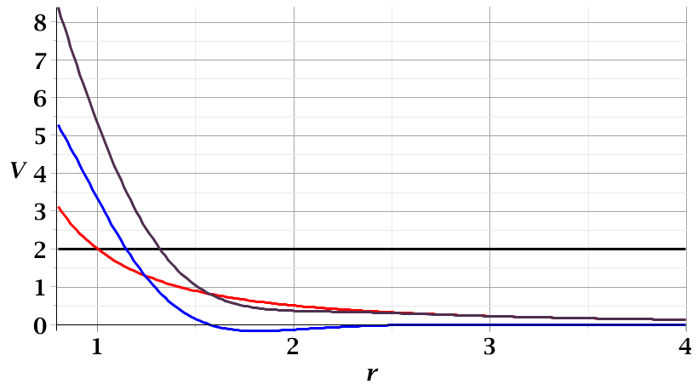
For a continuous potential interaction in center of mass reference frame:
Need to relate these parameters to differential cross section
E_{rel}
r_{min}

Slide 13
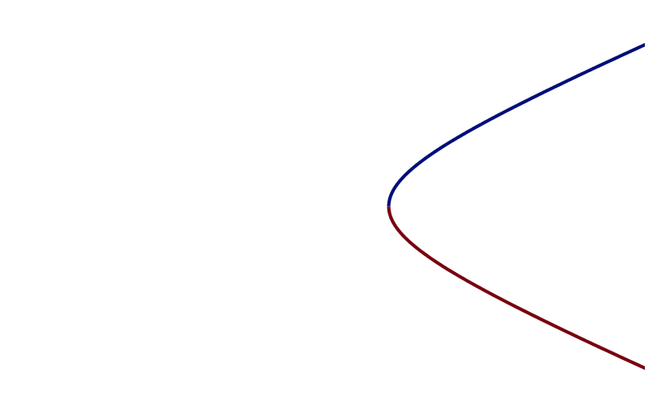
r(χ)
χ_{m}
χ
➔Need to find an equation for r(χ)
r_{min}
center of scattering.

Slide 14
How is this related to scattering?
➔
χ_{max}
χ_{max}
θ
Note that here θ is used for the scattering angle

Slide 15
Note that we have use ψ to denote the scattering angle in the center of mass frame, but your textbook uses θ (which we had used to denote the scattering angle in the lab frame). In this lecture our analysis is entirely in the center of mass frame and some of the equations use θ to denote the scattering angle.

Slide 16
Evaluation of constants far from scattering center --
r(t)
r_{min}
Notes:
Relating the constants of the problems to values determined when the particles are very far apart.

Slide 17
Notes:
Up to now we are expressing the trajectory as a function of time t. For this analysis however, we would like to find the trajectory as a function of the angle \phi. The relationship of the constant angular momentum to the \phi and time variables allows us to find r(\phi).

Slide 18
Notes:
Lots of algebra ….

Slide 19
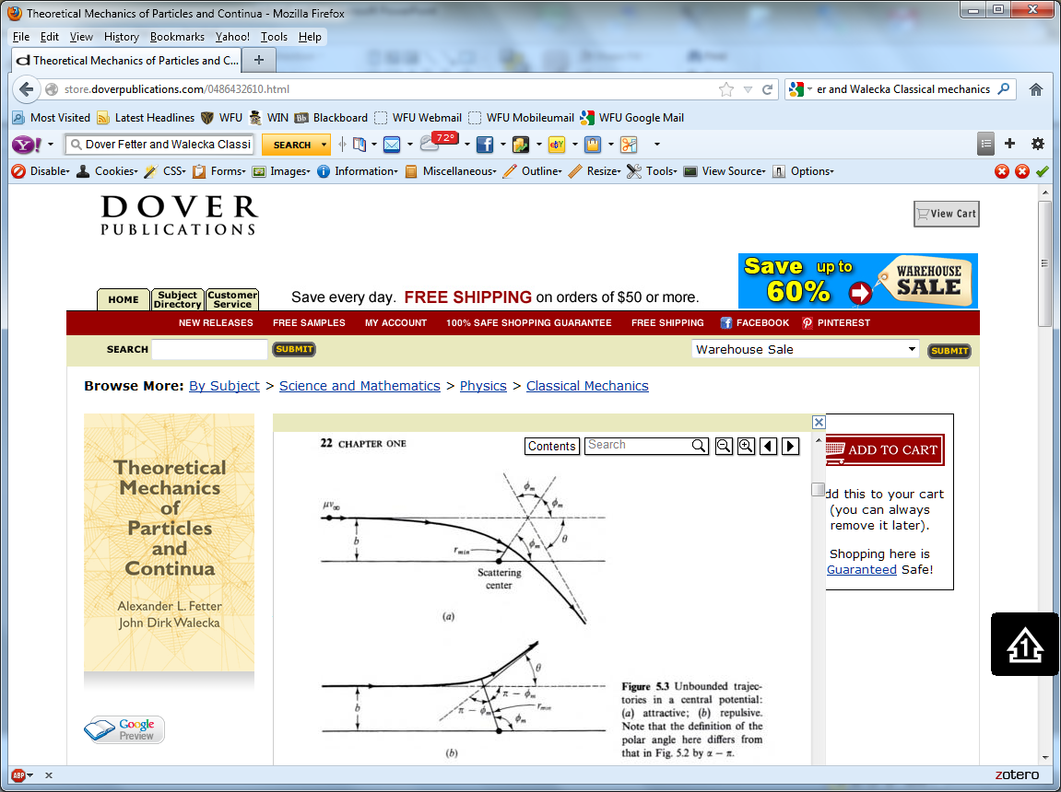
Notation switch –
Notes: χ
Text: φ
Notes:
This shows the relationship of the analysis of r(\phi) to the scattering event. The insert is a diagram from the textbook.

Slide 20
Notes:
The scattering process involves the aspects of the trajectory at large separations.

Slide 21
Notes:
When r=rmin, \phi=0. \phi increases to a maximum value.

Slide 22
Relationship between χ_{max} and θ:
Using the diagram from your text, θ represents the scattering angle in the center of mass frame and φ is used instead of χ.
Notes:
Problem with consistent notation. Here we are using the textbook’s definition of theta which is OK if the target mass is infinite.

Slide 23
Notes:
The last equation is a convenient change of variables.

Slide 24
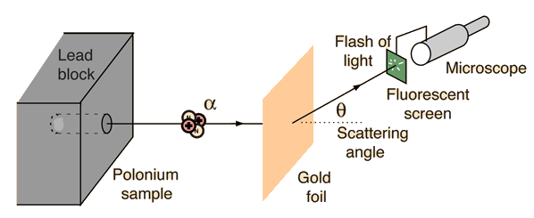
Example: Diagram of Rutherford scattering experiment
http://hyperphysics.phy-astr.gsu.edu/hbase/rutsca.html
Notes:
Here we use a diagram from the web about the Rutherford geometry.

Slide 25
Notes:
Summary of all of the equations and then specializing to the Coulomb interaction form.

Slide 26
Notes:
In this case, the integrals can all be evaluated analytically and simplify to this famous result.

Slide 27
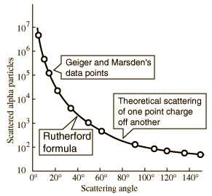
What happens as
θ →0?
From webpage: http://hyperphysics.phy-astr.gsu.edu/hbase/nuclear/rutsca2.html#c3
Notes:
Reconstructed data taken from the web.

Slide 28
Original experiment performed with α particles on gold
Question –
What do you think happens for θ →0?
  Big trouble; need to make sure experiment is designed to avoid that case.
  No problem
    Physics is altered in that case and nothing explodes.
    Rare event and rarely causes trouble.
Notes:
Evaluation of constant for this case.

Slide 29
Recap of equations for scattering cross section in the center of mass frame of reference
Notes:
Recap of the equations. This equation allows us to fine b(theta).

Slide 30
Digression– In general, it is possible to determine the trajectory r(χ) --

Slide 31
For the Rutherford case --

Slide 32
For the Rutherford case --

Slide 33
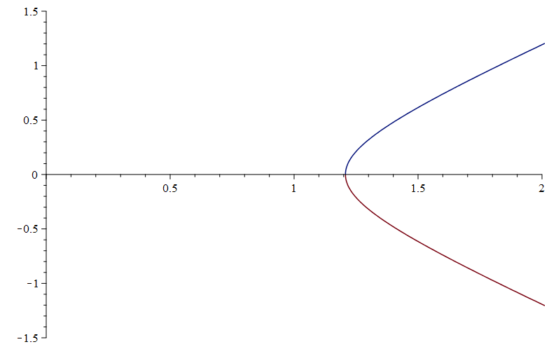
For the Rutherford case --
y
x
Visualization of trajectory in x-y plane --

