Slide 1
PHY 711 Classical Mechanics and Mathematical Methods
10-10:50 AM MWF in Olin 103
Discussion notes for Lecture 5
Review of classical mechanical
scattering theory – Chap 1 F&W
Some numerical considerations
Discussion questions
Review

Slide 3
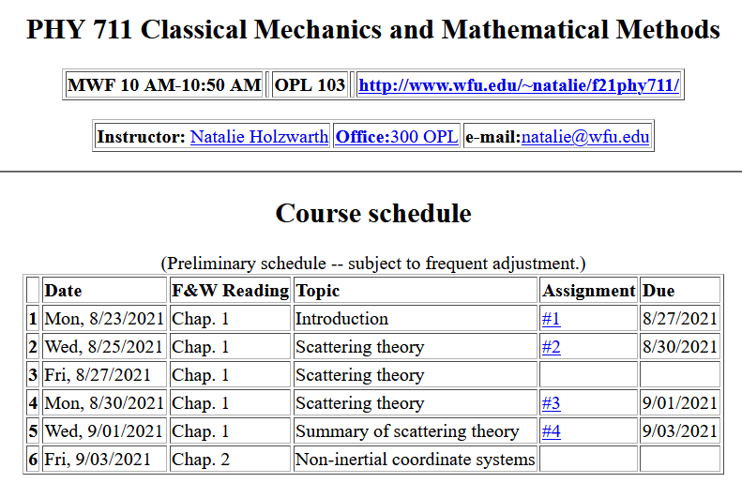

Slide 4
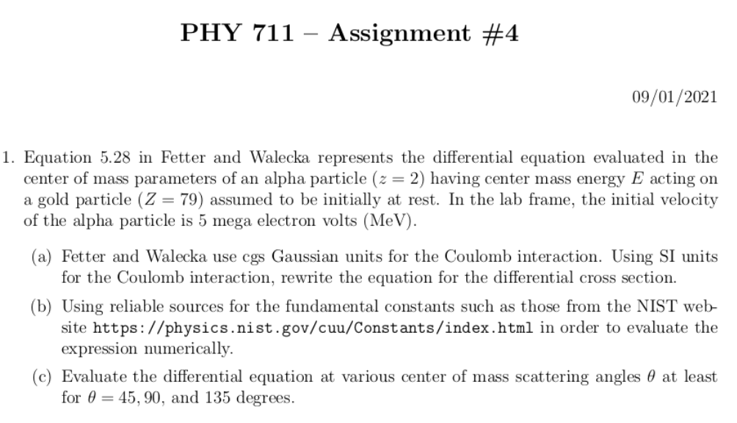

Slide 5
Comments on numerical evaluations
Fetter and Walecka like many older textbooks use cgs Gaussian units (centimeters, grams, seconds plus miscellaneous factors of 4π) while “modern” texts use SI units (meters, kilograms, seconds plus other miscellaneous factors of 4πε₀)
Coulomb force between ze and Ze at separation r:

Slide 6
Comments on numerical evaluations -- continued
MeV is a convenient unit of energy related to SI unit of Joules
1 eV=1.602176634x10⁻¹⁹ J
1 MeV= 1.602176634x10⁻¹³ J
More generally a reliable source for fundamental constants is available at the NIST website https://physics.nist.gov/cuu/Constants/index.html

Slide 8
What constants will you need to know?
What units will your answer have?

Slide 9
Your questions –
From Wells –
What if we considered an attractive potential which caused the incident particle to orbit the target particle? Would the analysis be similar to the hyperbolic orbits in gravitational potentials section except start by choosing an eccentricity of < 1? There would also be issues in the analysis such as multivalued functions caused by the orbit, correct?
From Manikanta –
Why the total cross section is not a finite value. I feel performing the integral over all solid angles should give 1 since it tells there is a 100% chance of finding a particle?
When ϴ = 0, differential cross section goes to infinity. By this do we mean we can trace an infinite number of particles ?
From Can –
1. My question is why on slide the angle scattering equation has negative Pi，whereas on the book is positive Pi.
From Owen –
1. Are non-central potentials ever used in scattering theory?
2. Are there any scattering experiments that test non-central potentials?

Slide 10
Reviewing – scattering in the laboratory
Figure from F&W:
detector

Slide 11
Owen is asking about angularly dependent interaction potentials V(r)
Comments -- These certainly occur in nature and are important. However, the equations we have used here have to be modified. The experimental set up will be the same, but the differential cross section will depend both on θ and φ.
detector

Slide 12
detector
Note that this diagram implies a repulsive interaction. Wells is asking how would it look if the interaction was attractive?

Slide 13
Close up of repulsive interaction
Relationship between χ_{max} and θ:
Using the diagram from your text, θ represents the scattering angle in the center of mass frame and φ is used instead of χ.
Notes:
Problem with consistent notation. Here we are using the textbook’s definition of theta which is OK if the target mass is infinite.

Slide 14
Can is asking about the sign of angles in these diagrams
Comment –
Never trust my signs.
Sometimes sign choices are equivalent.
For any system you are analyzing make sure the sign conventions are internally consistent.

Slide 15
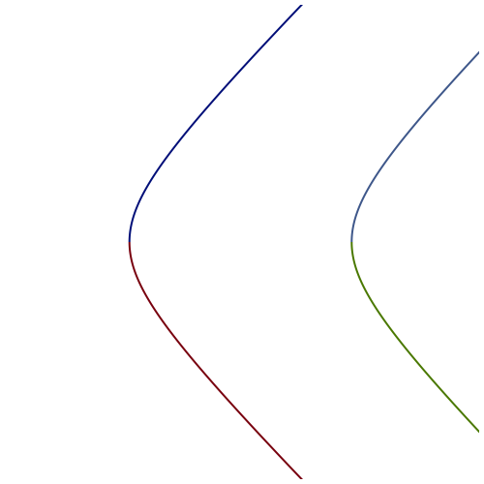
Question about repulsive and attractive interaction potentials
Comparison of repulsive and attractive trajectories for Coulomb interaction
y
x
repulsive
attractive

Slide 16
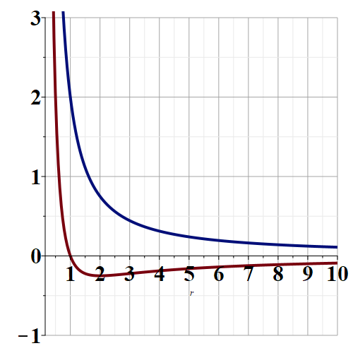
Energetic view
E
V(r)+L²/r²
Repulsive
→r
Attractive

Slide 17
Divergences in differential cross sections
In this example, the differential cross section diverges as θ→0 and the total cross section also diverges.
What to do?
Become a mathematician to better control the equations
Think about possible intervening physics for the θ→0 case.

Slide 18
Review of important equations --
Notes:
Problem with consistent notation. Here we are using the textbook’s definition of theta which is OK if the target mass is infinite.

Slide 19
b
Figure from Marion & Thorton, Classical Dynamics
Note that the same formula applies to the center of mass analysis.
Notes:
More review.

Slide 20
constants
vary in time
For scattering analysis only need to know trajectory before and after
the collision.
Notes:
Recall that the system of interest can be expressed in terms of constants and the particle separation r(t).

Slide 21
Some details --
Relationship between center of mass and laboratory frames of reference. At and time t, the following relationships apply --

Slide 22
More details
Since r(t) represents motion in a plane, we will analyze the system in that plane and use polar coordinates.

Slide 23
Clarification –
Energy of the center mass motion
Energy within the center of mass reference frame
In the following slides E_{rel} is written E

Slide 24
➔

Slide 25
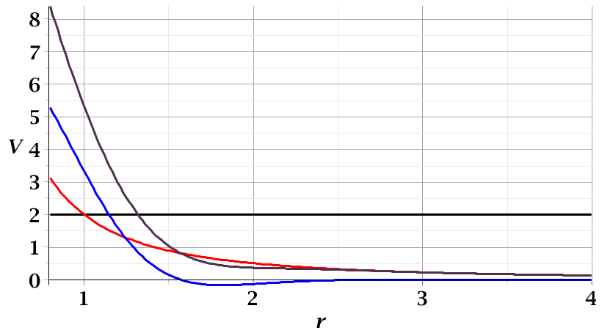
For a continuous potential interaction in center of mass reference frame:
Need to relate these parameters to differential cross section
E_{rel}
r_{min}

Slide 26
r(χ)
χ_{m}
χ
➔Need to find an equation for r(χ)
r_{min}
center of scattering.

Slide 27
How is this related to scattering?
➔
χ_{max}
χ_{max}
θ
Note that here θ is used for the scattering angle

Slide 28
Note that we have use ψ to denote the scattering angle in the center of mass frame, but your textbook uses θ (which we had used to denote the scattering angle in the lab frame). In this lecture our analysis is entirely in the center of mass frame and some of the equations use θ to denote the scattering angle.

Slide 29
Evaluation of constants far from scattering center --
r(t)
r_{min}
Notes:
Relating the constants of the problems to values determined when the particles are very far apart.

Slide 30
Notes:
Up to now we are expressing the trajectory as a function of time t. For this analysis however, we would like to find the trajectory as a function of the angle \phi. The relationship of the constant angular momentum to the \phi and time variables allows us to find r(\phi).

Slide 31
Notes:
Lots of algebra ….

Slide 32
Notes:
The scattering process involves the aspects of the trajectory at large separations.

Slide 33
Notes:
When r=rmin, \phi=0. \phi increases to a maximum value.

Slide 34
General equations for central potential V(r)
Notes:
The last equation is a convenient change of variables.

Slide 35
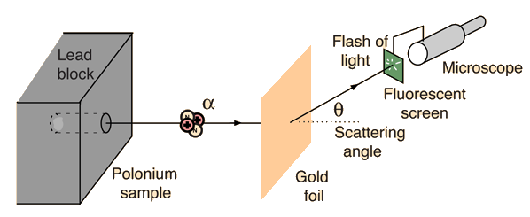
Example: Diagram of Rutherford scattering experiment
http://hyperphysics.phy-astr.gsu.edu/hbase/rutsca.html
Notes:
Here we use a diagram from the web about the Rutherford geometry.

Slide 36
Notes:
Summary of all of the equations and then specializing to the Coulomb interaction form.

Slide 37
Notes:
In this case, the integrals can all be evaluated analytically and simplify to this famous result.

Slide 38
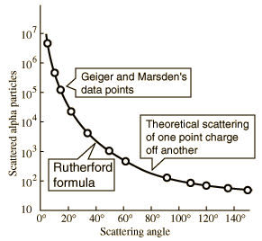
What happens as
θ →0?
From webpage: http://hyperphysics.phy-astr.gsu.edu/hbase/nuclear/rutsca2.html#c3
Notes:
Reconstructed data taken from the web.

Slide 39
Original experiment performed with α particles on gold
(in SI units)
Notes:
Evaluation of constant for this case.

Slide 40
Transformation between lab and center of mass results:
Differential cross sections in different reference frames – continued:
For elastic scattering

