Slide 1
PHY 711 Classical Mechanics and Mathematical Methods
10-10:50 AM MWF in Olin 103
Lecture notes for Lecture 6
Physics analyzed in accelerated coordinate frames – Chap 2 F&W
Angular acceleration
Linear and angular acceleration
Foucault pendulum
Notes:
In this lecture, we will briefly discuss the analysis of physics within accelerated reference frames as presented in Chapter 2 of your textbook.

Slide 2
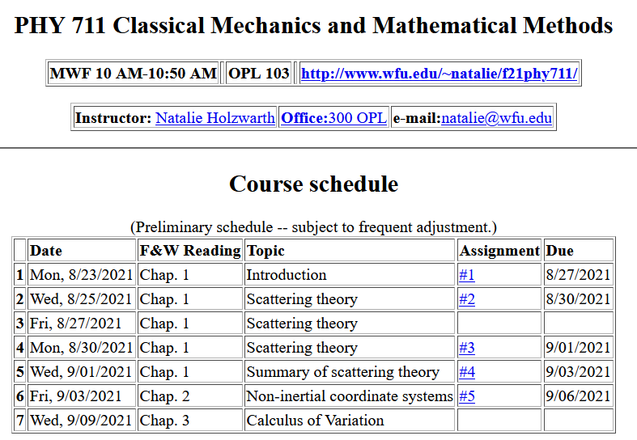
Notes:
We plan only one lecture on this topic, but it will come up again later in the course. On Wednesday, we will jump into the topic of calculus of variation in order to develop mathematical tools that form the backbone of the study of mechanics among other applications.

Slide 4
Physical laws as described in non-inertial coordinate systems
Newton’s laws are formulated in an inertial frame of reference
For some problems, it is convenient to transform the the equations into a non-inertial coordinate system
Notes:
By “inertial” frame of reference, we mean a reference frame that is either stationary or is moving at constant velocity. A non-inertial frame of reference is the opposite.

Slide 5
Comparison of analysis in “inertial frame” versus “non-inertial frame”
This represents the time rate of change of V measured within the e frame.
Notes:
The first question is how analyze quantities such as a vector V in the two frames of reference. The vector V may vary in time and its components

Slide 6
Properties of the frame motion (rotation only):
dΩ
dΩ
Notes:
Here omega is a vector whose magnitude is the time rate of change of rotation of the coordinate frame and whose direction is pointing along the axis of rotation (in this case the x-axis.

Slide 7
Properties of the frame motion (rotation only):
dΩ
dΩ
rotation matrix
Notes:
Here we “derivate” the cross product relation using the expression for finite rotation and then expanding to infinitesimal angle dOmega.

Slide 8
More details

Slide 9
Properties of the frame motion (rotation only):
dΩ
dΩ
Notes:
Summary of previous results.

Slide 10
Properties of the frame motion (rotation only) -- continued
Effects on 2nd time derivative -- acceleration (rotation only):
Notes:
Having established how to analyze the first time derivative, we apply the time derivative to the result in order to analyze the second time derivative (acceleration).

Slide 11
Application of Newton’s laws in a coordinate system which has an angular velocity ω and linear acceleration a
(Here we generalize previous case to add linear acceleration a.)
Newton’s laws; Let r denote the position of particle of mass m:
Coriolis
force
Centrifugal
force
Notes:
The highlighted terms are often called “fictictious” forces.

Slide 12
Have you every experienced any of these “fictitious” forces?
Examples –
Playing on a swing
Playing on a merry-go-round
Riding on a roller coaster
Sitting on the surface of the earth
Astronaut aboard the International Space Station
???

Slide 13
Motion on the surface of the Earth:
Earth’s gravity
Support force
Notes:
Considering now our case, standing or sitting on the surface of the rotating earth (neglecting other details like orbiting the sun). F’ is the support force meaning the floor on which we are standing/sitting and its support due to earth’s crust.

Slide 14
Non-inertial effects on effective gravitational “constant”
0.03 m/s²
9.80 m/s²
Notes:
Some details.

Slide 15
Is this justified?
Yes
No

Slide 16
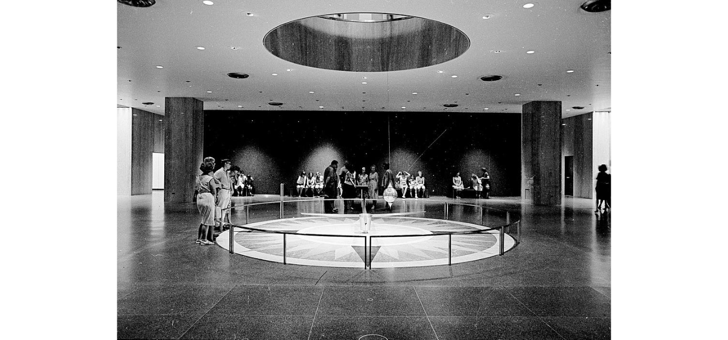
Foucault pendulum
http://www.si.edu/Encyclopedia_SI/nmah/pendulum.htm
The Foucault pendulum was displayed for many years in the Smithsonian's National Museum of American History. It is named for the French physicist Jean Foucault who first used it in 1851 to demonstrate the rotation of the earth.
Notes:
A very interesting example designed to show the effects of the earth’s rotation.

Slide 17
Equation of motion on Earth’s surface
ω
y (east)
z (up)
θ
x (south)

Slide 18
Foucault pendulum continued – keeping leading terms:
Notes:
Analyzing the pendulum motion in the given geometry.

Slide 19
Foucault pendulum continued – keeping leading terms:
Notes:
Simplifying the equations for the dominant terms.

Slide 20
Foucault pendulum continued – coupled equations:
Notes:
More details

Slide 21
Foucault pendulum continued – coupled equations:
Notes:
Solving the differential equations.

Slide 22
Notes:
More details and approximations.

Slide 23
Summary of approximate solution for Foucault pendulum:
Notes:
Summary

Slide 24
ω
y (east)
z (up)
θ
x (south)
Notes:
It is interesting to estimate the effects in different parts of the globe. Note that theta is defined for the polar angle, while if you look up your latitude you will find 90-theta.

Slide 25
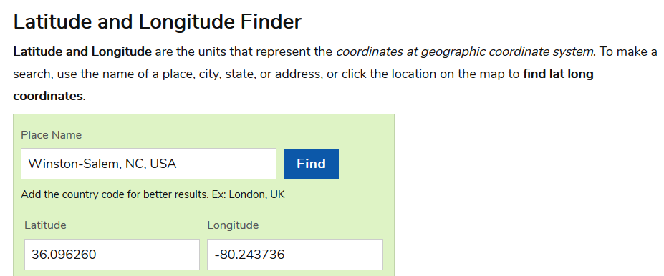
Latitude and Longitude
https://www.latlong.net/
Note that θ=90º - Latitude

