Slide 1
PHY 711 Classical Mechanics and Mathematical Methods
10-10:50 AM MWF in Olin103
Lecture notes for Lecture 7
Chapter 3.17 of F&W
    Introduction to the calculus of variations
    Mathematical construction
    Practical use
    Examples
Notes:
The topic of “calculus of variation” is covered in Chapter 3, Section 17 of your textbook. We will study the mathematical formalism first before showing how it is useful for studying mechanical systems.

Slide 2
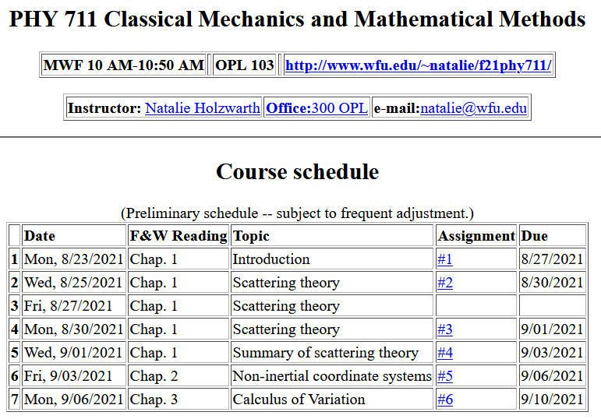
Notes:
There is a short problem on this subject that will be do on Friday.

Slide 3
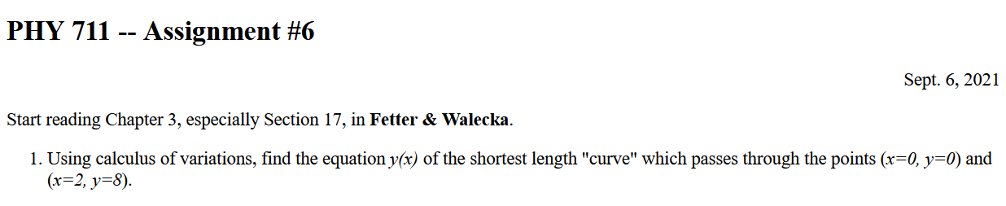

Slide 4
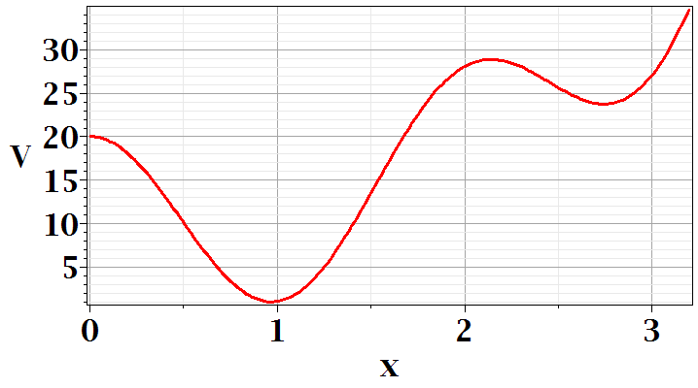
In Chapter 3, the notion of Lagrangian dynamics is developed; reformulating Newton’s laws in terms of minimization of related functions. In preparation, we need to develop a mathematical tool known as “the calculus of variation”.
Minimization of a simple function
local minimum
global minimum
Notes:
First we should review the notion of a minimum in a continuous function. Here is a plot of V(x) showing two different minima at two different points x.

Slide 5
Minimization of a simple function
local minimum
global minimum
Notes:
We see from this plot that a conduction for a function to have a minimum at a point is that its derivative is zero at that point. You see in this example another point where dV/dx, but there is not a minimum. So we say the dV/dx is a necessary but not sufficient condition on having a minimum.

Slide 6
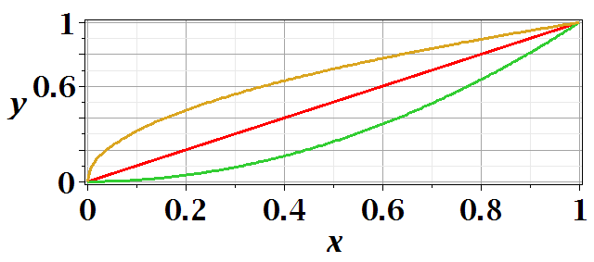
Functional minimization
Notes:
The calculus of variation also searches for minima, but instead of finding a point where a function has a minimum, we search for a functional form that minimizes an integral.

Slide 7
Difference between minimization of a function V(x) and the minimization in the calculus of variation.
Minimization of a function
➔Know V(x) ➔Find x₀ such that V(x₀) is a minimum.
Calculus of variation
Notes:
Comparison

Slide 8
Functional minimization
Notes:
The calculus of variation involves consideration of a function of a function. Here we use L to denote such a function.

Slide 9
Notes:
For this example we can write the distance along a curve between two points x=0,y=0 and x=1,y=1 as a normal integral over x as shown.

Slide 10
Calculus of variation example for a pure integral functions

Slide 11
Comment about notation concerning functional dependence and partial derivatives

Slide 12
After some derivations, we find
Note that this is a
“total” derivative
Notes:
Using calculus to simplify the integral.

Slide 13
“Some” derivations --
*
Notes:
Some details.

Slide 14
*
Note that the construction of this system is that

Slide 16
“Some” derivations (continued)--

Slide 17
Clarfication – Why does this term go to zero?

Slide 18
Recap --
Here we conclude that the integrand has to vanish at every argument in order for the integral to be zero
Necessary?
Overkill?

Slide 19
Notes:
Your homework problem is very similar to this.

Slide 20

Lamp shade shape y(x)
y
x_{i} y_{i}
x
x_{f} y_{f}
Notes:
Here is another example of the use of calculus of variation.

Slide 21
Notes:
After these steps, the solution is found up to some constants.

Slide 22
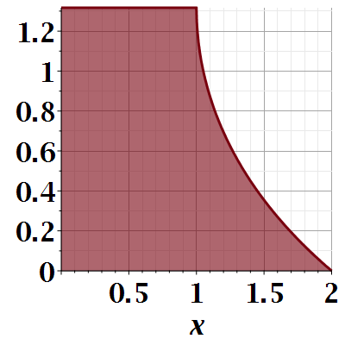

Slide 23
Notes:
Evaluating results for particular boundary values.

Slide 24
Another example:
  (Courtesy of F. B. Hildebrand, Methods of Applied Mathematics)
Notes:
Another example.

Slide 25
Euler-Lagrange equation
Alternate Euler-Lagrange equation
Notes:
Summary and extension.

Slide 26
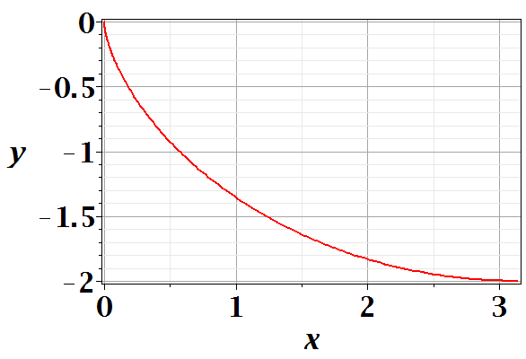
Brachistochrone problem: (solved by Newton in 1696)
http://mathworld.wolfram.com/BrachistochroneProblem.html
A particle of weight mg travels frictionlessly down a path of shape y(x). What is the shape of the path y(x) that minimizes the travel time from
y(0)=0 to y(π)=-2 ?
Notes:
Prelude to what we will cover next time.

Slide 27
Notes:
Some details.

Slide 28
Notes:
More details.

Slide 29
Parametric equations for Brachistochrone:

Slide 30
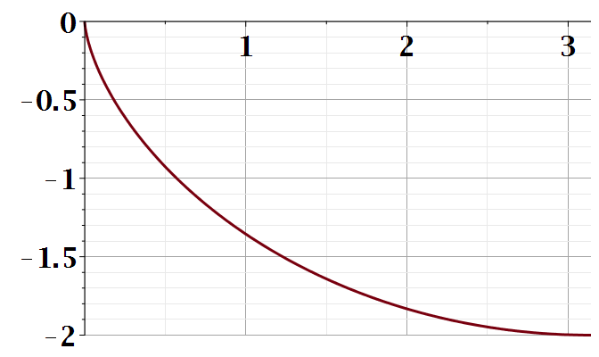
Parametric plot --
plot([theta-sin(theta), cos(theta)-1, theta = 0 .. Pi])
y
x

