Slide 1
PHY 711 Classical Mechanics and Mathematical Methods
10-10:50 AM MWF in Olin103
Lecture notes for Lecture 7
Chapter 3.17 of F&W
Introduction to the calculus of variations
Mathematical construction
Practical use
Examples
Notes:
The topic of “calculus of variation” is covered in Chapter 3, Section 17 of your textbook. We will study the mathematical formalism first before showing how it is useful for studying mechanical systems.

Slide 2
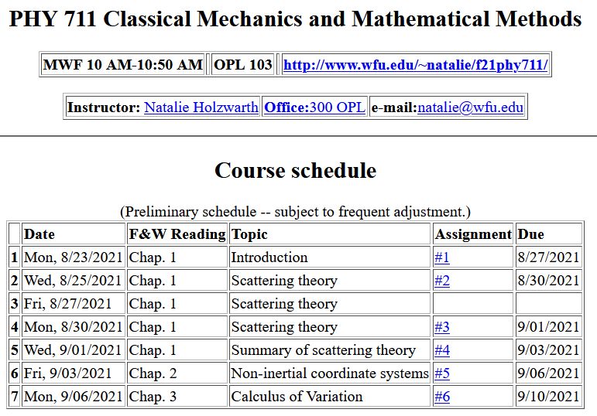
Notes:
There is a short problem on this subject that will be do on Friday.

Slide 4
Your questions –
From Can –
1. What kind of questions will be much easier to solve by Lagrongian than Newton？
From Owen –
1. My previous understanding of the Lagrangian was that it is a fundamental concept in physics which, like the Hamiltonian, forms the basis for more advanced topics. Is this true? And if, so what to what other topics is the Lagrangian applied?
Comments –
These are both very good questions dealing with the motivation and hierarchy of the Lagrangian formalism.

Slide 5
Comments on the motivation and hierarchy of the Lagrangian formalism.
I would guess that there have been lots of formulations of the equations of motion throughout the history of mathematics and science and the main ones that have survived are Newton’s “laws”, Lagrangian formalism, and Hamiltonian formalism. Each are mathematically sound and physical verified and useful for analysis in various context.
Lagrangian and Hamiltonian formalisms are more advanced because the mathematics is a little bit “harder” than Newton’s formulation. As long as they are correctly applied, they should describe the same physics. On the other hand, there are situations (like in quantum mechanics) where the Lagrangian and Hamiltonian formulations are preferred/needed.
Once you become comfortable with the Lagrangian formulation, you may find that it is easier to use in analysis, particularly in complicated coordinate systems or when there are constraints on the motion.
For now, a key motivation for the Lagrangian formalism is that it opens several powerful additional mathematical tools to the analysis of motion.
Your textbook starts with a “derivation” of the Lagrangian, but we will first develop the abstract mathematical tools first.

Slide 6
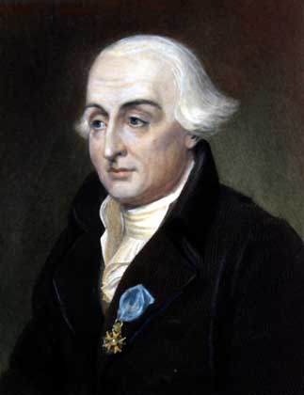
According wikipedia –
Joseph-Louis Lagrange (born Giuseppe Luigi Lagrangia or Giuseppe Ludovico De la Grange Tournier; 25 January 1736 – 10 April 1813), also reported as Giuseppe Luigi Lagrange or Lagrangia, was an Italian mathematician and astronomer, later naturalized French. He made significant contributions to the fields of analysis, number theory, and both classical and celestial mechanics.

Slide 7
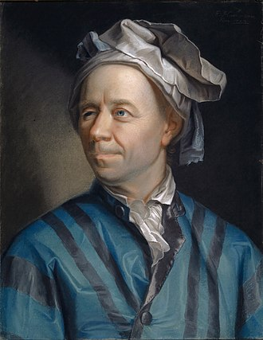
According to Wikipedia –
Leonard Euler (April 7, 1707-September 18, 1783) Swiss mathematician, physicist, astronomer, geographer, logician and engineer who founded the studies of graph theory and topology and made pioneering and influential discoveries in many other branches of mathematics such as analytic number theory, complex analysis, and infinitesimal calculus. He introduced much of modern mathematical terminology and notation, including the notion of a mathematical function. He is also known for his work in mechanics, fluid dynamics, optics, astronomy and music theory.

Slide 8
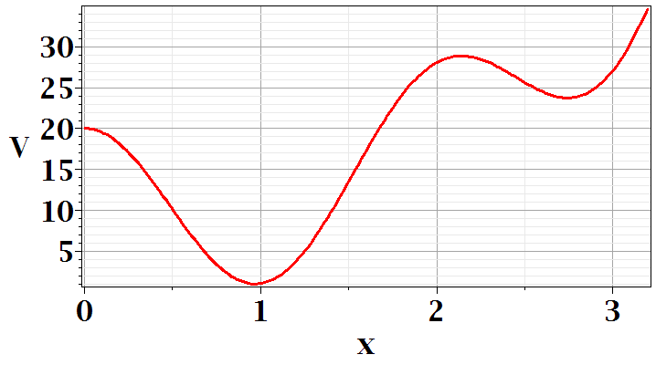
In Chapter 3, the notion of Lagrangian dynamics is developed; reformulating Newton’s laws in terms of minimization of related functions. In preparation, we need to develop a mathematical tool known as “the calculus of variation”.
Minimization of a simple function
local minimum
global minimum
Notes:
First we should review the notion of a minimum in a continuous function. Here is a plot of V(x) showing two different minima at two different points x.

Slide 9
Minimization of a simple function
local minimum
global minimum
Notes:
We see from this plot that a conduction for a function to have a minimum at a point is that its derivative is zero at that point. You see in this example another point where dV/dx, but there is not a minimum. So we say the dV/dx is a necessary but not sufficient condition on having a minimum.

Slide 10
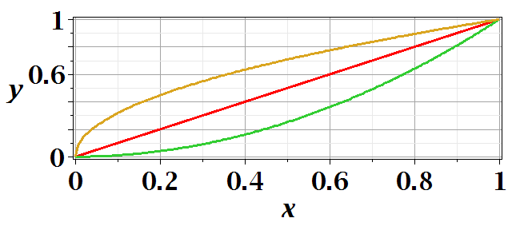
Functional minimization of an integral relationship
Notes:
The calculus of variation also searches for minima, but instead of finding a point where a function has a minimum, we search for a functional form that minimizes an integral.

Slide 11
Difference between minimization of a function V(x) and the minimization in the calculus of variation.
Minimization of a function
➔Know V(x) ➔Find x₀ such that V(x₀) is a minimum.
Calculus of variation
Notes:
Comparison

Slide 12
Functional minimization of an integral relationship
Notes:
The calculus of variation also searches for minima, but instead of finding a point where a function has a minimum, we search for a functional form that minimizes an integral.

Slide 13
Notes:
For this example we can write the distance along a curve between two points x=0,y=0 and x=1,y=1 as a normal integral over x as shown.

Slide 14
Calculus of variation example for a pure integral functions

Slide 15
Comment about notation concerning functional dependence and partial derivatives

Slide 16
After some derivations, we find
Note that this is a
“total” derivative
Notes:
Using calculus to simplify the integral.

Slide 17
“Some” derivations --
*
Notes:
Some details.

Slide 19
*
Note that the construction of this system is that

Slide 20
“Some” derivations (continued)--

Slide 21
Clarfication – Why does this term go to zero?

Slide 22
Recap --
Here we conclude that the integrand has to vanish at every argument in order for the integral to be zero
Necessary?
Overkill?

Slide 23
Notes:
Your homework problem is very similar to this. Actually stopped at this slide. Will continue discussion on Wednesday.

Slide 24
Lamp shade shape y(x)
y
x_{i} y_{i}
x
x_{f} y_{f}
Notes:
Here is another example of the use of calculus of variation.

Slide 25
Notes:
After these steps, the solution is found up to some constants.

Slide 26
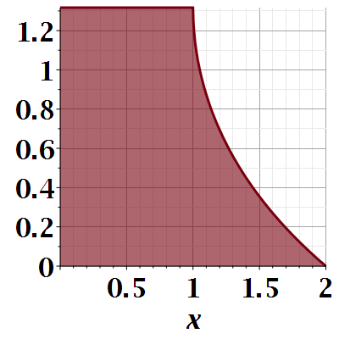

Slide 27
Notes:
Evaluating results for particular boundary values.

Slide 28
Another example:
(Courtesy of F. B. Hildebrand, Methods of Applied Mathematics)
Notes:
Another example.

Slide 29
Euler-Lagrange equation
Alternate Euler-Lagrange equation
Notes:
Summary and extension.

Slide 30
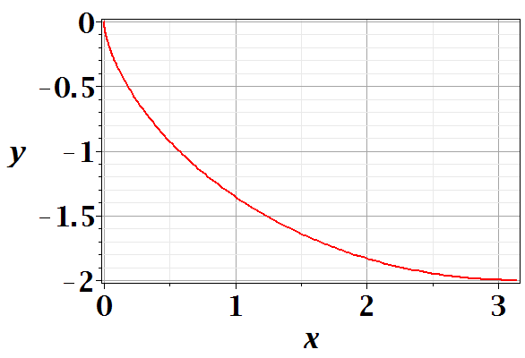
Brachistochrone problem: (solved by Newton in 1696)
http://mathworld.wolfram.com/BrachistochroneProblem.html
A particle of weight mg travels frictionlessly down a path of shape y(x). What is the shape of the path y(x) that minimizes the travel time from
y(0)=0 to y(π)=-2 ?
Notes:
Prelude to what we will cover next time.

Slide 31
Notes:
Some details.

Slide 32
Notes:
More details.

Slide 33
Parametric equations for Brachistochrone:

Slide 34
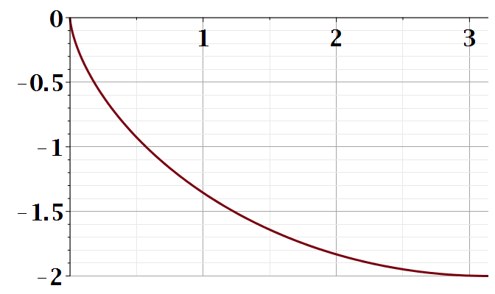
Parametric plot --
plot([theta-sin(theta), cos(theta)-1, theta = 0 .. Pi])
y
x

