Slide 1
PHY 711 Classical Mechanics and Mathematical Methods
10-10:50 AM MWF in Olin 103
Discussion of Lecture 8 – Chap. 3 F & W
Calculus of variation
Various examples – Area of lamp shade
Brachistochrone problem
Calculus of variation with constraints
Notes:
In this lecture, we will continue to develop notions of the calculations of variation. Next time we will show how they may be applied to classical mechanics.

Slide 3
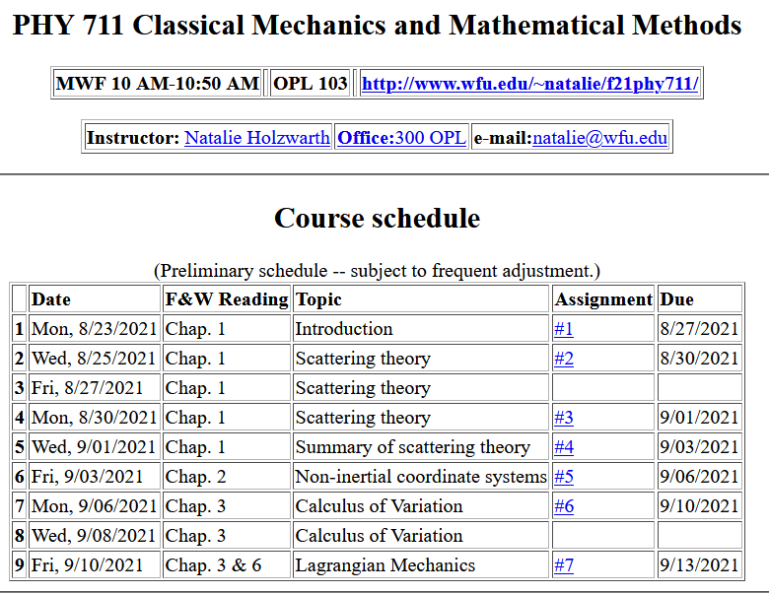
Notes:
There is one homework problem for this lecture.

Slide 4
Your questions –
From Can –
What type of problems that we can and can‘t use the method of calculus of variation to solve？
Comment – Typically we need to optimize an integral involving an unknown function and its derivative. This type of problem occurs in many contexts including mechanics.
From Wells –
Is the Lagrange multiplier always a scalar?
Comment -- Lagrange multipliers in our examples are constant scalars, but they may be more complicated.

Slide 5
Summary of the method of calculus of variation --
Notes:
Summary of equations to use.

Slide 6
Notes:
Your homework problem is very similar to this. Actually stopped at this slide. Will continue discussion on Wednesday.

Slide 7
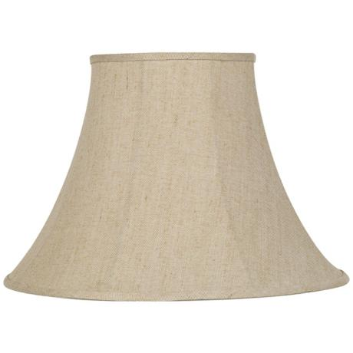
Lamp shade shape y(x)
y
x_{i} y_{i}
x
x_{f} y_{f}
Notes:
Here is another example of the use of calculus of variation.

Slide 8
Notes:
After these steps, the solution is found up to some constants.

Slide 9
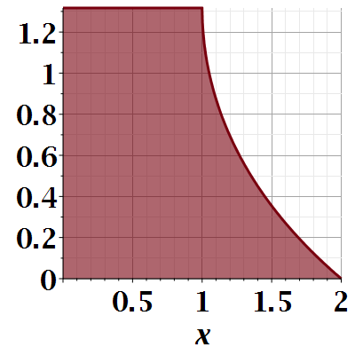

Slide 10
Notes:
Evaluating results for particular boundary values.

Slide 11
Euler-Lagrange equation
Alternate Euler-Lagrange equation
Notes:
Summary of the equations we worked out last time.

Slide 12
A few more steps --

Slide 13
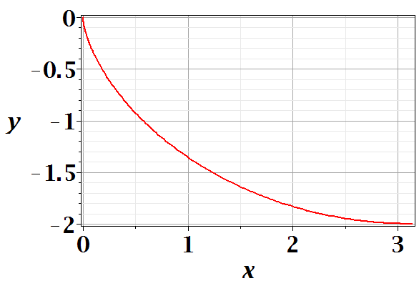
Brachistochrone problem: (solved by Newton in 1696)
http://mathworld.wolfram.com/BrachistochroneProblem.html
A particle of weight mg travels frictionlessly down a path of shape y(x). What is the shape of the path y(x) that minimizes the travel time from
y(0)=0 to y(π)=-2 ?
Notes:
This is the famous problem.

Slide 14
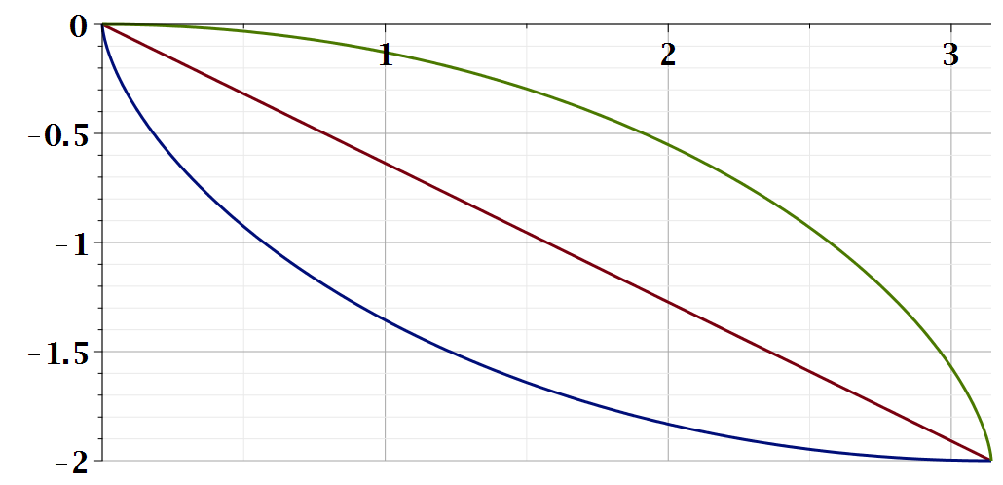
Vote for your favorite path
x
y
Which gives the shortest time?
Green
Red
Blue
Notes:
What curve will win the race?

Slide 15
Notes:
Some details of the Euler-Lagrange equations. The green equations look harder.

Slide 16
Question – why this choice?
Answer – because the answer will be more beautiful. (Be sure that was not my cleverness.)
Notes:
Calling the integration 2a is very convenient.

Slide 17
Parametric equations for Brachistochrone:
Notes:
Very clever mathematics.

Slide 18
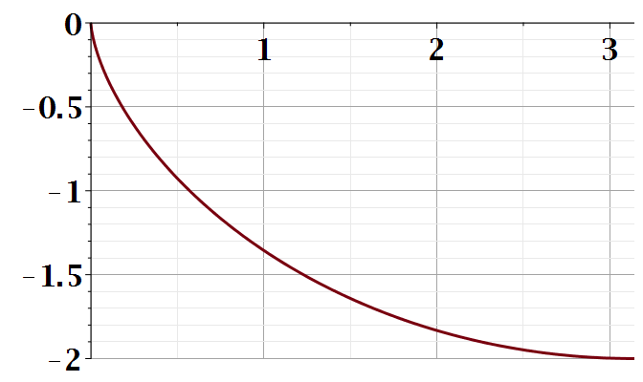
Parametric plot --
plot([theta-sin(theta), cos(theta)-1, theta = 0 .. Pi])
y
x
Notes:
Visualization of the result.

Slide 19
Checking the results
T=infinite
T=5.2668
T=4.4429
Notes:
How did you do with your bet?

Slide 20
Summary of the method of calculus of variation --
Notes:
Summary of equations to use.

Slide 21
Notes:
It is a good idea to remember these equations.

Slide 22
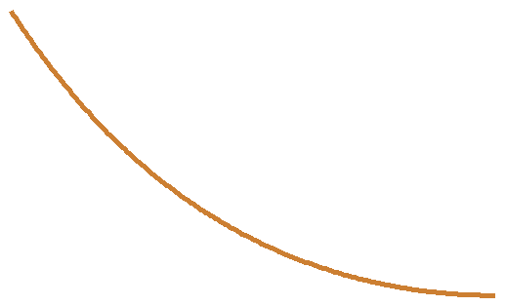
Another example optimization problem:
Determine the shape y(x) of a rope of length L and mass density ρ hanging between two points
x₁ y₁
x₂ y₂
Notes:
Another example needing extra information.

Slide 23
Example from internet --

Slide 24
Lagrange multiplier
Notes:
How to minimize with a constraint.

Slide 26
Notes:
Applying the equations.

Slide 28
Notes:
The solutions in (almost) convenient form.

Slide 29
Summary of results
or
Notes:
Summary again.

Slide 30
Application to particle dynamics – next time --
Notes:
We will now start to apply this mathematics to the physics of motion. Here we map the variables that will apply. A is called “action”. L is called “Lagrangian”.

